Slide 1
Chapter 4
CONTROL STRUCTURES
Introduction to computer science

Slide 2
Outline
1.Selection criteria
2.The if-else statement
3.Nested if statement
4. Repetition structure
5. while loops
6. for loops
7. Nested loops
8. do-while Loops

Slide 3
1. Selection structure
The flow of control means the order in which a program’s statements are executed.
Unless directed otherwise, the normal flow of control for all programs is sequential.
Selection, repetition and function invocation structures permit the flow of control to be altered in a defined way.
In this chapter, you learn to use selection structures and repetition structures in C++

Slide 4
SELECTION CRITERIA
Comparison Operators
Comparison operators are used to compare two operands for equality or to determine if one numeric value is greater than another.
A Boolean value of true or false is returned after two operands are compared. C++ uses a nonzero value to represent a true and a zero value to represent a false value.
Operator Description Examples
---------------------------------------------------------------------------------------
= = equal a ==‘y’
!= not equal m!= 5
> greater than a*b > 7
< less than b < 6
<= less than or equal b <= a
>= greater than or equal c >= 6

Slide 5
Logical operators
Logical operators are used for creating more complex conditions. Like comparison operators, a Boolean value of true or false is returned after the logical operation is executed.
Operator Description
---------------------------------------------------
&& AND
|| OR
! NOT
Example:
(age > 40) && (term < 10)
(age > 40) || (term < 10)
!(age > 40)
( i==j) || (a < b) || complete

Slide 6
Operator precedence
The relational and logical operators have a hierarchy of execution similar to the arithmetic operators.
Level Operator Associativity
-------------------------------------------------------
1. ! unary - ++ -- Right to left
2. * / % Left to right
3. + - Left to right
4. < <= > >= Left to right
5. = = != Left to right
6. && Left to right
7. || Left to right
8. = += -= *= /= Right to left

Slide 7
Example: Assume the following declarations:
char key = ‘m’;
int i = 5, j = 7, k = 12;
double x = 22.5;
Expression Equivalent Value Interpretation
--------------------------------------------------------------------------------------------
i + 2 = = k-1 (i + 2) = = ( k –1) 0 false
‘a’ +1 = = ‘b’ (‘a’ +1) = = ‘b’ 1 true
25 >= x + 1.0 25 >= (x + 1.0) 1 true
key –1 > 20 (key –1) > 20 0 false

Slide 8
Order of evaluation
The following compound condition is evaluated as:
(6*3 = = 36/2) || (13<3*3 + 4) && !(6-2 < 5)
(18 = = 18) || (13 < 9 + 4) && !(4 < 5)
1 || (13 < 13) && ! 1
1 || 0 && 0
1 || 0
1

Slide 9
The bool Data Type
As specified by the ANSO/ISO standard, C++ has a built-in Boolean data type, bool, containing the two values true and false.
The actual values represented by the bool values, true and false, are the integer values 1 and 0, respectively.
Example 4.1.1
#include<iostream>
using namespace std;
int main()
{
bool t1, t2;
t1 = true;
t2 = true;
cout << “The value of t1 is “<< t1
<< “\n and the value of t2 is “<< t2 << endl;
return 0;
}

Slide 10
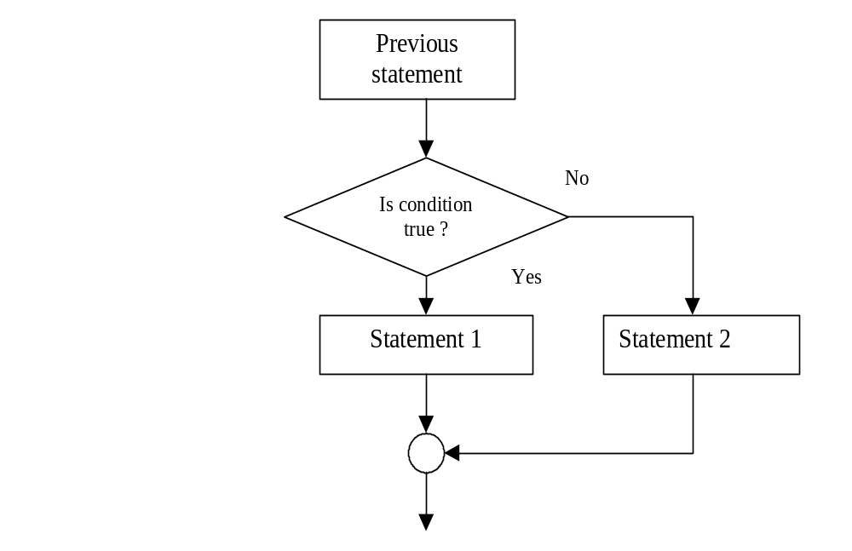
2. THE if-else STATEMENT
The if-else statement directs the computer to select a sequence of one or more statements based on the result of a comparison.
The syntax:
if (conditional expression) {
statements;
}
else {
statements;
}

Slide 11
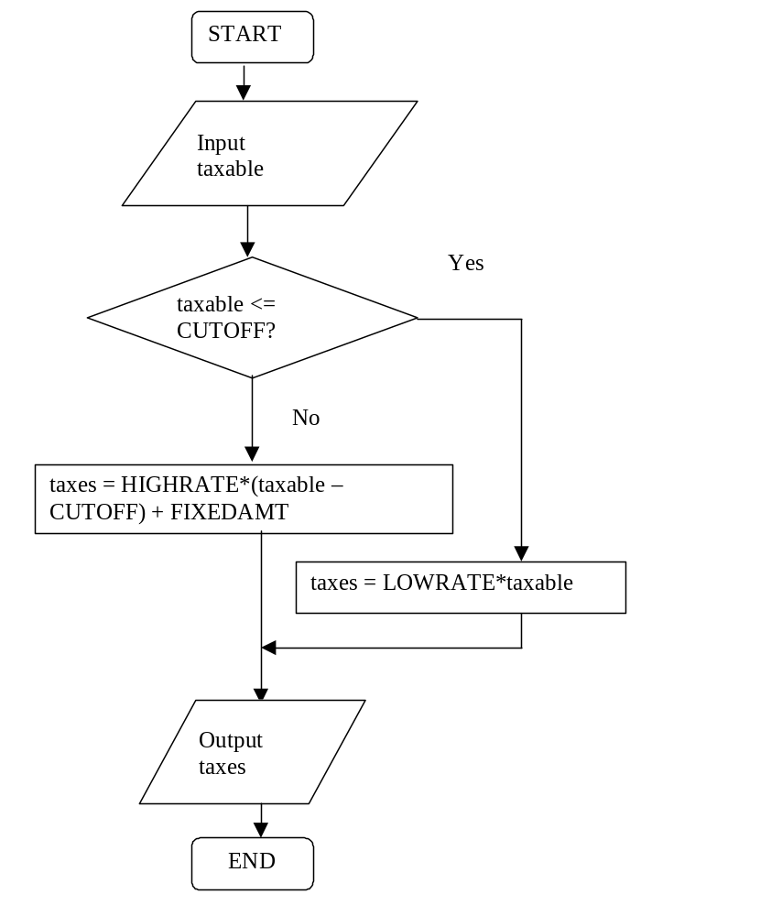
Example 4.2.1
We construct a C++ program for determining income taxes.
Assume that these taxes are assessed at 2% of taxable incomes less than or equal to $20,000. For taxable income greater than $20,000, taxes are 2.5% of the income that exceeds $20,000 plus a fixed amount of $400.

Slide 12
Example 4.2.1
#include <iostream>
#include <iomanip>
using namespace std;
const float LOWRATE = 0.02; // lower tax rate
const float HIGHRATE = 0.025; // higher tax rate
const float CUTOFF = 20000.0; // cut off for low rate
const float FIXEDAMT = 400;
int main()
{
float taxable, taxes;
cout << "Please type in the taxable income: ";
cin >> taxable;
if (taxable <= CUTOFF)
taxes = LOWRATE * taxable;
else
taxes = HIGHRATE * (taxable - CUTOFF) + FIXEDAMT;
// set output format
cout << setiosflags(ios::fixed)
<< setiosflags(ios::showpoint)
<< setprecision(2);
cout << "Taxes are $ " << taxes << endl;
return 0;
}

Slide 13
setiosflags this manipulator is used to control different input and output settings.
setioflag(ios::fixed) means the output field will use conventioan fixed-point decimal notation.
setiosflag(ios::showpoint) means the output field will show the decimal point for floating point number.
setiosflag(ios::scientific) means the output field will use exponential notation.
The results of the above program:
Please type in the taxable income: 10000
Taxes are $ 200
and
Please type in the taxable income: 30000
Taxes are $ 650

Slide 14
Block Scope
All statements within a compound statement constitute a single block of code, and any variable declared within such a block only is valid within the block.
The location within a program where a variable can be used formally referred to as the scope of the variable.

Slide 15
Example:
{ // start of outer block
int a = 25;
int b = 17;
cout << “The value of a is “ << a << “ and b is “ << b << endl;
{ // start of inner block
float a = 46.25;
int c = 10;
cout << “ a is now “ << a << “b is now “ << b
<< “ and c is “ << c << endl;
}
cout << “ a is now “ << a
<< “b is now “ << b << endl;
} // end of outer block
The output is
The value of a is 25 and b is 17
a is now 46.25 b is now 17 and c is 10
a is now 25 b is now 17

Slide 16
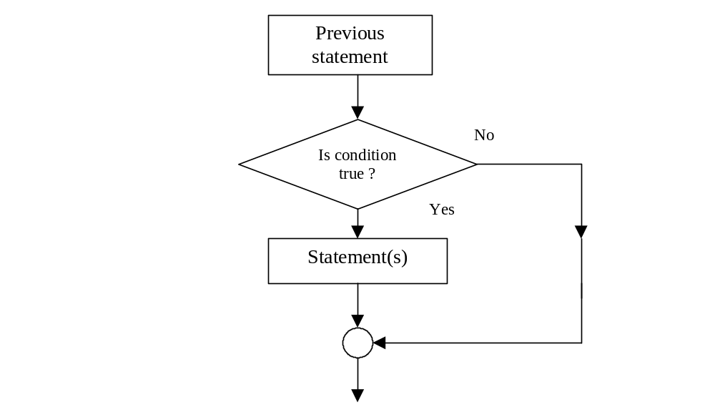
One-way Selection
A useful modification of the if-else statement involves omitting the else part of the statement. In this case, the if statement takes a shortened format:
if (conditional expression) {
statements;
}

Slide 17
Example 4.2.2
The following program displays an error message for the grades that is less than 0 or more than 100.
#include <iostream>
using namespace std;
int main()
{
int grade;
cout << "\nPlease enter a grade: ";
cin >> grade;
if(grade < 0 || grade > 100)
cout << " The grade is not valid\n";
return 0;
}

Slide 18
3. NESTED if STATEMENT
The inclusion of one or more if statement within an existing if statement is called a nested if statement.
The if-else Chain
When an if statement is included in the else part of an existing if statement, we have an if-else chain.
if (expression-1)
statement-1
else if (expression-2)
statement-2
else
statement-3
Example 4.3.1
// This program can solve quadratic equation

Slide 19
The output of the above program:
Enter the coefficients of the equation:
1 5 6
x1 = -2.0 x2 = -3.0
#include <iostream>
#include <cmath>
#include <iomanip>
using namespace std;
int main()
{
double a, b, c, del, x1, x2;
cout << “Enter the coefficients of the equation: “<< endl;
cin >> a >> b >> c;
del = b*b – 4.0*a*c;
if (del == 0.0)
{
x1 = x2 = -b/(2*a);
cout << "x1 = “ << x1 << setw(20) << “x2 = “ << x2 << endl;
}
else if (del > 0.0)
{
x1 = (-b + sqrt(del))/(2*a);
x2 = (-b – sqrt(del))/(2*a);
cout << "x1 = “ << x1 << setw(20) << “x2 = “ << x2 << endl;
}
else
cout << "There is no solution\n";
return 0;
}

Slide 20
4. Repetition structures
C++ provides three different forms of repetition structures:
while structure
for structure
do-while structure
Each of these structures requires a condition that must be evaluated.
The condition can be tested at either (1) the beginning or (2) the end of the repeating section of code.
If the test is at the beginning of the loop, the type of loop is a pre-test loop.
If the test is at the end of the loop, the type of loop is a post-test loop.

Slide 21
Fixed count loop and variable condition loop
In addition to where the condition is tested, repeating sections of code are also classified.
In a fixed count loop, the condition is used to keep track of how many repetitions have occurred. In this kind of loops, a fixed number of repetitions are performed, at which point the repeating section of code is exited.
In many situations, the exact number of repetitions are not known in advance. In such cases, a variable condition loop is used.
In a variable condition loop, the tested condition does not depend on a count being achieved, but rather on a variable that can change interactively with each pass through the loop. When a specified value is encountered, regardless of how many iterations have occurred, repetitions stop.

Slide 22
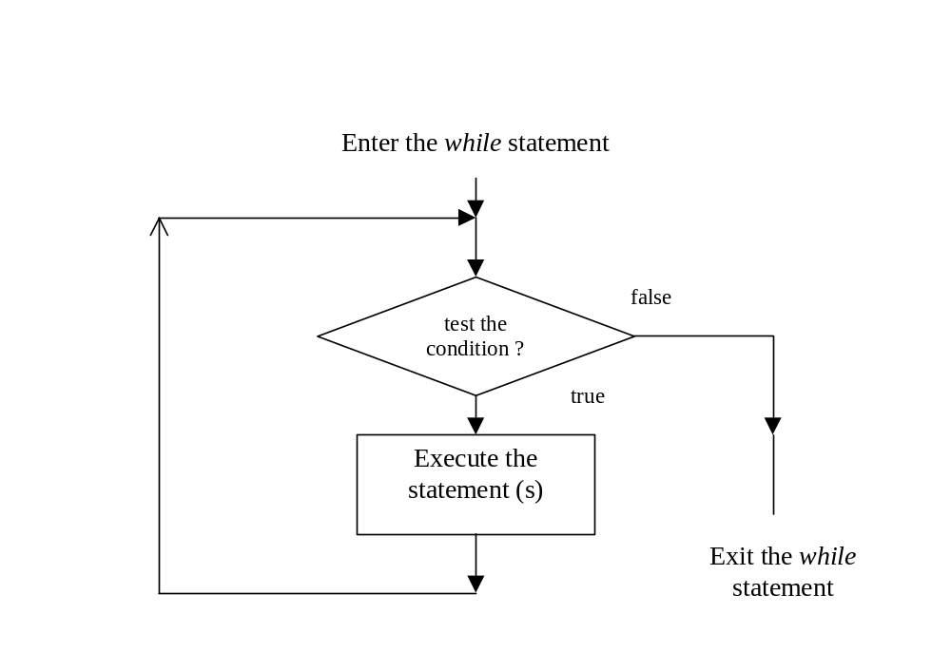
5.while loops
The while statement is used for repeating a statement or series of statements as long as a given conditional expression is evaluated to true.
The syntax for the while statement:
while( condition expression){
statements;
}

Slide 23
Example 5.2.1
// This program prints out the numbers from 1 to 10
#include <iostream>
using namespace std;
int main()
{
int count;
count = 1; // initialize count
while (count <= 10){
cout << count << " ";
count++; // increment count
}
return 0;
}
The output of the above program:
1 2 3 4 5 6 7 8 9 10

Slide 24
In the above program, the loop incurs a counter-controlled repetition. Counter-controlled repetition requires:
1) the name of a control variable (the variable count )
2) the initial value of the control variable ( count is initialized to 1 in this case )
3) the condition that tests for the final value of the control
variable (i.e., whether looping should continue) ;
4) the increment (or decrement) by which the control variable is modified each time through the loop.

Slide 25
Sentinels
In programming, data values used to indicate either the start or end of a data series are called sentinels.
The sentinels must be selected so as not to conflict with legitimate data values.
Example 5.3.2
#include <iostream>
using namespace std;
const int HIGHGRADE = 100; // sentinel value
int main()
{
float grade, total;
grade = 0;
total = 0;
cout << "\nTo stop entering grades, type in any number"
<< " greater than 100.\n\n";

Slide 26
cout << "Enter a grade: ";
cin >> grade;
while (grade <= HIGHGRADE)
{
total = total + grade;
cout << "Enter a grade: ";
cin >> grade;
}
cout << "\nThe total of the grades is " << total << endl;
return 0;
}
In the above program, the sentinel is the value 100 for the entered grade.

Slide 27
break statement
The break statement causes an exit from the innermost enclosing loop.
Example:
while( count <= 10)
{
cout << “Enter a number: “; cin >> num;
if (num > 76){
cout << “you lose!\n”;
break;
}
else
cout << “Keep on trucking!\n”;
count++;
}
//break jumps to here

Slide 28
continue Statements
The continue statement halts a looping statement and restarts the loop with a new iteration.
while( count < 30)
{
cout << “Enter a grade: “;
cin >> grade;
if (grade < 0 || grade > 100)
continue;
total = total + grade;
count++;
}
In the above program, invalid grades are simply ignored and only valid grades are added to the total.

Slide 29
The null statement
All statements must be terminated by a semicolon. A semicolon with nothing preceding it is also a valid statement, called the null statement. Thus, the statement
;
is a null statement.
Example:
if (a > 0)
b = 7;
else ;
go to statement
A go to statement is a kind of jump statement. Its destination is specified by a label within the statement. A label is simply an identifier followed by a statement, separated by a colon.
Example:
if (a > 20)
go to esc;
else cout << a*a;
esc: cout << endl;

Slide 30
6. for LOOPS
The for statement is used for repeating a statement or series of statements as long as a given conditional expression evaluates to true.
One of the main differences between while statement and for statement is that in addition to a condition, you can also include code in the for statement
- to initialize a counter variable and
- changes its value with each iteration
The syntax of the for statement:
for ( initialization expression; condition; update statement){
statement(s);
}

Slide 31
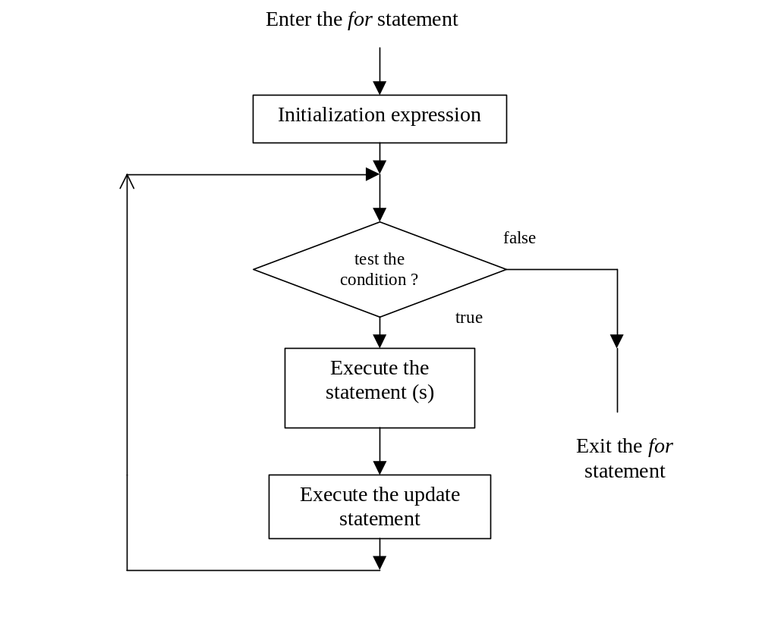

Slide 32
Example 4.6.1
// This program prints the even number from 2 to 20
#include <iostream>
using namespace std;
int main()
{
int count;
for (count = 2; count <= 20; count = count + 2)
cout << count << " ";
return 0;
}
The output of the above program:
2 4 6 8 12 14 16 18 20

Slide 33
Example 4.6.2 In this example, we have to solve the problem:
A person invests $1000.00 in a saving account with 5 percent interest. Assuming that all interest is left on deposit in the account, calculate and print the amount of money in the account at the end of each year for 10 years. Use the following formula for determining these amounts:
a = p(1 + r)^{n}
where p is the original amount invested, r is the annual interest rate and n is the number of years and a is the amount on deposit at the end of the nth year.
#include <iostream>
#include <iomanip>
#include <cmath>
using namespace std;
int main()
{
double amount,
principal = 1000.0, rate = 0.05;
cout << "Year” << setw(21) << "Amount on deposit" << endl;

Slide 34
cout << setiosflags(ios::fixed | ios::showpoint) << setprecision(2);
for (int year = 1; year <= 10; year++)
{
amount = principal*pow(1.0 + rate, year);
cout << setw(4) << year << setw(21) << amount << endl;
}
return 0;
}
The output of the above program:
Year Amount on deposit
1 1050.00
2 1102.50
3 1157.62
4 1215.51
5 1276.28
6 1340.10
7 1407.10
8 1477.46
9 1551.33
10 1628.89

Slide 35
7. NESTED LOOPS
In many situations, it is convenient to use a loop contained within another loop. Such loops are called nested loops.
Example 4.7.1
#include <iostream>
using namespace std;
int main()
{
const int MAXI = 5;
const int MAXJ = 4;
int i, j;
for(i = 1; i <= MAXI; i++) // start of outer loop
{
cout << "\n i is now " << i << endl;
for(j = 1; j <= MAXJ; j++) // start of inner loop
cout << " j = " << j; // end of inner loop
} // end of outer loop
cout << endl;
return 0;
}
The output of the program:
i is now 1
j = 1 j = 2 j = 3 j = 4
i is now 2
j = 1 j = 2 j = 3 j = 4
i is now 3
j = 1 j = 2 j = 3 j = 4
i is now 4
j = 1 j = 2 j = 3 j = 4
i is now 5
j = 1 j = 2 j = 3 j = 4

Slide 36
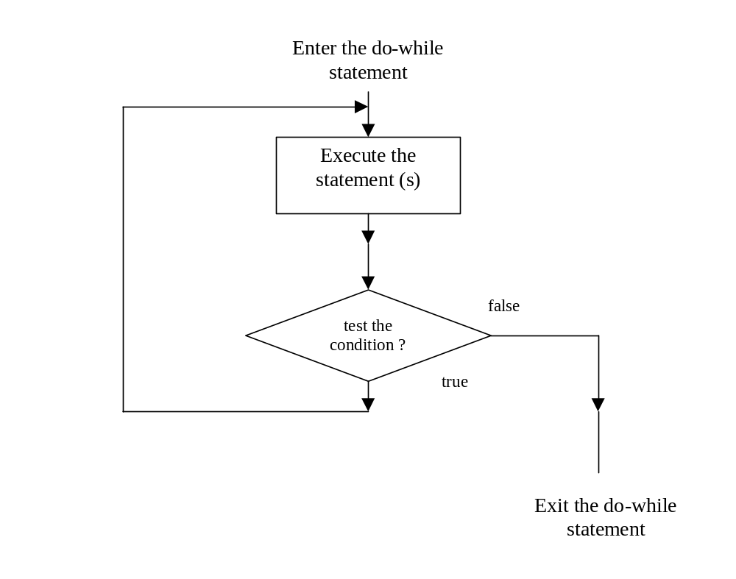
8. do-while LOOPS
do..while statement is used to create post-test loops.
The syntax:
do {
statements;
} while (conditional expression);

Slide 37
Example of do-while
Example 4.8.1 A program to find the sum of even numbers: 2+4+…+n
#include<iostream>
using namespace std;
void main() {
int max, sum = 0, digit;
digit = 2;
cout << “ enter a number \n”;
cin >> max;
do {
sum = sum + digit;
digit = digit + 2;
} while (digit <= max);
cout << “ 2 + 4 +… + “<< max << “ sum = ‘’;
cout << sum << endl;
}
Output of the program:
Enter a number
2+4+ …+10 sum = 30

