Slide 1
Define your own optimization function CS 269 Seminar Natural Language Processing

Slide 2
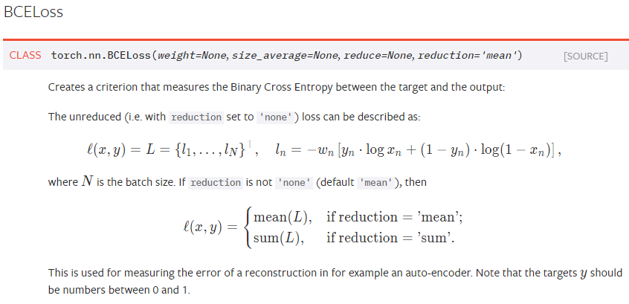
Loss functions
Many classification problems have well-known loss functions.
For example: binary classification in Pytorch
Bernoulli log likelihood

Slide 3
Your own optimization function
Pytorch is able to take derivative of a function.
You can solve a lot of optimization problems.
Linear programming
Quadratic programming
Some other sorts of optimization.
Expectation Maximization problem.

Slide 4
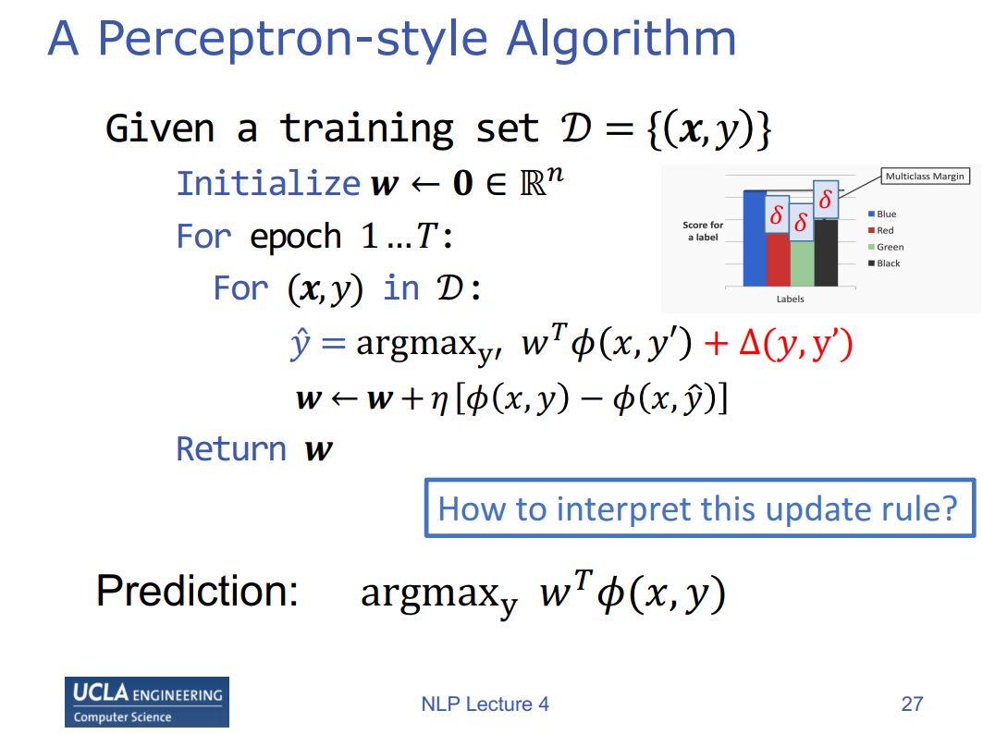
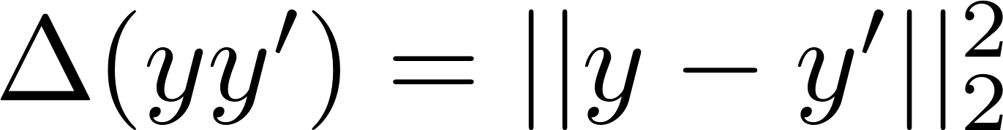
This tutorial
How do we max over y?
Define this function
Easy to update w

Slide 5
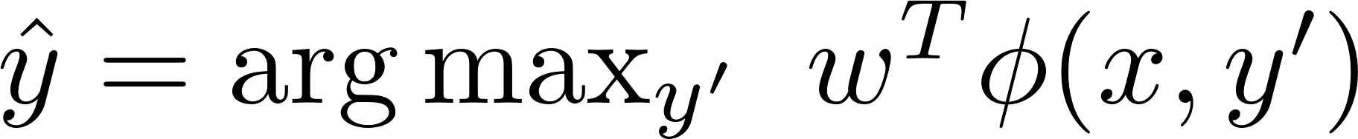
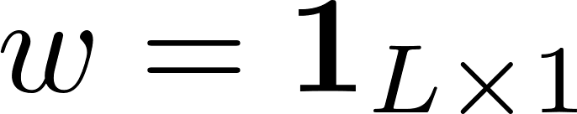
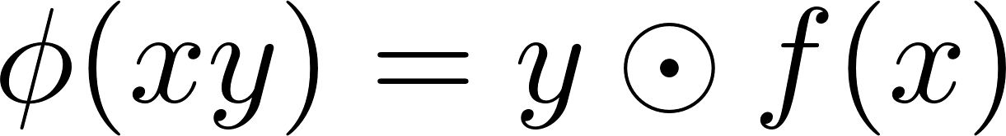
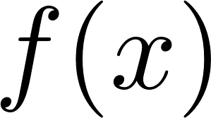
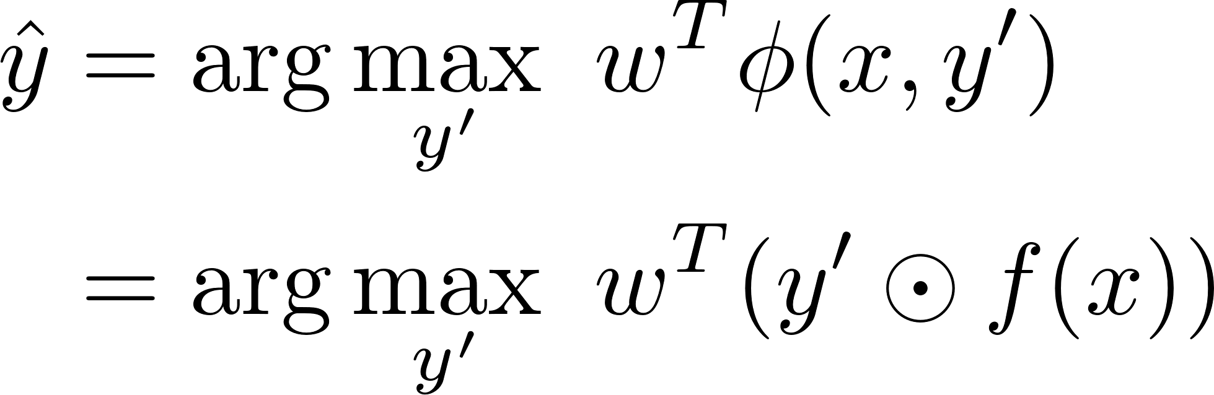
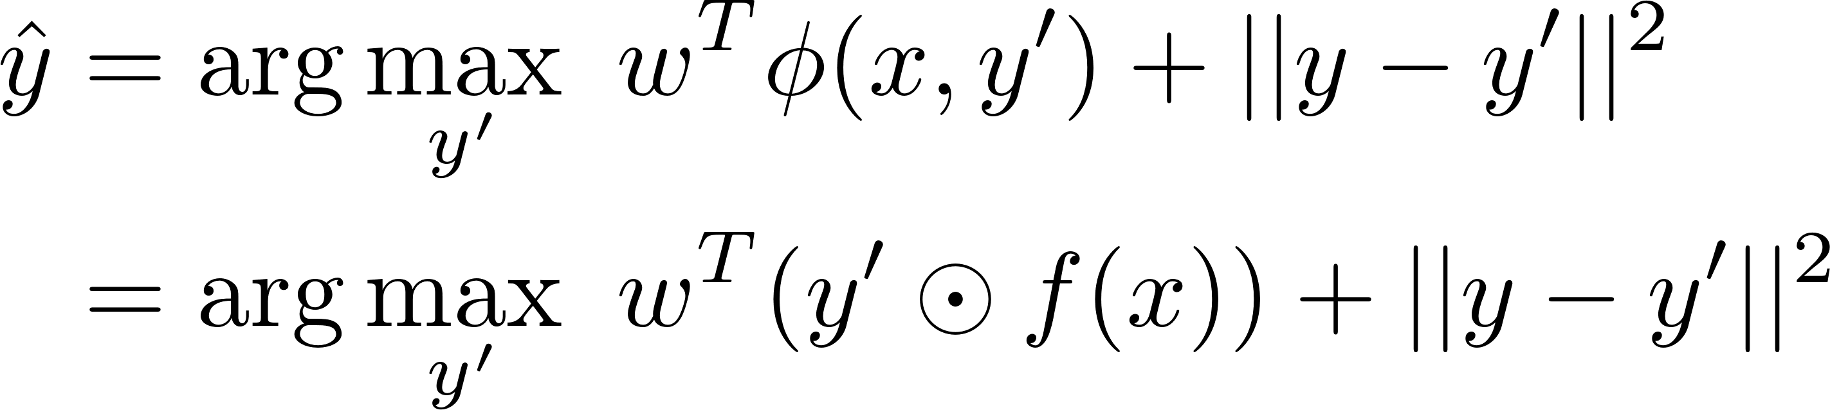
This tutorial
Skip
How do we find
In this step, w is a constant. Assume
Assume element-wise multiplication
is feed-forward neural network.
Assume
Try to code on your own

Slide 6
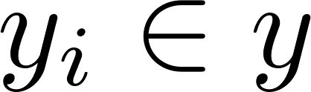
Each entry is 0 or 1, so brute force will work.
If there are many labels, then gradient descent is faster.
Relax constraint so let be between 0 and 1.
No guarantee gradient descent gives output between 0 and 1.
Must use projected gradient descent.
Now, we will learn how to code this optimization in pytorch.

Slide 7
Go here for tutorial code, we will do this demo live.
https://github.com/datduong/CS269_tutorial
To begin, I assume you already know how to do these steps.
Install Anaconda python3 https://www.anaconda.com/distribution/#windows
Install pytorch
https://pytorch.org/get-started/locally/

Slide 8
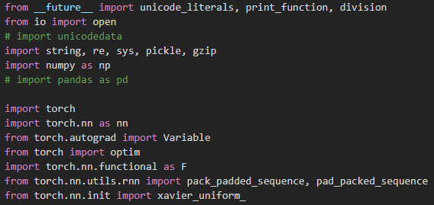
First, we load the libraries

Slide 9
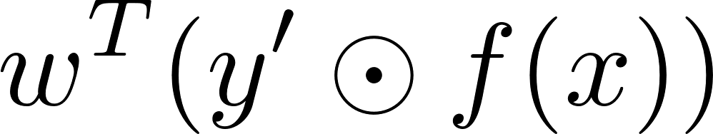
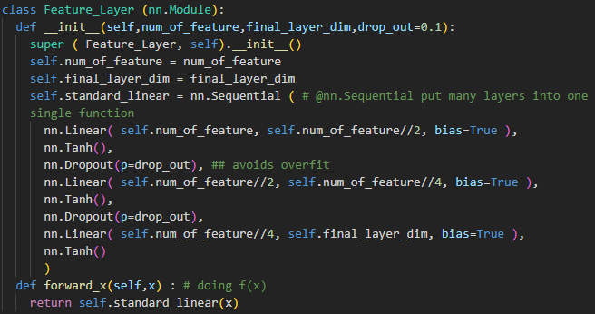
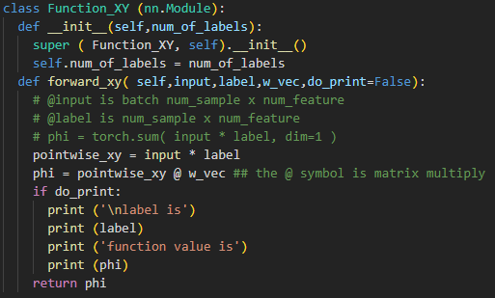
is feed-forward neural network.

Slide 10
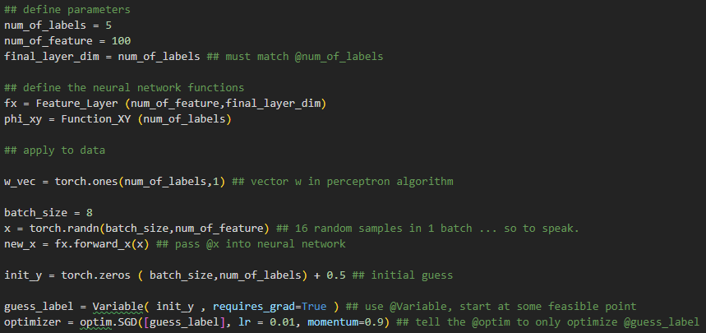
Initialize some values for w, x, y
Define the optimizer.

Slide 11
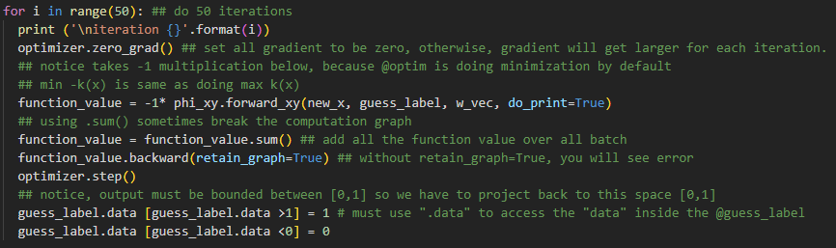
Do the optimization
y is not strictly 0 or 1 because of gradient descent.
You can heuristically round output y to nearest 0 or 1.

Slide 12
Variable object
Variable is part of the torch.autograd
Variable has 4 key fields (we will see them in demo code)
data
requires_grad
grad
is_leaf

Slide 13
retain_graph=true
In the demo code, we use function_value.backward(retain_graph=True)
Without this option retain_graph=True, the optimization fails.
Why ?
Computation graph is created “on-the-fly”, so at every epoch, the graph is destroyed, and then remade.
The variables exist, but “links” between variables are destroyed.
Let’s look our computation graph on the board.

Slide 14
It is possible to avoid retain_graph=True.
We need to create every single variables required for the computation AGAIN.
https://discuss.pytorch.org/t/runtimeerror-trying-to-backward-through-the-graph-a-second-time-but-the-buffers-have-already-been-freed-specify-retain-graph-true-when-calling-backward-the-first-time/6795/28
Observe this in the second part of the demo code.

Slide 15
Try by yourself, modify code to solve

