Slide 1
Define your own optimization function CS 269 Seminar Natural Language Processing

Slide 2
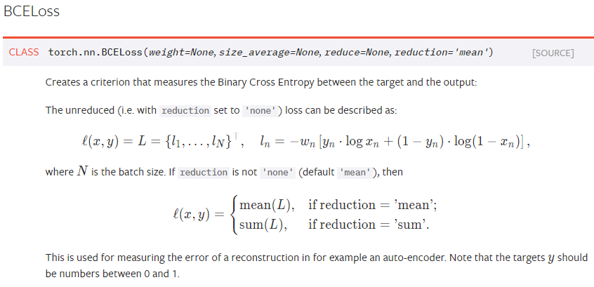
Loss functions
Many classification problems have well-known loss functions.
For example: binary classification in Pytorch
Bernoulli likelihood

Slide 3
Your own optimization function
Pytorch is able to take derivative of a function.
You can solve a lot of optimization problems.
Linear programming
Quadratic programming
Some other sorts of constraint optimization.
Expectation Maximization problem.
Maximization step:

Slide 4
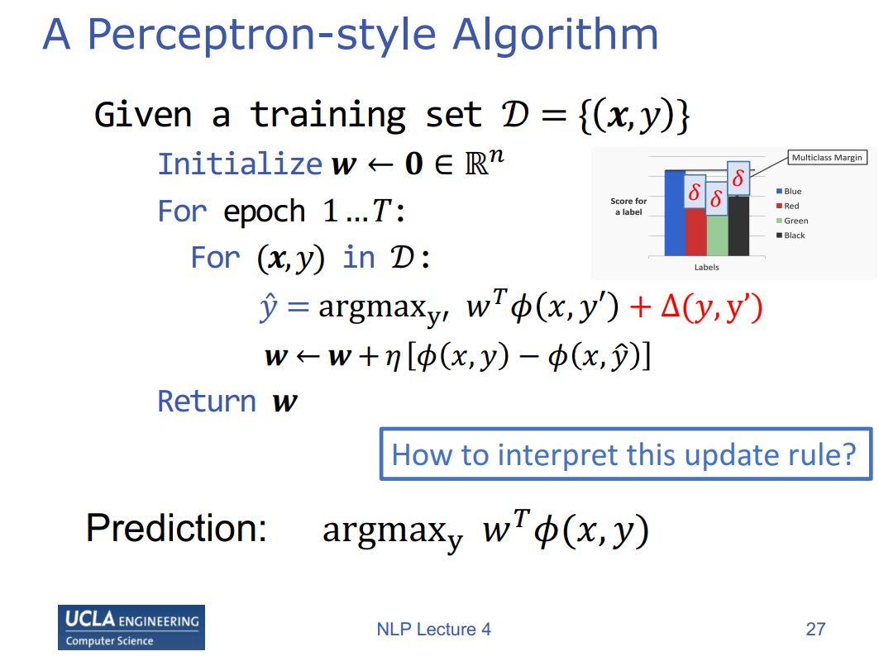
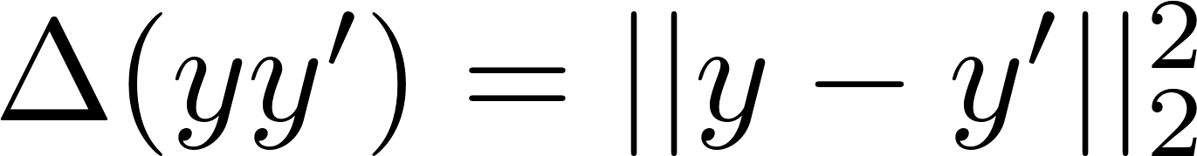
This tutorial
How do we max over y?
Define this function
Easy to update w

Slide 5
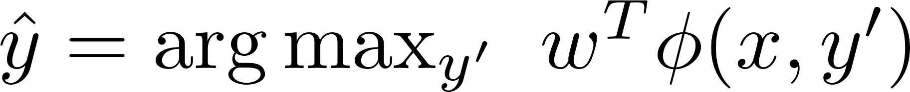
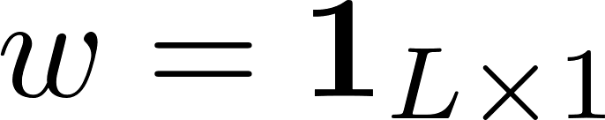
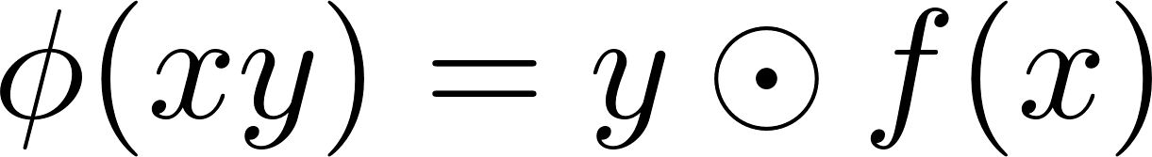
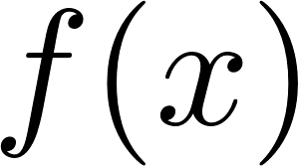
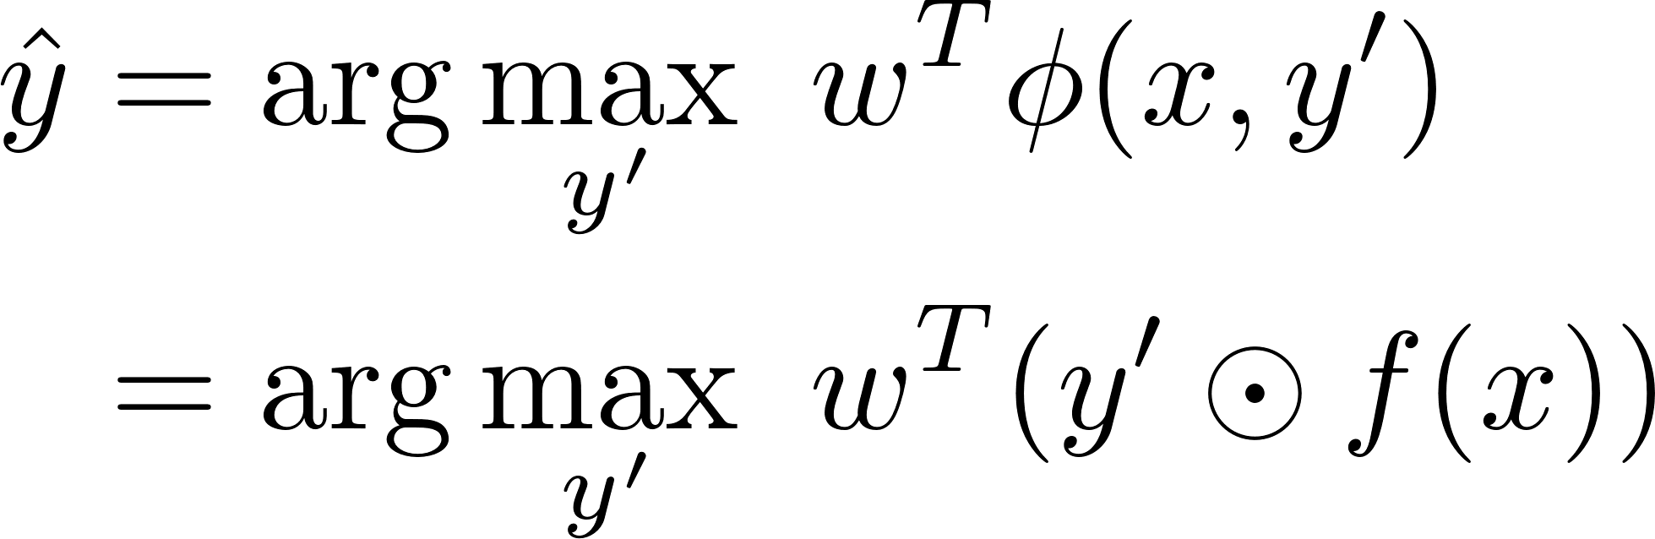
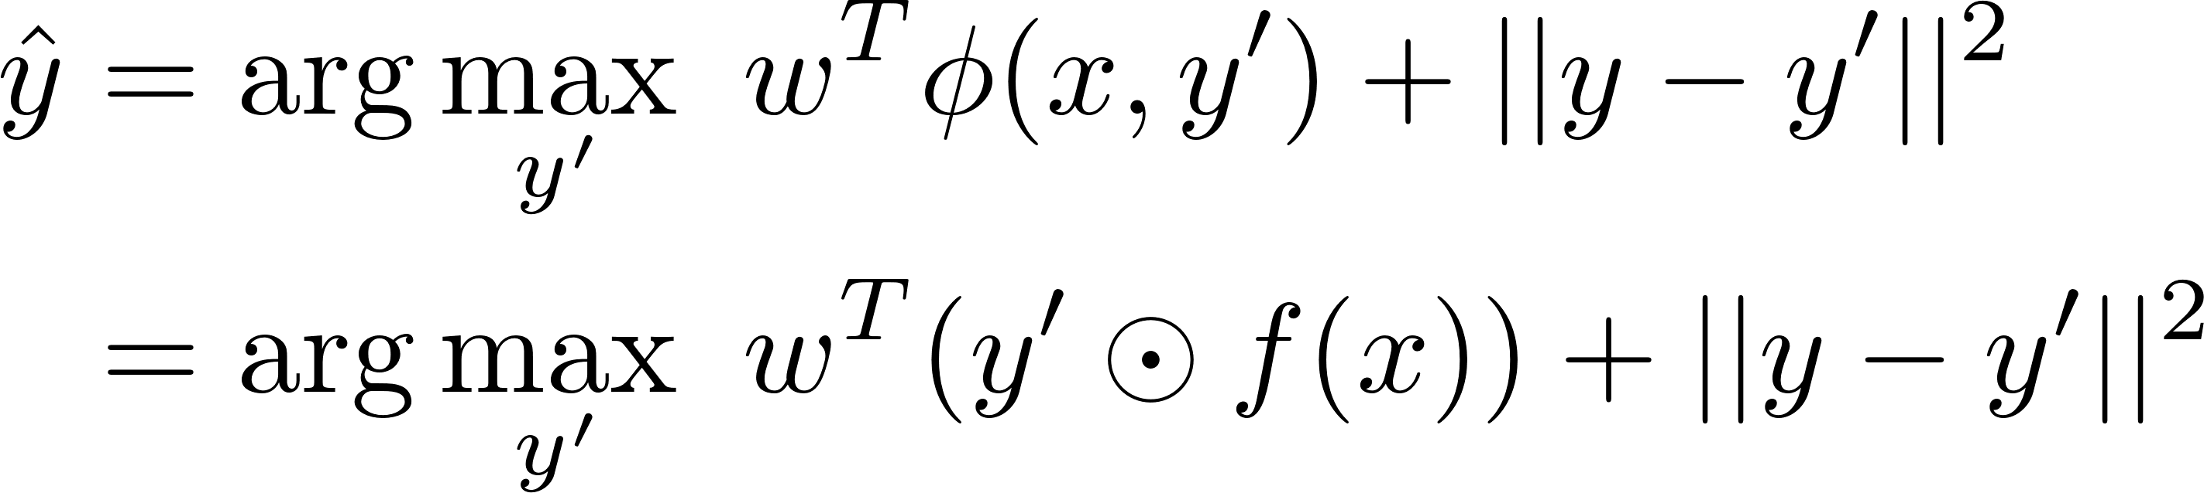
This tutorial
Skip
How do we find
In this step, w is a constant. Assume
Assume element-wise multiplication
is feed-forward neural network.
Assume
Try to code on your own

Slide 6
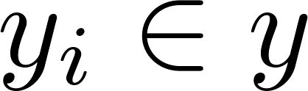
Each entry is 0 or 1, so brute force will work.
If there are many labels, then gradient descent is faster.
Relax constraint so let be between 0 and 1.
No guarantee gradient descent gives output between 0 and 1.
Must use projected gradient descent.
Now, we will learn how to code this optimization in pytorch.

Slide 7
Go here for tutorial code
https://github.com/datduong/CS269_tutorial
To begin, I assume you already know how to do these steps.
Install Anaconda python3 https://www.anaconda.com/distribution/#windows
Install pytorch
https://pytorch.org/get-started/locally/

Slide 8
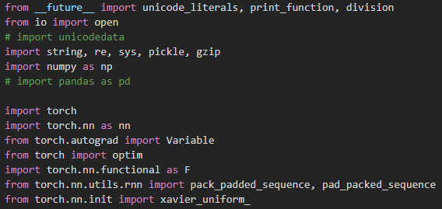
First, we load the libraries

Slide 9
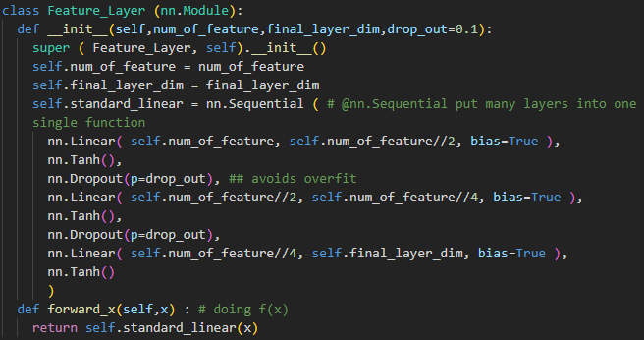
is feed-forward neural network.

Slide 10
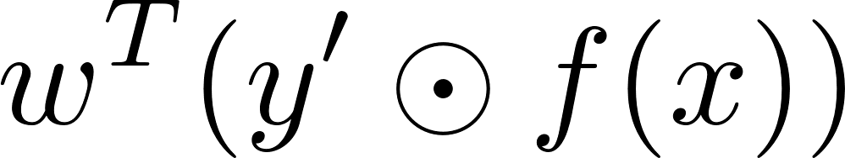
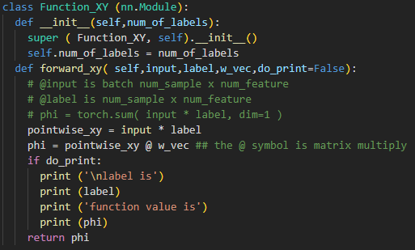

Slide 11
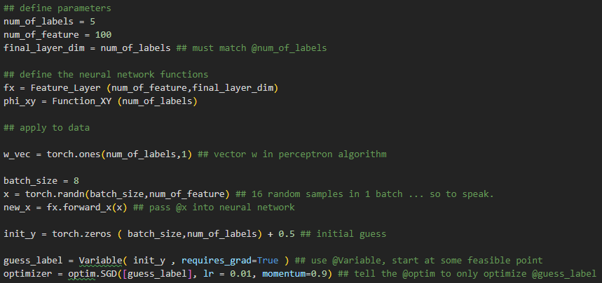
Initialize some values for w, x, y
Define the optimizer.

Slide 12
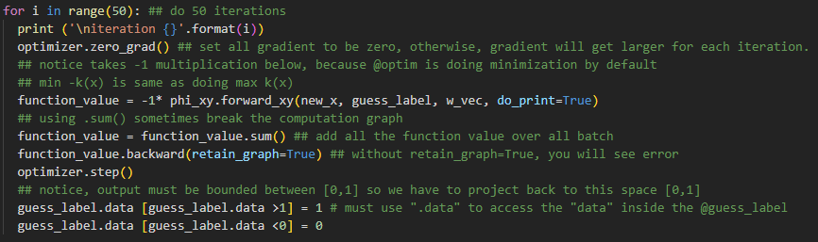
Do the optimization

Slide 13
Output y will not be perfectly 0 or 1 because we use gradient descent instead of brute force.
You can heuristically round output y to nearest 0 or 1.

Slide 14
Try by yourself, modify code to solve

