Slide 1

City Traffic Simulator Increment 1 Retrospective
Team Members
Zoe Fu
Dat Nguyen
Reid Stagemeyer

Slide 2
Overview
Project Description
Functional Requirements
Nonfunctional Requirements
Use Cases
Reflection

Slide 3


Our client
Pixi City
The Pac Mayor man

Slide 4
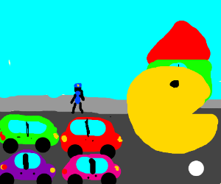
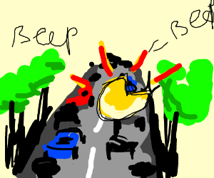
Our Client
https://drawception.com/

Slide 5
Project Overview
Purpose: Application will help Mayor Mann simulate traffic flow and allow the city to plan construction projects.
Scope: Allow user to investigate impact of changing traffic components placement vs density of traffic.

Slide 6
Objectives and Success Criteria
Give user most realistic view of the traffic flow
System allows multiple simulations to be run with various combination
Simulation will be finished once every car on the map reaches their destination

Slide 7
Proposed System Overview
System must allow The Pac Mayor Mann to efficiently determine the optimal traffic placement of traffic components
Reports and statistics will be shown to help the user gain insights about the traffic flow. Some statistic fields include:
Density of a traffic node. (number of cars in a region)
Density of flow coming in and out of an intersection
Speed and states of each car.

Slide 8
Overview
Project Description
Functional Requirements
Nonfunctional Requirements
Use Cases
Reflection

Slide 9
Functional Requirements
F1 Run multiple simulations
F2 Let user change the location of traffic components
F3 Let user change the combination of traffic components
F4 Analyze traffic performance

Slide 10
Functional Requirements
F5 Allow user to change the number of cars.
F6 Allow user to change start/end locations for each car.
F7 Make the map layout customizable

Slide 11
Overview
Project Description
Functional Requirements
Nonfunctional Requirements
Use Cases
Reflection

Slide 12
Nonfunctional Requirements
N1: Usability
N2: Reliability
N3: Performance
N4: Supportability
N5: Implementation

Slide 13
N1: Usability
Provide statistical summary
Desktop application supported (Java applet)
Visualization

Slide 14
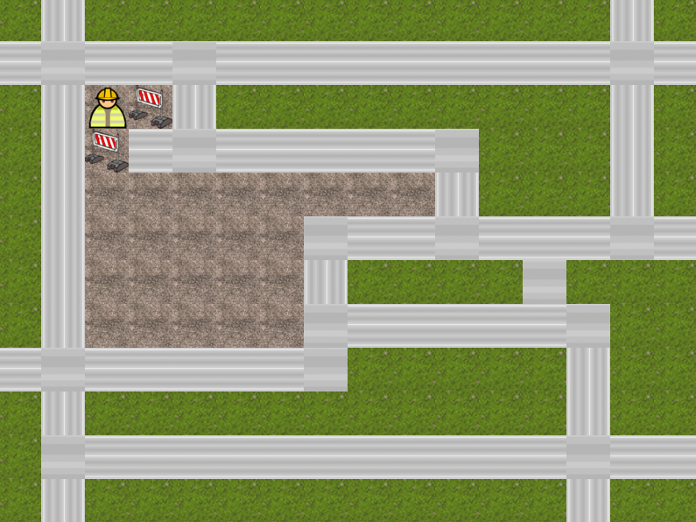
N2: Reliability
Start/end points should on the map
Car moves along the road
One and only one traffic component per intersection

Slide 15
N3: Performance
Multiple car moving supported
Not map dependent

Slide 16
N4: Supportability
Works for all Java supported platform
Web application supported with 2D visualization

Slide 17
N5: Implementation
Coding in Java; shared in GitLab
2D visualization by PixiJS

Slide 18
Overview
Project Description
Functional Requirements
Nonfunctional Requirements
Use Cases
Reflection

Slide 19

Use Case
- (1) Users can input # of cars, position of cars
- (2) Users set combinations of traffic lights and stop signs/ optional: system set combinations randomly
- (3) start simulation: user decides to press stop and change combinations
- (4) track progress
- (5) System show stat data of their performance
- (6) end

Slide 20
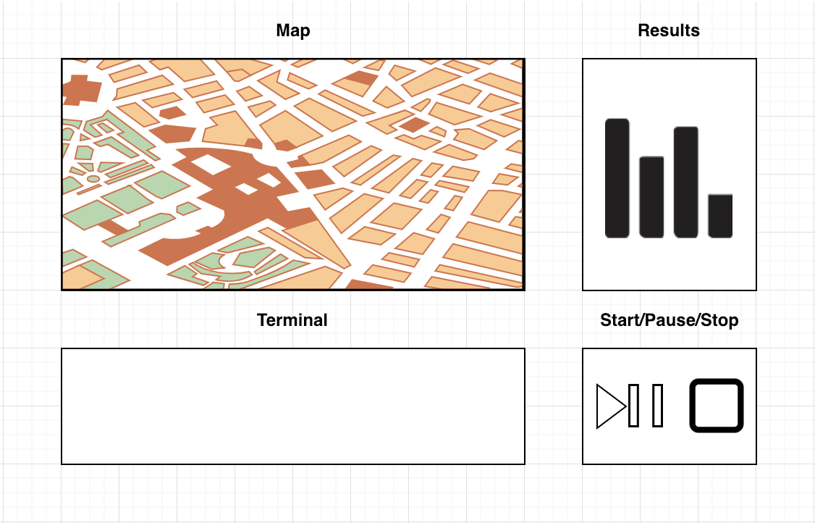
User Interface

Slide 21
Overview
Project Description
Functional Requirements
Nonfunctional Requirements
Use Cases
Reflection

Slide 22
Reflection What went well
Met consistently. Made progress along the way.
Allowed us to refine questions and requirements.

Slide 23
Reflection Something to Improve
Complete use case
Discuss User interface
jframe, applet, terminal.

Slide 24
Summary
Project Description
Functional Requirements
Nonfunctional Requirements
Use Cases
Reflection

