Slide 1

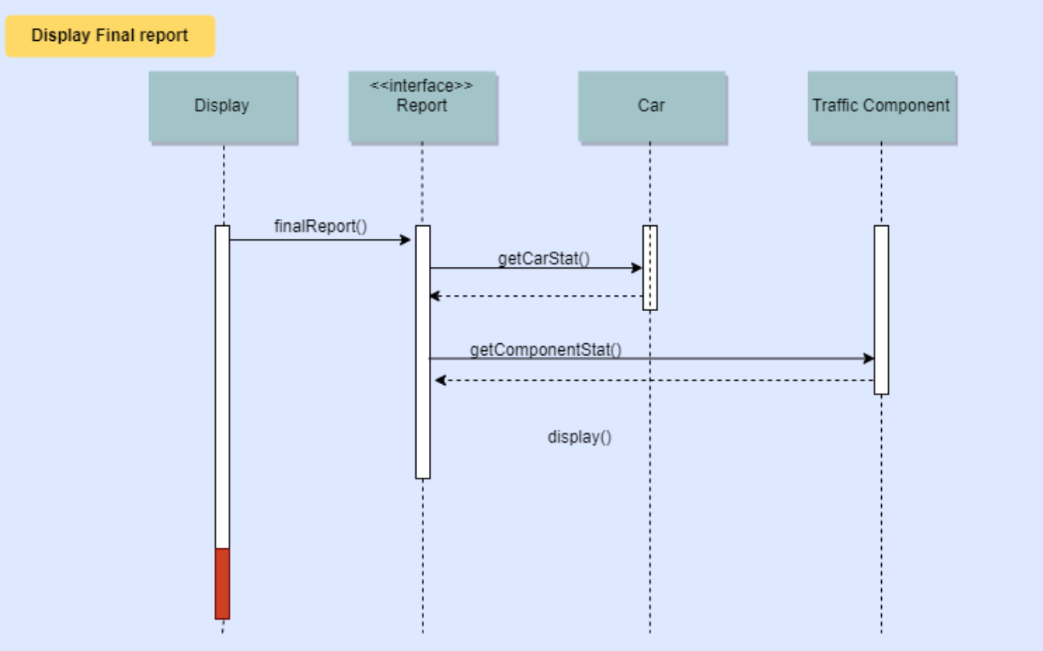
City Traffic Simulator Increment 2 Retrospective
Team Members
Zoe Fu
Dat Nguyen
Reid Stagemeyer

Slide 2
Overview
Project Description
Use Case Model
Use Case Diagram
Use Cases
Domain Model
Class Diagram
Sequence Diagrams
Reflection

Slide 3


Our client
Pixi City
The Pac Mayor man

Slide 4
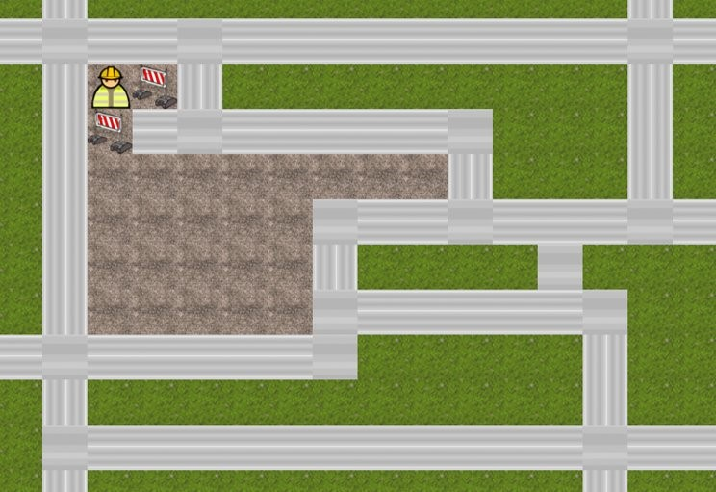
Project Overview
Purpose: Application will help Mayor Mann simulate traffic flow and allow the city to plan construction projects.
Scope: Allow user to investigate impact of changing traffic components placement vs density of traffic.

Slide 5
Overview
Project Description
Use Case Model
Use Case Diagram
Use Cases
Domain Model
Class Diagram
(Activity Diagrams)
Sequence Diagrams
(State Machine Diagrams)
Reflection

Slide 6
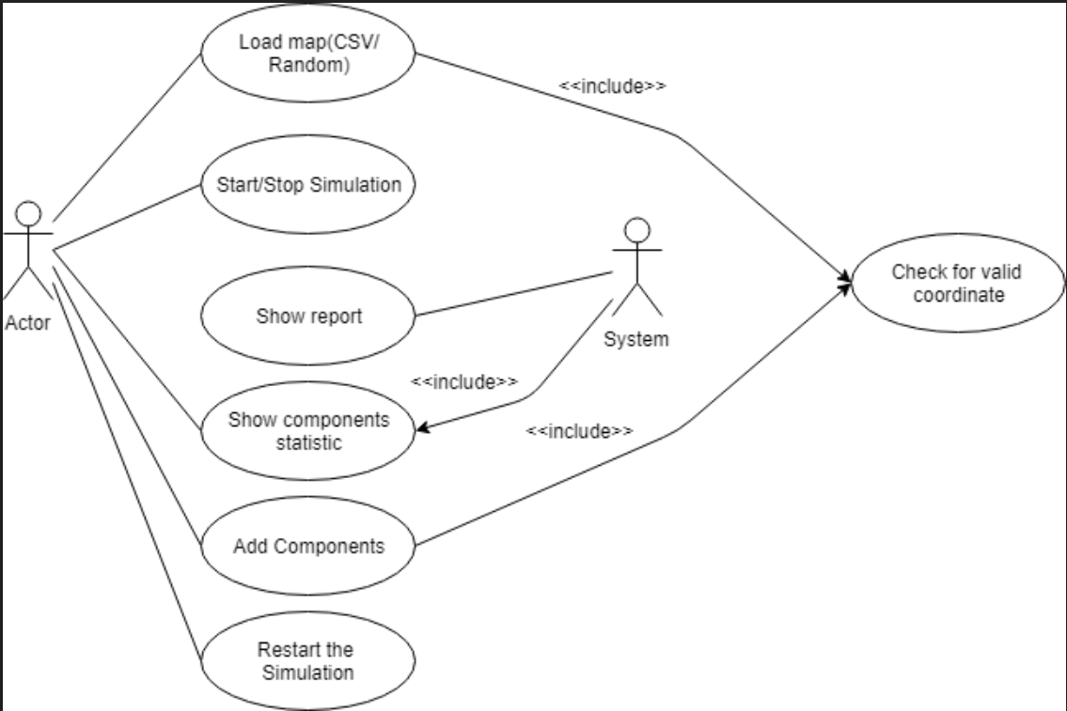
Use Case Diagram

Slide 7
Use Case: Precondition
1. Users load CSV file indicate # of cars, position of cars
2. Users set combinations of traffic lights and stop signs (optional: system set combinations randomly)
3. Start the simulation, users decide to press stop and change traffic combination. Restart at the end of simulation
3. Track progress and show statistic of traffic.
4. System shows final report of the traffic flow

Slide 8
Use Case: Post Condition
1. Users load CSV file indicate # of cars, position of cars
2. Users set combinations of traffic lights and stop signs (optional: system set combinations randomly)
3. Start the simulation, users decide to press stop and change traffic combination. Restart at the end of simulation
3. Track progress and show statistic of traffic.
4. System shows final report of the traffic flow

Slide 9
Overview
Project Description
Use Case Model
Use Case Diagram
Use Cases
Domain Model
Class Diagram
(Activity Diagrams)
Sequence Diagrams
(State Machine Diagrams)
Reflection

Slide 10
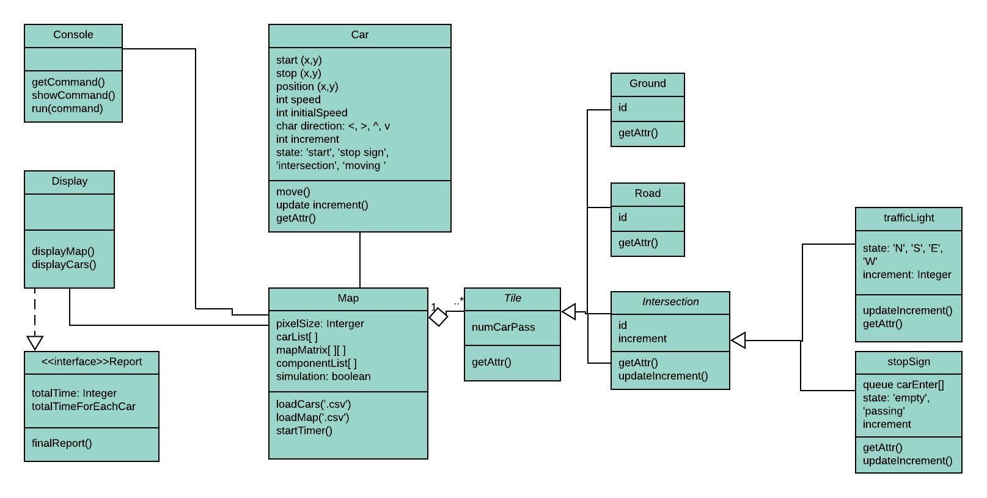
Structural Model

Slide 11
Structural Model
Report: gengerate and show final report
Console: user input
Display: show map and cars
Car: speed, position, direction, status
Map: mapMatrix, car(List), component
Tile (abstract): designed for easier when implement a new map
Ground, Road, Intersection (abstract)
Traffic Light and Stop Sign

Slide 12
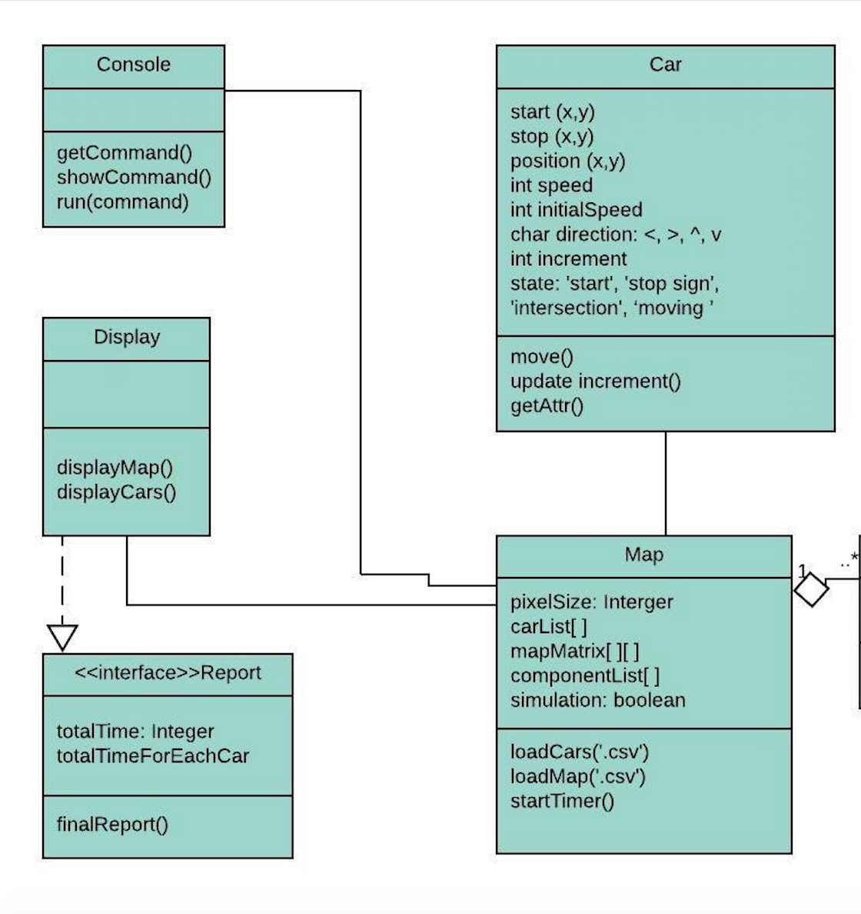
Structural Model
Console, Display, and Car are associated with Map.
Map has a public attribute carList[] call Car object, so that other classes associated with Map will be able to call Car.
Display will implement the Report interface

Slide 13
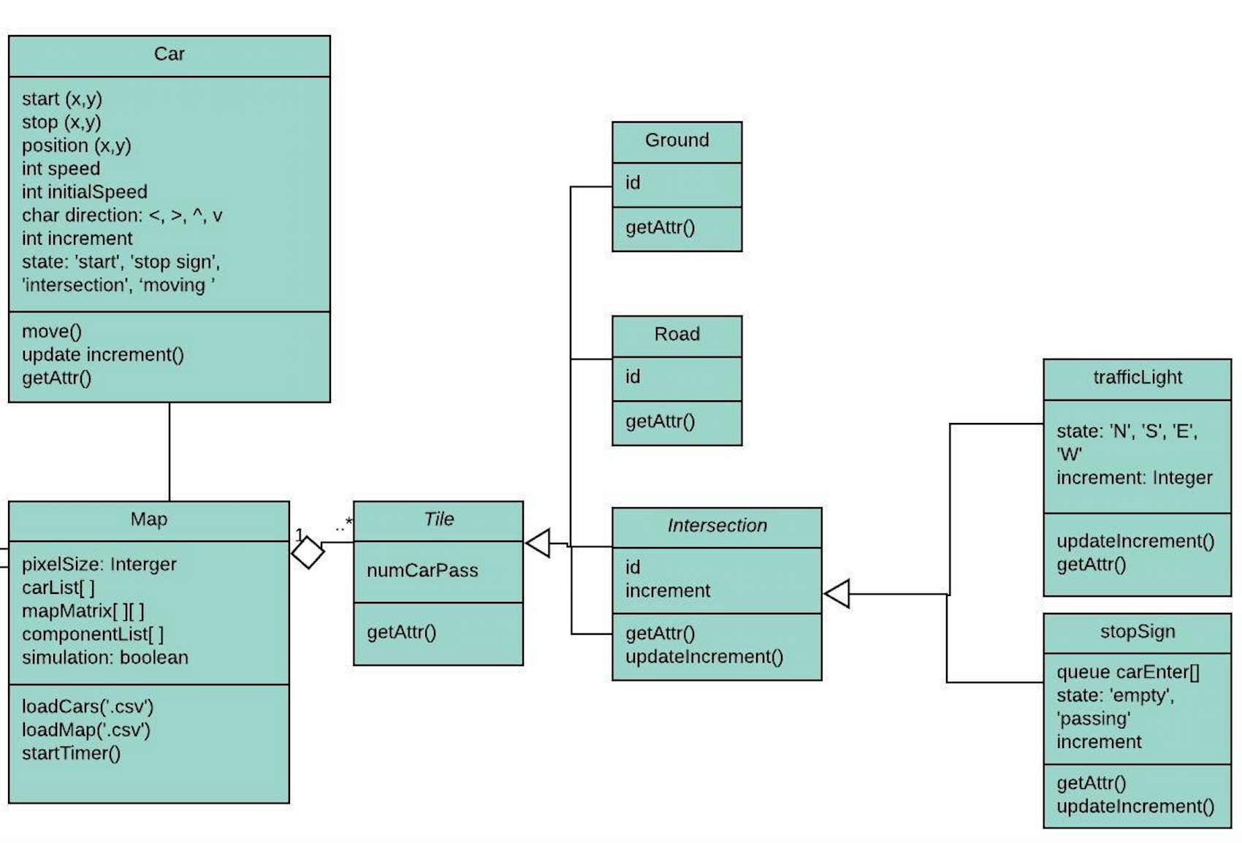
Structural Model
One Map will have multiple tiles
A tile will be a ground, road, or intersection
An intersection will have at least one traffic component, either traffic light or stop sign

Slide 14
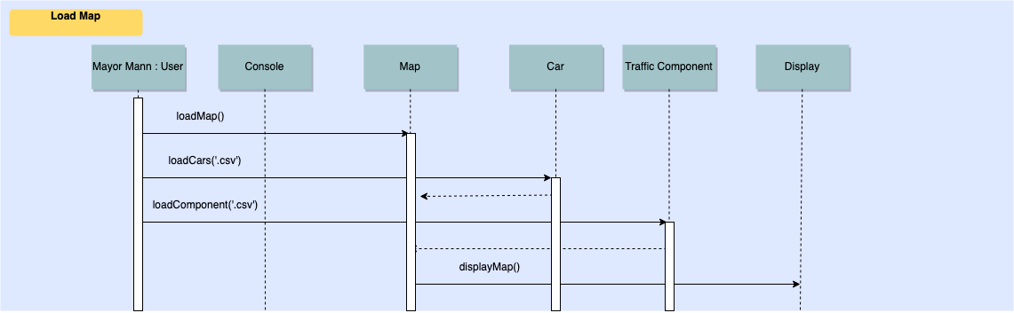
Behavioral Model – Sequence Diagrams

Slide 15
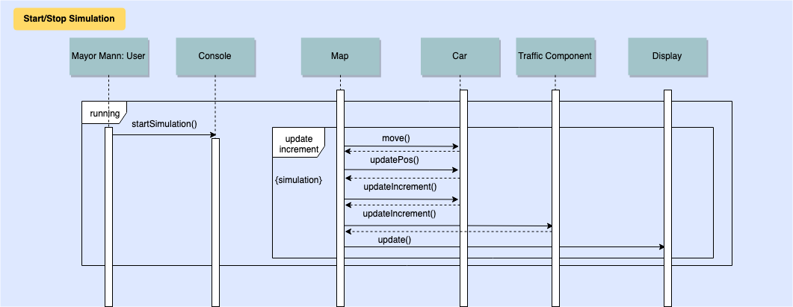

Slide 16
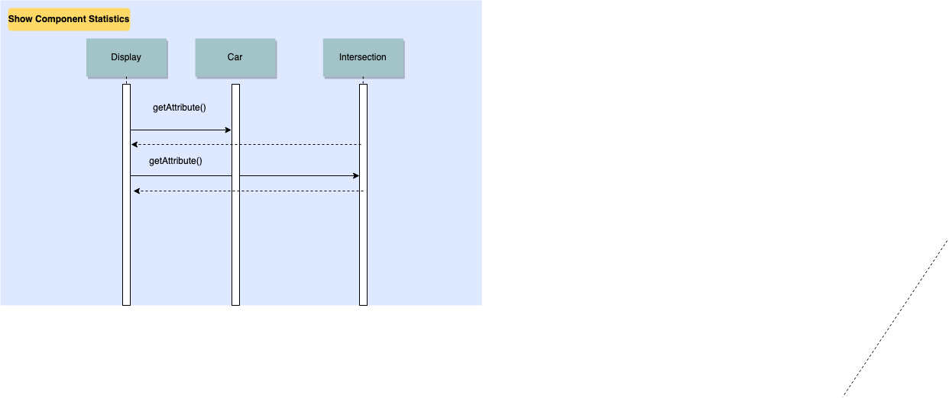

Slide 17
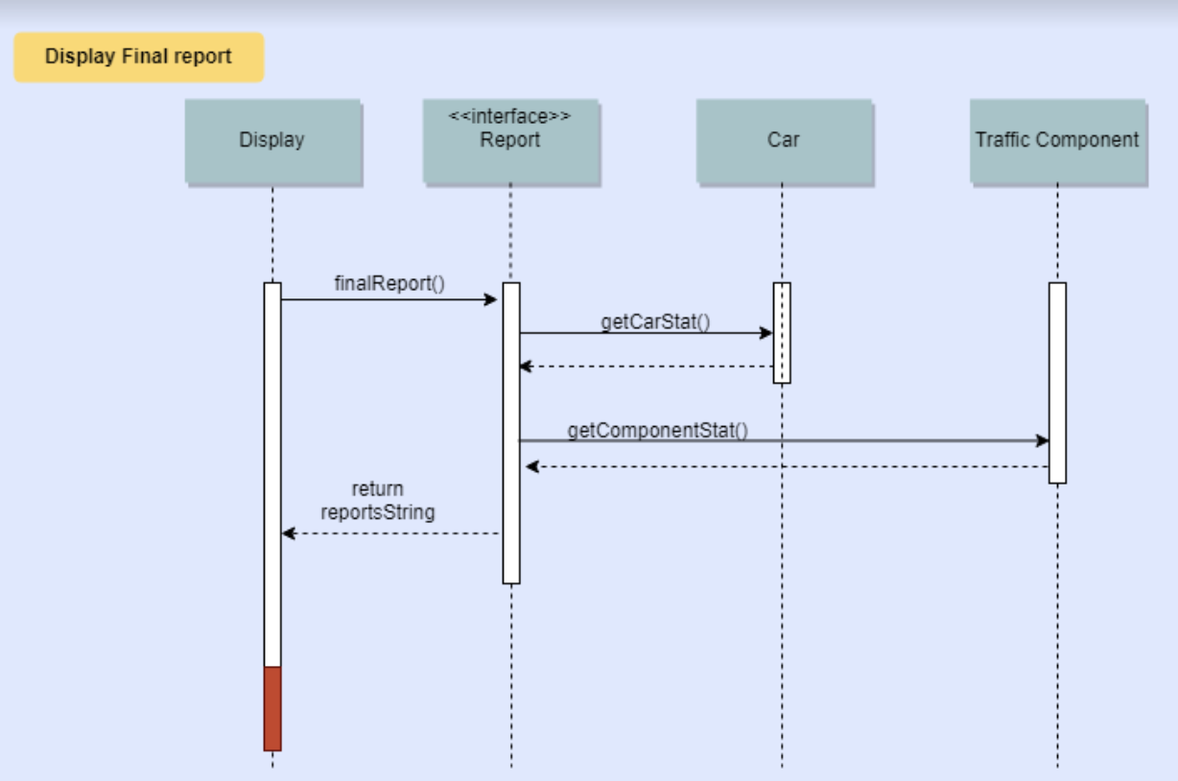

Slide 18
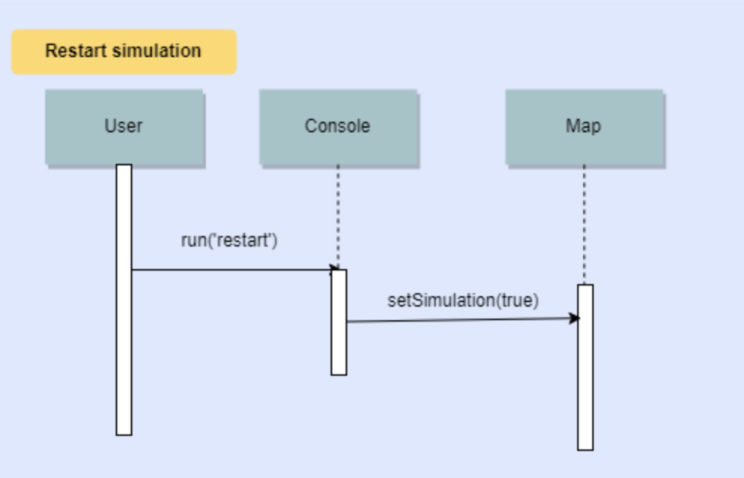

Slide 19
Dynamic Model
Show two or three of the more interesting behavioral diagrams (sequence diagrams, state machine diagrams, activity diagrams).

Slide 20
Overview
Project Description
Use Case Model
Use Case Diagram
Use Cases
Domain Model
Class Diagram
(Activity Diagrams)
Sequence Diagrams
(State Machine Diagrams)
Reflection

Slide 21
Reflection What went well
Start early.

Slide 22
Reflection What didn’t go well

Slide 23
Reflection Something to Improve
Coding language to use.
Be specific with the attributes and methods

Slide 24
Overview
Project Description
Use Case Model
Use Case Diagram
Use Cases
Domain Model
Class Diagram
(Activity Diagrams)
Sequence Diagrams
(State Machine Diagrams)
Reflection

