Slide 1



Student Project Management System
Supervisor:
Mr. Nguyễn Trung Kiên
Team Members:
Đỗ Hồng Sơn
Đỗ Sơn Tùng
Nguyễn Mạnh Cường
Nguyễn Quang Tuấn
Đào Xuân Đạt

Slide 2

Application Roles/Actors

Slide 3

Roles of project
Admin
Subject Manager
Trainer
Student

Slide 4
USER CASE - Common
Register
Login
Common
Send Contact
Home
Change Password
View Profile
Reset Password

Slide 5
USER CASE - Admin
Dashboard
Setting
Management
Admin
User Management
Subject Management

Slide 6
USER CASE - Manager
Subject Management
Subject Setting
Management
Manager
Iteration Management
Criteria Management
Class Management

Slide 7
USER CASE - Trainer
Class Setting Management
Team Management
Iteration Evaluation
Trainer
Student Management
Milestone Management
Issue Management

Slide 8
USE CASE - Student
Update Evaluated Functions
Submit Functions
Student
Function Management
Issue Management
Milestone Submit

Slide 9

Application Design

Slide 10
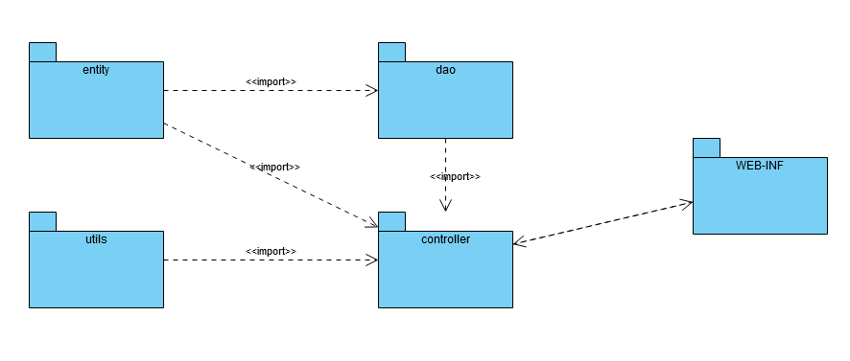
Package diagram
No | Package | Description
1 | controller | Act as a go-between for the front-end and the back-end, passing on different inputs, attribute, and parameters
2 | dao | This package helps connect to and interact with the database.
3 | entity | This package includes data models used to receive and send data from the database and controller classes.
4 | utils | This package contains custom java code utilities used by controller classes.
5 | WEB-INF | This package contains all jsp files.

Slide 11
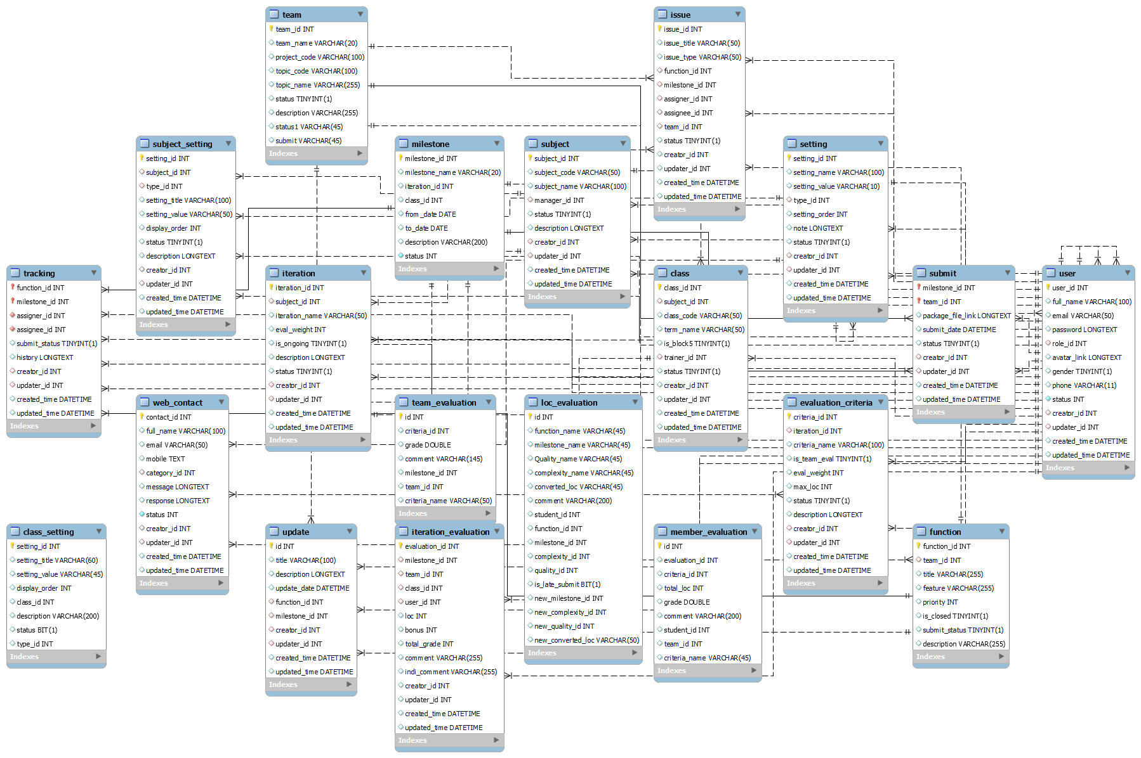
Database schema

Slide 12
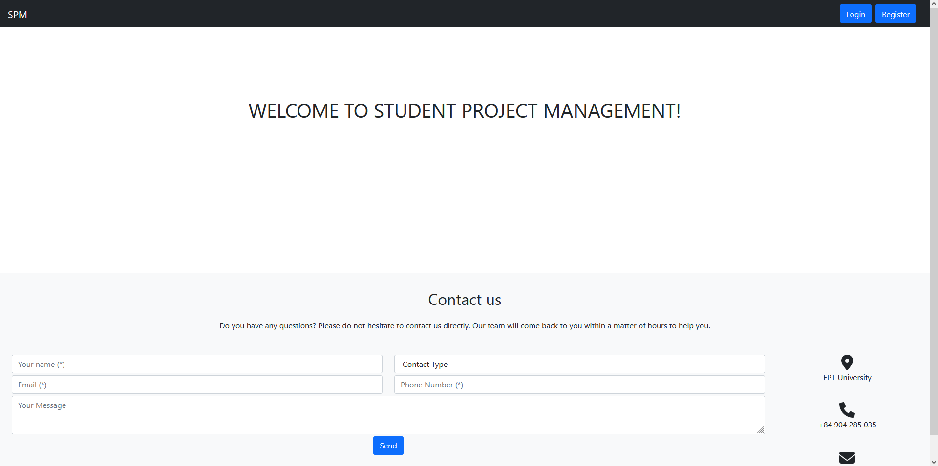
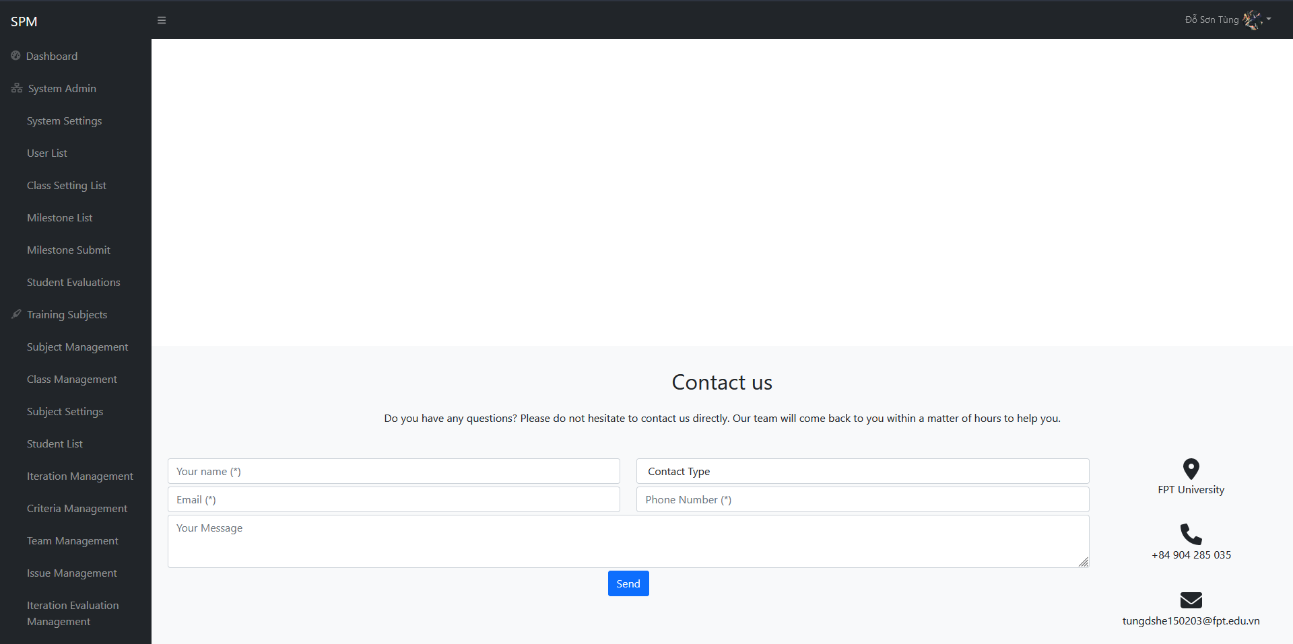
UI Design
Theme: startbootstrap.com

Slide 13
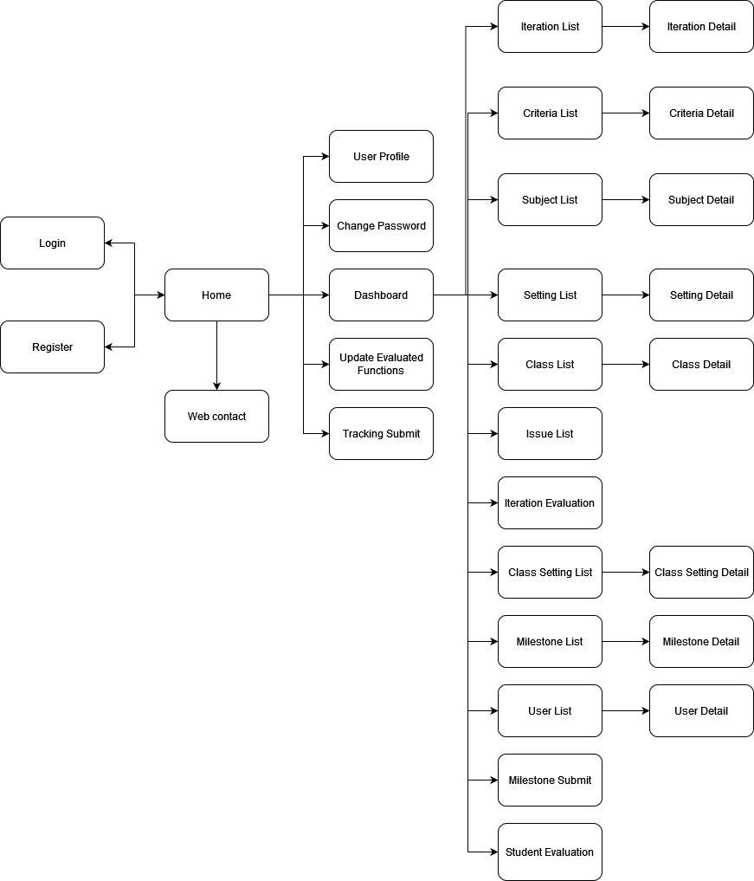
Screen Flow

Slide 14

Project Results

Slide 15
Status of the project
The project is about 70% complete.
User-friendly interface, easy to use

Slide 16




Lessons learned
Teamwork skills
Source code management skills: Gitlab
Database management skills
Project building skills through requirement

Slide 17

The end
Thanks for listening

