Slide 1
pd.DataFrame({Name: [Maier, Müller], …})
Pandas DataFrame
pd.Series({Klasse: [5, 5, …]})
Indices:
.loc [.iloc]
Index:
Pandas Series
 | Name [0] | Notenschnitt [1] | Klasse [2]
1 [0] | Maier | 2.75 | 5
2 [1] | Müller | 2.5 | 5
3 [2] | Schmidt | 3.2 | 6
4 [3] | Huber | 3.8 | 7
5 [4] | Bäcker | 1.9 | 5
 | DType: object / string | DType: float64 | DType: int64
 | Klasse [0]
1 [0] | 5
2 [1] | 5
3 [2] | 6
4 [3] | 7
5 [4] | 5
 | DType: int64
Name:
"Klasse"
df['Klasse']
5 | 5 | 6 | 7 | 5
NumPy Array
np.array([5, 5, 6, 7, 5])

Slide 2
mask = df['Z'] <= 45
df
 | X | Y | Z
a | 6 | 3 | 45
b | 2 | 3 | 98
c | 4 | 9 | 24
d | 8 | 27 | 11
e | 16 | 81 | 64
 | Z
a | True
b | False
c | True
d | True
e | False
df[mask]
 | X | Y | Z
a | 6 | 3 | 45
c | 4 | 9 | 24
d | 8 | 27 | 11

Slide 3
2 | 4 | 6 | 8
2 + 3 | 4 + 5 | 6 + 7 | 8 + 9
+
=
=
5 | 9 | 13 | 17
3 | 5 | 7 | 9

Slide 4
 | ag…bug | ag…fire | … | ag…water | ag…steel
Bug | 0.8 | 0.7 | … | 1.3 | 0.3
Fire | 2.1 | 1 | … | 0.46 | 1.3
… | … | … | … | … | …
Water | 1.2 | 0.3 | … | 1 | 0.4
Steel | 1.76 | 0.9 | … | 1.2 | 1

Slide 5
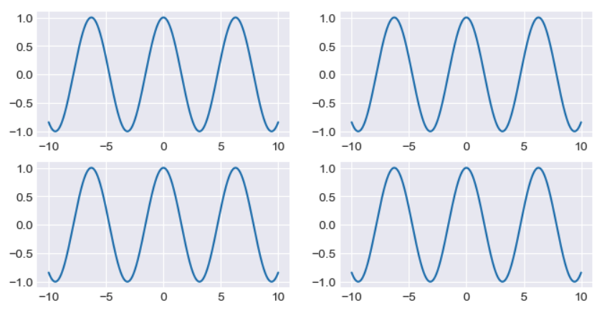
fig, ((ax1, ax2), (ax3, ax4)) = plt.subplots((2, 2))
Titel
fig
(ax1, ax2)
ax2
fig.suptitle(„...“)
fig.tight_layout()
ax4.text()
ax4.set_xticks()
ax4.set_xticklabels()
ax4.set_title()
Test
Titel

Slide 6
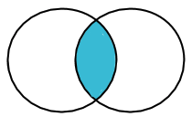
inner join
ID | Name
24 | Mark
48 | Antonia
76 | Sabine
99 | Erwin
ID | Alter
15 | 23
48 | 31
76 | 28
113 | 55
ID | Name | Alter
48 | Antonia | 31
76 | Sabine | 28
+
=

Slide 7
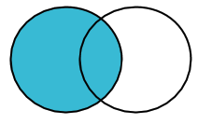
left join
ID | Name
24 | Mark
48 | Antonia
76 | Sabine
99 | Erwin
ID | Alter
15 | 23
48 | 31
76 | 28
113 | 55
ID | Name | Alter
24 | Mark | <NA>
48 | Antonia | 31
76 | Sabine | 28
99 | Erwin | <NA>
+
=

Slide 8
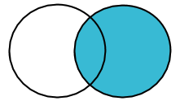
right join
ID | Name
24 | Mark
48 | Antonia
76 | Sabine
99 | Erwin
ID | Alter
15 | 23
48 | 31
76 | 28
113 | 55
ID | Name | Alter
15 | <NA> | 23
48 | Antonia | 31
76 | Sabine | 28
113 | <NA> | 55
+
=

Slide 9
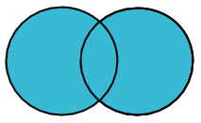
outer join
ID | Name | Alter
15 | <NA> | 23
24 | Antonia | <NA>
48 | Antonia | 31
76 | Sabine | 28
99 | Erwin | <NA>
113 | <NA> | 55
ID | Name
24 | Mark
48 | Antonia
76 | Sabine
99 | Erwin
ID | Alter
15 | 23
48 | 31
76 | 28
113 | 55
+
=

