Slide 1
Project Group: Cyber-SWAT
Multi Level Authentication Web Application
Vinit Date
Carl Mohn
Rajeeva Revankar
Benjamin Adeline

Slide 2
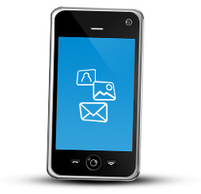
What is Multi-factor Authentication?
The use of one form of identification from each of the 3 categories of authentication.
1) Knowledge (something I know)
2) Possession (something I have)
3) Inherence (something I am)
Notes:
Change second image to Mobile. Expand explanation of Inheritance to include Challenge Response as Well.
SOMETHING YOU KNOW: User Login Screen: username and password
SOMETHING YOU HAVE: Voice Call with OTP
SOMETHING YOU ARE: Iris eye, finger print, voice recognition... - biometrics

Slide 3
Why Multi-factor
1) Increasing amount of personal digital data
2) Passwords can be cracked
3) Pin codes can be stolen
4) Secret questions may include public knowledge
5) Social engineering combined with any of the above
Notes:
We are creating a(POC) MFA for Web Application.

Slide 4
Objective
1) Create a Web application with Multi-factor Authentication
2) Capability to meet the CIA (Confidentiality, Integrity Accessibility) principles
3) Combine programming skills with theory about security, be creative and learn new things about existing and new technology.

Slide 5
Technologies Used
1) Ubuntu Linux 12.04 Virtual Machine,1 CPU 2GB
2) Glass Fish 4.1.1 Open Source Application Server
3) MySQL Database
4) Open Source Asterisk PBX to initiate phone call
5) NetBeans IDE
6) SSL (Secure Socket Layer 256bits encryption)
Notes:
Need to tidy this slide with look and feel like previous one.

Slide 6
Overview
Notes:
FOR VINIT : Decision Tree + “k-means clustering” ← (from Signal Processing = cluster analysis in data mining)
Deviations from association rules
Fuzzy logic

Slide 7
Implementation
Security Examples
Presentation
Layer
Third party VoIP provider
Validate I/O
e.g. restrict char length on login form
*.html , *.jsp
Application
Layer
Soft PBX Asterisk
Java Servlets
Prepared statement
Encrypted DB.
Call Initiator Script
Helper
Layer
OTP Generator
MySQL DB
Connector
Encryption Helper
MySQL DB Encrypted columns
Glassfish Application Server
SSL network communication.

Slide 8
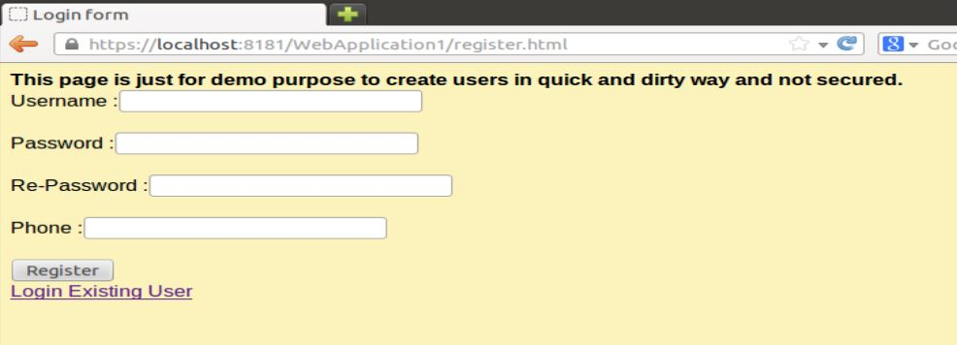
Registration
Method of encryption SHA-256
Notes:
Phone number is not encrypted

Slide 9
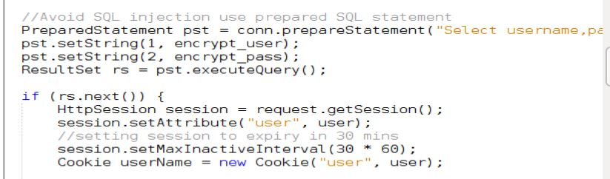
Registration security
Method of encryption SHA-256

Slide 10
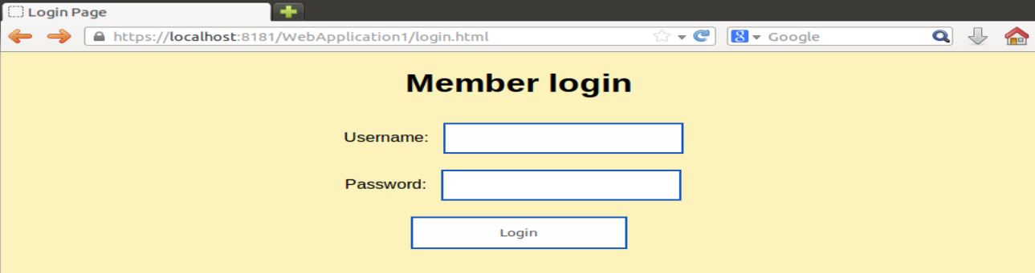
1st Authentication Factor
Method of encryption SHA-256

Slide 11
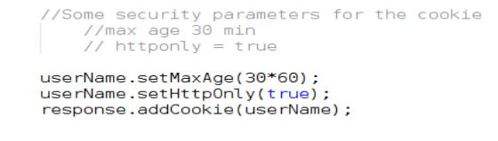
Session control
Method of encryption SHA-256

Slide 12
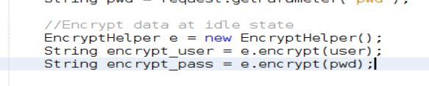
1st Authentication Factor
Method of encryption SHA-256

Slide 13
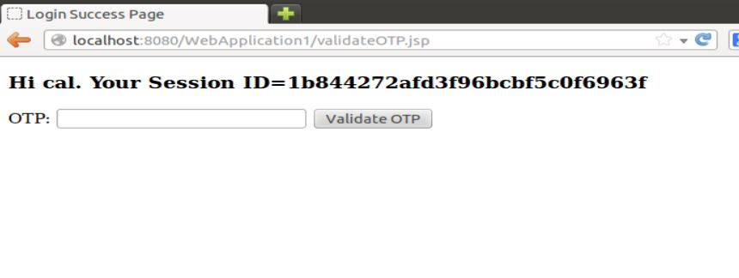
The Second factor of authentication
Confirmation Phone Code Via Voice
Notes:
Creates an OTP and calls your phone

Slide 14
System Architecture

Slide 15
Implementation
Security Examples
Presentation
Layer
Third party VoIP provider
Validate I/O
e.g. restrict char length on login form
*.html , *.jsp
Application
Layer
Soft PBX Asterisk
Java Servlets
Prepared statement
Encrypted DB.
Call Initiator Script
Helper
Layer
OTP Generator
MySQL DB
Connector
Encryption Helper
MySQL DB Encrypted columns
Glassfish Application Server
SSL network communication.

Slide 16
Architecture outlined
The presentation layer
GUI frontend - control threats by:
1) Performing user input validation
2) Session control
Notes:
is the GUI frontend interacting with users web browser. It consists *.html and *.jsp the Java Server pages.
The presentation layer attempts to control threats by
preventing browser cache ensuring that data is available for valid user and session.

Slide 17
Architecture outlined: Application layer
1) Business logic for authentication
2) Java Servlets for security of the application layer
3) Single session ID, managed by server side cookies.
4) Encrypt information before saving/retrieving from database.
5) Use Prepared Statements for SQL queries.
Notes:
Application layer
business logic for authentication. The steps are to obtain user name and the password, followed by validation of user phone using one-time password (OTP). The layer is represented by Java Servlets. For security the application layer
Contains the application web pages to a single session ID. The session is managed on server side by server side cookies.
Encrypt any user identifiable information before saving/retrieving from database.
Use Prepared Statements for SQL queries. This is to counter SQL injection threats.

Slide 18
Architecture outlined: Helper layer
OTP generator : 4 digit One Time Password.
The password is picked by third party application
Conveyed to the user with a voice call.
Encryption helper :
User information → SHA-256 hash
Only the hash is stored in database ensuring security for data at rest.
The sample application deals with two table objects user and session.
Notes:
Helper layer
OTP generator : The OTP Generator generates 4 digit one time password. This password is unique to session for a user The password is picked by third party application ( asterisk soft pbx) and conveyed to the user with a voice call.
Encryption helper :
All user identifiable information like username , password, session is converted in SHA-256 hash by the encryption helper. Only the hash is stored in database ensuring security for data at rest. The sample application deals with two table objects user and session.

Slide 19
Architecture outlined: Helper layer
Database Connection and Query engine
The Query engine → connection to database
DDL or DML requests to database.
Glassfish Application Server
The framework for the application.
The connections are provided over SSL using self-signed certificate. →
In-flight data encrypted for enhanced security.
Notes:
Database Connection and Query engine : The Query engine takes care of connection to database and aiding DDL or DML requests to database.
Glassfish Application Server
The Glassfish Application server provides framework for application. The connections are provided over SSL using self-signed certificate. This ensures in-flight data encryption for enhanced security.

Slide 20
Architecture outlined: Helper layer
Plugin to deliver OTP via voice call
1) Open source software PBX called Asterisk
2) Asterisk is provided with the phone number and associated OTP to make the phone call.
3) The actual phone call is carried over by many of commercial sip providers one of famous one in Ireland is blueface.ie
4) The Asterisk server sits in DMZ zone and is not user accessible.
Notes:
Plugin to deliver OTP via voice call
The plugin is developed around open source software Private Branch Exchange called asterisk (http://www.asterisk.org/) . asterisk is provided with the phone number and associated OTP to make the phone call. The actual phone call is carried over by many of commercial sip providers one of famous one in Ireland is blueface.ie (www.blueface.ie).
The asterisk server sits in DMZ zone and is not user accessible .

Slide 21
Conclusion
Education value for team.
Multi-factor authentication is most of all a highly effective deterrent.
MFA can be secure but will be slow

