Slide 1


BRAND BOARD
Eye Site Sacramento
How to use this file. Keep it as your master. To start any new post, make a copy of this design, delete the pages you do not need and work from a template page. Every color on page 2 and 3 is already in this document, so they appear under Document colors in Canva.
Version 1 · November 2026 · design-system/tokens.json is the source of truth
EYESITEMD.COM
Notes:
Brand board page: brand-cover. Keep as reference; copy this design to start new work.

Slide 2

COLORS · BLUES AND SURFACES
The practice's own blue
Navy carries the logo and the dark posts. Blue is the working color for eyebrows, links and the italic word. The rest are surfaces.
Navy
Navy deep
Blue
#102040
#081838
#0063A0
Dark posts, headings on light
Darkest end of a navy gradient
Eyebrows, links, italic word, website line
Blue deep
Sky
Mist
#164C71
#78AEDD
#B3CFEA
Hover states, SACRAMENTO in the logo
Quote mark, never text on white
Body and labels on navy
Ice
Paper
White
#E9F2FA
#FAF6F0
#FFFFFF
Review posts, the arc motif
Light posts (social only)
Logo tile on navy, headings on navy
Roughly 60% surface, 30% navy or blue, 10% amber
EYESITEMD.COM
Notes:
Brand board page: brand-colors-1. Keep as reference; copy this design to start new work.

Slide 3
COLORS · ACCENT AND TEXT
One accent, amber
Amber appears once per post: the rule, the stars or the award icon. Never as a fill behind text, never with white text on it.
Amber
Amber deep
Amber ink
#F0A32B
#D18A12
#8A5A0B
The rule, stars, award icon
Hover on an amber button
Chip text
Amber pale
Ink
Slate
#FDF1DC
#102040
#4A5A6E
Chip fill, the sun motif
Headlines on light
Body text on light
Mute
Hairline
Surface
#67788C
#D9E2EC
#F4F7FA
Captions, counters, source lines
1px dividers and borders
Website only; not used on posts
Text on light: ink, slate, mute. Text on navy: white, mist.
EYESITEMD.COM
Notes:
Brand board page: brand-colors-2. Keep as reference; copy this design to start new work.

Slide 4
TYPOGRAPHY
Two fonts, both free in Canva
Playfair Display for headlines with one italic word in blue. Inter for everything else: Light for reading, Medium for labels.
Night driving getting harder?
Headline
Playfair Display Regular
84 px · line 1.08
EYE HEALTH
Eyebrow
Inter Medium 30 px
uppercase · spacing 200
Blink more, look 20 feet away every 20 minutes.
Body
Inter Light 38 px
line 1.5
Everyone explained each step.
Review quote
Inter Light 46 px
line 1.4
EYESITEMD.COM
Label, website line
Inter Medium 32 px
uppercase · spacing 140
01
Carousel number
Playfair Display 200 px
blue
Nothing below 28 px on a 1080 px post. Sentence case. No exclamation points.
EYESITEMD.COM
Notes:
Brand board page: brand-type. Keep as reference; copy this design to start new work.

Slide 5


LOGO
Once per post, never altered
Lockup at 200 px tall on light surfaces, bottom left. On navy or a photo it sits on a white tile with 12 px corners. Mark alone at 64 to 72 px on carousel slides, or inverted to white on navy. Clear space 48 px, minimum 180 px wide. Never recolor, stretch, crop the wordmark out, or redraw it.
Files: eye-site-logo-transparent.png · eye-site-mark.png
EYESITEMD.COM
Notes:
Brand board page: brand-logo. Keep as reference; copy this design to start new work.

Slide 6



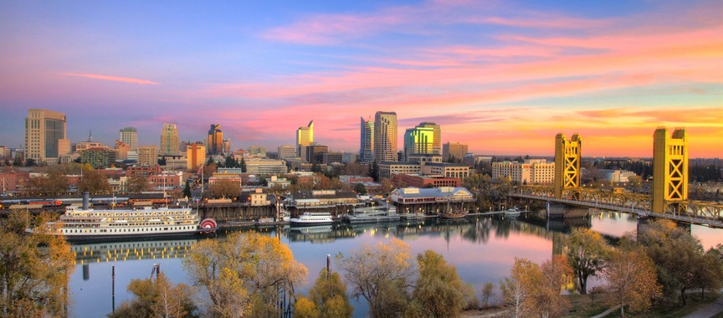
ELEMENTS
The small parts that make it ours
NEW PATIENTS WELCOME
Amber rule, 48 x 6 px, 3 px corners. Opens every post above the eyebrow.
Chip: amber pale fill, amber ink text, Inter Medium 26 px, pill corners.
One sourced accolade
Five stars in amber on review posts, 40 px, 6 px apart.
Award icon, 1.75 px stroke, beside a doctor's accolade.
Motif: ice crescent (the logo's eye arc) and an amber pale disc, faint, behind the content.
Hairline dividers; carousel progress bar in blue.
NEW PATIENTS WELCOME
On navy the chip is 10% white with light amber text; the arc is mist at 10%.
Photos: desaturate 15%, navy gradient heavier on the left so white text reads.
96 px safe margin on every side; 250 px top and bottom on stories
EYESITEMD.COM
Notes:
Brand board page: brand-elements. Keep as reference; copy this design to start new work.

Slide 7
VOICE AND CAPTIONS
Warm, plain English, confident
On the graphic
"You" for the patient, "we" for the practice, "Dr. Jones" for doctors. Plain word first, medical term second: cloudy lens (cataract). Sentence case; one italic word per headline, usually the last. No hype, no medical promises, no exclamation points, no emoji.
Every caption, four parts
1. First line says what it is (the only line visible before "more"). 2. One or two sentences on why it matters to patients. 3. A light call to action: call, visit the link, or comment. 4. Three to five hashtags, the same core set: #EyeSiteSacramento #SacramentoEyeDoctor #EastSacramento.
Before anything goes out
No patients, names, schedules or screens in frame. Staff shown have said yes. Awards use the exact name, organization and year from the source. "Board certified" only with the full board name. The Kings line only in wording Dr. Rashidi confirmed. Administration's approval is in the sheet.
Sacramento 916-452-8105 · Folsom 916-983-9823
EYESITEMD.COM
Notes:
Brand board page: brand-writing. Keep as reference; copy this design to start new work.

Slide 8
CATARACTS
Night driving
getting harder?
Halos around headlights and faded colors are common early signs of a cloudy lens (cataract). A dilated exam will tell you where you stand.
NEW PATIENTS WELCOME
EYESITEMD.COM
Notes:
Education (paper). Tips, condition explainers, FAQ answers. Swap or delete the photo band; keep one amber element (the rule). Chip is optional.

Slide 9

FOLSOM OFFICE
Early Friday hours,
6:30am to 2:00pm
Fit your exam in before work. Free parking at the door.
CALL FOLSOM
916-983-9823
EYESITEMD.COM
Notes:
Announcement (navy). Hours, closures, new services. Keep the phone number of the office concerned in the serif.

Slide 10
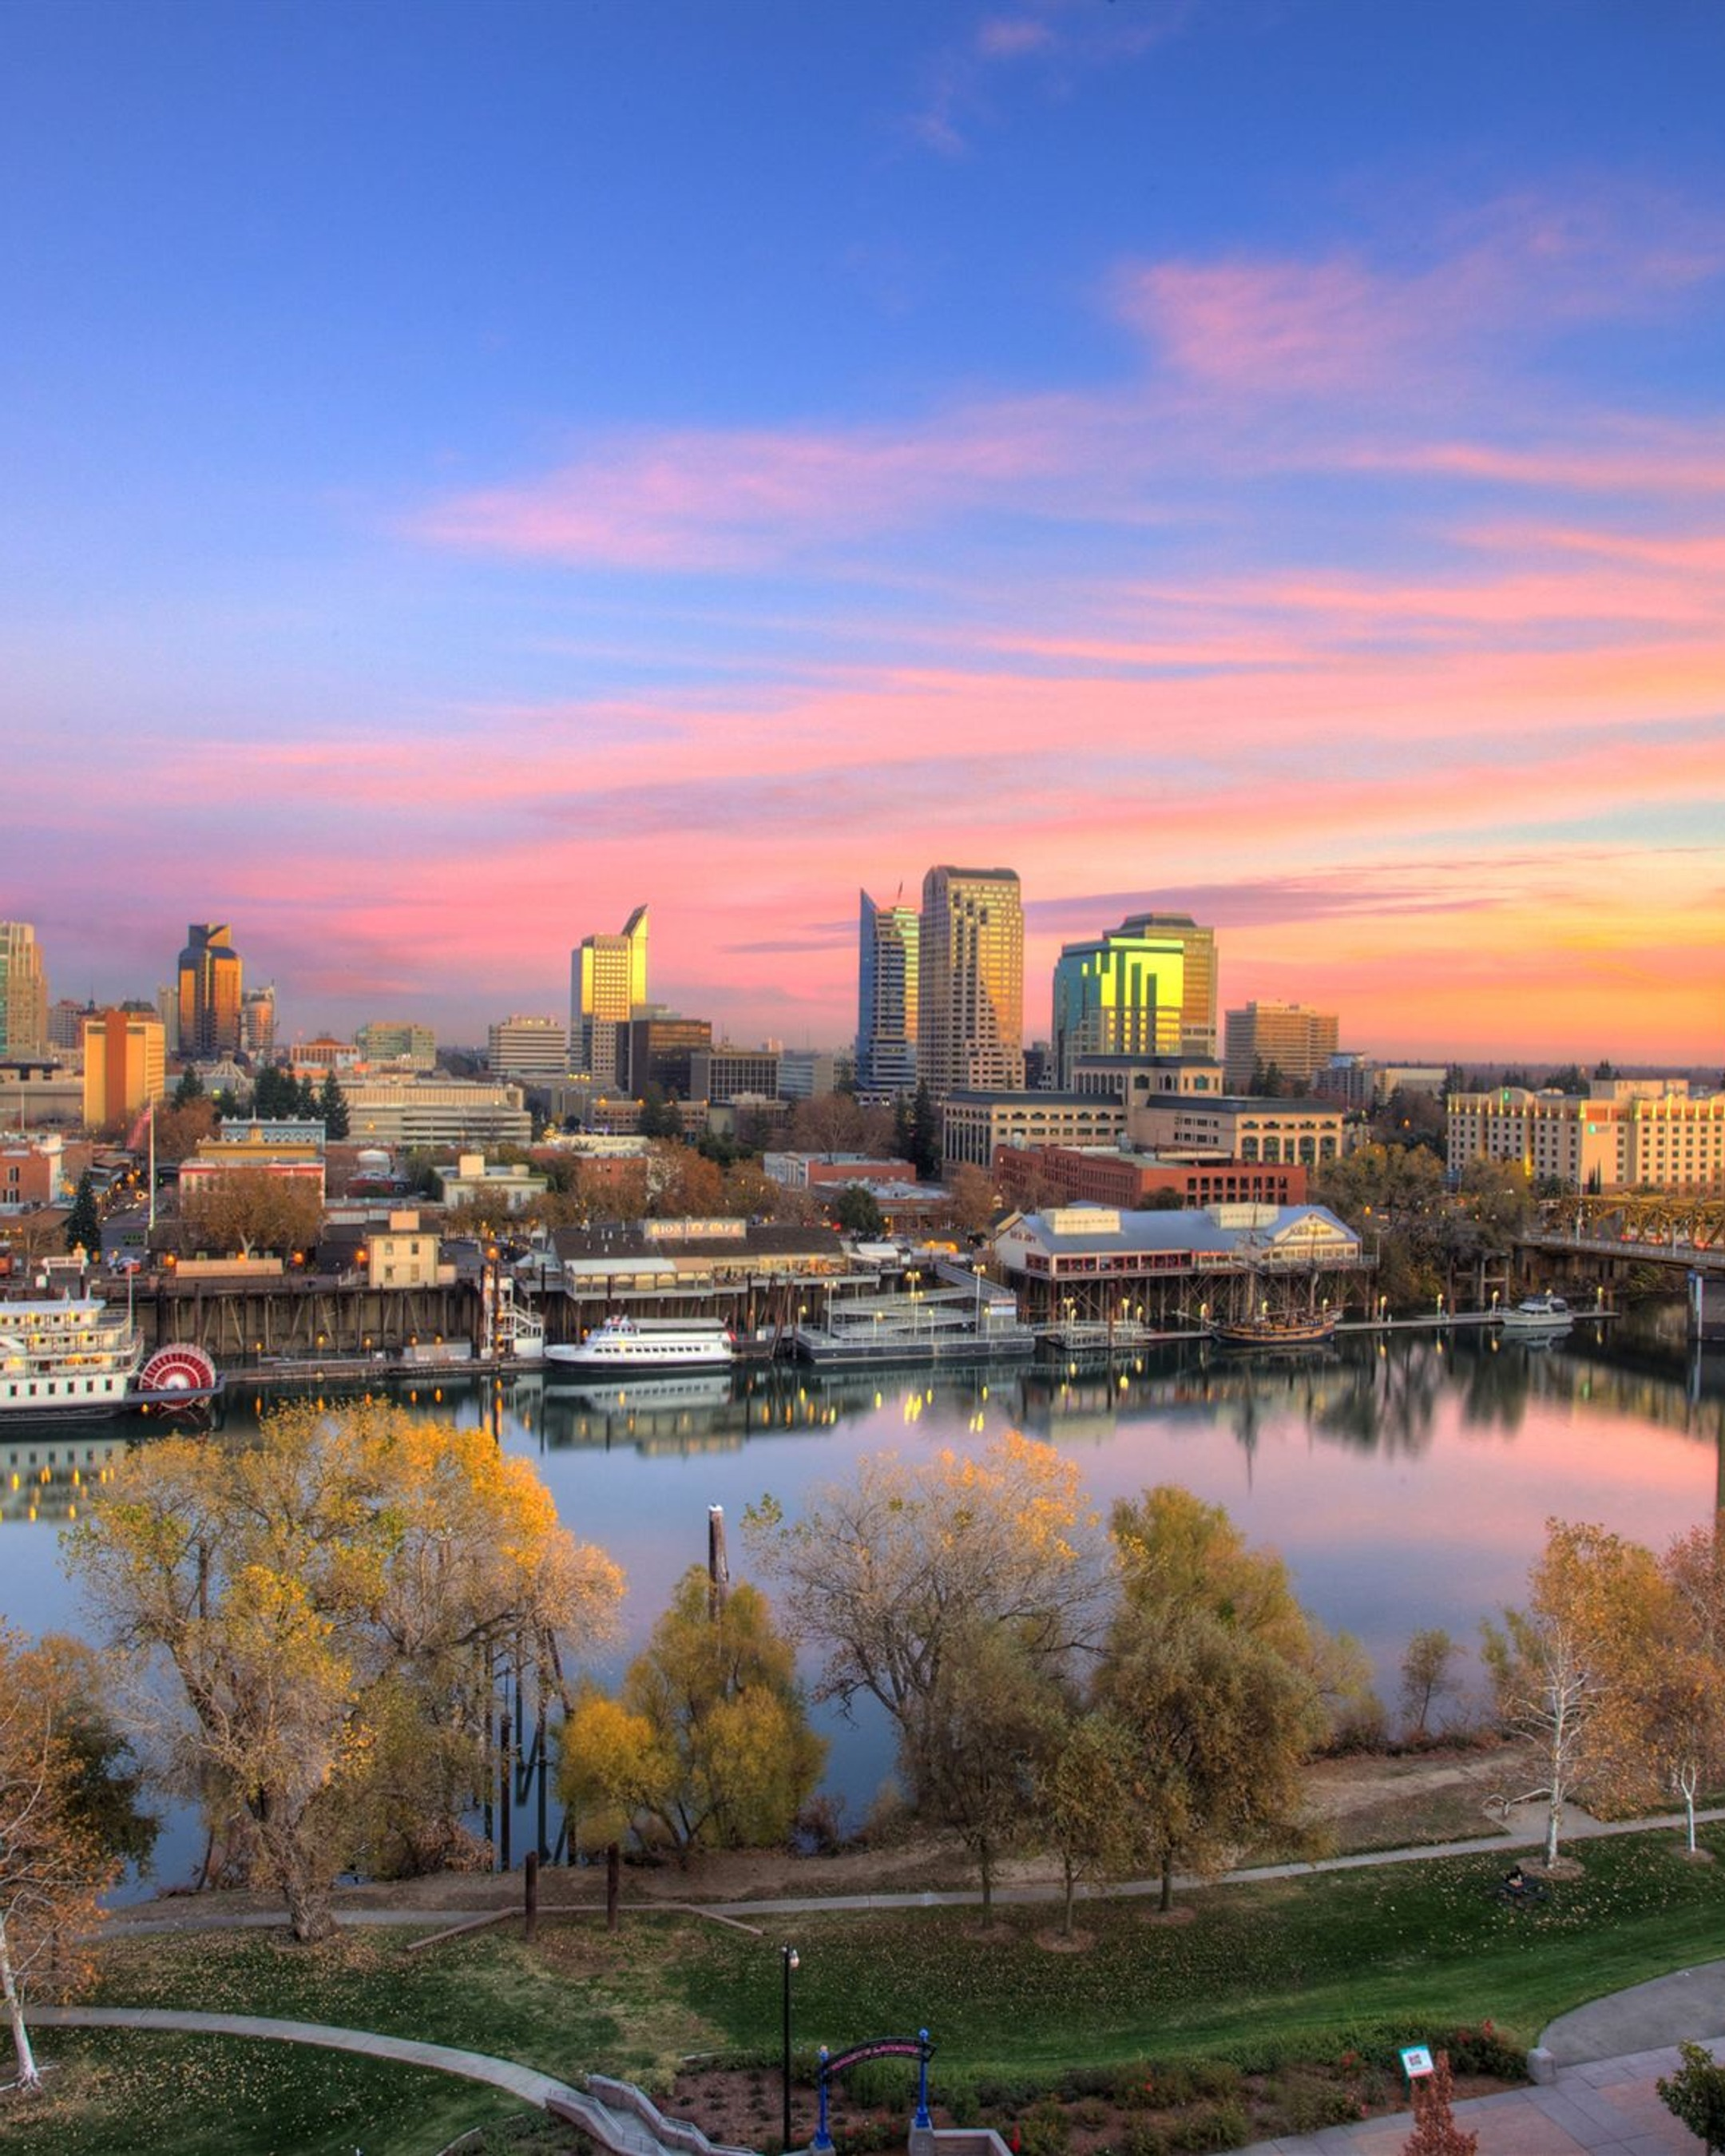
SACRAMENTO AND FOLSOM
Caring for
Sacramento’s
eyes since 1987
Five board-certified ophthalmologists and two optometrists, two offices, free parking at both.
NEW PATIENTS WELCOME
EYESITEMD.COM
Notes:
Photo. Team news, awards, office photos. Replace the photograph; the navy overlay stays on top so white text always reads.

Slide 11

“
Paste the patient’s review here, word for word, once they have given permission to share it. Keep it under about 40 words so it stays large.
First name, City · Google review
EYESITEMD.COM
Notes:
Review (ice). Quote real reviews with permission, under about 40 words. Stars are the one amber element.

Slide 12
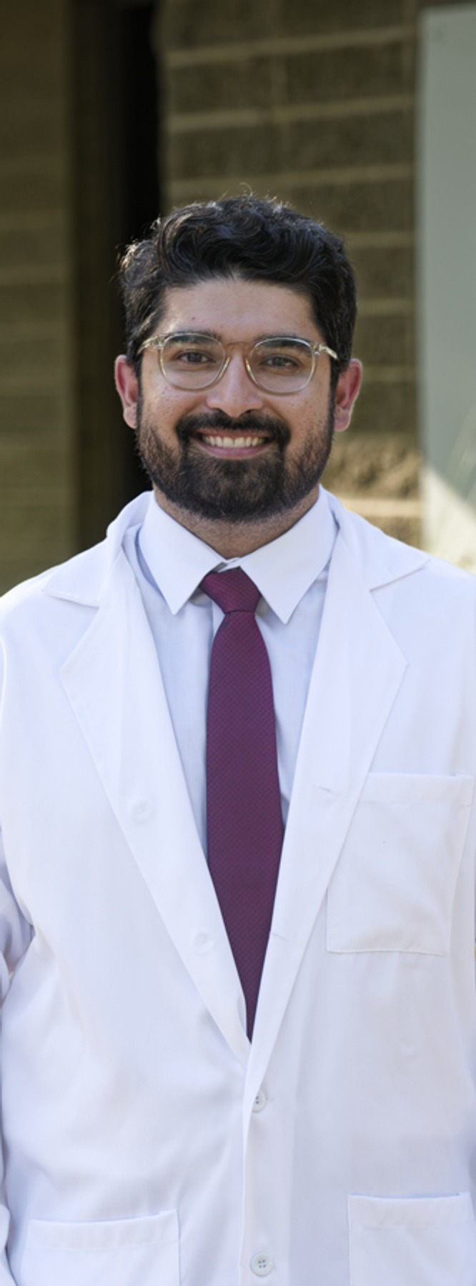

MEET THE DOCTORS
Dr. Rashidi
CORNEA SPECIALIST
Team ophthalmologist for the Sacramento Kings
Confirm wording and source before posting
NEW PATIENTS WELCOME
EYESITEMD.COM
Notes:
Doctor spotlight. Replace the portrait (at least 1200px tall), name, role and one sourced accolade.

Slide 13
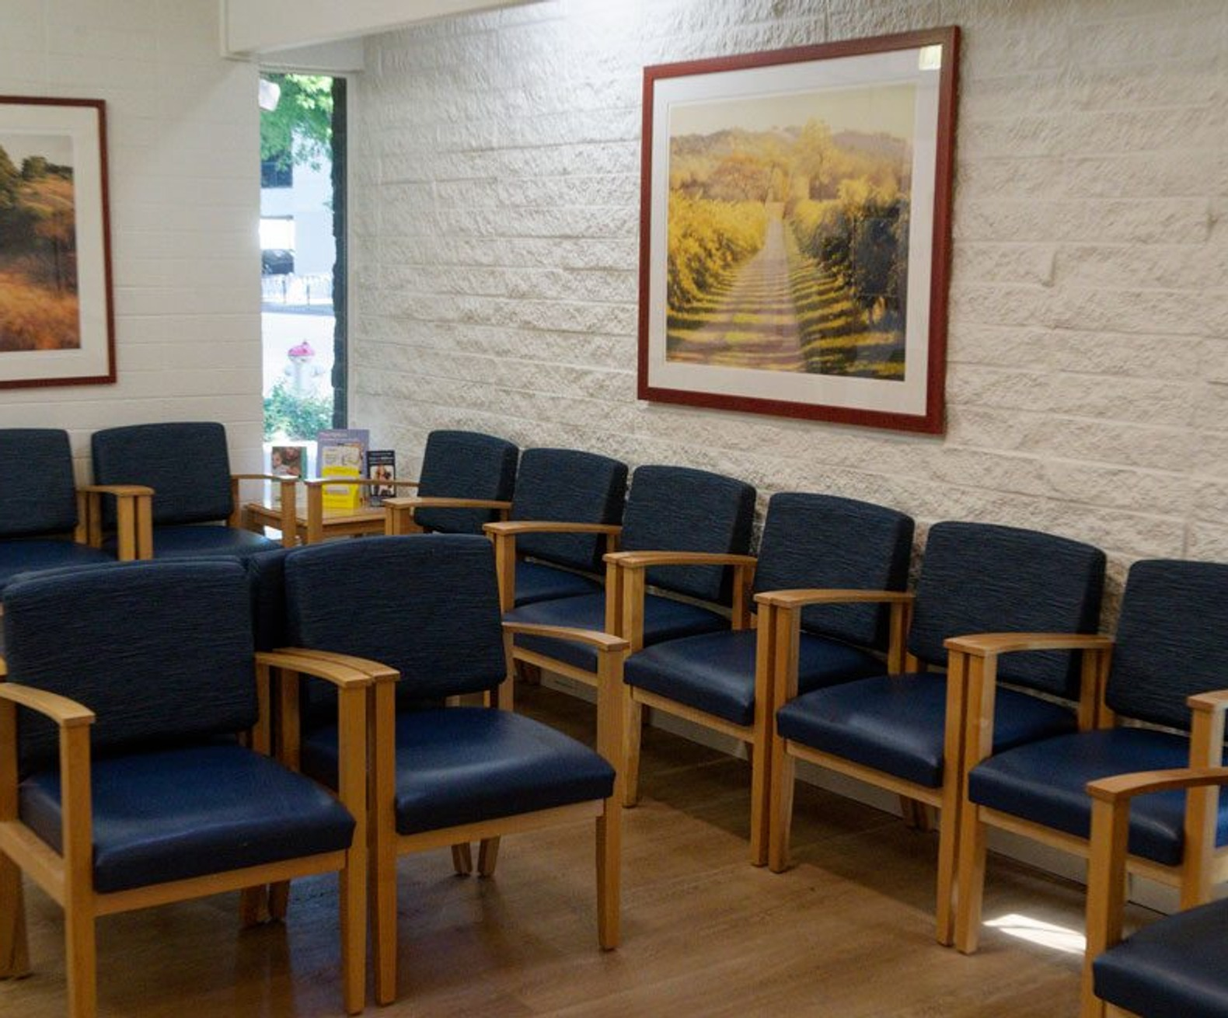
LIFE AT EYE SITE
A caption in the serif
A second line in Inter Light for names or dates.
EYESITEMD.COM
Notes:
Brand board page: frame. Keep as reference; copy this design to start new work.

Slide 14

CATARACT SURGERY
What happens at
a cataract consult
Four steps, one visit. Swipe through.
SWIPE
Notes:
Carousel cover (navy). Page 1 of a multi-slide explainer; the logo appears here only.

Slide 15
CATARACT SURGERY
01 / 01
01
A dilated exam
Drops widen your pupils so the doctor can see the lens and the retina behind it. Plan for blurry near vision for a few hours afterward.
EYESITEMD.COM
Dr. [name] reviewed this
Notes:
Carousel slide. Duplicate per step; update the number, counter and progress bar.

