Slide 1

Group No: -
T3_6
A
Presentation on
“DIGITAL CIVIC ENGAGEMENT”
Guide :-
Mrs. A.R. Lokhande
Submitted By:-
Daware Atharv Shrikant Exam No:T190363075
Deotale Yash Pravin Exam No:T190363079
Deshmukh Arya Rajesh Exam No:T190363080
Department of Electronics & Telecommunication Engineering
Smt. Kashibai Navale College of Engineering, Pune - 41.

Slide 2
CONTENTS
Aim
Objectives
Introduction
Literature Survey
Proposed Block Diagram and Description
Hardware/ Software /Specifications
Design and Implementation
Results
Applications and Future Scope
Advantages and Disadvantages
Bill of Material
Conclusions
References

Slide 3
AIM
To develop a website on Digital Civic Engagement to empower citizens, increasing participation and building stronger communities.

Slide 4
OBJECTIVES
To increase participating by making voter registration and information readily available online.
To make it easier for people to get involved in their communities using digital tools.
To strengthen community by enhancing digital literacy and provide access information.
To promote transparency and accountability by monitoring government performance and streamline public record requests.

Slide 5
INTRODUCTION
The Digital Civic Engagement Platform revolutionizes citizen participation in local governance by offering accessible web and mobile interfaces.
Through an array of features including forums, event calendars, and surveys, the platform empowers citizens to actively contribute to community initiatives.
It aims to create a dynamic space where communication and collaboration flourish, bridging the gap between residents and local government with transparency and efficiency.

Slide 6
LITERATURE SURVEY
[01] Gerding, Jeffrey M. (2017). [IEEE 2017 IEEE International Professional Communication Conference (ProComm) - Madison, WI, USA (2017.7.23-2017.7.26)] 2017 IEEE International Professional Communication Conference (ProComm) - Examining the rhetoric of civic engagement in government Digital Service design: Case study of the Federal Source Code Policy's use of GitHub in a public comment period.
1.It highlight studies that discuss the importance of digital platforms in facilitating citizen participation in government processes. This includes research on the role of technology in enhancing transparency, accountability, and responsiveness of public institutions.

Slide 7
LITERATURE SURVEY
2.To focus on studies that analyze the persuasive elements and public discourse employed in digital platforms like GitHub during policy-making processes and highlight how rhetoric is used to engage citizens, solicit feedback, and build consensus around government initiative.
3.To explore literature discussing policy implementation in the context of stakeholder engagement. Identify studies that examine the effectiveness of public comment periods in shaping policy outcomes and fostering inclusive governance. Consider research on the challenges and best practices of using digital platforms like GitHub to engage diverse stakeholders in policy development and decision-making processes.

Slide 8
LITERATURE SURVEY
[02] 2019 IEEE 39th International Conference on Distributed Computing Systems (ICDCS) Rafael Angarita, Nikolaos Georgantas, Inria Paris, France
1. Investigate existing research on the intersection of social media and civic engagement. Examine how social media platforms have been leveraged to promote citizen involvement, dialogue, and collective action in public affairs.
2.Identify studies that explore the design and deployment of digital tools, to empower citizens, strengthen governance, and bridge the gap between governments and communities. Highlight the evolving landscape of civic tech and its implications for inclusive democracy.

Slide 9
BLOCK DIAGRAM
Digital Civic Engagement
Web and Mobile Interface
Community Engagement
Tools
Display issues to be sloved and resolved issues on LCD
Forums,Event Calenders
Figure 1: Block Diagram of Digital Civic Engagement

Slide 10
BLOCK DIAGRAM DESCRIPTION
Digital Civic Engagement enhances community participation and interaction. The project aims to develop online platforms to enhance citizen participation in democratic processes and community decision-making by use of today’s technology.
Web and Mobile Interfaces are responsible for developing user-friendly interfaces accessible on both web and mobile platforms.
Community Engagement Tools implements various tools to enhance community engagement, including forums, event calendars, and interactive survey features.

Slide 11
BLOCK DIAGRAM DESCRIPTION
Tools provide platforms for citizens to discuss, participate in events, and share their opinions on different matters.
Frontend focuses on developing intuitive web and mobile interfaces to ensure a positive user experience.
The number of issues to be solved and number of issues which are to be solved are shown on the LCD to maintain the transparency between citizens and local government.

Slide 12
TECHNICAL SPECIFICATION OF PROJECT
Software Specifications:
MongoDB
Express
React
Node.js.
Cloudanary
2. Hardware Specifications:
Arduino UNO
LCD

Slide 13
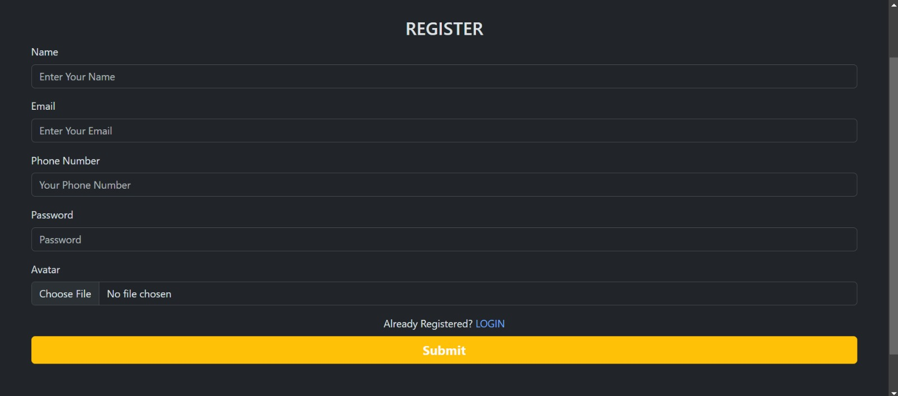
RESULTS

Slide 14

RESULTS

Slide 15
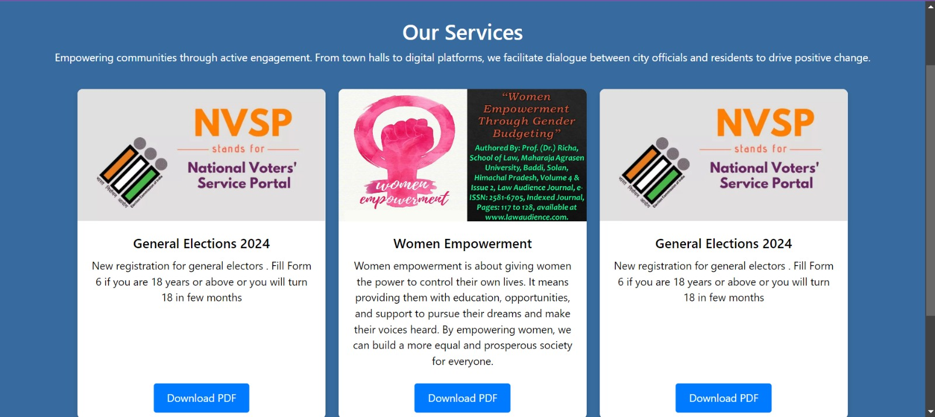
RESULTS

Slide 16
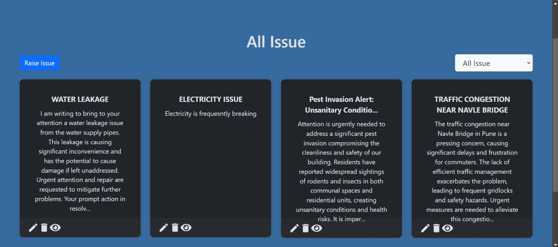
RESULTS

Slide 17
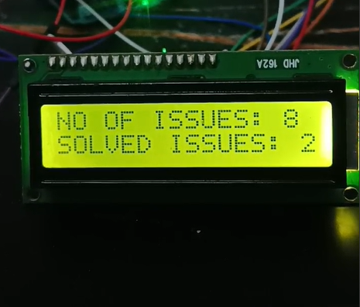
RESULTS

Slide 18
FUTURE SCOPE & APPLICATIONS
Digital platforms will facilitate broader and more inclusive participation in civic processes, enabling citizens to engage directly in policymaking and governance.
Blockchain technology can be used to ensure transparency and accountability in public processes such as voting and budget allocation, fostering trust between governments and citizens.
These platforms will facilitate cross-border collaboration on global issues like climate change, public health, and human rights.

Slide 19
FUTURE SCOPE & APPLICATIONS
Applications
Community-Building Platforms
Global Collaboration and Knowledge Sharing
Online Voting Platforms
Community Feedback and Surveys

Slide 20
ADVANTAGES, DISADVANTAGES
Advantages:
Increases accessibility and inclusivity for diverse communities to participate in civic discussions.
Facilitates efficient data collection and analysis for evidence-based policymaking.
Enhances transparency and accountability by promoting open dialogue and sharing of information.
Raises awareness and engagement levels among citizens, strengthening democratic participation.

Slide 21
ADVANTAGES, DISADVANTAGES
2. Disadvantages:
Excludes segments of the population with limited digital literacy or access to technology.
Risks amplifying certain voices or issues over others due to online algorithms or biases.
Can compromise privacy and data security, potentially deterring participation.
Vulnerable to misinformation and manipulation, undermining the integrity of discussions.
Limits face-to-face interaction and personal connections critical for nuanced dialogue and understanding.

Slide 22
BILL OF MATERIAL
SR. No. | Component Used | Total Quantity | Cost
1. | Arduino UNO | 1 | 650
2. | LCD(16*2) | 1 | 250
3. | Connecting Wires | 10 | 100
TOTAL COST OF MINI PROJECT |  |  | 1000

Slide 23
CONCLUSION
The Digital Civic Engagement Platform project empowers citizens to actively participate in local governance. With user-friendly interfaces and interactive tools, the platform enhances community collaboration and communication.

Slide 24
REFERENCES (in IEEE format)
[01] Gerding, Jeffrey M. (2017). [IEEE 2017 IEEE International Professional Communication Conference (ProComm) - Madison, WI, USA (2017.7.23-2017.7.26)] 2017 IEEE International Professional Communication Conference (ProComm) - Examining the rhetoric of civic engagement in government Digital Service design: Case study of the Federal Source Code Policy's use of GitHub in a public comment period.
[02] 2019 IEEE 39th International Conference on Distributed Computing Systems (ICDCS) Rafael Angarita, Nikolaos Georgantas, Inria Paris, France

Slide 25
THANK YOU.

