Slide 1
Team:
N Datha Sai
V Reshmi
MULIT-MODAL EMOTION AND DISTRACTION DETECTION SYSTEM (MEDDS)
Advisor: Prof. Hilal Tayara

Slide 2

PROBLEM STATEMENT
Growth of digital learning in modern era.
Limited accuracy of single-modality systems.
Lack of spoof & distraction detection.

Slide 3
OBJECTIVE
Take multiple types of inputs (face and voice).
MULTI-MODAL
EMOTION &
Detect emotional state.
DISTRACTION
Detect distraction level.
DETECTION
Identify spoofing.
SYSTEM
Real-time monitoring through UI.

Slide 4



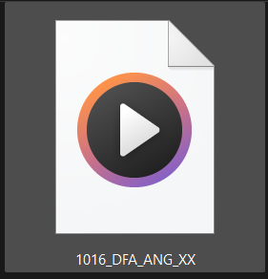







DATASETS
Face samples.
Total: 63,568
Voice samples.
Total: 11,490
Spoof samples.
Total: 11,377

Slide 5






ARCHITECTURE version 1
CNN
Distraction level
UI
CNN + LSTM
Final emotion

Slide 6
EVALUATION
Face and voice are processed independently.
No multi-modal fusion.
Emotion is heavily relied on voice.
No spoof identification.

Slide 7
ARCHITECTURE version 2
MobileNet
Distraction level
MobileNet
UI
Fusion model
Final emotion
LamNet

Slide 8
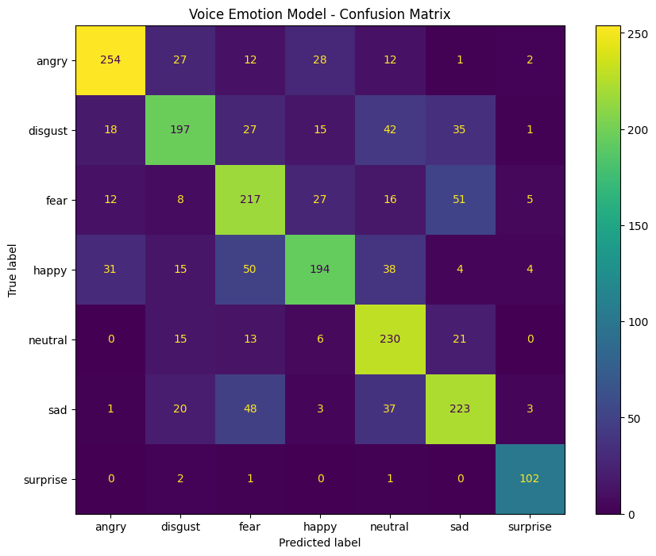
EVALUATION
Feature level information is lost.
Limited improvement in accuracy.
Heavy on machine to train. ( ~30-50 min per epoch )
No spoof identification.

Slide 9
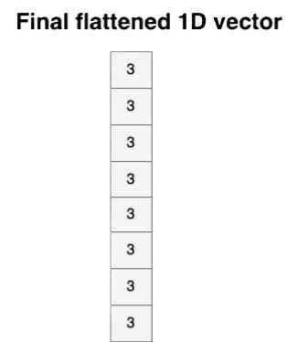
ARCHITECTURE version 3
EfficientNet
Spoof Detection
&
Distraction level
EfficientNet
UI
Weighted fusion
CNN
Final emotion
Whisper

Slide 10
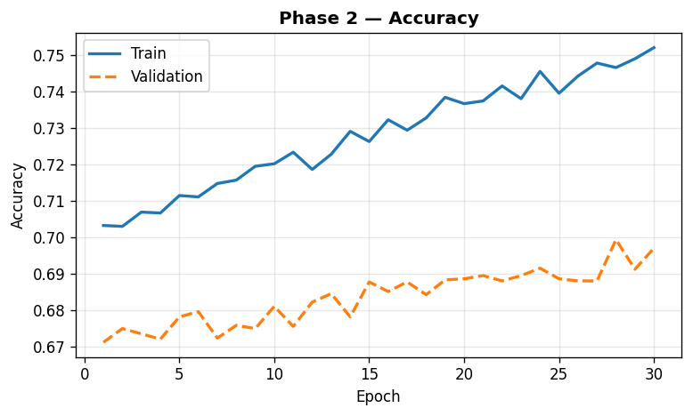
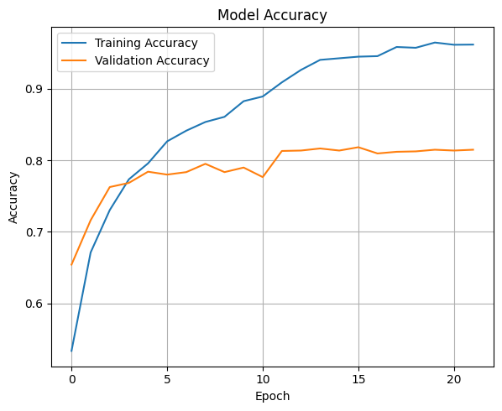
EVALUATION
Feature level information is lost.
Limited improvement in accuracy.
Heavy on machine to train. ( ~30-50 min per epoch )
No spoof identification.

Slide 11
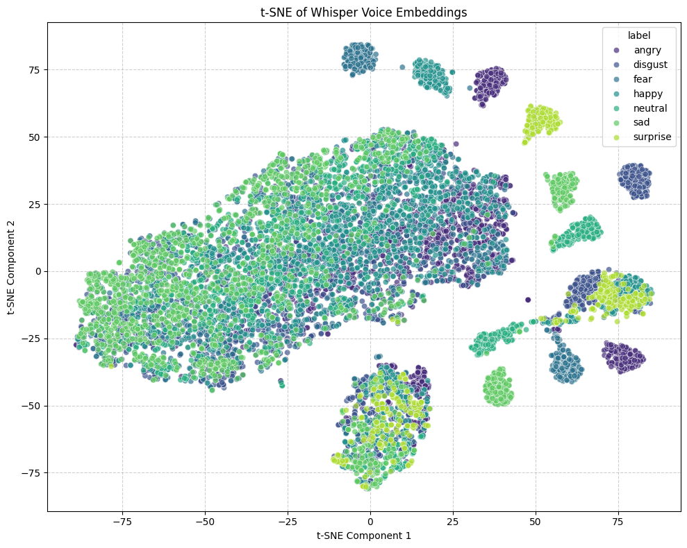
EVALUATION
Feature level multi-modal fusion.
High improvement in accuracy.
Faster to build and process in real-time.
Real-time spoof detection.

Slide 12
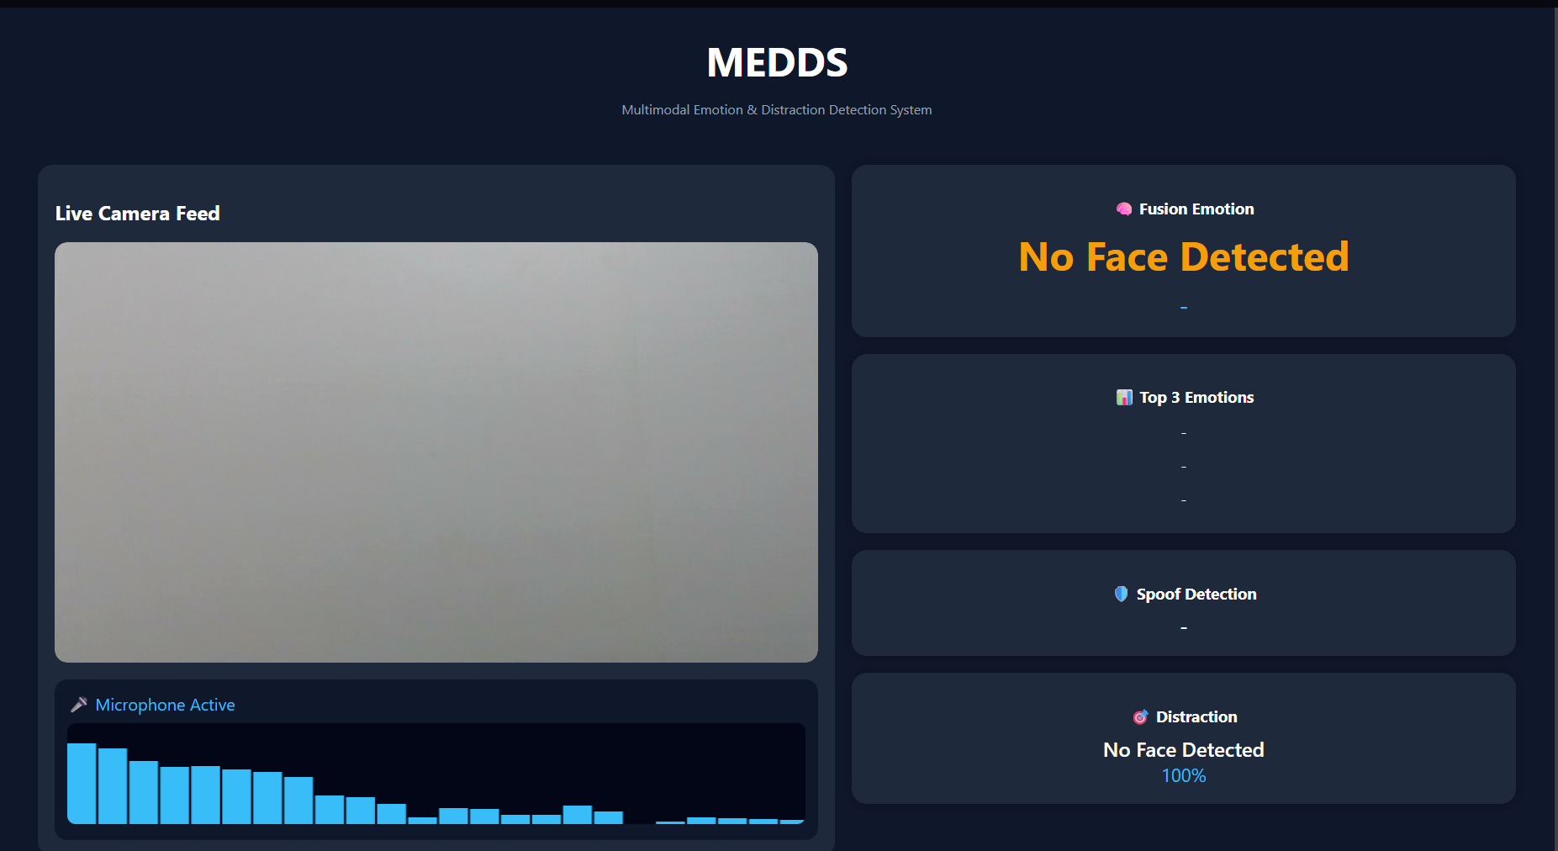
FINAL RESULTS

Slide 13
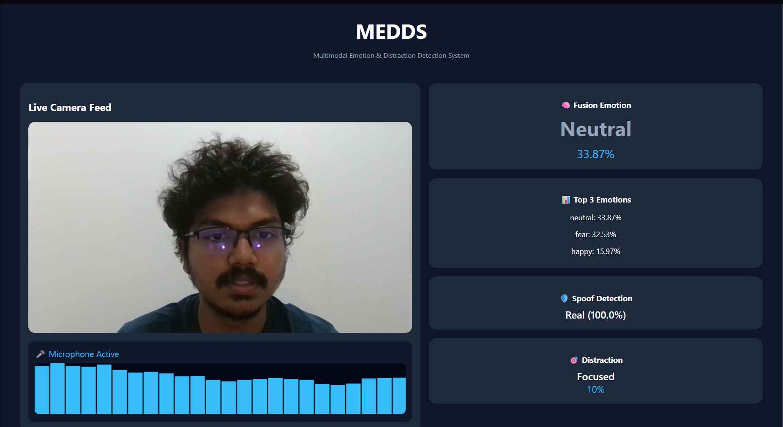
FINAL RESULTS

Slide 14
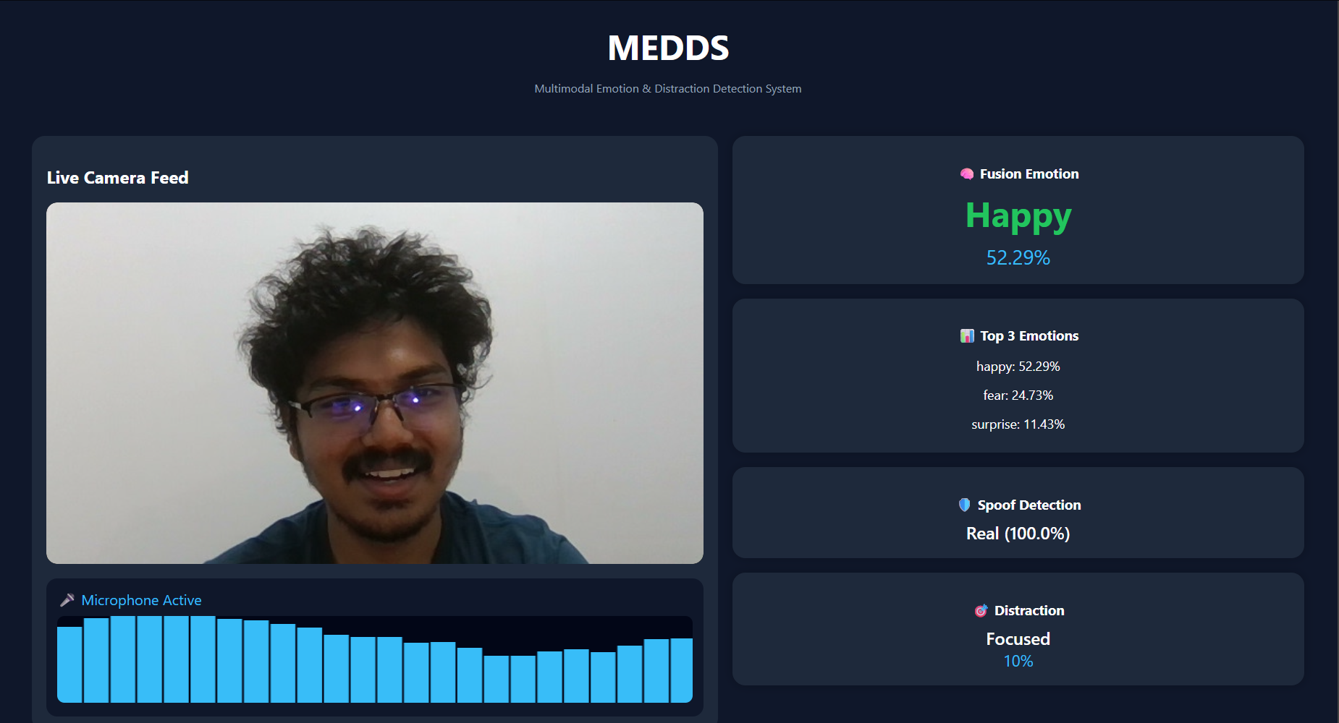
FINAL RESULTS

Slide 15
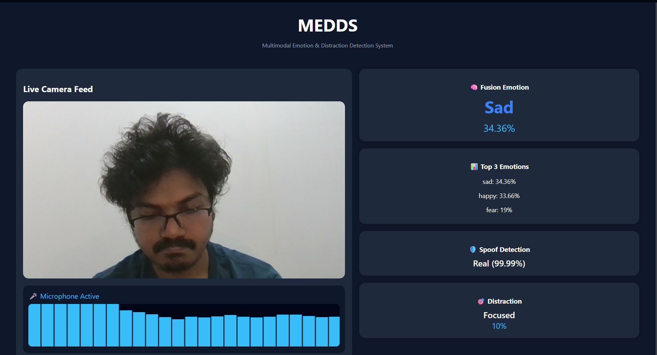
FINAL RESULTS

Slide 16
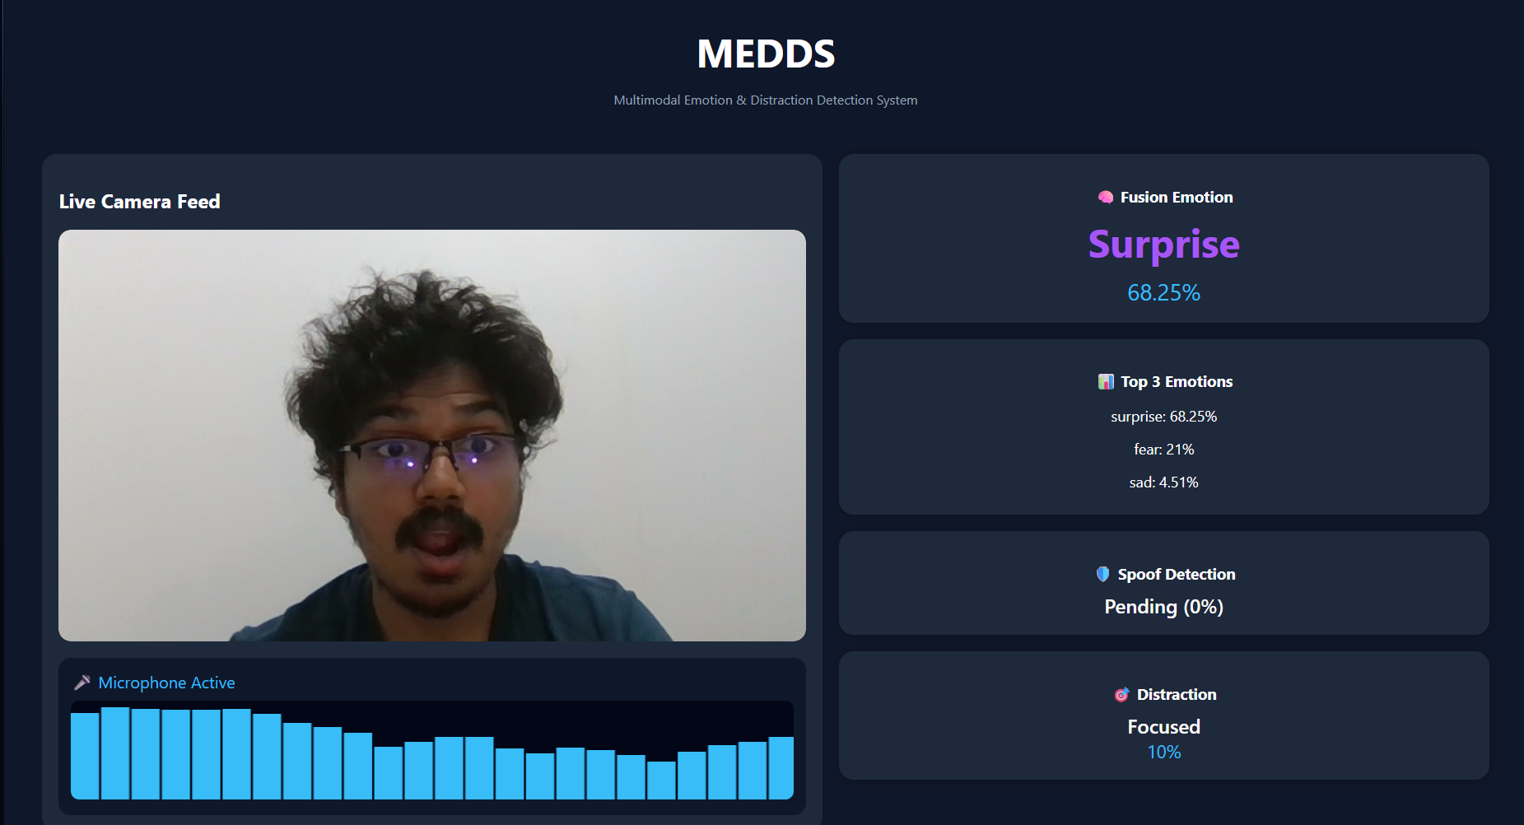
FINAL RESULTS

Slide 17
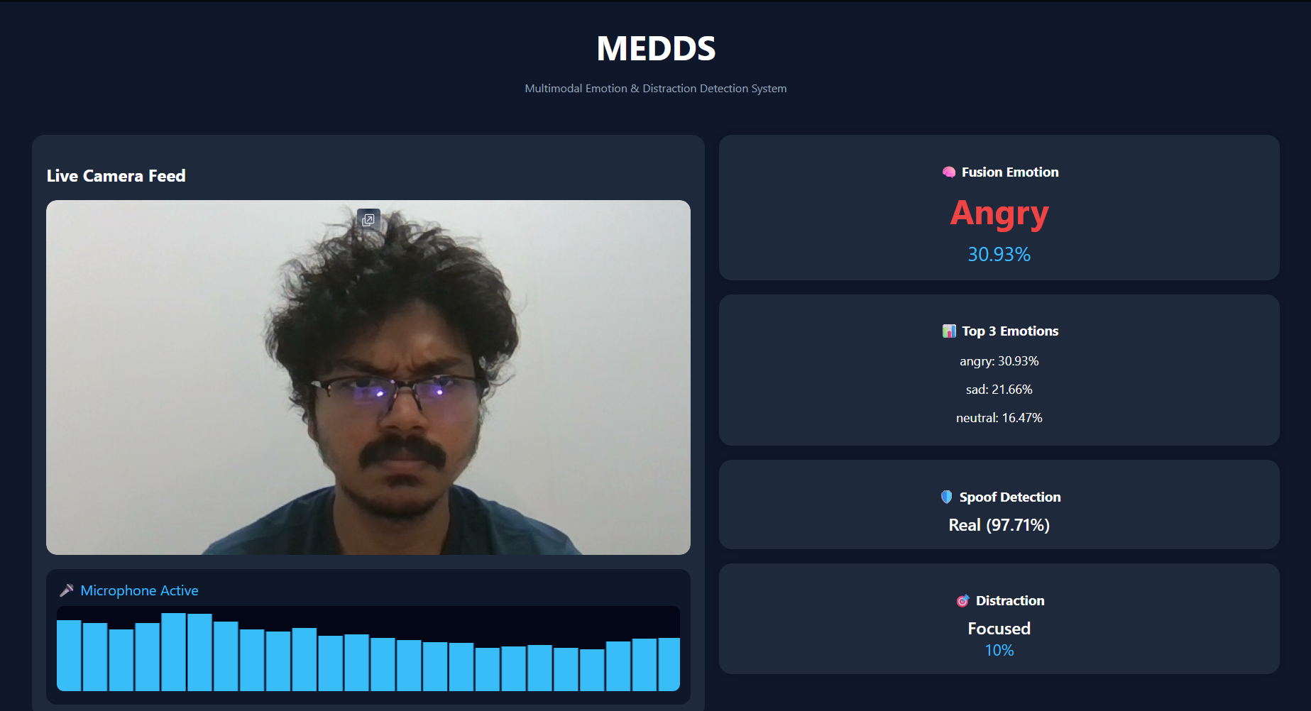
FINAL RESULTS

Slide 18
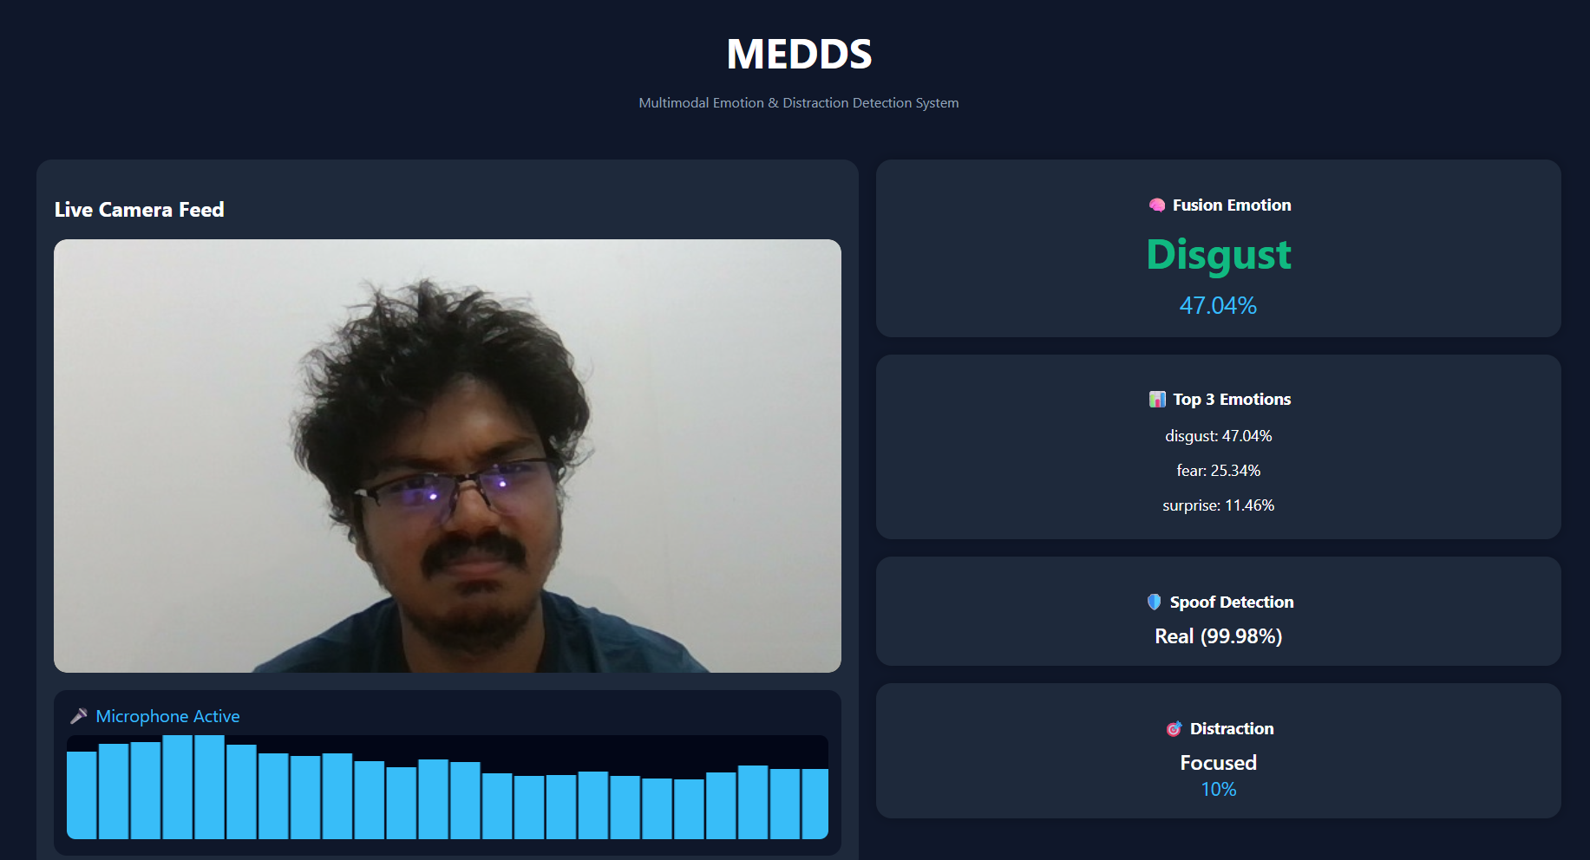
FINAL RESULTS

Slide 19
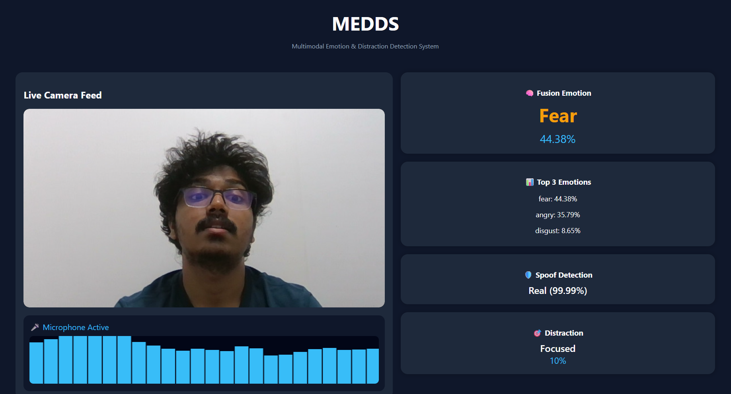
FINAL RESULTS

Slide 20
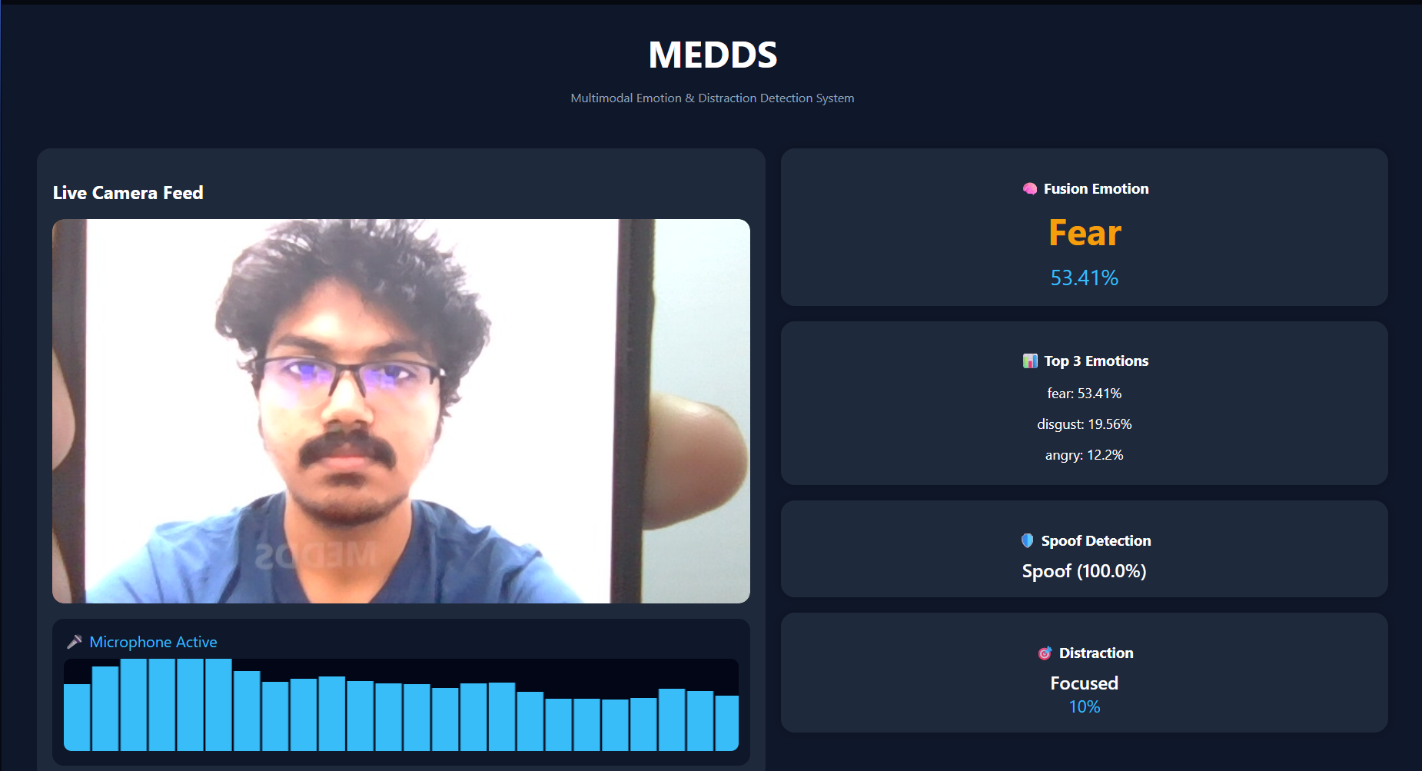
FINAL RESULTS

Slide 21
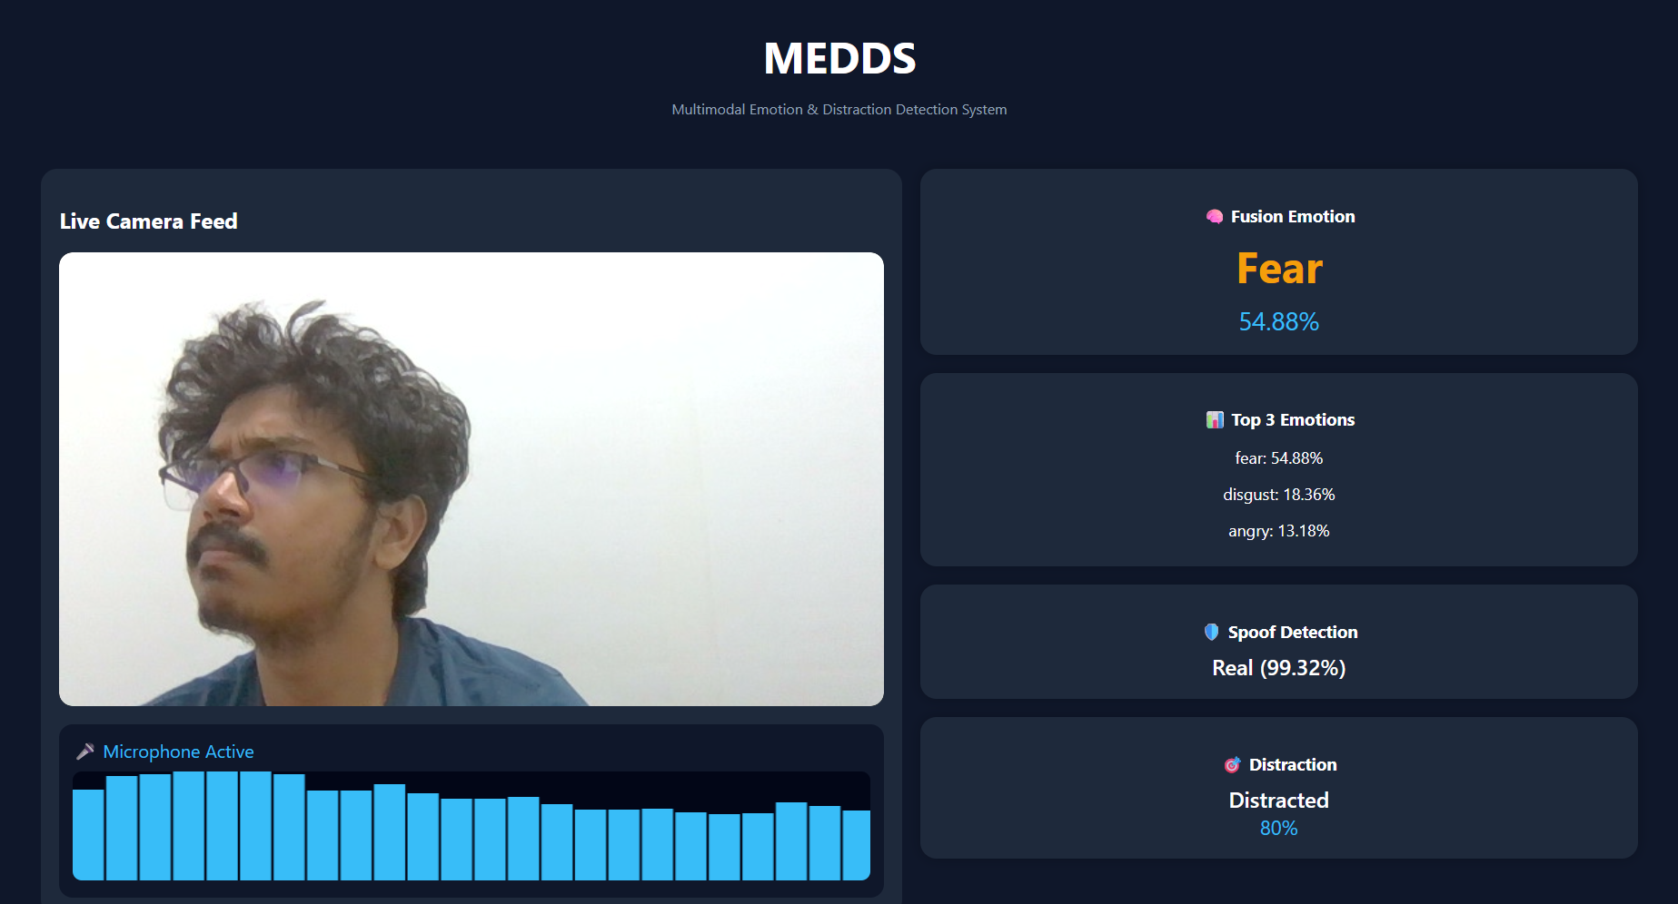
FINAL RESULTS

Slide 22


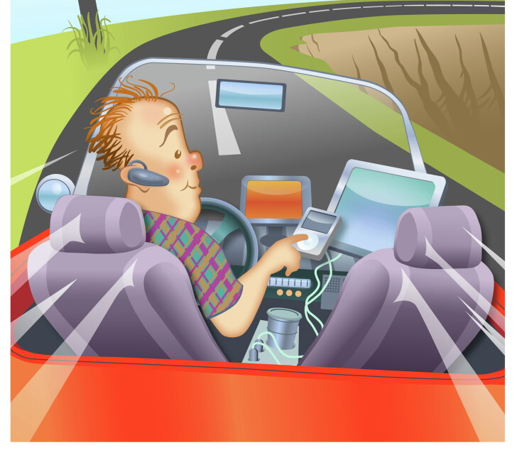
APPLICATIONS
Online Learning.
Driver Monitoring.
Online Examinations.

Slide 23
THANK YOU

