Slide 1
For those about to Mock
An intro to Mocks for C# developers

Slide 2


Slide 3
Agenda
Introduction
Warm-up: unit testing refresher
Challenges with unit testing
Roll your own
Use mocking frameworks
Moq
Rhino.Mocks
NSubstitute
Conclusion

Slide 4


A few words about me
Mathias Brandewinder / @brandewinder
Background: economics, operations research
.NET developer for 8+ years
C#, VSTO, F#
Bay.Net San Francisco, SFSharp.org
Yes I have an accent
www.clear-lines.com/blog

Slide 5
Why this talk?
I am very passionate about TDD
Took me a while to “get” Mocks

Slide 6
The goal
Demystify mocking frameworks
Understanding what the problem is
Show you the basics of on library, Moq
Nsubstitute, Rhino
Show you how to use it, in practice
Not advanced usage of frameworks

Slide 7
Refresher: Unit Testing

Slide 8
From R. Osherove
A unit test is a fast, in-memory, consistent, automated and repeatable test of a functional unit-of-work in the system.
A unit of work is any functional scenario in the system that contains logic. It can be as short as a function, or it can span multiple classes and functions, and it provides internal or business value to the system under test.

Slide 9
Recap
[TestFixture], [Test], Assert
Testing for exceptions
Write tests as “sentences”
“when this happens then this should be observed”
Arrange, Act, Assert
Take something
Do something to it
Check its state

Slide 10
Challenges with Unit Tests

Slide 11

Testing isolated units is easy…

Slide 12
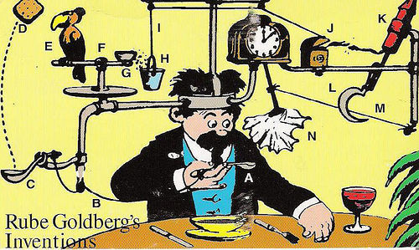
Real systems have dependencies

Slide 13
Introducing the Translator
The Translator
Calls Google Translate service for translation
Records events using a Log (log4Net)
We want to test that the Translator works
Very simple example
Representative of real problems
Our approach is complete overkill

Slide 14
Let’s look at the code

Slide 15
Translator
Translate text
Translator
Record action
Call service
Log
TranslateClient
public string EnglishToFrench(string original)
{
this.log.Debug(“Translating”);
var result = this.client.Translate(original);
return result;
}

Slide 16
What testing challenges do you see?

Slide 17
What testing challenges do you see?
Log
Depends on configuration
Parse the log file? Ugh
TranslateClient
Web connectivity?
Test for failure?
Slow
Untestable design!

Slide 18
“Representative” problem
Silly example, but…
Good illustration of real issue
Database dependency
Shared resources
Difficult to tear down
Config dependent resources
Connectivity dependent resources
Slow resources
3rd party resources

Slide 19
What is our goal?
We need dependencies for each test
We will carry the weight of both all the way up
We want to “cut off” the weight
Mocks & Stubs help keep your tests nimble
Mocks & Stubs will NOT help testing the dependency itself
No magic there

Slide 20


Slide 21
Re-design / refactor
Tightly coupled design = testing problems
Injection of Dependencies
Allows to swap dependencies
Encapsulation
Allows to isolate our class
Patterns: extract interface, strategy, injection, adapter

Slide 22
How do you test an interface?
Can’t instantiate it
Should we test with every implementation?

Slide 23
Hand-rolled Stubs and Mocks

Slide 24

Fake it

Slide 25
Behavior verification
Unit test: typically state validation
Mocking:
Verify interaction of
Class Under Test
With its Collaborators
Replace instance of collaborator by interface
Verify that the right calls are made
Don’t care how the collaborator handles calls

Slide 26
Example
Translator
ILog
ITranslationClient
FakeLog
FakeTranslationClient
File
Email
Google
Microsoft

Slide 27
Let’s roll

Slide 28
Hand-rolled
Works just fine
Is pretty tedious, hard to maintain
Lots of repetitive code
Lots of extra classes

Slide 29
Stubs vs. Mocks
Stubs: the test is about the me
Just need the dependency to “be there”
Mocks: the test is about my collaborator
Did we “follow the contract”?
Stub: assert is on me
Mock: assert is on my collaborator
Test can fail because of collaborator

Slide 30
Leveraging Frameworks

Slide 31
Mocking/Isolation frameworks
Frameworks simplify the process of
Creating fake in-memory collaborators
Defining how the collaborator should behave
Verifying that interactions follow expectations

Slide 32
Some popular frameworks
Moq
http://code.google.com/p/moq/
Rhino.Mocks
http://www.ayende.com/projects/rhino-mocks/downloads.aspx
Nsubstitute:
http://nsubstitute.github.com
TypeMock Isolator, JustMock
Moles
NMocks

Slide 33
Let’s use the frameworks

Slide 34
Caveats
Be suspicious: make sure your test fails first, and succeeds for the right reason.

Slide 35
Limits
You can mock interfaces, abstract classes
Not concrete classes
Issue if class is out of your control and has no interface

Slide 36
Limits, addressed
TypeMock Isolator, JustMock
Moles, Shims (VS11)
Create derived class
Example: Random.Next()
Adapter pattern
Example: DateTime.Now()

Slide 37
Food for thought
An alternative: functional style
Interfaces are typically about exposing methods, the “Contract”
Why not pass a function instead of an interface?
+ No framework required
- If you need multiple functions

Slide 38
Conclusion

Slide 39
Recap
Good OOD creates dependencies
Mocking allows you to isolate dependencies
Stubs = create a lightweight fake
Mocks = validate interactions
Frameworks simplify work
Mocking is a great fit with TDD
Allows you to “sketch” system

Slide 40
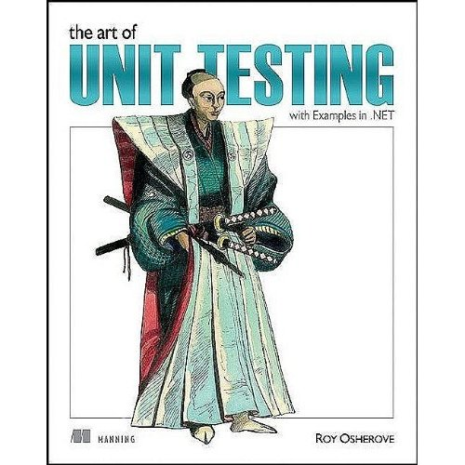
The art of Unit Testing
Roy Osherove
Manning

Slide 41

Test-Driven Development by Example
Kent Beck
Addison-Wesley

Slide 42
Questions?

Slide 43
To contact me…
mathias@clear-lines.com

