Slide 1
Machine Learning on .NET
F# FTW!

Slide 2


A few words about me
Mathias Brandewinder / @brandewinder
Background: economics, operations research
.NET developer for 10~ years (C#, VSTO, F#)
Bay.Net San Francisco, SFSharp.org
Yes I have an accent
www.clear-lines.com/blog

Slide 3
How about you?
Who is…
C#, VB.NET developer
F#
Other Functional Language
Data Science / Machine Learning

Slide 4
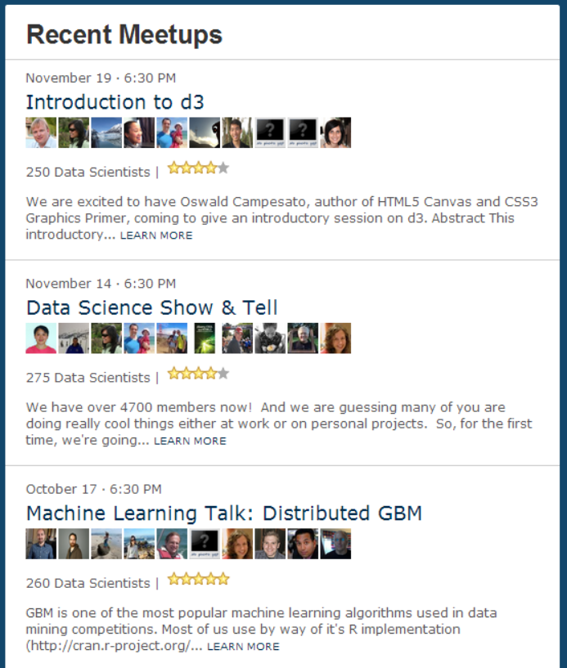
Why this talk
Machine Learning, Data Science are red-hot topics
... and relevant to developers
.NET is under-represented

Slide 5
My goal
Give you a sense for what Machine Learning is
Illustrate why I think F# is a great fit
Try to give everyone something

Slide 6
The plan
Classification
Regression
Unsupervised
Type Providers
Existing .NET libraries
Algebra
Functional fit

Slide 7
Classification & Regression

Slide 8
Goal
Give a sense for “a day of Machine Learning”
Illustrate Classification and Regression

Slide 9
Classification, Regression
Classification = using data to classify items
Ex: Spam vs. Ham, Character Recognition, …
Regression = predicting a number
Ex: price of item given attributes, …
Both belong to Supervised Learning
You know what question you are trying to answer
You use data to fit a predictive model

Slide 10
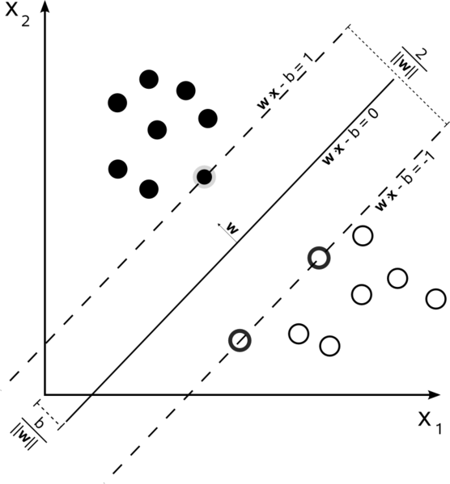
Support Vector Machine
Classic algorithm
Tries to separate the 2 classes by the widest possible margin
Using Accord.NET implementation

Slide 11
Demo

Slide 12
Take-aways
F# is a first-class citizen in .NET
Decent libraries: Accord.NET, Math.NET, Alea.cuBase
Interactive experience with the REPL
Classification, Regression, Cross-Validation

Slide 13
Unsupervised

Slide 14
Goal
Illustrate unsupervised learning
Functional programming and ML are a great fit

Slide 15
Writing your own
Usually not advised
Useful for ML because
You don’t always have a library
As you learn your domain, you may need a custom model

Slide 16
Most ML algorithms are the same
Read data
Transform into Features
Learn a Model from the Features
Evaluate Model quality

Slide 17
Translates well to FP
Read data
Transform into Features -> Map
Learn a Model from the Features -> Recursion
Evaluate Model quality -> Fold

Slide 18
Focus on transforms, not objects
Algorithms need to be generic
Need to transform rapidly Features
Don’t care if it’s an IMammal, Customer, …

Slide 19
What is Unsupervised Learning?
“Tell me something about my data”
Example: Clustering
Find groups of “similar” entities in my dataset

Slide 20
Example: clustering (1)

Slide 21
Example: clustering (2)
“Assign to closest Centroid”

Slide 22
Example: clustering (3)
“Update Centroids based on Cluster”

Slide 23
Example: clustering (4)
“Stop when no change”

Slide 24
Demo

Slide 25
Type Providers

Slide 26
No data, no learning
Most of ML effort is spent acquiring data
Unpleasant trade-off:
Dynamic: easy hacking but runtime exceptions
Static: straight-jacket

Slide 27
Demo

Slide 28
Conclusion

Slide 29
F# is a perfect fit for ML on .NET
Functional style fits very well with ML
REPL/interactive experience is crucial
Smooth integration with all of .NET
Type Providers: static types, without the pain

Slide 30
Learning more
FSharp.org, the F# Foundation

Slide 31
Contacting me
mathias@clear-lines.com
@brandewinder

