Slide 1

AUTONOMOUS VEHICLE TRACKING AND MONITORING USING IoT

Slide 2
INTRODUCTION:
In an agricultural environment, heavy vehicles like harvesters, tractors are used to perform farming-related activities. Using IoT, diagnostic information of the vehicle will be shared to the cloud platform and the GPS location of the vehicle is also transmitted to the server. These received data will be analyzed and helpful for the owner of the vehicles to make sure to take the necessary actions to get less downtime.

Slide 3
COMPONENTS USED:
HARDWARE:
NodeMCU
L293D motor driver
BO motors
Power Supply
DHT 11
GPS Module
Jumper wires
SOFTWARE:
Arduino IDE
ThingSpeak
Blynk

Slide 4
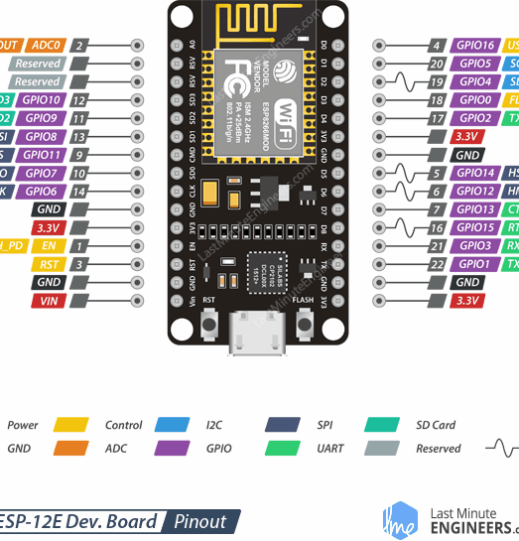
NODE MCU:
NodeMCU is an open-source IoT platform. It includes firmware that runs on the ESP8266 Wi-Fi SoC from Espressif Systems and hardware based on the ESP-12 module. The ESP8266 chip requires a 3.3V power supply voltage. NodeMCU ESP-12E dev board can be connected to 5Vusing a micro USB connector or Vin pin available on board. The I/O pins of ESP8266 communicate or input/output max 3.3V only. i.e. the pins are NOT 5V tolerant inputs.

Slide 5
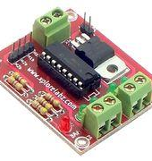
L293 MOTOR DRIVER
The L293D is a popular 16-Pin Motor Driver IC. As the name suggests it is mainly used to drive motors. A single L293D IC is capable of running two DC motors at the same time; also the direction of these two motors can be controlled independently.
Motor voltage Vcc2 (Vs): 4.5V to 36V
Supply Voltage to Vcc1(VSS): 4.5V to 7V

Slide 6
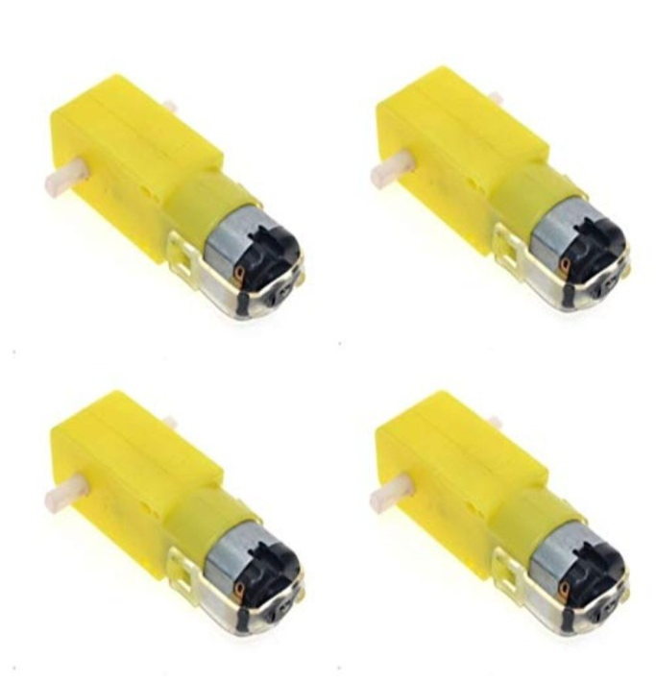
BO MOTORS
BO (Battery Operated) lightweight DC geared motor which gives good torque and rpm at lower voltages. This motor can run at approximately 150 RPM when driven by a single Li-Ion cell. Great for battery-operated lightweight robots. A specific type of DC geared motors can be operated through the battery and that is known as Battery Operated (BO) motors. It is used for lightweight applications mostly.

Slide 7
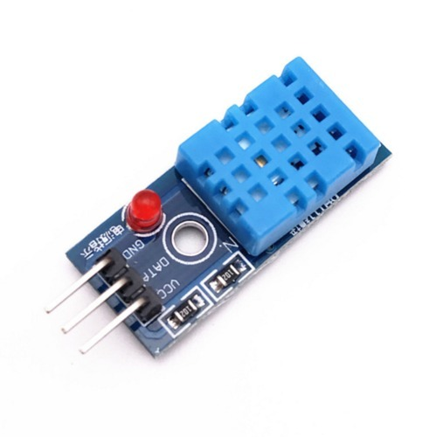
DHT 11
The DHT11 is a basic, ultra low-cost digital temperature and humidity sensor. It uses a capacitive humidity sensor and a thermistor to measure the surrounding air and spits out a digital signal on the data pin (no analog input pins are needed). It’s fairly simple to use but requires careful timing to grab data. You can get new data from it once every 2 seconds, so when using the library from Thingspeak, sensor readings can be up to 2 seconds old.

Slide 8
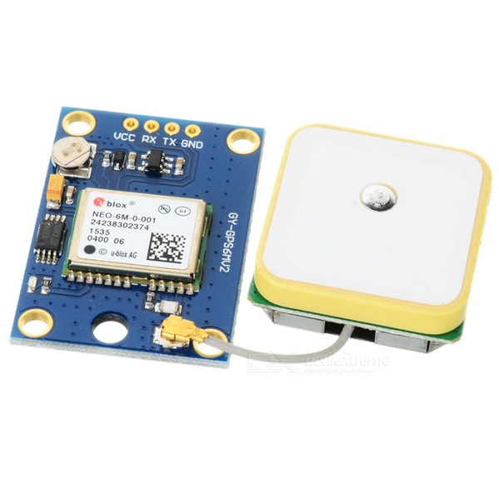
GPS MODULE
GPS modules contain tiny processors and antennas that directly receive data sent by satellites through dedicated RF frequencies. From there, it'll receive a timestamp from each visible satellite, along with other pieces of data.
The GPS receiver also knows the exact position in the sky of the satellites, at the moment they sent their signals. So given the travel time of the GPS signals from three satellites and their exact position in the sky, the GPS receiver can determine your position in three dimensions – east, north, and altitude.

Slide 9
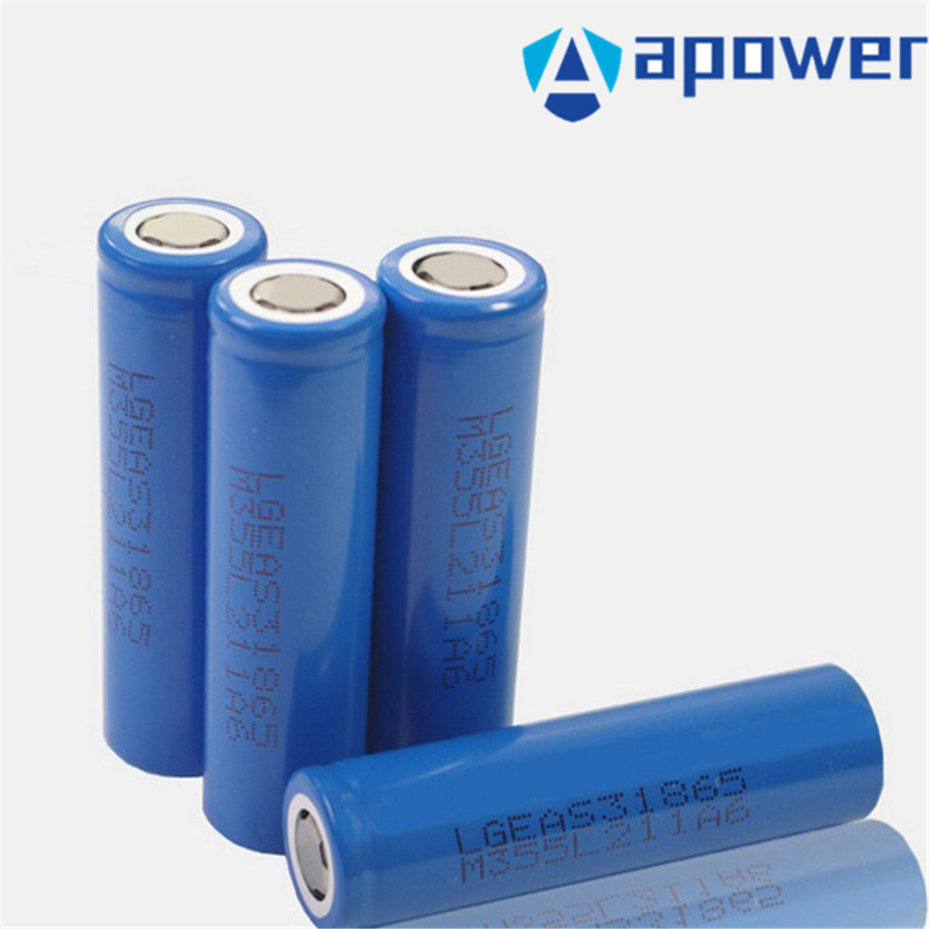
POWER SUPPLY:
Lithium-ion batteries are used to give power to the system. It is connected to the motor driver, nodemcu, and the sensors. Each battery consists of 3.7v and when connected in series it will produce 11.3v approximately. This will run the sensors and actuators present in our system.

Slide 10
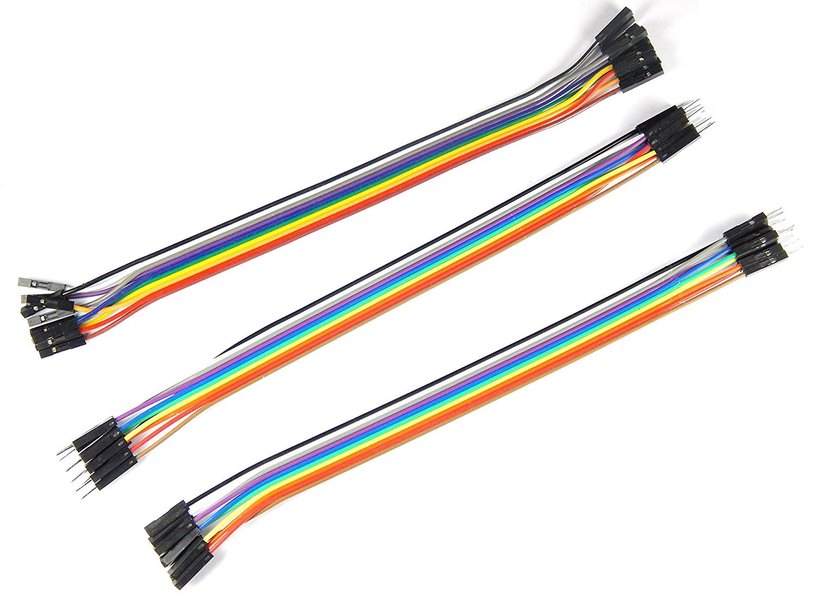
JUMPER WIRES
A jump wire (also known as jumper wire, or jumper) is an electrical wire, or group of them in a cable, with a connector or pin at each end (or sometimes without them – simply "tinned"), which is normally used to interconnect the components of a breadboard or other prototype or test circuit, internally or with other equipment or components, without soldering.

Slide 11
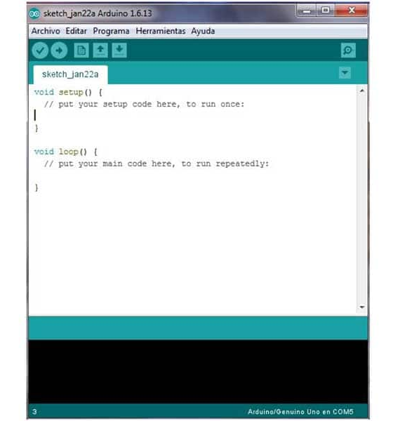
ARDUINO IDE
The Arduino Integrated Development Environment - or Arduino Software (IDE) - contains a text editor for writing code, a message area, a text console, a toolbar with buttons for common functions and a series of menus. It connects to the Arduino and Genuino hardware to upload programs and communicate with them

Slide 12
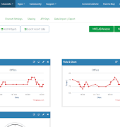
THINGSPEAK
ThingSpeak™ is an IoT analytics platform service that allows you to aggregate, visualize and analyze live data streams in the cloud. ThingSpeak provides instant visualizations of data posted by your devices to ThingSpeak.

Slide 13
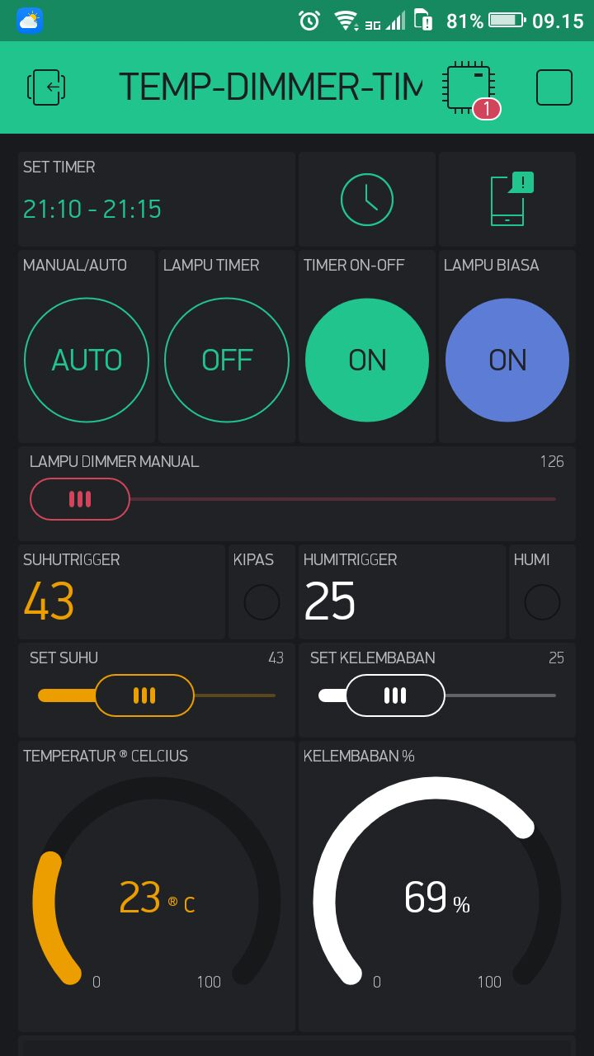
BLYNK APP
Blynk was designed for the Internet of Things. It can control hardware remotely, it can display sensor data, it can store data, vizualize it and do many other cool things. There are three major components in the platform: ... Blynk Server - responsible for all the communications between the smartphone and hardware.

Slide 14
ADVANTAGES
Can be used to track the location of a particular thing
Can be used to measure humidity at any place
Can be operated automatically
Reduces manpower

Slide 15
FUTURE SCOPE
This prototype can be developed by using Lora technology which enables the user to transmit the signals from a long-range.

