Slide 1
Network Configuration Using Cisco Packet Tracer

Slide 2
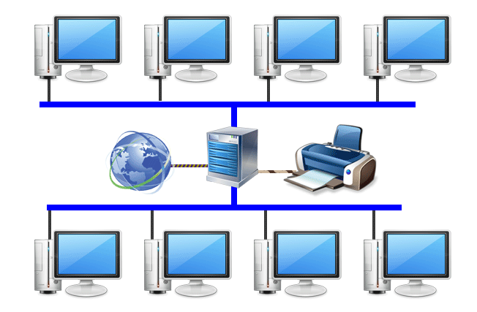
What is Network ?

Slide 3
A Typical Organizational Network

Slide 4
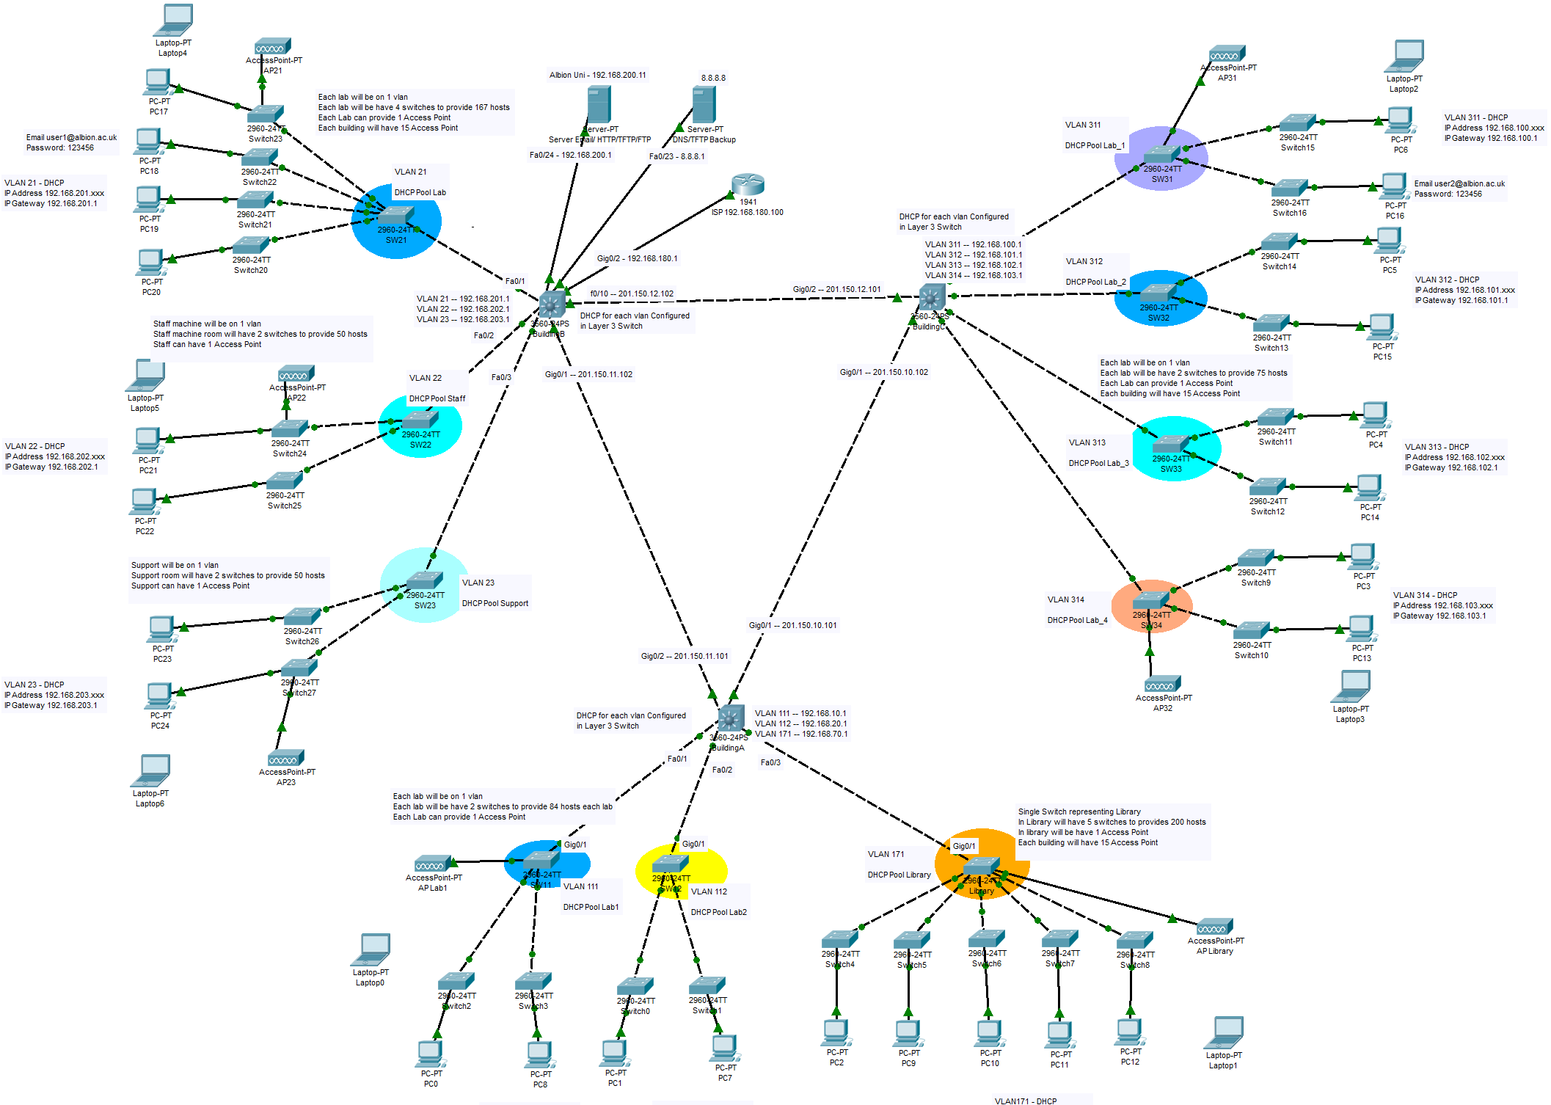

Slide 5
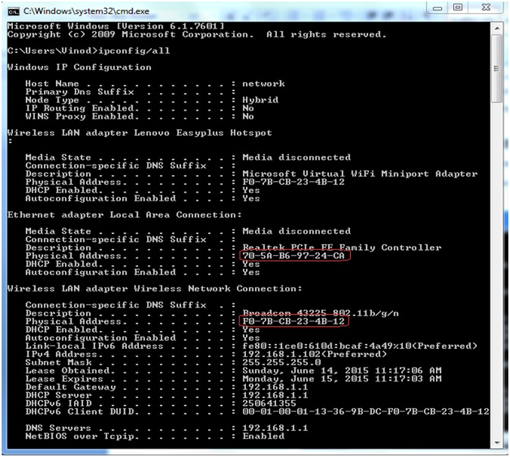
Types of Addresses in Networking
MAC Address: 48 bit
IP Address: 32 bit
Port Address: 16 bit
Specific Address:
URL, E-mail

Slide 6
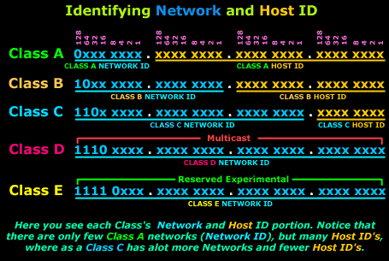
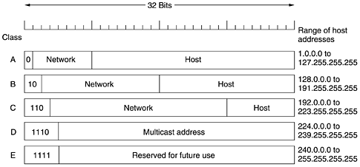
IP Addressing Mechanism
Ip address mechanism:
Classful addressing
Classless addressing

Slide 7
Need of subnetmask
The functionality of Routers is to forward the packets from one network to another network.
IP address has hieratical structure:
Network Part
Host Part
The network mask help the router to find the Network ID and can forward the packet to that network.

Slide 8
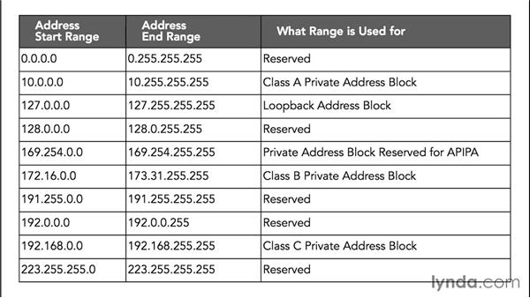
Public and Private IP

Slide 9
Installation Procedure
Go to the following URL: https://www.netacad.com/courses/packet-tracer
To download Packet Tracer, follow these steps to create your Networking Academy registration:
Click the 'Enroll to Download Packet Tracer' button
Enroll in the Introduction to Packet Tracer course
Complete your Networking Academy registration
Launch the Introduction to Packet Tracer course
Download instructions are found within the course

Slide 10
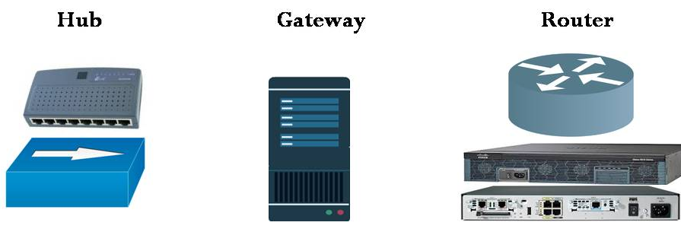
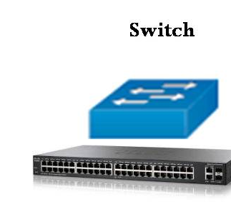
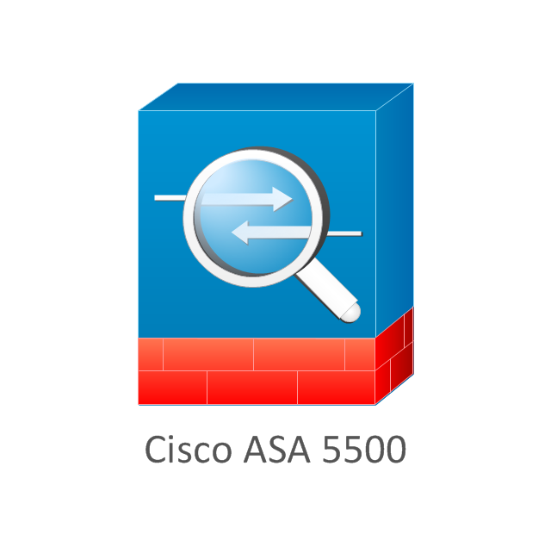
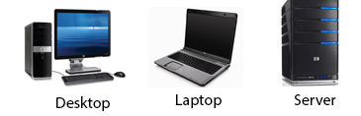
Network Devices

Slide 11
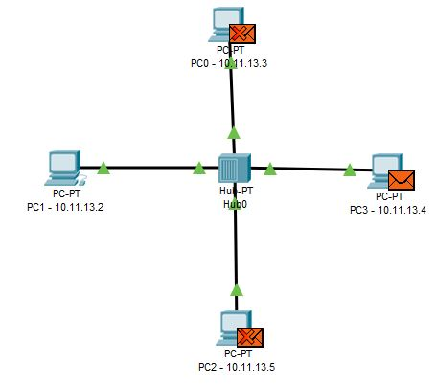
Hub
Hub:
- A network hub has no intelligence on where to send information and broadcasts all network data across each connection.
- Most hubs can detect basic network errors such as collisions, but having all information broadcast to multiple ports can be a security risk and cause bottlenecks

Slide 12



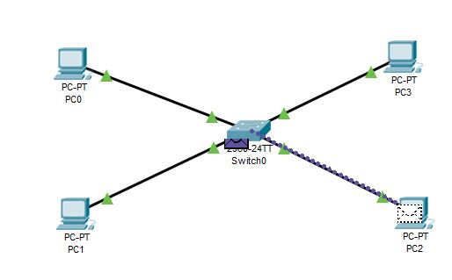
Switch
# 100
Post destination is #200
# 200
# 300

Slide 13
Router

Slide 14
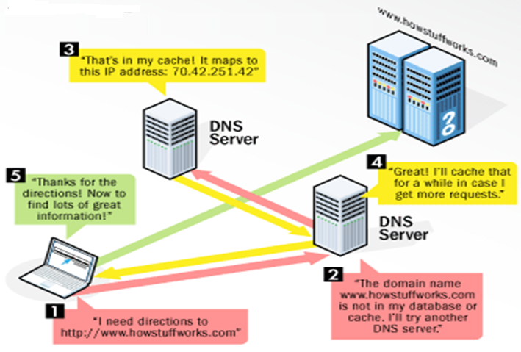
Domain Name System (DNS)

Slide 15
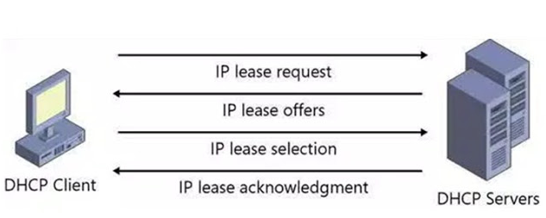
DHCP

Slide 16
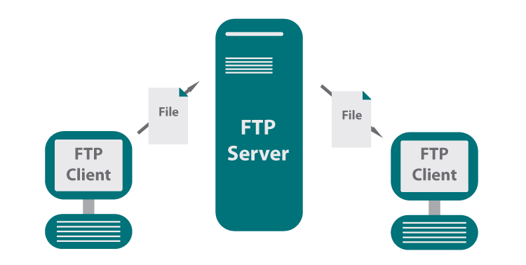
File Transfer Protocol (FTP)

Slide 17
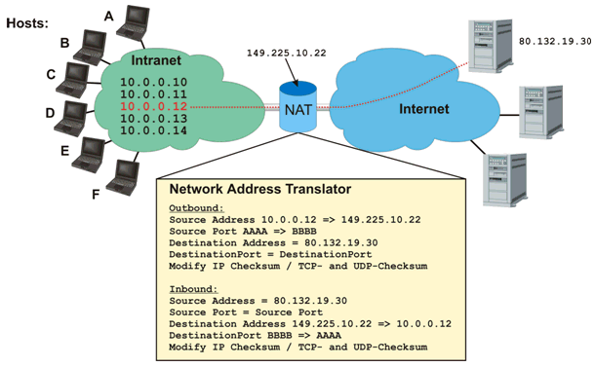
Network Address Translation (NAT)

Slide 18
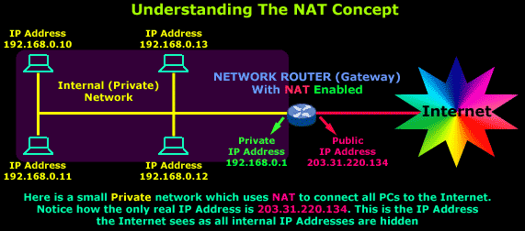
Network Address Translation (NAT)

Slide 19
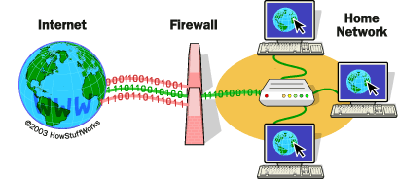
Firewall

Slide 20
Thankyou

