Slide 1
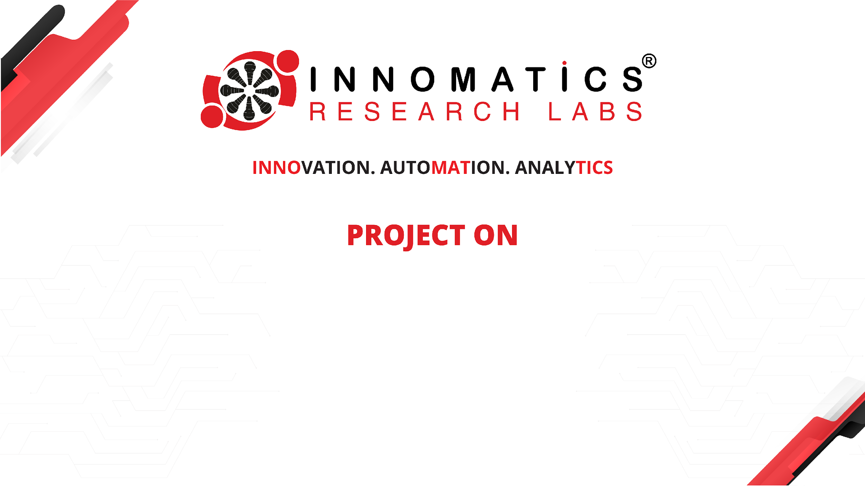
Employee Management System

Slide 2
About me
Background? (B-tech or M-tech) – B-tech
I am B. Sreepada Dathu, a graduate in Electronics and Communication Engineering from Sathyabama Institute of Science and Technology. I have professional experience at Cognizant, where I worked as an Associate on an e-commerce retail project
Why you want to learn Data Science
Data Science is a rapidly growing and in-demand field, offering a wide range of career opportunities across industries.
Any work experience
Yes, worked as an Associate in cognizant for 3years 8months
Share your LinkedIn and GitHub profile URLs

Slide 3
Agenda (This should be the PPT flow)
Objective of the Project
ER Diagram and schema explanation
Key analysis questions (use cases)
SQL query results with screenshots or summaries
Final business insights and recommendations
Conclusion (Key finding overall)
Q&A Slide
Your Experience/Challenges working on SQL – Data Analysis Project.

Slide 4
Objective of the Project
The objective of this project is to design and develop an Employee Management System.
This helps organizations to efficiently manage employee information such as personal details, job roles, departments, leave records, and payroll.
It improve accuracy, and provide quick access to employee data.

Slide 5
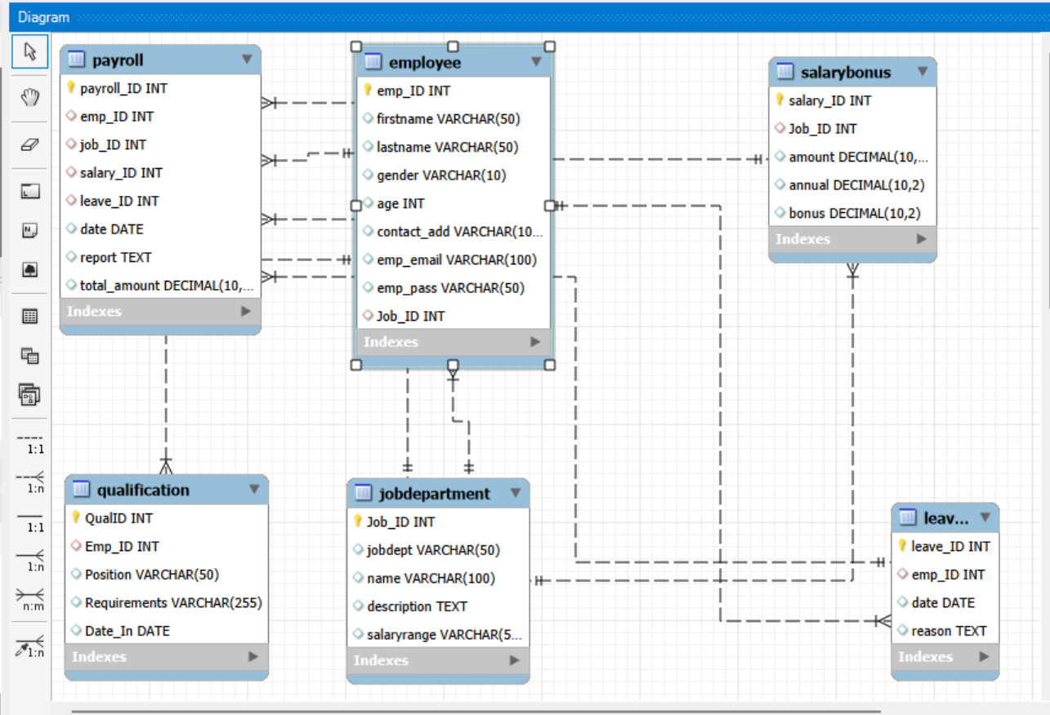
ER Diagram and schema explanation

Slide 6
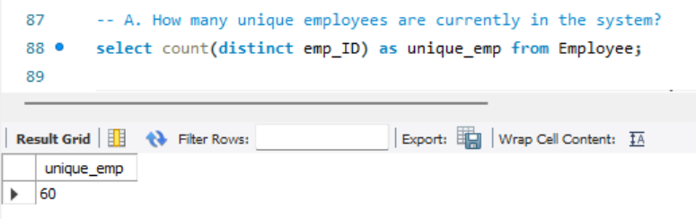
Key analysis questions (use cases)
1. EMPLOYEE INSIGHTS

Slide 7
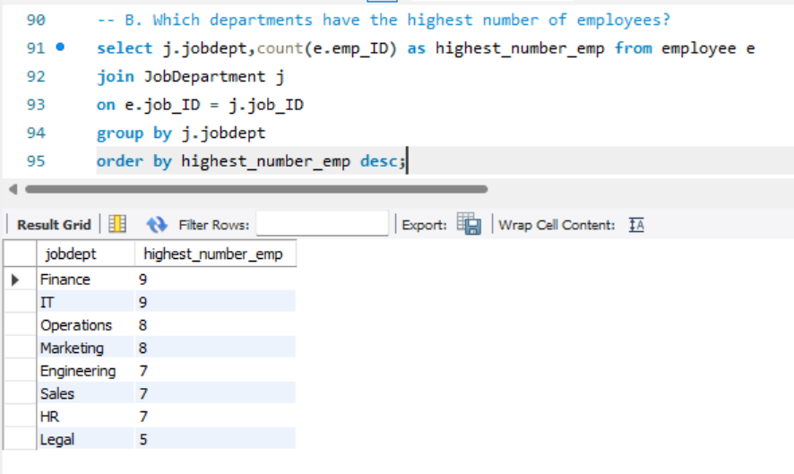

Slide 8
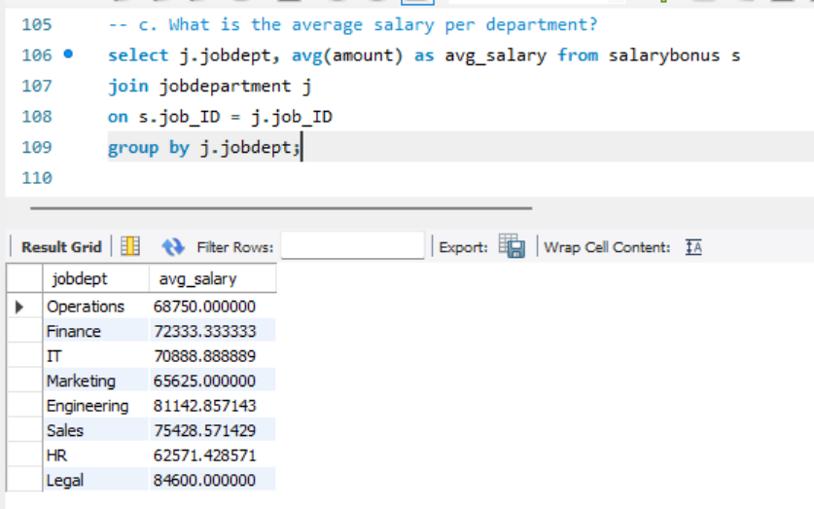
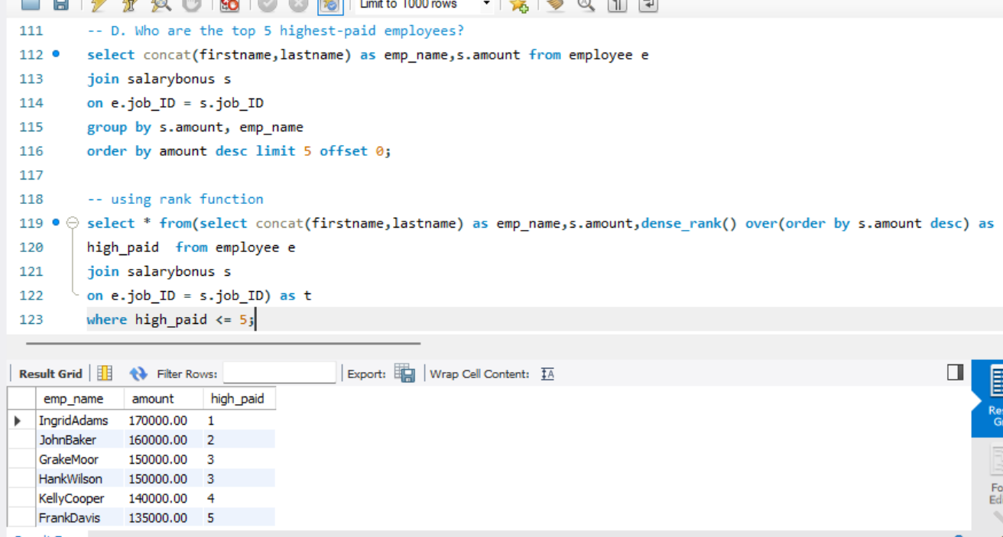

Slide 9
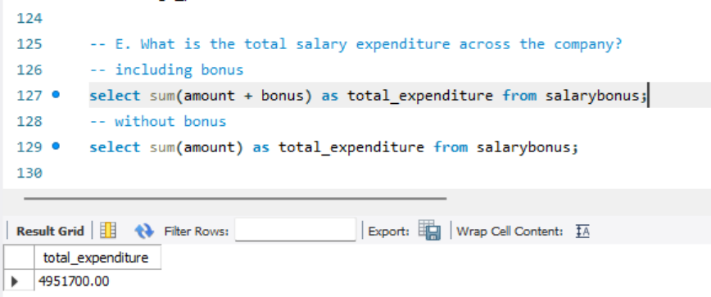
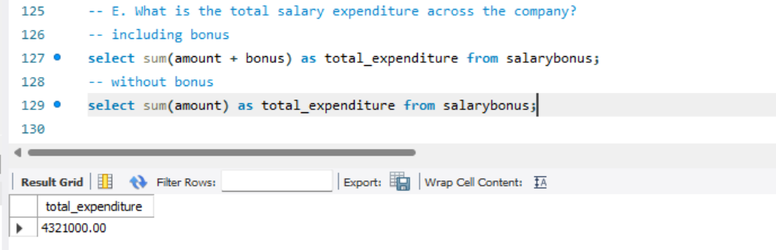

Slide 10
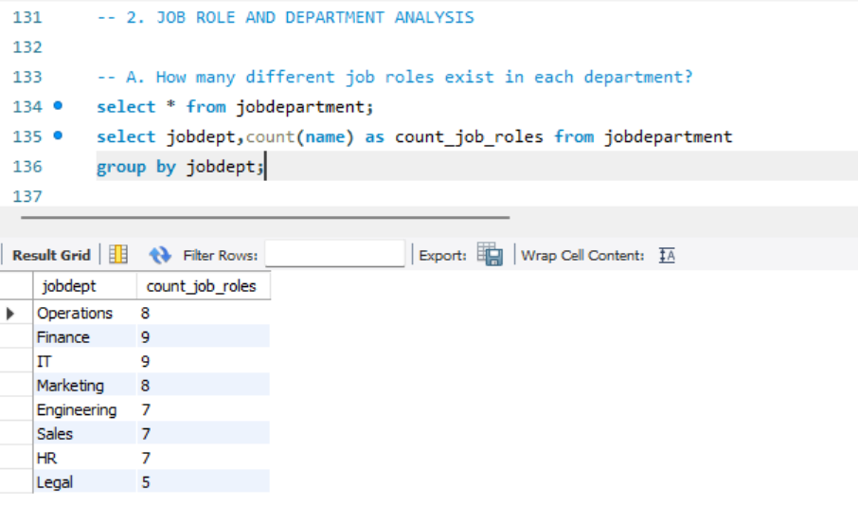
Job roles and Department Analysis

Slide 11
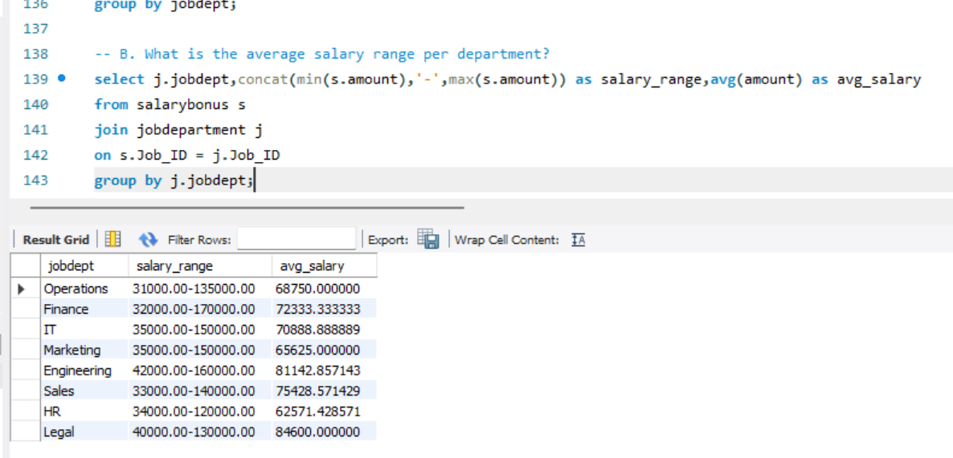

Slide 12
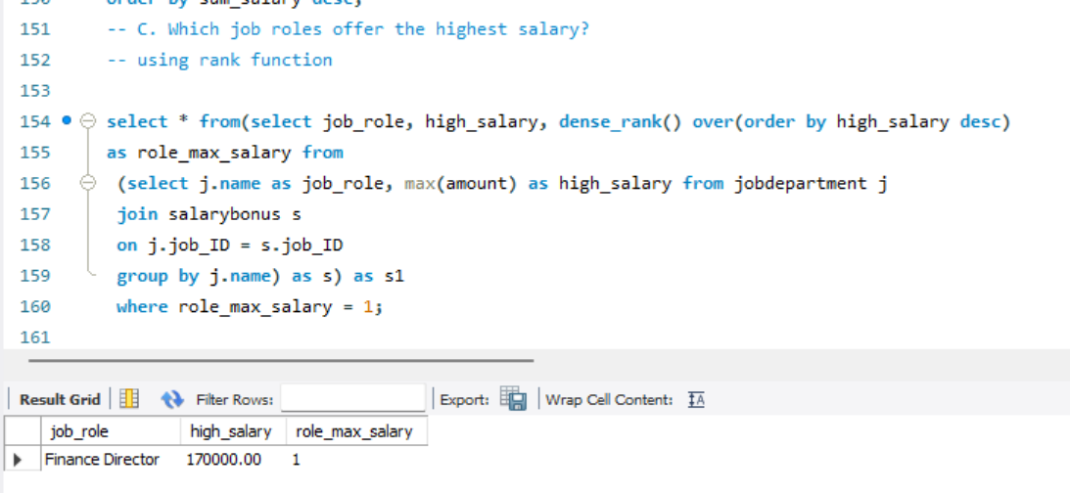

Slide 13
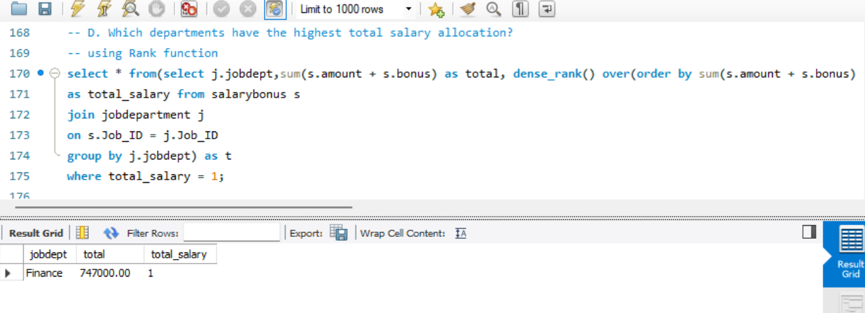

Slide 14
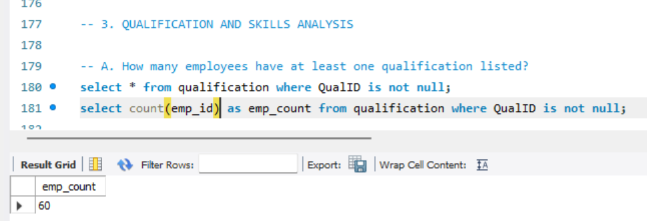
3. QUALIFICATION AND SKILLS ANALYSIS

Slide 15
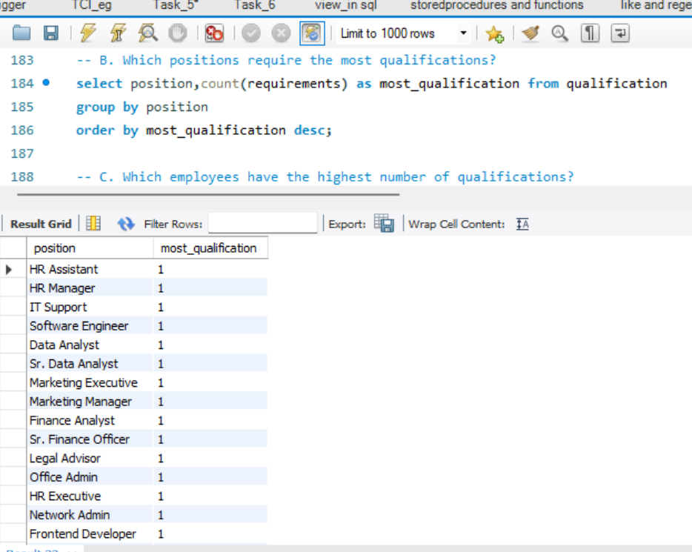

Slide 16
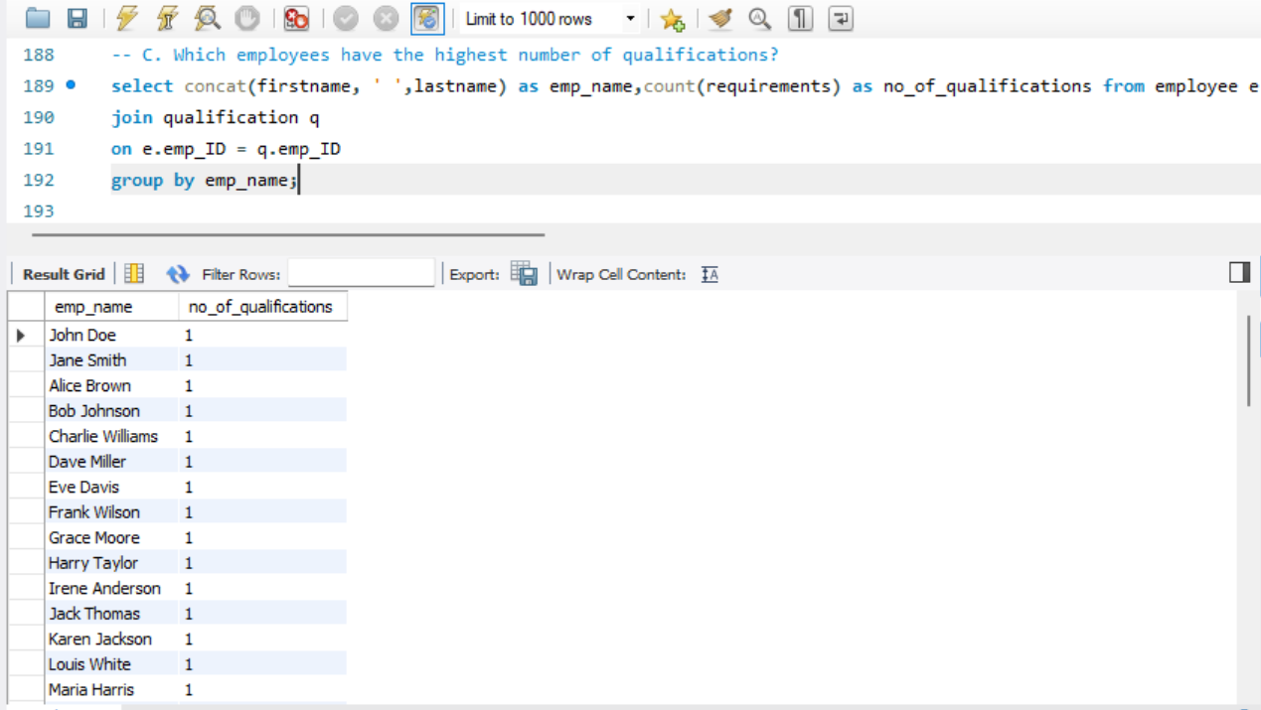

Slide 17
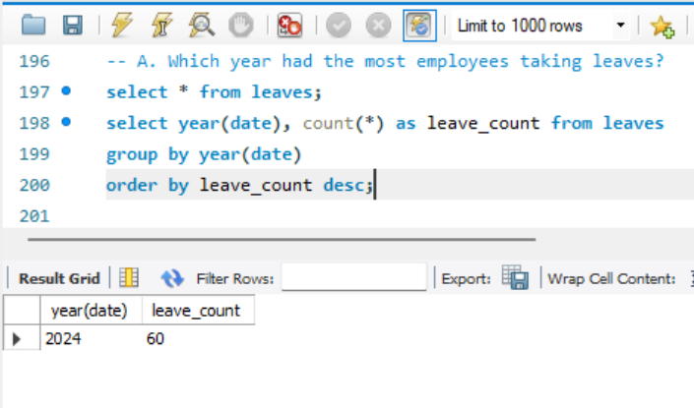
4. LEAVE AND ABSENCE PATTERNS

Slide 18
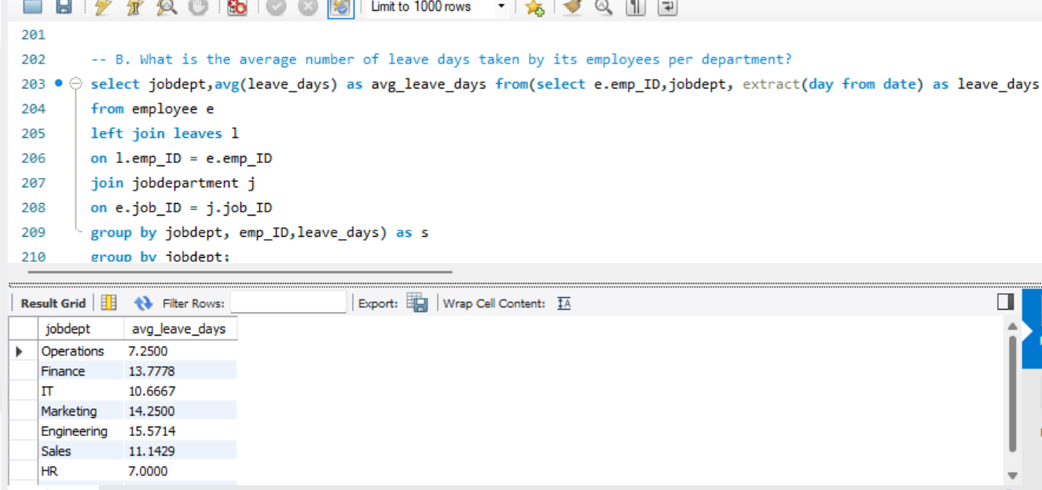

Slide 19
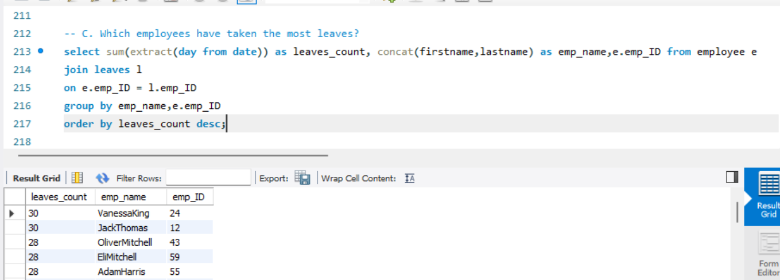

Slide 20
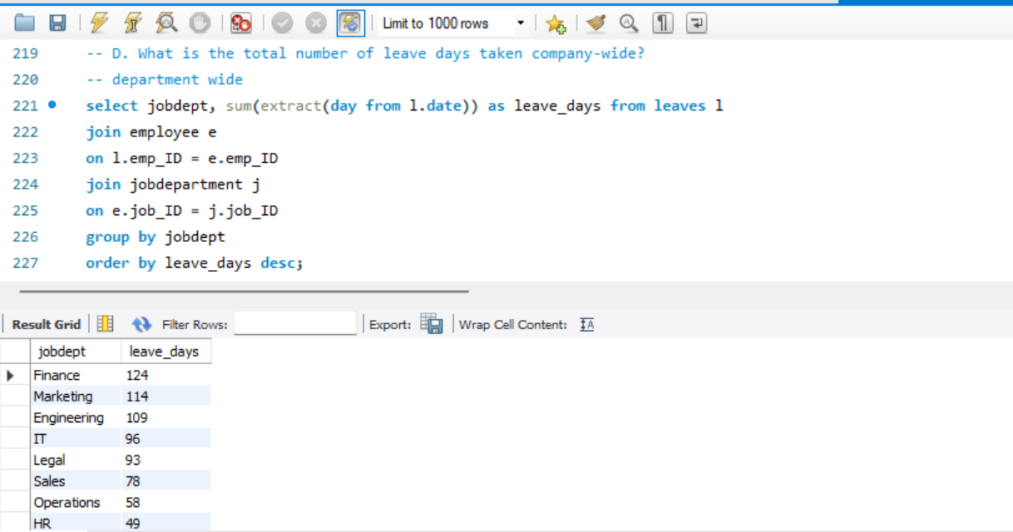
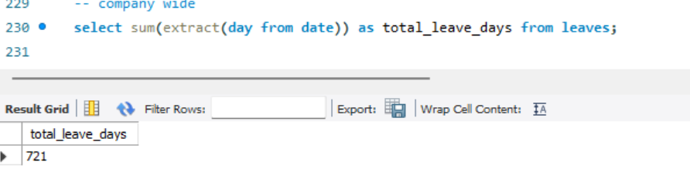

Slide 21
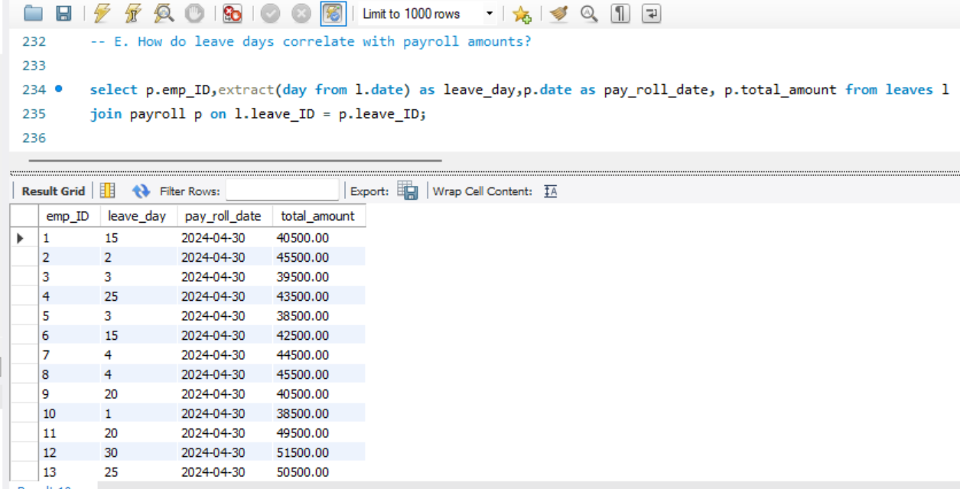

Slide 22
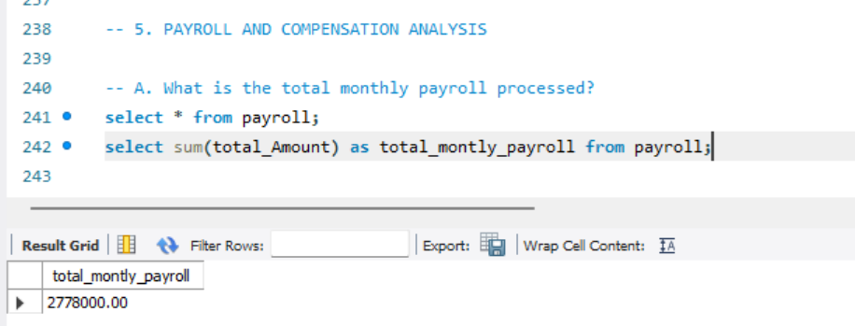
5. PAYROLL AND COMPENSATION ANALYSIS

Slide 23
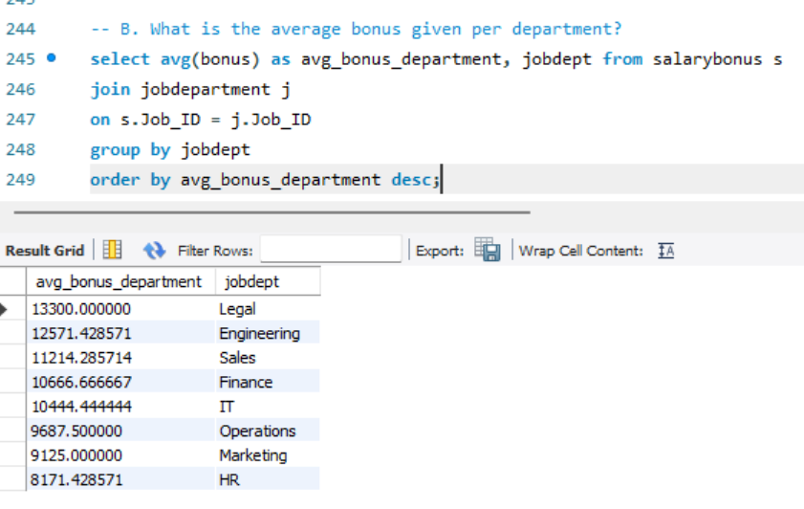

Slide 24
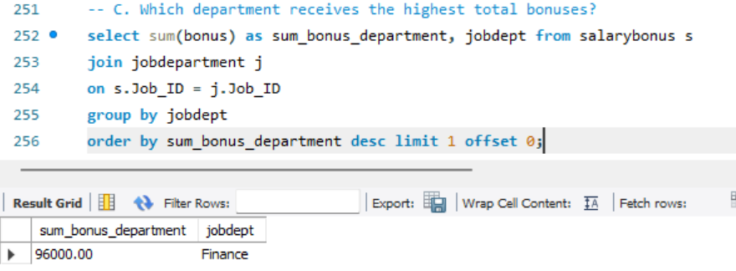

Slide 25
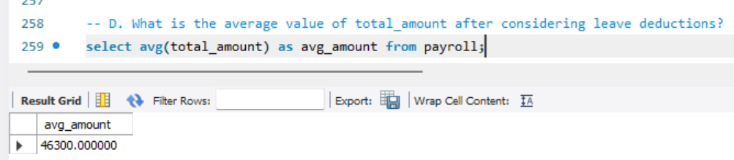

Slide 26
Final business insights and recommendations
Key insights:
Departments with higher employees tend to have higher salary expenditure
Certain job roles offers higher salaries and bonuses, influencing employee retention
Finance and IT has highest number of employees and also offers slightly more roles compared to other departments
The Legal department has the highest average salary and average bonus. This indicates that, even though the salary range may not be the highest, employees receive strong bonus compensation, resulting in a comparatively high take-home (in-hand) salary within the given pay scale

Slide 27
Business recommendations
Regular backups and security checks are recommended to protect sensitive employee information.
Management should use system reports(Analytics) to analyze employee performance, leave trends, and departmental workload.
Offer training program for roles requiring high qualifications
Automate payroll to minimize the manual errors and speed up processing

Slide 28
Conclusion
The Employee Management System successfully demonstrates how SQL can handle and analyze large employee datasets.
It reduces manual effort, improves data accuracy, and enhances efficiency.
The system supports better decision-making and transparency, making it an effective solution for modern organizations.

Slide 29

THANK YOU

