Slide 1
Pointers
Pointer Constant
Pointer Variable
Declaring Pointers
Initializing Pointers
Address Operator
Indirection / Dereference Operator

Slide 2
Pointer constant
a
10
int a = 10;
printf("%d\n", a);
printf("%p\n", &a);
0065FDF4
Output:
10
0065FDF4

Slide 3
Pointer variable
a
10
int a = 10;
int *ptr;
ptr = &a;
printf("%d\n", a );
printf("%p\n", ptr);
printf("%p\n", &ptr);
printf("%d\n", *ptr);
0065FDF4
ptr
0065FDF4
005FE368

Slide 4
Pointer variable
a
10
int a = 10;
int *ptr;
ptr = &a;
printf("%d\n", a );
printf("%p\n", ptr);
printf("%p\n", &ptr);
printf("%d\n", *ptr);
0065FDF4
ptr
0065FDF4
10
0065FDF4
005FE368
10
005FE368

Slide 5
a
b
Pointer variable
10
int a = 10;
int b;
int *ptr;
ptr = &a;
b = a + 1; a++;
ptr
&a

Slide 6
a
b
Pointer variable
10
11
int a = 10;
int b;
int *ptr;
ptr = &a;
b = a + 1; a++;
ptr
&a
b = *ptr + 1; *ptr++; // ???

Slide 7
a
b
Pointer variable
10
11
int a = 10;
int b;
int *ptr;
ptr = &a;
b = a + 1; a++;
ptr
&a
b = *ptr + 1; (*ptr)++;

Slide 8
What is wrong with the following program fragment?
pi
double pi = 3.14; double *ptr;
printf("%f\n", pi );
printf("%p\n", &ptr);
printf("%p\n", ptr);
printf("%f\n", *ptr);
3.14
ptr

Slide 9
Output
3.140000
0065FDEC
CCCCCCCC
-6184294701188139800000000000000000000000000000000000000000000000000000000000000
00000000000000000000000000000000000000000000000000000000000000000000000000000000
00000000000000000000000000000000000000000000000000000000000000000000000000000000
000000000000000000000000000000.000000

Slide 10
p
q
r
int a;
int b;
int c;
int *p;
int *q;
int *r;
a
b
c

Slide 11
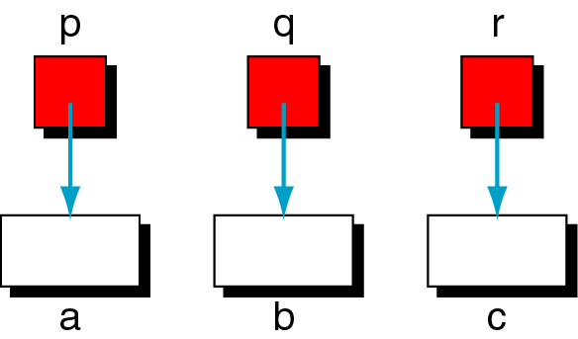
int a;
int b;
int c;
int *p;
int *q;
int *r;
p = &a;
q = &b;
r = &c;

Slide 12
int a;
int b;
int c;
int *p;
int *q;
int *r;
p = &a;
q = &b;
r = &c;
p
q
r
a
b
c

