Slide 1

Notes:
Welcome. This is an invitation to every school and robotics club in Ghana to enter teams in MRC Ghana 2027, the national edition of the Minoan RobotSports Competition, on 29 and 30 January 2027 in Accra. The cover photo is from the opening ceremony of the MRC Global Olympiad 2026 in Crete, the international final that top teams can be selected for.

Slide 2
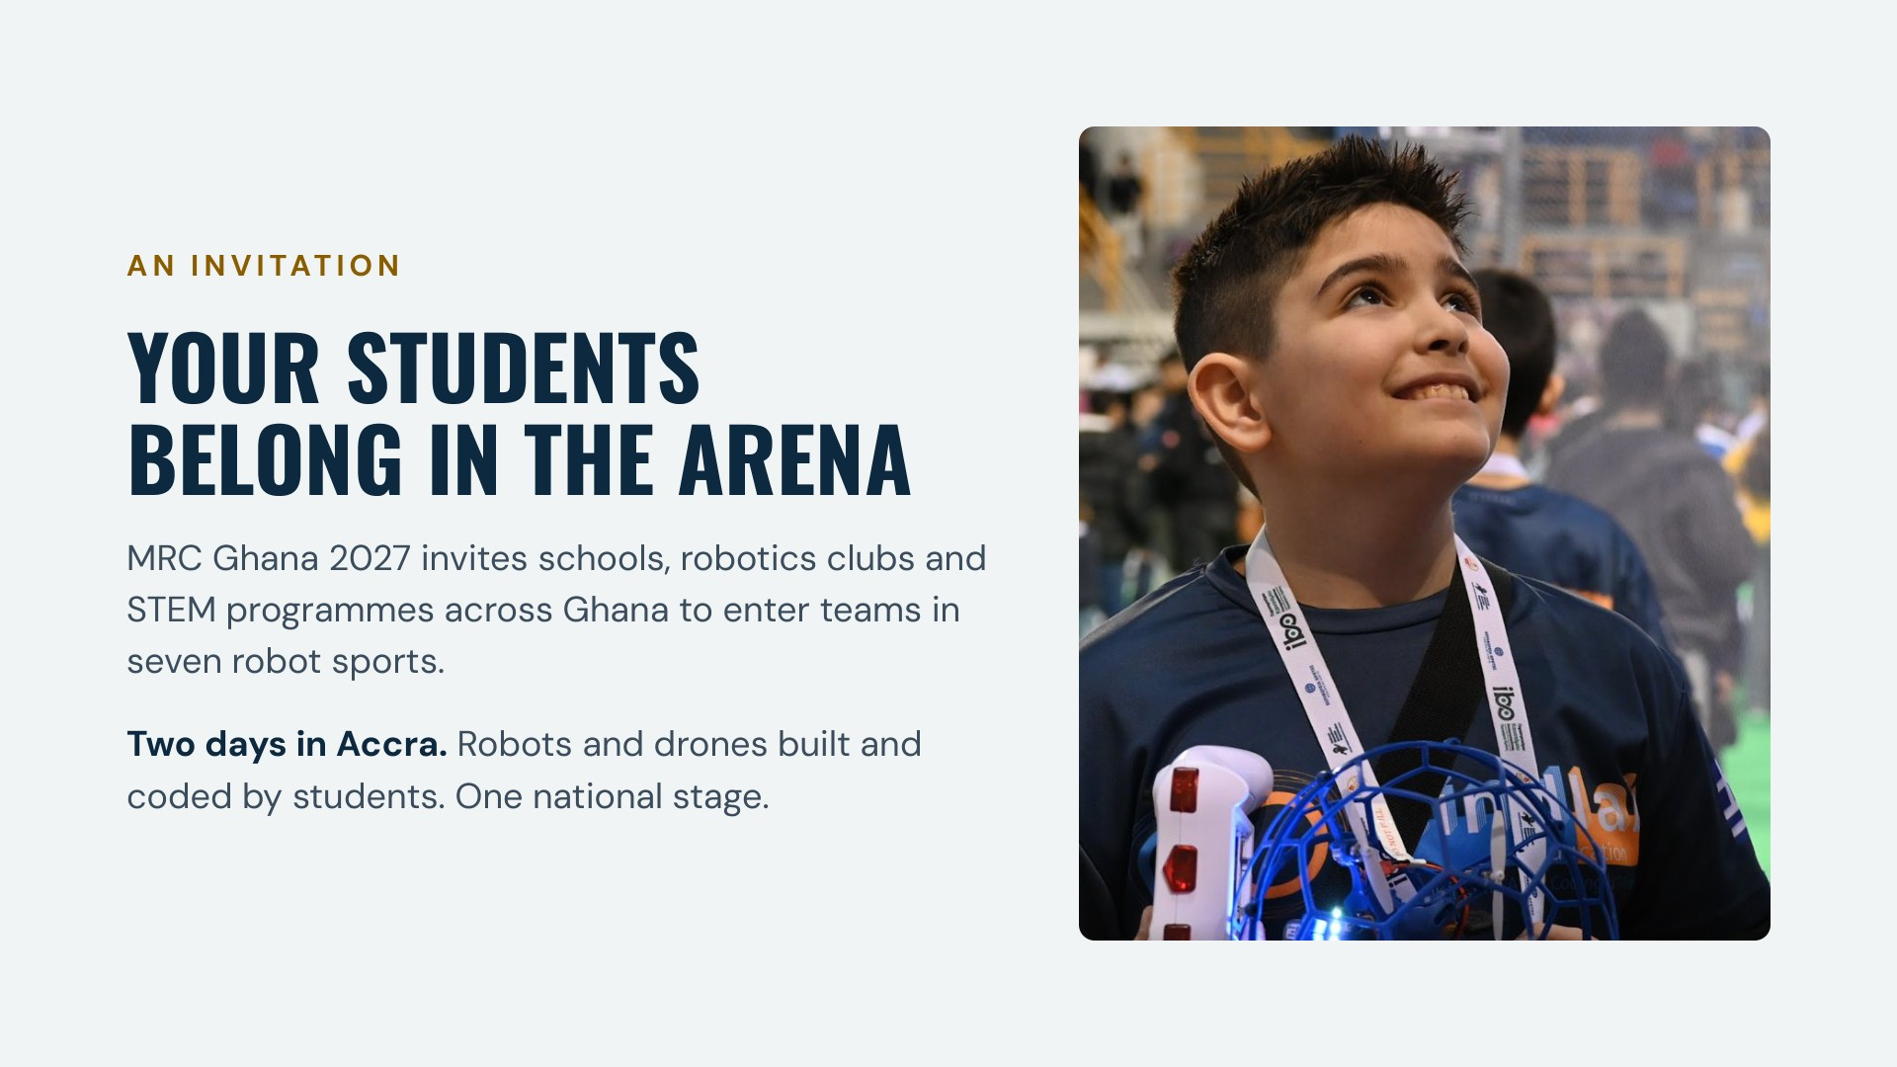
Notes:
We are inviting every school, robotics club and STEM programme in Ghana to enter teams. Students design, build and program their own robots and drones, then compete over two days in Accra on 29 and 30 January 2027. The photo is from the MRC Global Olympiad 2026.

Slide 3
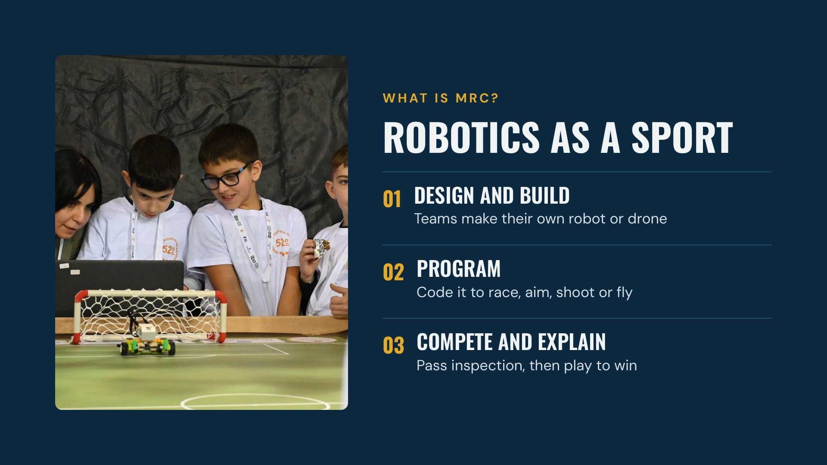
Notes:
MRC turns engineering into athletics. Teams design and build a robot or drone, program it, pass a technical inspection where they explain how it works, and then compete against other teams under the official H.E.R.O. rules.

Slide 4
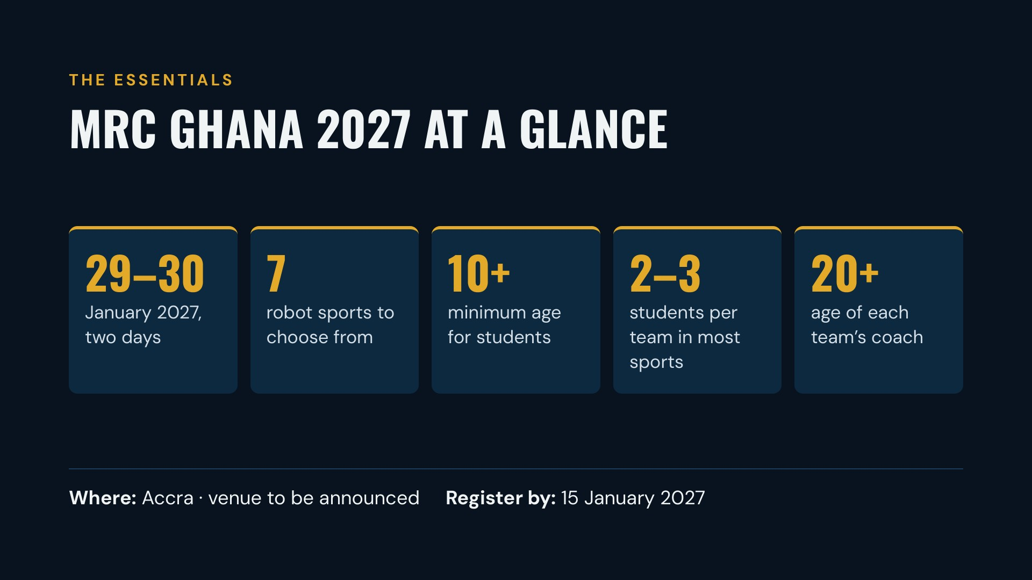
Notes:
The essentials: 29 and 30 January 2027 in Accra, with the venue still to be announced. Seven sports. Students aged 10 and over, mostly in teams of two or three, each with an adult coach aged 20 or over. Registration closes on 15 January 2027. MRC Ghana is organised by The MakersPlace as part of the Minoan RobotSports Competition run by the Hellenic Educational Robotics Organization.

Slide 5

Notes:
The seven sports. Drones: a precision flying course. Drone Soccer 3×3: aerial football with caged drone balls, played in alliances of three teams. Marathon: an autonomous line-following robot races a secret track. Football 3×3: remote-controlled robots play five-minute matches in alliances. Shooting: a handheld, sensor-triggered foam-dart launcher. Archery: an autonomous robot bow that adjusts its own aim. Exhibition: a showcase for original projects; H.E.R.O. has not yet published its 2027 rules.

Slide 6
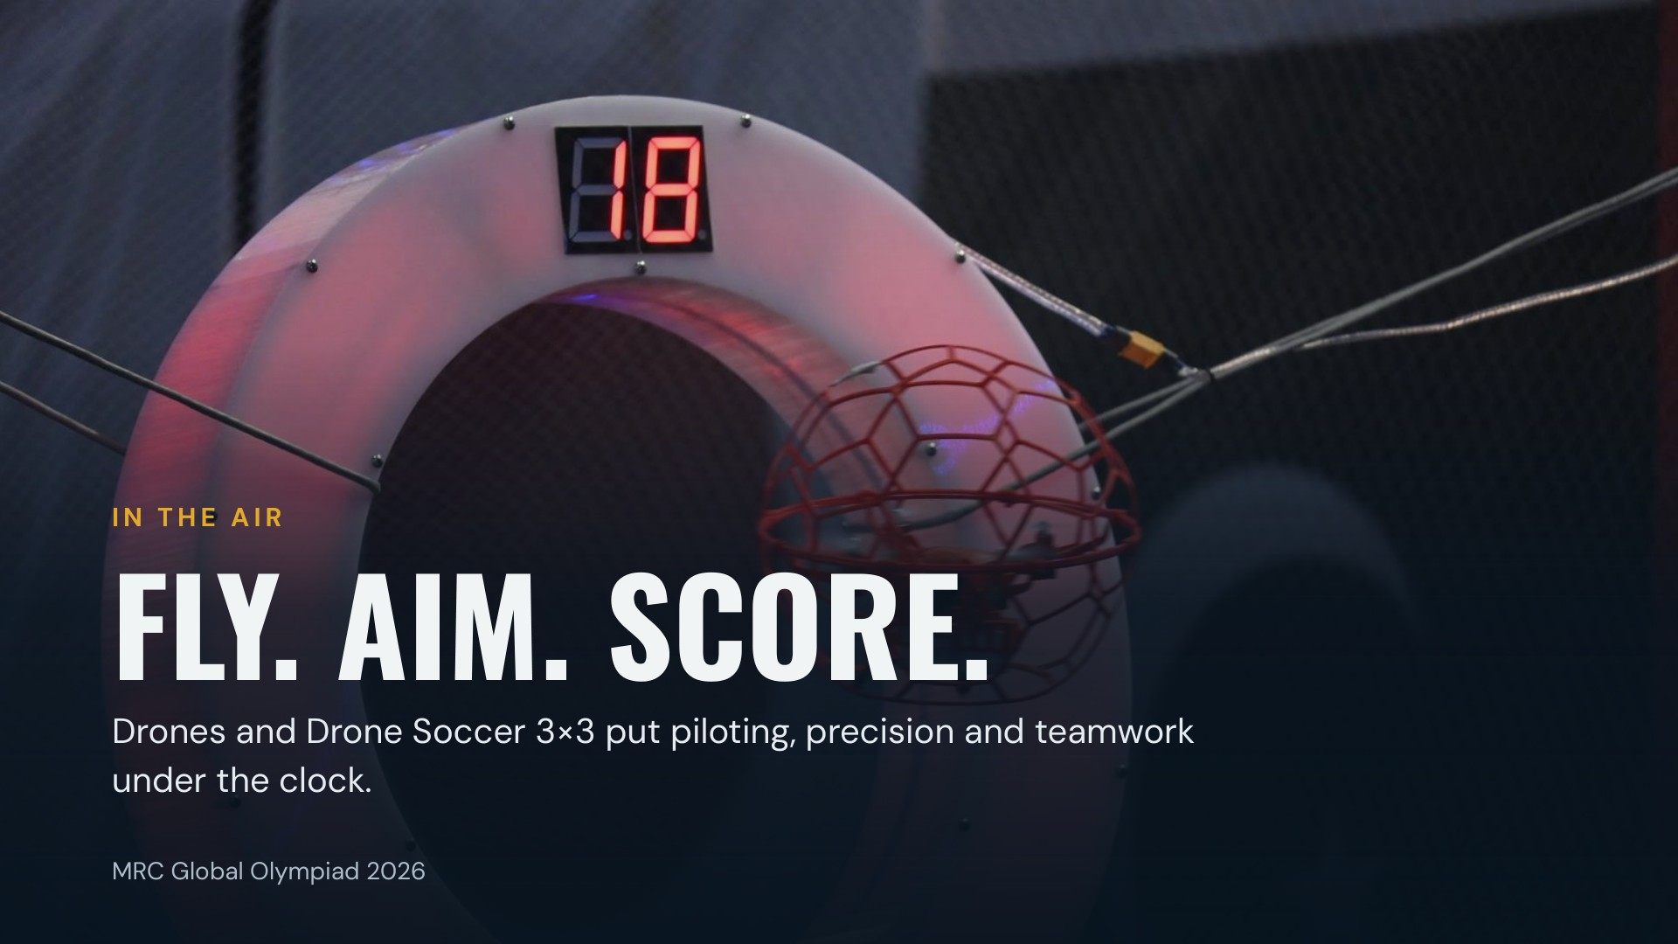
Notes:
The two drone sports. In Drones, teams pilot a small indoor drone through a course of hoops, obstacles and landing pads. In Drone Soccer 3×3, alliances of caged drone balls play aerial football. Photo from the MRC Global Olympiad 2026.

Slide 7
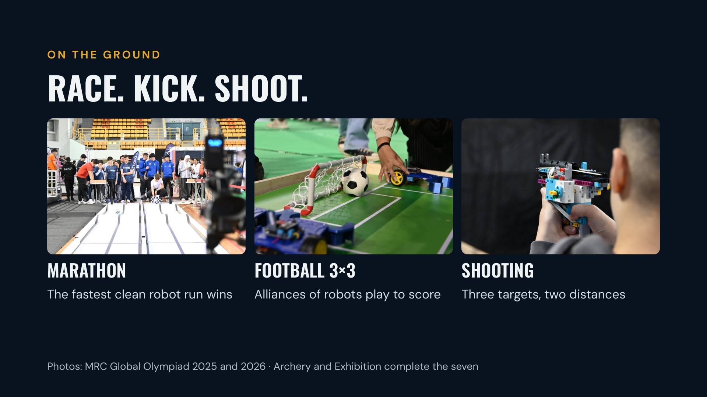
Notes:
Three of the ground sports. Marathon: an autonomous robot follows a black line around a secret track, and the fastest clean run within three minutes wins. Football 3×3: alliances of three remote-controlled robots play five-minute matches. Shooting: teams build a handheld, sensor-triggered foam-dart launcher and aim at three targets from two distances. Archery and Exhibition complete the seven. The Marathon photo is from 2025; the others are from 2026.

Slide 8
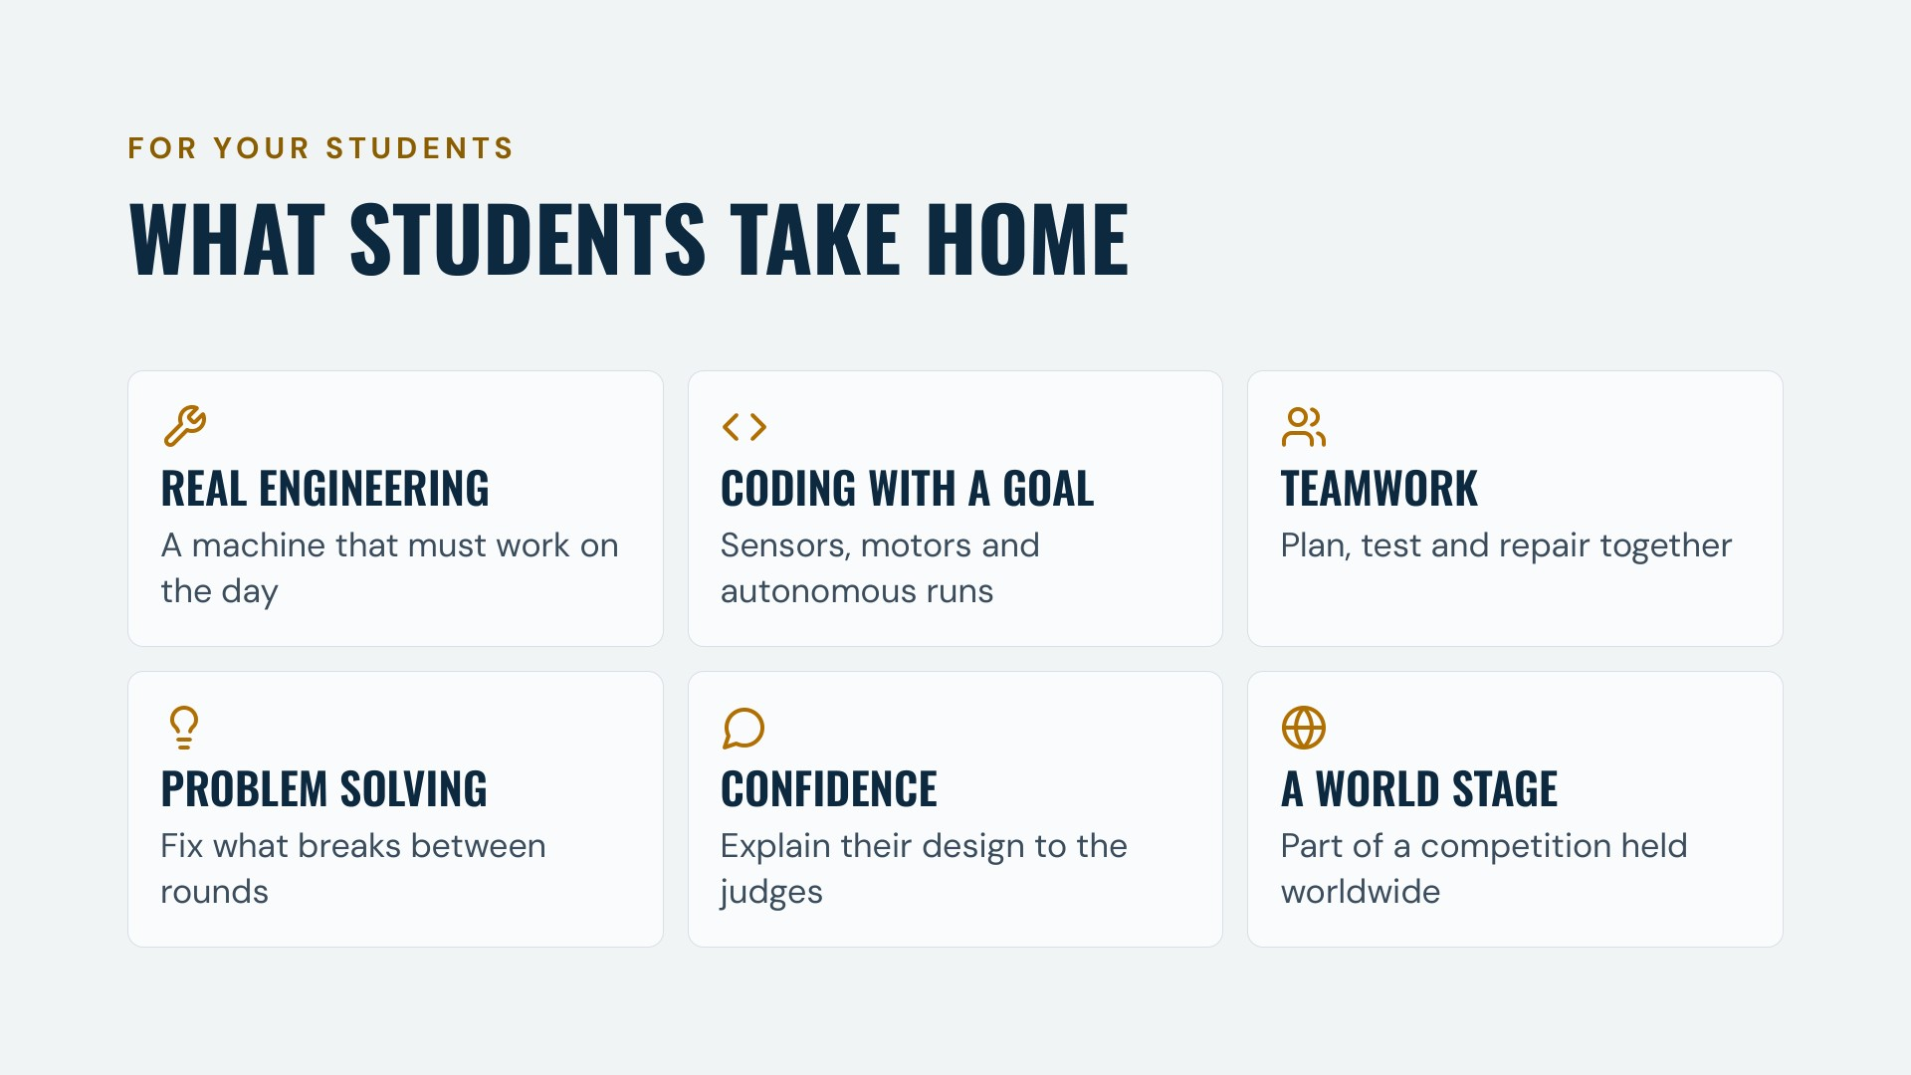
Notes:
What students take home: hands-on engineering on a machine that must work on competition day; coding with a real goal; teamwork; problem solving between rounds; the confidence to explain their design to judges at technical inspection; and membership of an international robot sports community.

Slide 9
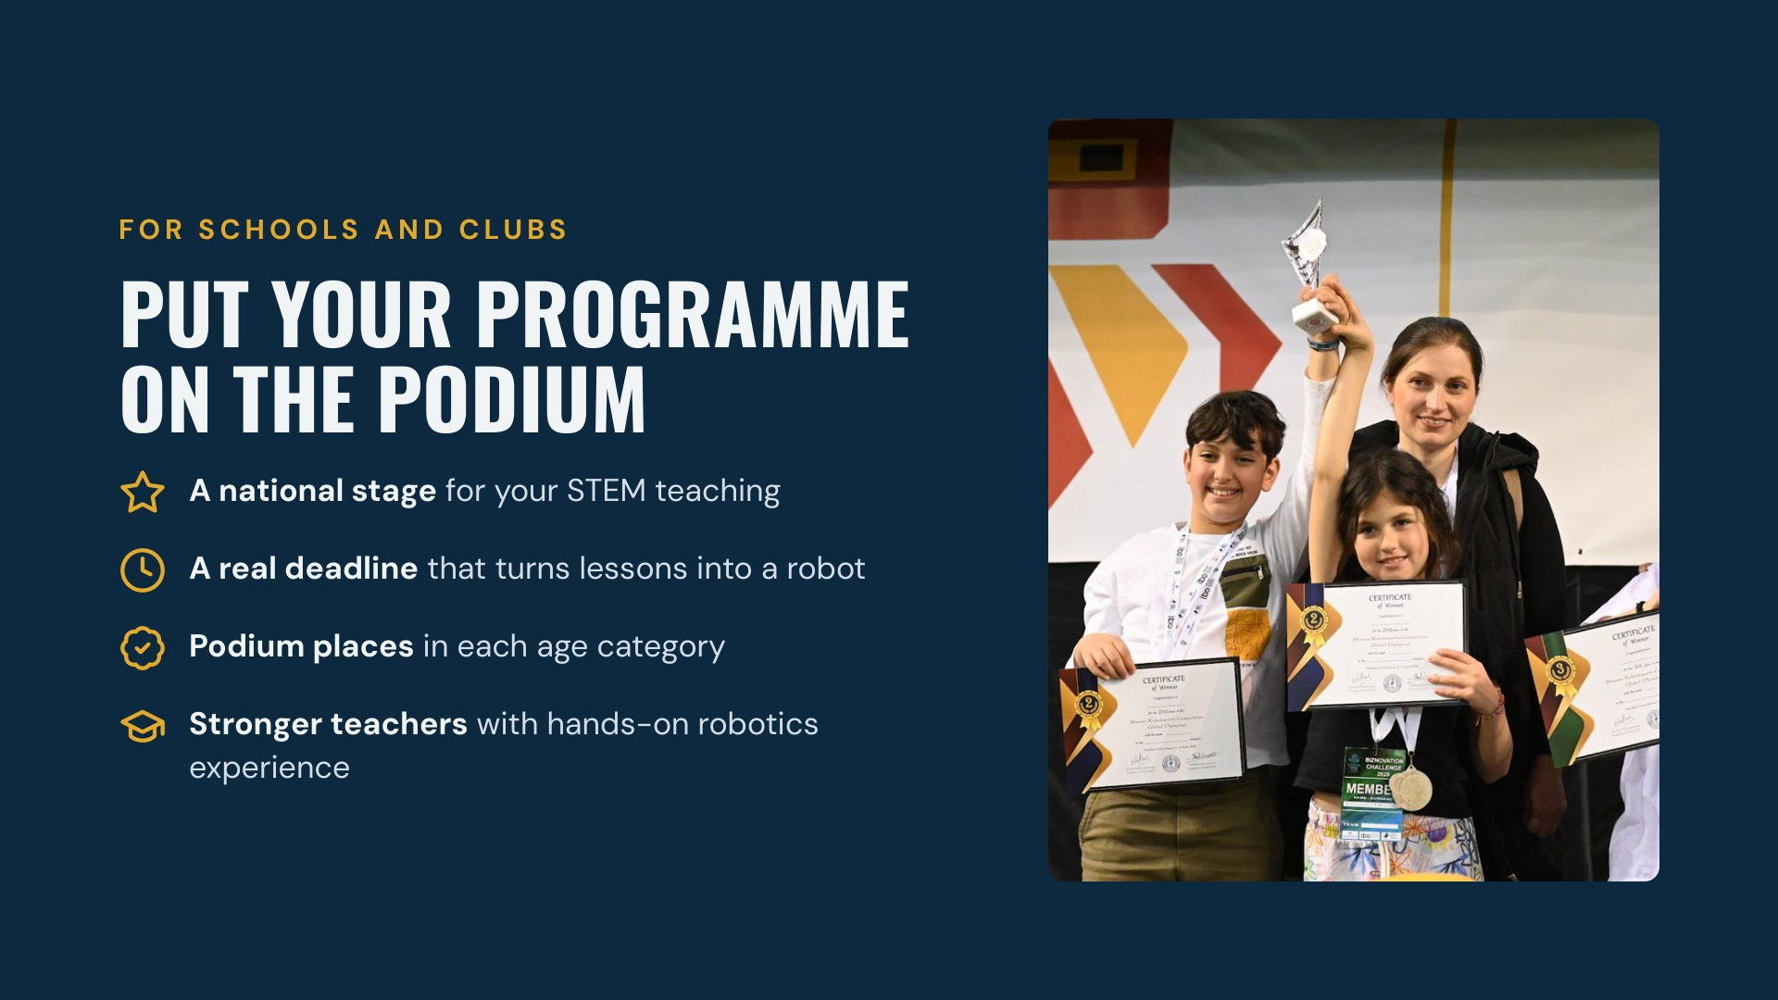
Notes:
For a school or club, MRC Ghana is a national stage for your STEM programme, a real deadline that turns lessons into a working robot, a chance at podium places in each age category under the official rules, and practical robotics experience for the teachers who coach. Photo from the awards stage at the MRC Global Olympiad 2026.

Slide 10
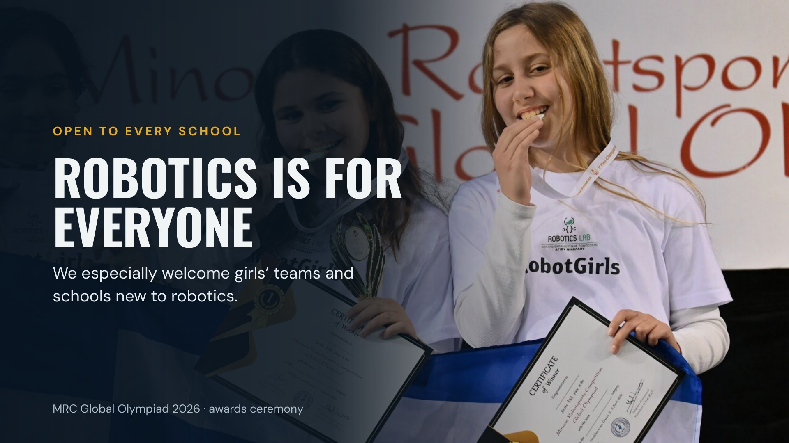
Notes:
MRC is open to every school and club, whatever its experience. We especially welcome girls’ teams and schools taking part in robotics for the first time. The photo shows medal winners from a girls’ robotics team at the MRC Global Olympiad 2026.

Slide 11

Notes:
This is the big prize. MRC Ghana 2027 is Ghana’s route to the MRC Global Olympiad, the international final in Crete. Top teams can be selected to represent Ghana there. Be clear with students and parents: progression depends on eligibility, the national selection process and the number of places confirmed, so a win in Ghana alone is not a guarantee, and travel and fees are not included unless confirmed in writing.

Slide 12

Notes:
The MRC Global Olympiad is the international final of the Minoan RobotSports Competition, run by H.E.R.O. The 6th edition takes place on 23 to 26 April 2027 at the Chania Kladissos Indoor Hall in Chania, Crete. Details from he-ro.gr, checked 14 October 2026. The photo is from the 2026 edition.

Slide 13
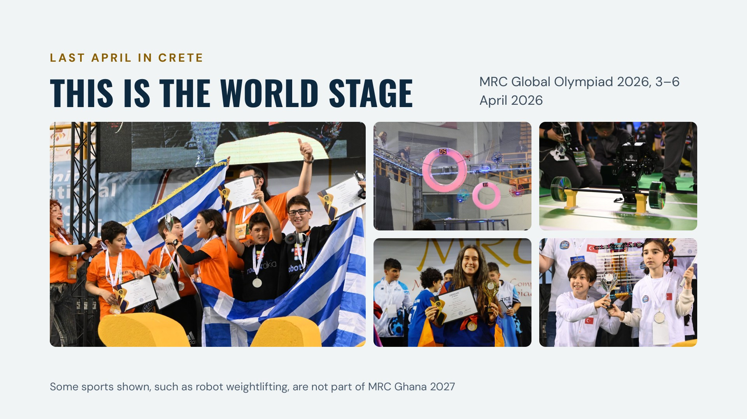
Notes:
This is what the international final looks like. These photos are from the MRC Global Olympiad 2026, held from 3 to 6 April 2026: teams celebrating on the awards stage, drones flying through scoring rings, a humanoid robot lifting weights, and young medal winners. Some of the sports shown are Global Olympiad events that are not part of the seven MRC Ghana sports.

Slide 14

Notes:
Ghana is not new to MRC. Team Ghana took part in the MRC Global Olympiad 2025 in Heraklion, Crete, carrying the Ghana flag in the parade of nations. MRC Ghana 2027 is how the next Ghanaian teams can earn that chance.

Slide 15
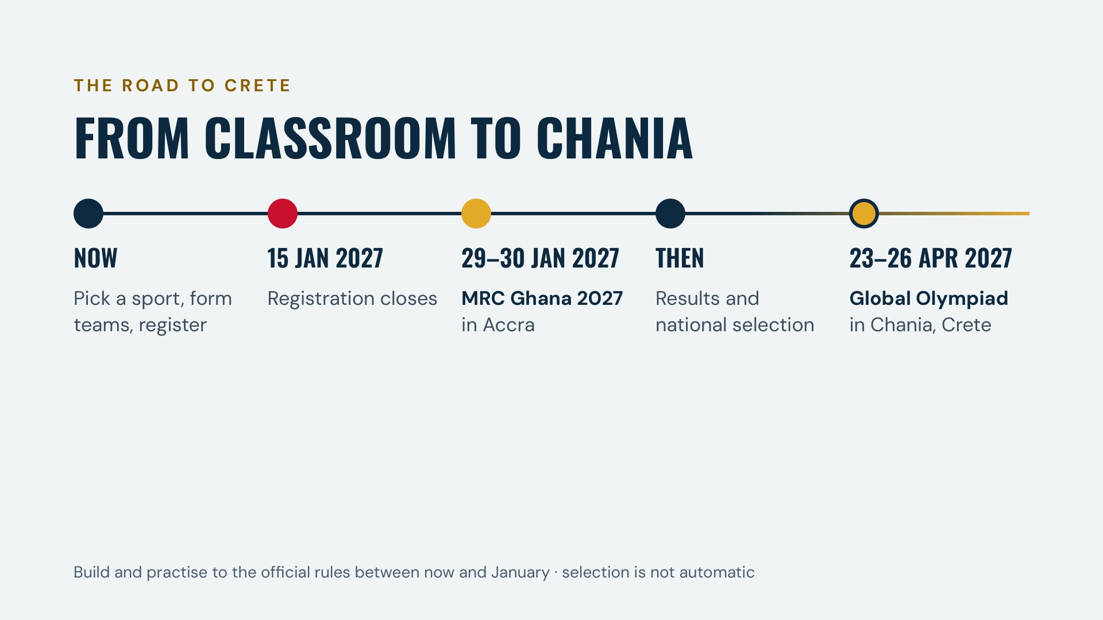
Notes:
The road from classroom to Chania: pick a sport, form teams and register now; registration closes on 15 January 2027. Compete at MRC Ghana 2027 in Accra on 29 and 30 January. Then come results and national selection, with the Global Olympiad in Chania on 23 to 26 April 2027. Selection is not automatic.

Slide 16
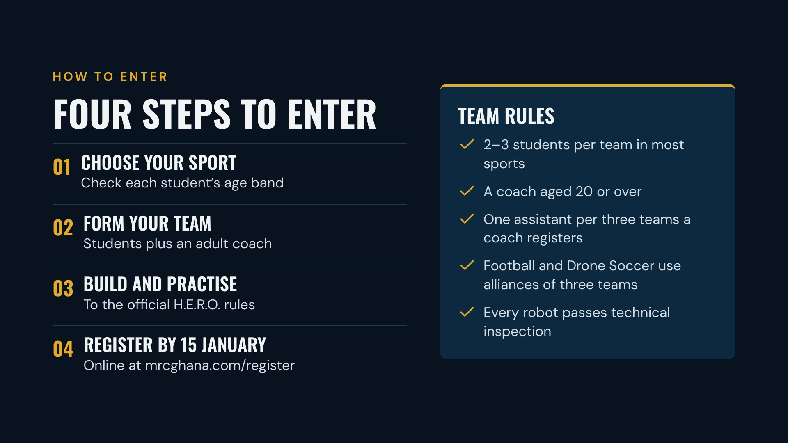
Notes:
Four steps: choose a sport and check the age band for each student; form a team of two or three students with an adult coach aged 20 or over; build and practise to the official H.E.R.O. specifications; then register online at mrcghana.com/register by 15 January 2027. A coach must bring one assistant for every three teams they register. Football and Drone Soccer are played in alliances of three teams. Every robot passes technical inspection, and the official rules always take precedence. Rules and age bands for each sport are at mrcghana.com/categories.

Slide 17

Notes:
Register your team today at mrcghana.com/register. Registration closes on 15 January 2027, and the competition takes place on 29 and 30 January 2027 in Accra. For questions, call +233 249 391 817 or +233 556 310 034, or email partnerships@makersplacegh.com. See you there.

