Slide 1

School Bus sharing for near-by students
Supervisor: Nguyễn Anh Khoa
Members: Nguyễn Việt Hùng (Leader)
Thái Hiếu Trung
Ngô Thế Vinh
Tống Văn Giang

Slide 2
AGENDA
Introduction
Implementation
Algorithms
Pros and cons
Q&A

Slide 3

01 Introduction
Brief description
Problem definition
Proposed solution
About application

Slide 4
Introduction Brief description
We developed a system called
School Bus
to take children go to school daily
based on contracts created by
customers and drivers

Slide 5
Introduction Problem definition
Most of families have kids at the school age.
The direction to school is different from the direction to office.
School time can be different from the office time.

Slide 6
Introduction Problem definition
Solution 1
Parents take their kids to school
Waste of time

Slide 7
Introduction Problem definition
Solution 2
Ask for help from relatives, friends
Based on relationship, not effective

Slide 8
Introduction Problem definition
Solution 3
Use transportation services such as taxi, Grab, …
Lack of trusts and customers have to repeat booking service daily.

Slide 9
Introduction Proposed solution
A SchoolBus-liked sharing platform in which:
Parents who have car would open a transporting service
Parents who want a driver taking their kids to school would create a transporting requirement.
After services and requirements are matched, some transporting contracts would be created. Then everyday, the driver comes and take children to their school.

Slide 10
Introduction About application
Running on both Android and iOS.
Separated application for driver and customer.
Driver:
Open and manage services.
Start trip daily.
Get notifications from customers.
Customer:
Register requirements for transporting service.
Track driver’s trip.

Slide 11
02 Implementation
Architecture
Main context and demo
Other contexts and demo

Slide 12
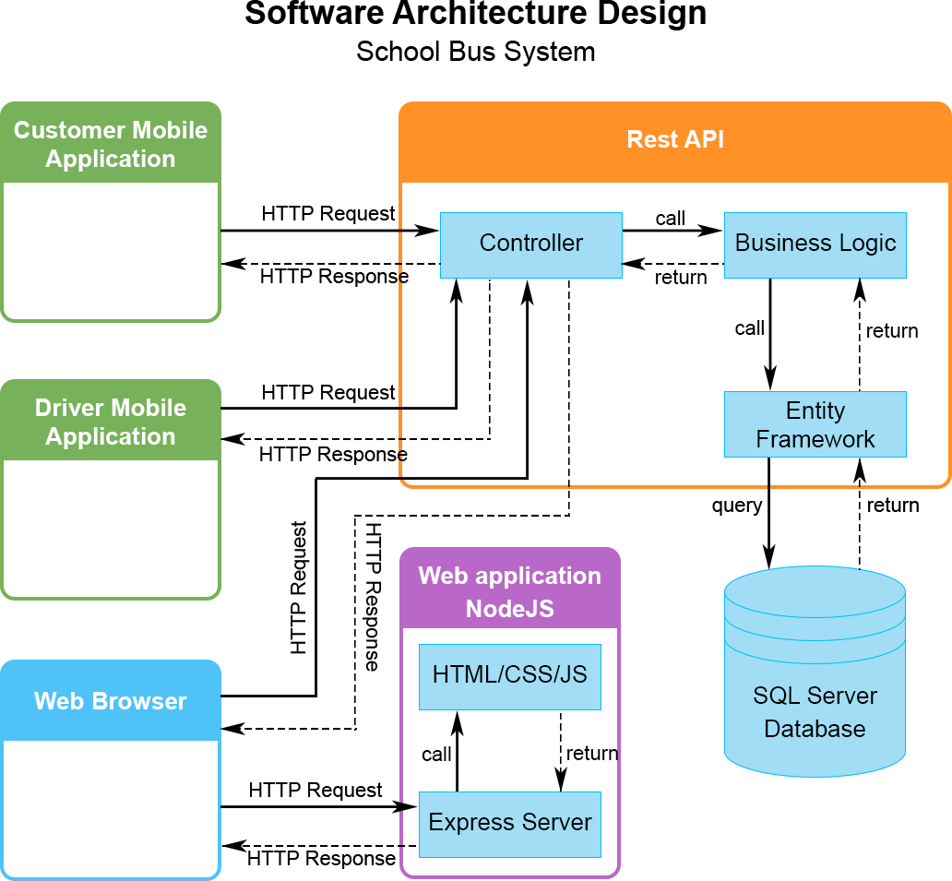
Implementation Architecture

Slide 13
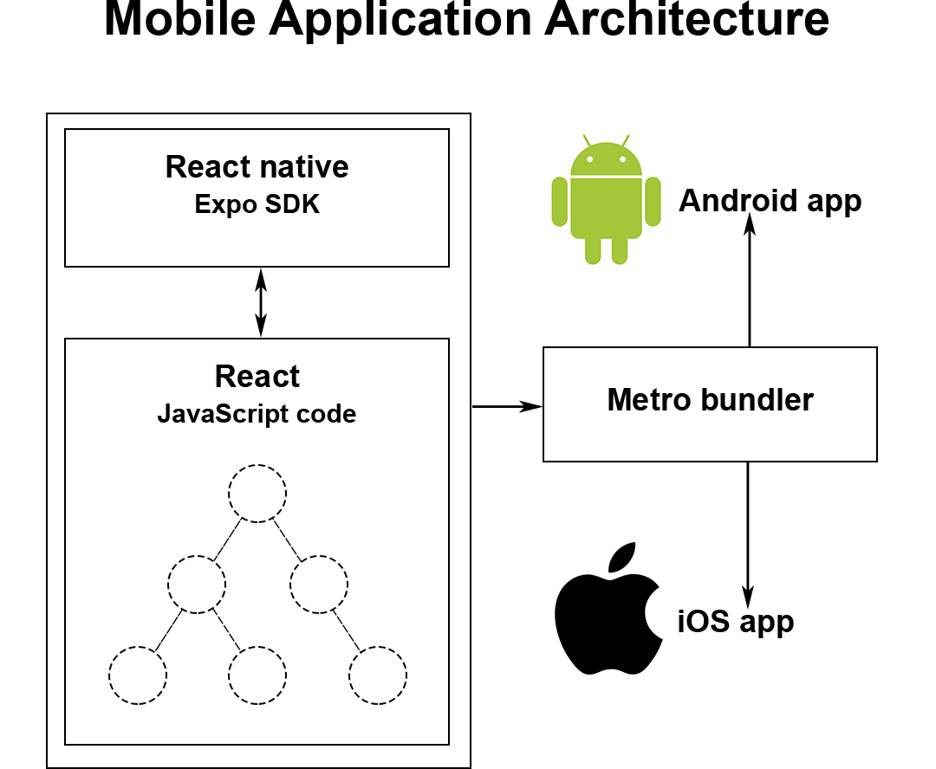
Implementation Architecture

Slide 14








Implementation Main context
DriverService
DaysOfWeek
StartTime
ArrivalTime
ReturnTime
StartAddress
School
CapacityAvailable
CustomerRequirement
DaysOfWeek
StartTime
ArrivalTime
ReturnTime
PickUpAddress
School
StartDate
EndDate
Open service
Create requirement
Accept
Make contract agreement

Slide 15




Implementation Main context

Slide 16

Implementation Main context

Slide 17

Implementation Other contexts
Cancel trip
Notify driver

Slide 18
Implementation Other contexts

Slide 19
Implementation Other contexts

Slide 20

Implementation Other contexts
Notify customer
Cancel trip
Notify customer
Create temporary contract
Accept

Slide 21

Implementation Other contexts
...

Slide 22
Implementation Other contexts

Slide 23
03 Algorithms
Find matching driver service and customer requirement
Shortest way for driver trip

Slide 24
Algorithms Find matching driver service and customer requirement
Total 4 steps.
First of all, the destinations of driver’s service and customer’s requirement must be the same.

Slide 25
Algorithms Find matching driver service and customer requirement
Secondly, the location of requirement’s picking up address must be within a configured radius around the service’s main route.

Slide 26

Algorithms Find matching driver service and customer requirement
To do this,
First, we split the route to several points.
Then we find out if the picking up location is within the circle drawn with these points as centers.

Slide 27
Algorithms Find matching driver service and customer requirement
Thirdly, the difference between service’s time and requirement’s time must be below a configured number.
DriverService
StartTime
ArrivalTime
ReturnTime
CustomerRequirement
StartTime
ArrivalTime
ReturnTime

Slide 28
Algorithms Find matching driver service and customer requirement
The final step is that:
- Find current active contracts of driver within the period of customer requirement (from startDate to endDate).
- Compare to requirement’s days of week to those contracts to checkout if any available slots in those days.
- Get the ratio of available days in week and total days in week in requirement.
- If the ratio greater than a configured percentage, then the service is matched. However, customer will be notified about the missing days.

Slide 29
Algorithms Shortest way for driver trip
Situation: The driver has to go to multiple places to pick up kids before going to school. An optimized route for driver is required.
Input: - Start point (latitude, longitude)
- End point (latitude, longitude)
- Stop points during the trip (latitude, longitude)
Output: A sequence of points, from start point, to every of stop points and to end point.

Slide 30
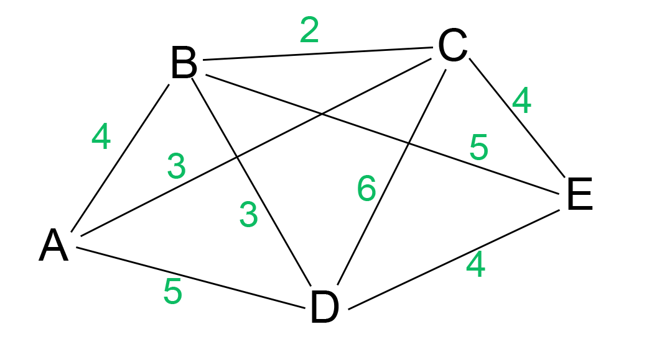
Algorithms Shortest way for driver trip
End point
Start point

Slide 31
Algorithms Shortest way for driver trip – Dijkstra approach
From A, we have 3 routes: AB – 4, AC – 3, AD – 5
Route list: [AC – 3, AB – 4, AD – 5]
From AC, we have 2 routes: ACB – 5, ACD – 9
Route list: [AB – 4, AD – 5, ACB – 5,
ACD – 9]
From AB, we have 2 routes: ABC – 6, ABD – 7
Route list: [AD – 5, ACB – 5, ABC – 6,
ABD – 7, ACD – 9]
From AD, we have 2 routes: ADB – 8, ADC – 11
Route list: [ACB – 5, ABC – 6, ABD – 7, ADB – 8,
ACD – 9, ADC – 11]

Slide 32
Algorithms Shortest way for driver trip – Dijkstra approach
Similar to that, we have
Route list: [ACBD – 8, ACD – 9, ADBC – 10
ADC – 11, ABCD – 12, ABDC – 13]
From here, we found ACBDE – 12 as one of
the shortest routes.
Still need to check out if any route is shorter.
Keep continuing, we found ADBCE – 14, still bigger than 12.
Shortest way is ACBDE – 12.

Slide 33
Algorithms Shortest way for driver trip – Greedy approach
From A, the next shortest route is AC – 3
From AC, the next shortest route is ACB – 5
From ACB, the next shortest route is ACBD – 8
From ACBD, we found the route ACBDE – 12.

Slide 34
Algorithms Shortest way for driver trip
Dijkstra approach: Accuracy but slow
Greedy approach: Fast but lack of effectiveness
Conclusion: We use Dijkstra approach when number of stop points no greater than 7 and Greedy approach for the rest.

Slide 35
04 Pros and Cons
Current pros and cons
Future plans

Slide 36
Pros and Cons
Pros:
Save customers’ time
Trust between customer and driver
Extra earnings for drivers
Cons:
Not support multiple schools for one drive
Not support payment method yet

Slide 37
Pros and Cons Future plans
Integrate payment methods.
Promotions and redeem codes.
Support web application for customers.
Handle adjustments on some specific days in contract.
Support multiple schools.

Slide 38
School Bus sharing for near-by students
Thank you for listening

Slide 39
05 Question and Answer

