Slide 2
Q1. Identifying psychiatric disorders and psychotropic medications associated with increased ICU readmission.
Icustays.csv
Admission.csv patients.csv
All adult patients (≥18 years)
diagnoses_icd
d_icd_diagnoses
ICU patients with ICD-9/10 diagnoses codes indicating psychiatric disorders:
ICU stay linked to a valid hospital admission (hadm_id) and patient (subject_id).
First ICU admission per hospitalization.
'296', '295', '303', '304', '305', 'F20', 'F21', 'F22', 'F23', 'F24', 'F25',
'F28', 'F29', 'F30', 'F31', 'F32', 'F33', 'F34', 'F39', 'F10', 'F11', 'F12',
'F13', 'F14', 'F15', 'F16', 'F17', 'F18', 'F19', 'F40', 'F41', 'F42', 'F43',
'F44', 'F45', 'F48', 'F50', 'F51', 'F52', 'F53', 'F54', 'F59', 'F60', 'F61',
'F62', 'F63', 'F64', 'F65', 'F66', 'F68', 'F69', 'F70', 'F71', 'F72', 'F73',
'F74', 'F75', 'F78', 'F79', 'F80', 'F81', 'F82', 'F83', 'F84', 'F88', 'F89',
'F90', 'F91', 'F92', 'F93', 'F94', 'F95', 'F98', 'F99'
prescriptions
d_items
'haloperidol', 'risperidone', 'quetiapine', 'olanzapine', 'lorazepam', 'diazepam', 'alprazolam’, 'fluoxetine', 'sertraline', 'citalopram', 'escitalopram', 'paroxetine', 'venlafaxine', 'duloxetine’, 'bupropion', 'mirtazapine', 'valproate', 'lithium'

Slide 3
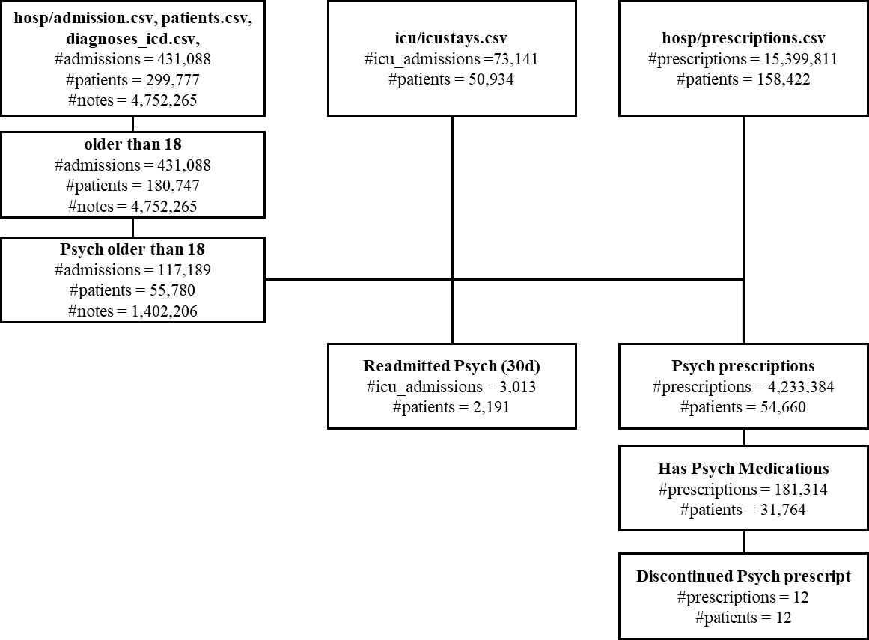
Q1
Step | Actions | Key methods / Algo | Alternatives - Reason | Outputs
0. Helpers | icd_group() collapses ICD codes to three-character buckets; rate_ci() gives a quick Wald 95 % CI for a proportion. | rule-based string parsing; Wald CI |  | functions
1. Load data | Read: - Psych ICU admissions (icu_psych_readmissions.csv) Psych diagnoses Psych prescriptions, and ICD long titles. | pandas.read_csv |  | 4 DataFrames
2. Disorder screen | - Attach dx_group to every diagnosis row. - Keep one row per (hadm_id, dx_group) and join the 30-day readmission flag. - For each group g: – Build a 2 × 2 table (g vs. rest × readmit vs. not). – Assess association btw 2 cat vars: Fisher’s exact test (small contingency table) → odds ratio + p-value. – Compute readmission rate ± CI. - Collect into dx_stats and sort by OR. | scipy.stats.fisher_exact (exact OR/p), custom CI | Chi-square requires contingency table cells’ value >=5 which some disorder and dx have less. | dx_stats (one row per disorder bucket)
3. Medication screen | Mirror of step 2 but group by drug. | same |  | rx_stats (one row per drug)
4. Visualise | Scatter plot: OR (x) vs. readmission rate (y); blue = disorders, red = drugs, each point labelled. | matplotlib |  | figure
5. Report | Print top-10 disorder buckets and top-10 drugs by descending OR. | DataFrame.head().to_string() |  | console tables

Slide 4
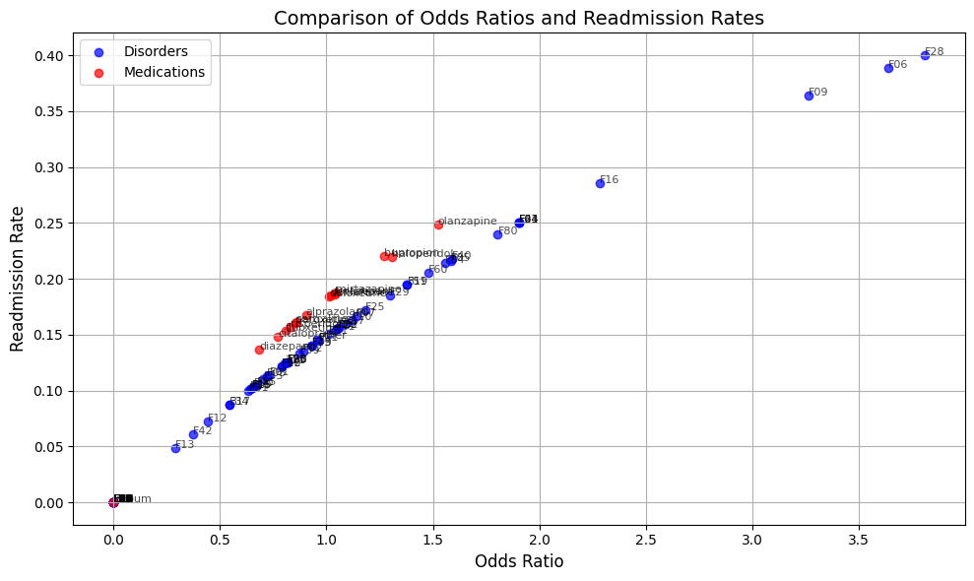
Q1. Identifying psychiatric disorders and psychotropic medications associated with increased ICU readmission.
Define readmision rate

Slide 5
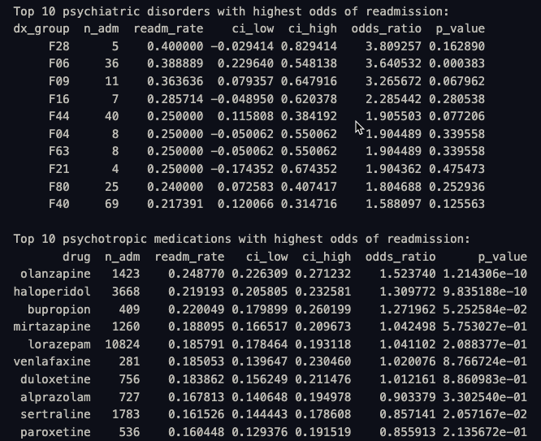
Q1. Identifying psychiatric disorders and psychotropic medications associated with increased ICU readmission.

Slide 6
Q2. Evaluating if discontinuation or improper reconciliation of psychiatric medications at discharge contributes to higher readmission risks.
Readmitted_30d
Drug discont
Last_psych_med_time
dischtime
Cont
Last_psych_med_time
label
features

Slide 7
Q2
Step | Actions | Key methods/Algo | Alternative - Reason | Output
1. Build cohort | Read: • ICU admissions with 30-day readmission flag (icu_psych_readmissions.csv). • timestamp of each admission’s last inpatient psychotropic order (last_prescriptions_processed.csv). • Inner-join on hadm_id → keeps only admissions that received at least one psych med. | pandas.read_csv, merge |  | cohort DataFrame (one row / ICU stay with med info)
2. Flag medication discontinuation | Define boolean psych_discontinued: last med order finished > 24 h before hospital discharge. | Simple time arithmetic (Timedelta('24h')) |  | True = early stop; False = continued/tapered
3. Unadjusted association | - Construct 2 × 2 table: discontinued × readmitted. - Run Fisher’s exact test to get odds ratio (OR) and exact p-value. - Compute readmission rates and Wald 95 % CI for both rows of the table. | scipy.stats.fisher_exact (exact OR, p).Custom rate_ci (Wald). | Pearson Chi-square requires count >=5 | Printed table, OR, p, rates ± CI
4. Adjusted association (still univariate) | Fit a logistic regression with intercept and the discontinuation dummy to estimate log-odds effect and its standard error. | statsmodels.api.Logit (MLE, Wald z-tests). | Multivariable logistic need covariates | model.summary() (β, SE, z, p, CI, LL)

Slide 8

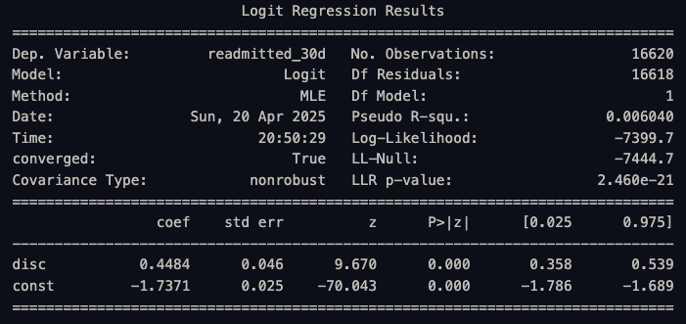
Q2. Evaluating if discontinuation or improper reconciliation of psychiatric medications at discharge contributes to higher readmission risks.

Slide 9
Q3. Identify features influence risk of ICU patients readmission due to psychiatric factors
Predictive model
Psychiatric diagnosis indicators
Pos/neg
Psychotropic medication status
Criteria/Features
Measurements
Demographic
Class/type
ICU/hospital features
Comorbidities
length of stay
SOFA score
first_day_urine_output
first_day_vitalsign
first_day_gcs
first_day_lab
first_day_bg_art
ventdurations
first_day_blood_gas
ventilator_setting
oxygen_delivery
ventilation
complete_blood_count
chemistry
blood_differential
coagulation
enzyme
Dem
Charlson index
SIRS

Slide 10
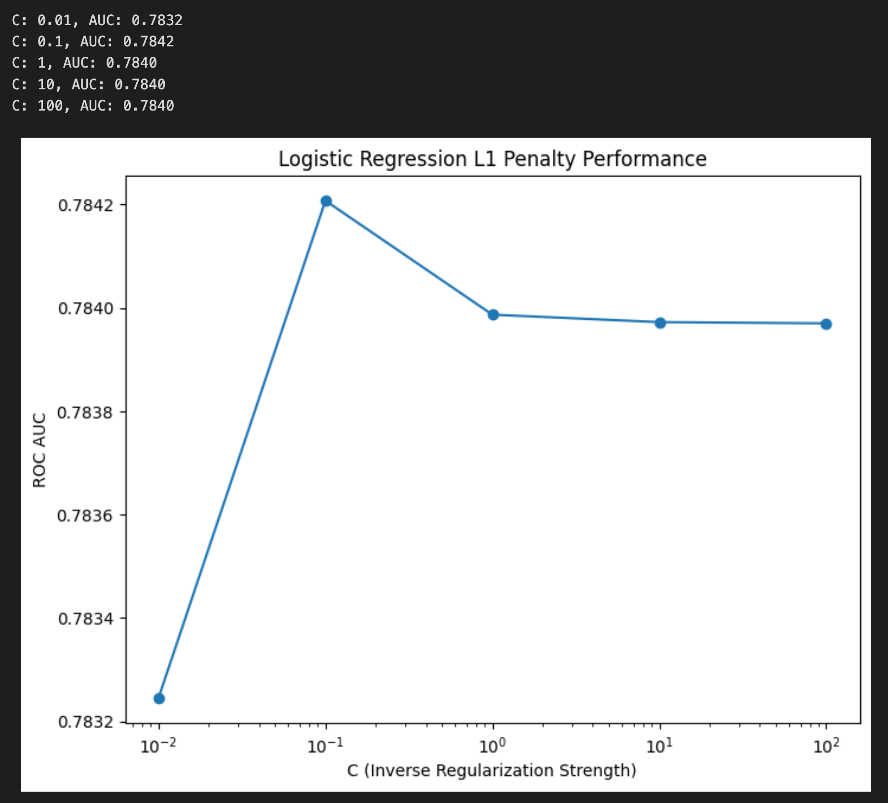
Step | Actions | Main method / algorithm | Output
1. Pre-process data | Standardise numeric columns, one-hot encode categoricals inside a ColumnTransformer. | StandardScaler, OneHotEncoder wrapped in Pipeline | Consistent, model-ready design matrix
2. Fit lasso-regularised logistic regression | Train LogisticRegression(solver="saga", penalty="l1") over a grid of C values, pick C = 0.1. | L1 shrinks coefficients, performs embedded feature selection | Best ROC-AUC printed and plotted
3. Model-level p-value (logistic) | 1 000-fold permutation test with 5-fold CV: shuffle labels, refit, compare AUCs. | permutation_test_score | p_log — probability that a random label assignment gives ≥ observed AUC
4. Coefficient p-values (logistic) | Refit an unpenalised logit in statsmodels on the subset of features whose L1 β ≠ 0; read Wald z-tests. | statsmodels.Logit | Per-feature β, SE, z, p, CI
5. Feature importance (logistic) | Repeated permutation importance on the held-out set. | permutation_importance | Mean drop in AUC per feature (top 15 printed)
6. SHAP / further analysis | (Commented in outline) SHAP can explain LightGBM; not executed here. | shap.TreeExplainer | Potential local/global explanations

Slide 11
Objective 4 plan
Predict readmission rate of Psychologic patients base on admission history

Slide 12
Data
Tables:
./hosp: patients, admissions, diagnoses_icd.
./icu: icustays
MIMIC-IV-Note (NOTEEVENTS.csv in MIMIC-III)

Slide 13
Cohort
Age ≥ 18 yrs
First admission with any F-code in diagnoses_icd | Simple scenario first
Discharged alive (non-deceased) | Need chance to be readmitted.
Gap btw admissions >= 24h

Slide 14
Prediction Windows
Task | Window (days)
Short-term | 1 < t =< 2
 | 1 < =< 4
Mid-term | 1 < t =< 7
 | 1 < t =< 10
Long-term | 1 < t =< 15
 | 1 < t =< 30

Slide 15
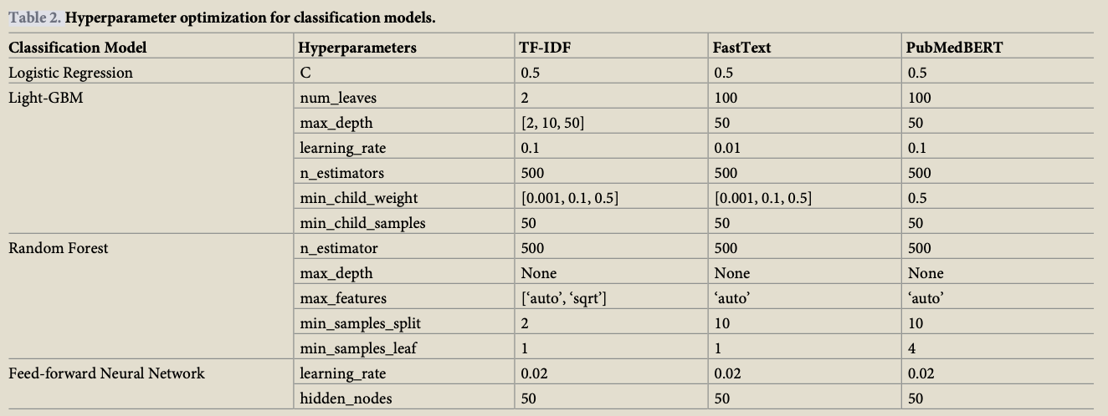
Feature extraction
Technique | Best Settings | Notes
TF-IDF | max_features= 5000 | Simple, high signal; top performer in mortality
FastText | 300-d avg-embedding | Captures morphology; light compute.
ClinicalBERT / PubMedBERT | Token limit 512, block & average trick | Keeps context; follow same truncation-block method in the paper to avoid losing long notes.

Slide 16
Modeling
 | Extraction/Model | Hyper-params (start) | Notes
Baseline | Logistic regression | C = 0.5; class_weight = “balanced” | Strong baseline, interpretable.
 | LightGBM | leaves = 100, depth = 50 | Handles non-linearities.
 | Random forest | 500 trees | Robust to noise.
 | 3-layer FFNN | 768-200-50-1, LR = 0.02 | Matches paper for fair comparison.
New | ClinicalBERT (2020) |  | Trained on MIMIC-III
 | RETAIN (2016) |  | Interpretable RNN that weighs past visits; good if feed multiple prior admissions.
 | TabNet |  | Learns sparse feature masks—can focus on a few labs or terms per patient.

Slide 17
Evaluation
Hold-out 20 % test set, patient-level split.
Metrics: AUROC, F1
Handle imbalance with class weights.

