Slide 2
Q1. Identifying psychiatric disorders and psychotropic medications associated with increased ICU readmission.
Icustays.csv
Admission.csv patients.csv
All adult patients (≥18 years)
diagnoses_icd
d_icd_diagnoses
ICU patients with ICD-9/10 diagnoses codes indicating psychiatric disorders:
ICU stay linked to a valid hospital admission (hadm_id) and patient (subject_id).
First ICU admission per hospitalization.
'296', '295', '303', '304', '305', 'F20', 'F21', 'F22', 'F23', 'F24', 'F25',
'F28', 'F29', 'F30', 'F31', 'F32', 'F33', 'F34', 'F39', 'F10', 'F11', 'F12',
'F13', 'F14', 'F15', 'F16', 'F17', 'F18', 'F19', 'F40', 'F41', 'F42', 'F43',
'F44', 'F45', 'F48', 'F50', 'F51', 'F52', 'F53', 'F54', 'F59', 'F60', 'F61',
'F62', 'F63', 'F64', 'F65', 'F66', 'F68', 'F69', 'F70', 'F71', 'F72', 'F73',
'F74', 'F75', 'F78', 'F79', 'F80', 'F81', 'F82', 'F83', 'F84', 'F88', 'F89',
'F90', 'F91', 'F92', 'F93', 'F94', 'F95', 'F98', 'F99'
prescriptions
d_items
'haloperidol', 'risperidone', 'quetiapine', 'olanzapine', 'lorazepam', 'diazepam', 'alprazolam’, 'fluoxetine', 'sertraline', 'citalopram', 'escitalopram', 'paroxetine', 'venlafaxine', 'duloxetine’, 'bupropion', 'mirtazapine', 'valproate', 'lithium'

Slide 3
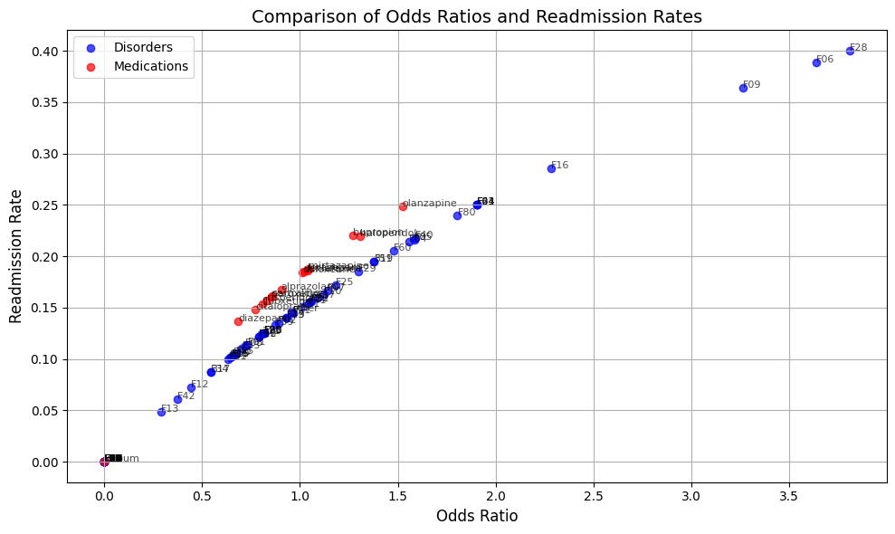
Q1. Identifying psychiatric disorders and psychotropic medications associated with increased ICU readmission.
Define readmision rate

Slide 4
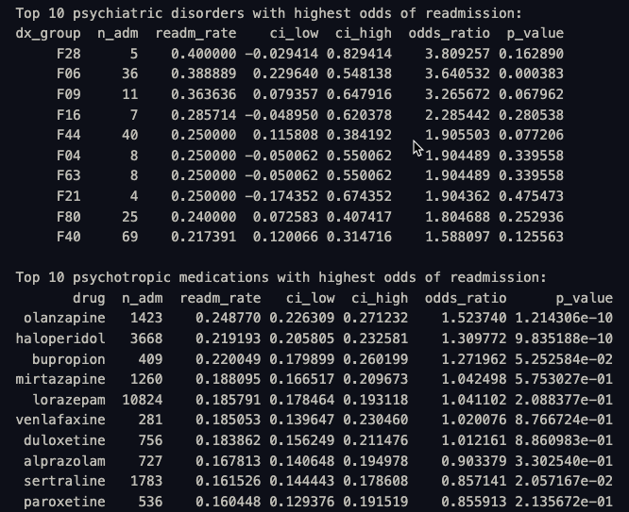
Q1. Identifying psychiatric disorders and psychotropic medications associated with increased ICU readmission.

Slide 5
Q2. Evaluating if discontinuation or improper reconciliation of psychiatric medications at discharge contributes to higher readmission risks.
Readmitted_30d
Drug discont
Last_psych_med_time
dischtime
Cont
Last_psych_med_time
label
features

Slide 6

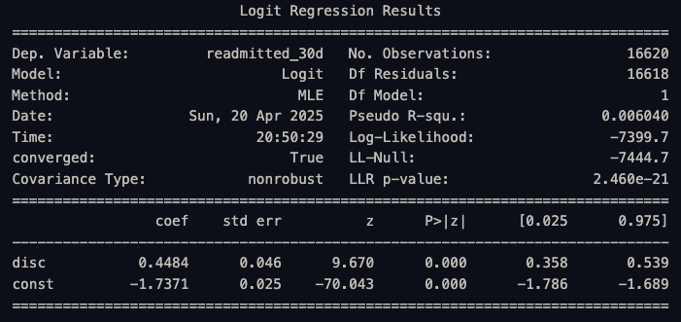
Q2. Evaluating if discontinuation or improper reconciliation of psychiatric medications at discharge contributes to higher readmission risks.

Slide 7
Q3. Identify features influence risk of ICU patients readmission due to psychiatric factors
Predictive model
Psychiatric diagnosis indicators
Pos/neg
Psychotropic medication status
Criteria/Features
Measurements
Demographic
Class/type
ICU/hospital features
Comorbidities
length of stay
SOFA score
first_day_urine_output
first_day_vitalsign
first_day_gcs
first_day_lab
first_day_bg_art
ventdurations
first_day_blood_gas
ventilator_setting
oxygen_delivery
ventilation
complete_blood_count
chemistry
blood_differential
coagulation
enzyme
Dem
Charlson index
SIRS

Slide 8
Objective 4 plan
Predict readmission rate of Psychologic patients base on admission history

Slide 9
Data
Tables:
./hosp: patients, admissions, diagnoses_icd.
./icu: icustays
MIMIC-IV-Note (NOTEEVENTS.csv in MIMIC-III)

Slide 10
Cohort
Age ≥ 18 yrs
First admission with any F-code in diagnoses_icd | Simple scenario first
Discharged alive (non-deceased) | Need chance to be readmitted.
Gap btw admissions >= 24h

Slide 11
Prediction Windows
Task | Window (days)
Short-term | 1 < t =< 2
 | 1 < =< 4
Mid-term | 1 < t =< 7
 | 1 < t =< 10
Long-term | 1 < t =< 15
 | 1 < t =< 30

Slide 12
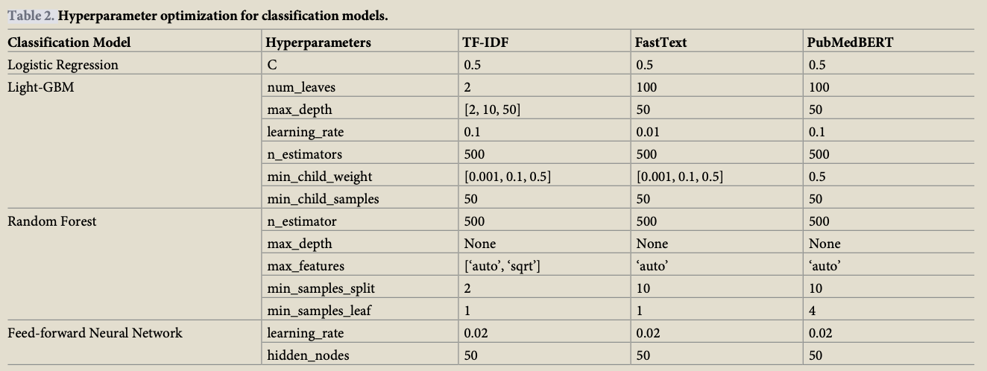
Feature extraction
Technique | Best Settings | Notes
TF-IDF | max_features= 5000 | Simple, high signal; top performer in mortality
FastText | 300-d avg-embedding | Captures morphology; light compute.
ClinicalBERT / PubMedBERT | Token limit 512, block & average trick | Keeps context; follow same truncation-block method in the paper to avoid losing long notes.

Slide 13
Modeling
 | Extraction/Model | Hyper-params (start) | Notes
Baseline | Logistic regression | C = 0.5; class_weight = “balanced” | Strong baseline, interpretable.
 | LightGBM | leaves = 100, depth = 50 | Handles non-linearities.
 | Random forest | 500 trees | Robust to noise.
 | 3-layer FFNN | 768-200-50-1, LR = 0.02 | Matches paper for fair comparison.
New | ClinicalBERT (2020) |  | Trained on MIMIC-III
 | RETAIN (2016) |  | Interpretable RNN that weighs past visits; good if feed multiple prior admissions.
 | TabNet |  | Learns sparse feature masks—can focus on a few labs or terms per patient.

Slide 14
Evaluation
Hold-out 20 % test set, patient-level split.
Metrics: AUROC, F1
Handle imbalance with class weights.

