Slide 1
E-Pharmacy
Team: PharmaDAD
(Zhomartuly Almas, Tokmukhanbet Daulet, Dauren Khametov)

Slide 2
Medicine
The emergence of new medicines
The increase in the cost of medicines
All these factors contributed to the creation of this project.

Slide 3
Introduction. Why is it important?
Pharmacists are the first port of call in a health crisis, and sometimes even saves lives! Care beyond prescriptions and medicine.
What makes our project different from others. We have focused on the conditions of pandemics from the beginning. We made our service easy, fast, affordable.

Slide 4
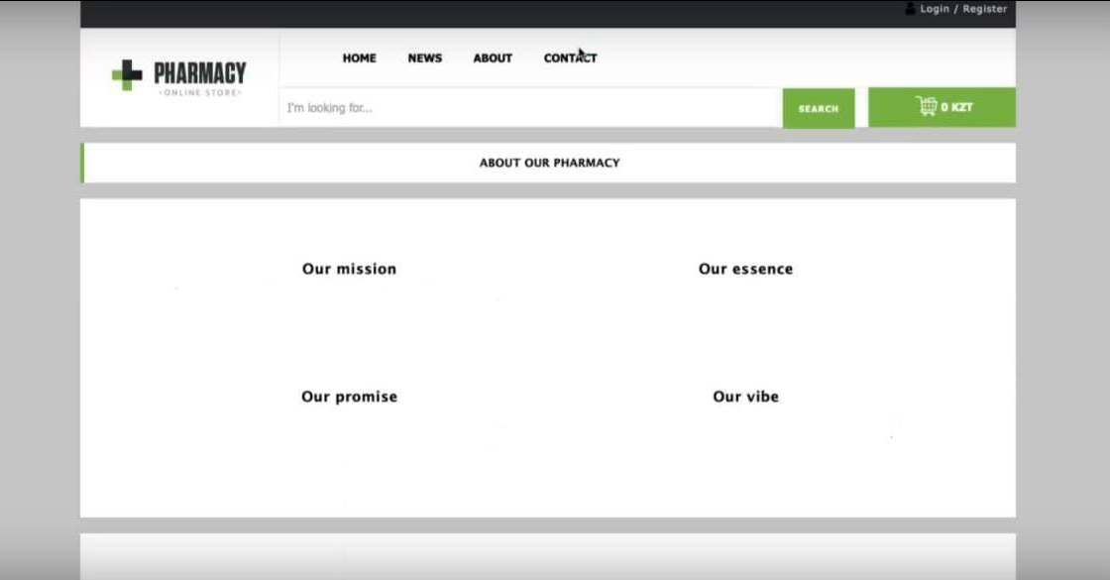

Slide 5
Statistic for 21/04/2021
During the pandemics, changes also affected the pharmaceutical industry. We, in turn, contributed to this. This had to be modified, improved, because pharmaceuticals play an important role in the life of a person's health. Pandemic - Online format of work / training - Online purchases / services.
13%
87%
Recovered
Lethal outcomes

Slide 6
Pharmaceutical problems encountered during pandemics.
01
02
03
04
Disruption of the global supply chain in the pharmaceutical sector, which entails an increase in the cost of active pharmaceutical ingredients (APIs).
Intensive care medicine shortages and bottlenecks in their production / distribution.
The decline in demand for prescription drugs due to the minimization of patients' contact with the healthcare system and a change in the mechanism of interaction between patients and doctors.

