Slide 1

Machine Learning Based Modelling of Spatial Data Using R Language
Laboratorium Analisis Lingkungan dan Geospasial Modeling
©2023 Ziyadatul Hikmah | Analisis Spasial Lingkungan

Slide 2
Concept of Spatial Model
Spatial Data
Input
Phenomena
Raster
Vektor
Past
Present
Prediction
Output
Future
Classification
Regression
Dynamic
Static
Statistic Model

Slide 3
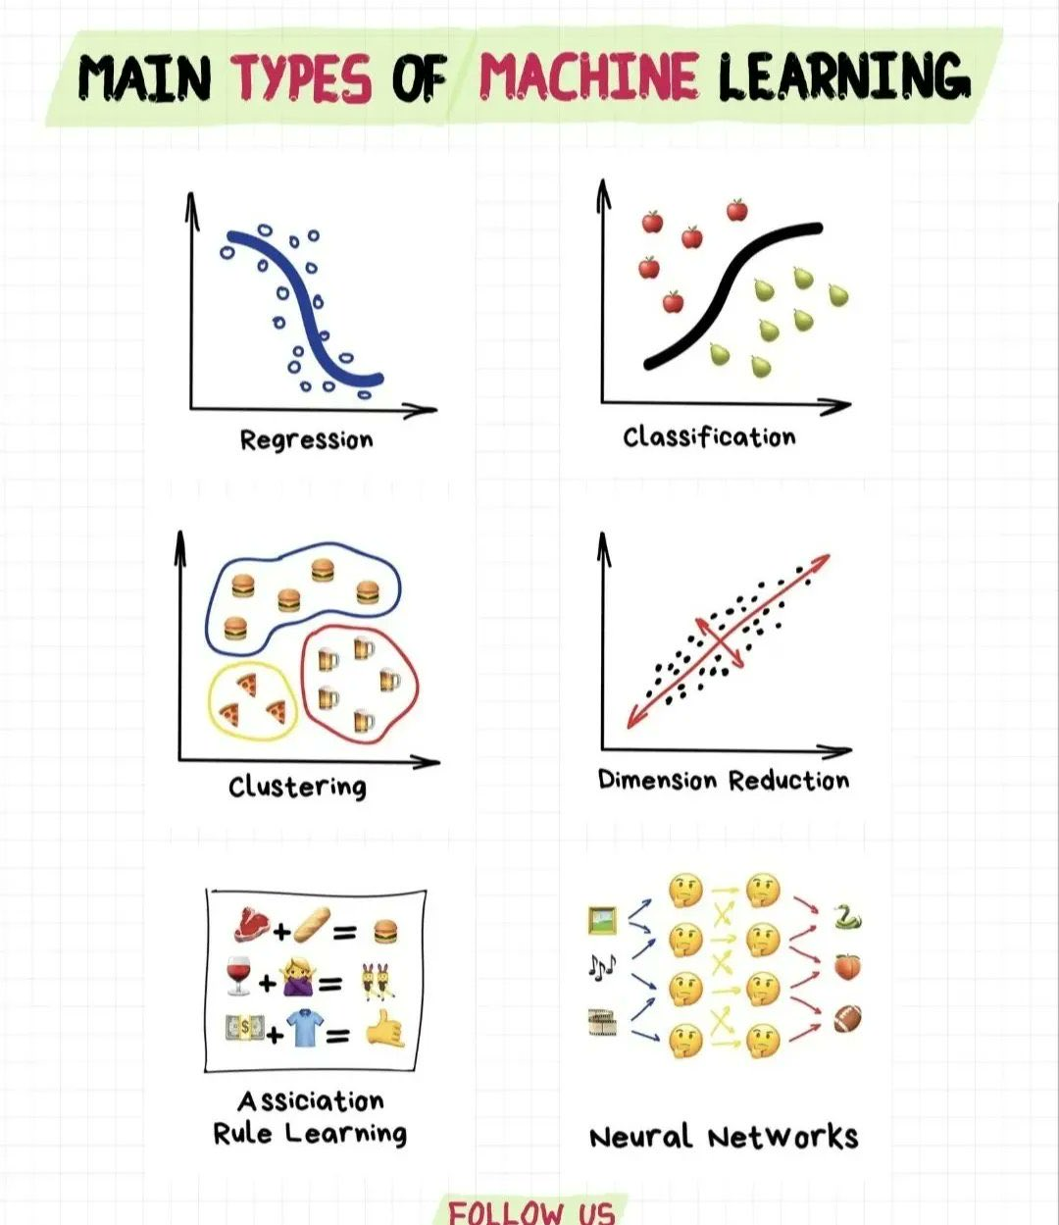
Machine Learning in R
Many packages for different ML algorithms (e.g. Random Forests, Neural Networks, Support Vector Machines, ...)
Main type of machine learning

Slide 4
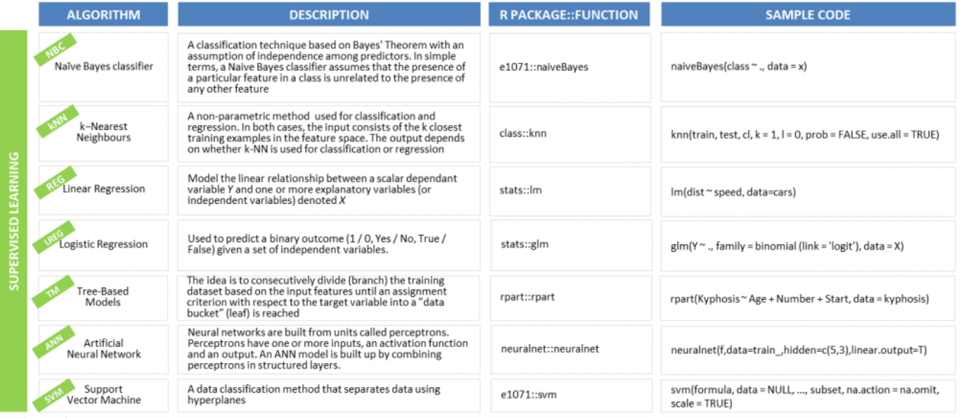
Machine Learning Modelling in R :: Cheat Sheet
Supervised & Unsupervised Learning

Slide 5
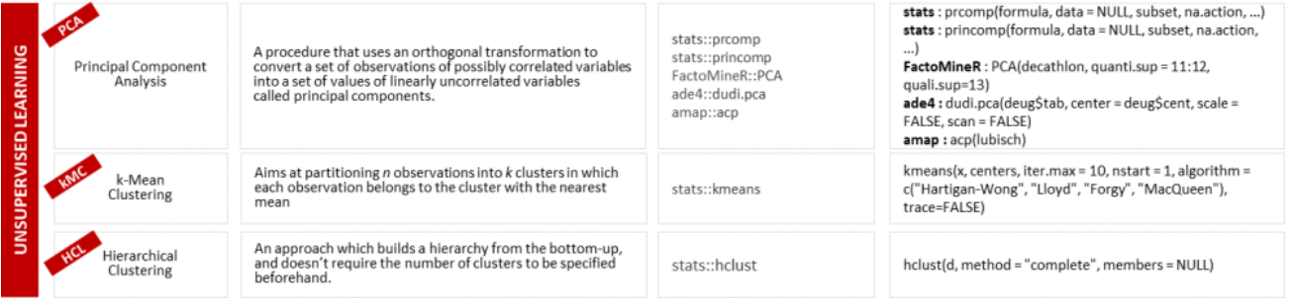
Machine Learning Modelling in R :: Cheat Sheet
Supervised & Unsupervised Learning

Slide 6
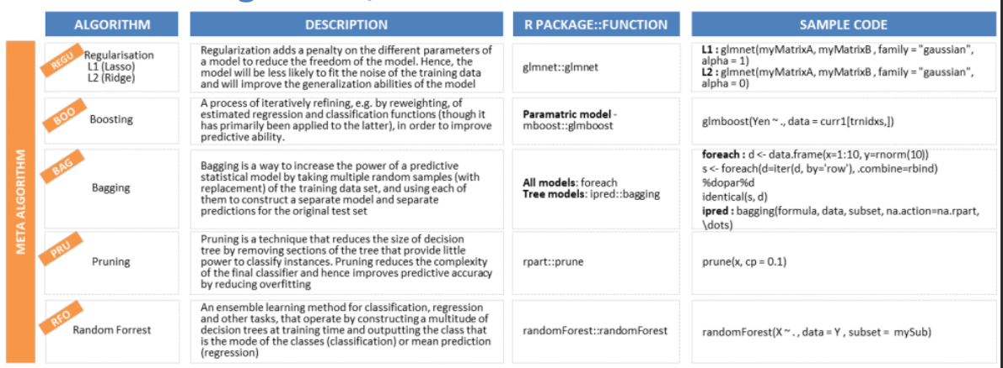
Machine Learning Modelling in R :: Cheat Sheet
Meta-Algorithm, Time Series & Model Validation

Slide 7
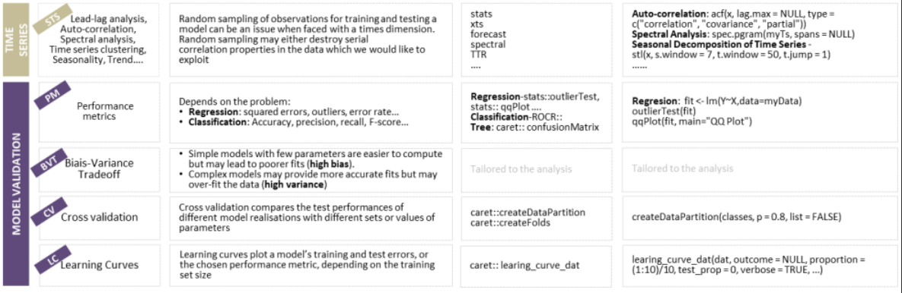
Machine Learning Modelling in R :: Cheat Sheet
Meta-Algorithm, Time Series & Model Validation

Slide 8
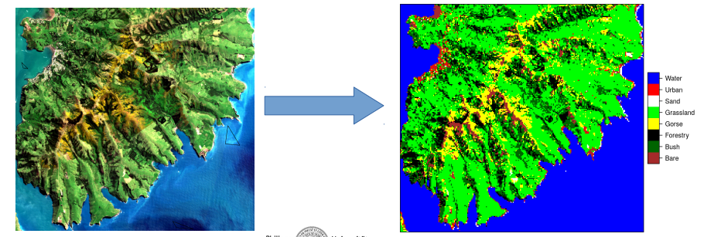
Outlook Computer Practice!
Case study: Land cover classification with ML in R
Task: identify the invasive gorse (Ulex europaeus) on the Banks Peninsula in New Zealand based on Sentinel satellite data
Technical Focus: Random Forest model training and spatial prediction
Material: https://github.com/HannaMeyer/Geostat2018/
Data: Sentinel spectral channel (sentinel2017.grd) and polygon containing training sites (trainingSites.shp)

Slide 9
So, let’s get started!

Slide 10
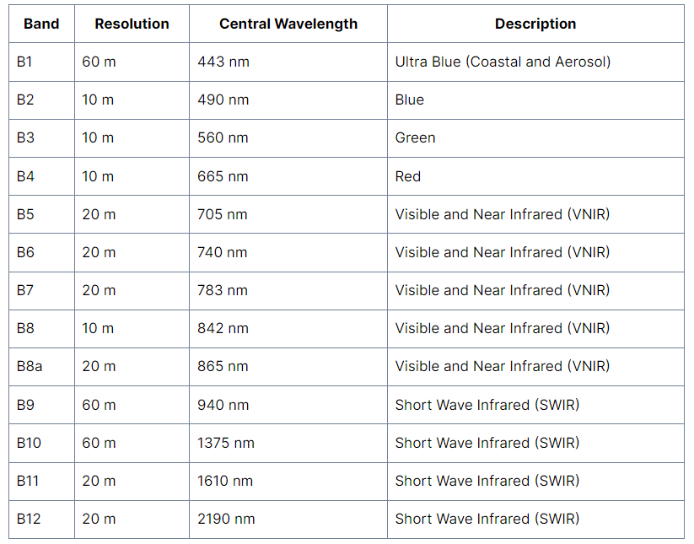
Sentinel 2 Bands

Slide 11
Sentinel 2 Band Combinations
Combinations | Channels
Natural color | Red (B4), green (B3), blue (B2)
Color infrared | Near-infrared (B8), red (B4), green (B3)
Short-wave infrared | SWIR-2 (B12), NIR (B8A), red (B4)
Agriculture | SWIR-1 (B11), near-infrared (B8), blue (B2)
Geology | SWIR-2 (B12), SWIR-1 (B11), blue (B2)
Bathymetric | Red (B4), green (B3), coastal band (B1)
Vegetation index/ NDVI | (B8-B4)/(B8+B4)
Yellowness index | (B4+B3-B2)/(B4+B3+B2)
Moisture index | (B8A-B11)/(B8A+B11)
https://gisgeography.com/sentinel-2-bands-combinations/

Slide 12
Thank you

