Slide 1
#UNITEDBYHCL SalesMax.ai – For DHL
TEAM NAME:
Mohammad Nurdin bin Norazan
Esa Ezzatinor bin Abdul Hamid
Nurul Azrin binti Mohd Nasir

Slide 2
Abstract/Description of system
SalesMax.ai is Artificial Intelligence-powered tool that allows maximization of potential sales revenue for DHL. It uses predictive analysis and sentiment analysis at the core of its engine.

Slide 3
Problem Statement
Getting new customers is a tough task for sales team doing B2B deals.
Maintaining the existing customers and keeping them happy is an even bigger challenge.

Slide 4
Introduction
SalesMax.ai is Artificial Intelligence-powered tool that allows maximization of potential sales revenue for DHL. It uses predictive analysis and sentiment analysis at the core of its engine, which allows:
Identification of high potential prospects which should be targeted by sales agent using predictive analysis
Prediction of existing customers who are most likely to terminate business dealings using sentiment analysis on social media
Predict which center agents are most likely to quit and the primary drivers for attrition to reduce turnover

Slide 5
Objectives
Agent Churn - Predict which center agents are most likely to quit and the primary drivers for attrition to reduce turnover and decrease hiring expenses
Customer Churn - Predict which customers are most likely to stop using DHL services and integrate with DHL CRM to enhance sales center agent knowledge
Cross Sell Opportunities - Predict which customers are most likely to accept a new offer or service and integrate with DHL CRM to improve revenue by targeted selling

Slide 6
Methodology/Framework - Classification
Input (dataset)
Describe the statistic
Data cleaning, integration, selection & transformation
Classify using Random Forest
Interpretation & evaluation
Dataset from DHL (Customer-country_data_5-5.csv)
Algorithmic scoring: Random forest classifier

Slide 7
Methodology/Framework - Clustering
Input (dataset)
Describe the statistic
Data cleaning, integration, selection & transformation
Cluster using PCA
Interpretation & evaluation
Dataset from DHL (Opportunities_examples.csv)
Algorithmic scoring: PCA Dimension Reduction

Slide 8
Methodology/Framework – Sentiment Analysis
Input (keyword)
Streaming twitter data
Data Pre-processing
Algorithmic scoring of tweets
Classified tweets
Report based on consumer behaviour
Input (keyword) or query term by a user: DHL, USPS, FedEx
Streaming : a few of samples of data of keyword
Data Pre-processing: remove unwanted words as below
Short forms
Numbers
Punctuation
Stop words
URL
Icon
Repeated letters

Slide 9
Methodology/Framework – Sentiment Analysis
Algorithmic scoring of tweets: Random forest classifier
Classified tweets: tweets are classified into 3-tier
Positive | Positive indicator on topic (e.g.: like, excited, happy)
Neutral | Neither positive nor negative indicators Mixed positive and negative indicators On topic, but indicator undeterminable Simple factual statements Questions with no strong emotions indicated
Negative | Negative indicator on topic (e.g: don’t, dislike, angry)

Slide 10
Solution
DHL Engine
Predictive Analysis
Sentiment Analysis

Slide 11
How it Works
Internal & external data
Analysis
Visualization

Slide 12
Techniques or Algorithms/ Tools Used
PCA Dimension Reduction
Random Forest Approach
Mostly used proven in research paper.
Mostly used proven in research paper.
It’s better compare to Lexicon and Max Entropy approaches.
Used for predictive analysis to predict customer churn and potential customer.
Used for sentiment analysis on social media such as Facebook & Twitter.

Slide 13
Significant/Novelty
Go internationally as it support Multilanguage such as Malay, English, Spain, Japan, Italy
Domain focus on logistic sector
Use for future work for getting customer sentiment on logistic sector
Identify the possibility churn of customers
Identify the customer loyalty/positivity towards the services

Slide 14
Advantages
Reduce time consuming to gathering the data
Reduce the cost for getting the data
Go green as it is paperless
Easy to get as many type of data from twitter posting made by many people

Slide 15
Disadvantages
Not all user use twitter to express their thought
Need expertise to develop the software

Slide 16
References
Chamlertwat, W., Bhattarakosol, P., Rungkasiri, T., & Haruechaiyasak, C. (2012). Discovering Consumer Insight from Twitter via Sentiment Analysis. J. UCS, 18(8), 973-992.
Liu, B. (2012). Sentiment analysis and opinion mining. Synthesis lectures on human language technologies, 5(1), 1-167.
Golinelli, R., & Parigi, G. (2004). Consumer sentiment and economic activity. Journal of Business Cycle Measurement and Analysis, 2004(2), 147-170.
Taboada, M., Brooke, J., Tofiloski, M., Voll, K., & Stede, M. (2011). Lexicon-based methods for sentiment analysis. Computational linguistics, 37(2), 267-307.
Jansen, B. J., Zhang, M., Sobel, K., & Chowdury, A. (2009). Twitter power: Tweets as electronic word of mouth. Journal of the American society for information science and technology, 60(11), 2169-2188.
L. Breiman, “Random Forests”, Machine Learning, 45(1), 5-32, 2001.
Go, A., Bhayani, R., & Huang, L. (2009). Twitter sentiment classification using distant supervision. CS224N Project Report, Stanford, 1(12).

Slide 17
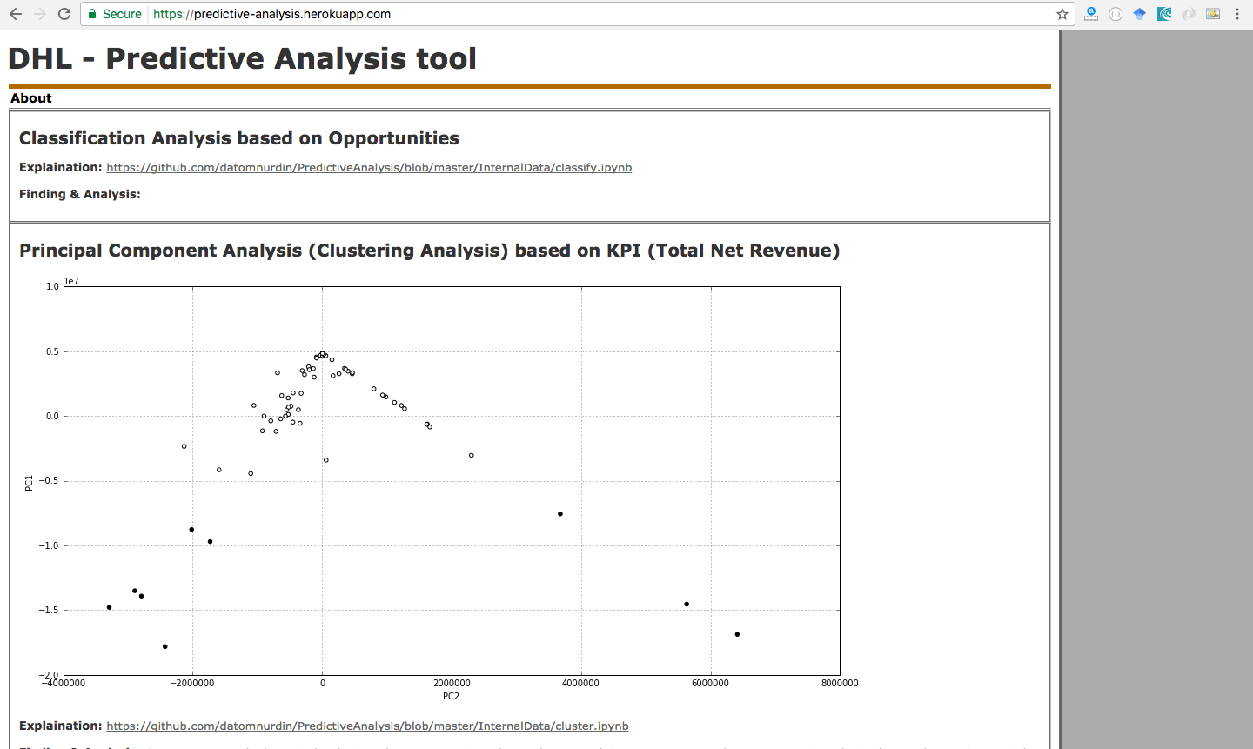
Appendix

Slide 18
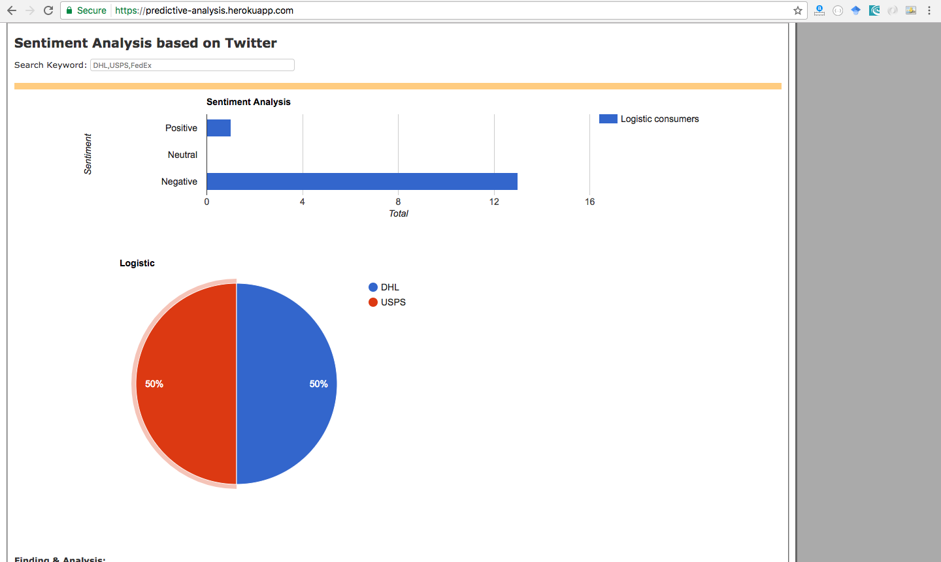
Appendix

Slide 19
Appendix
Demo: https://predictive-analysis.herokuapp.com/
Repository link: https://github.com/datomnurdin/PredictiveAnalysis
Instructions to run:
Classification >> https://github.com/datomnurdin/PredictiveAnalysis/blob/master/InternalData/classify.ipynb
Clustering >> https://github.com/datomnurdin/PredictiveAnalysis/blob/master/InternalData/cluster.ipynbSentiment
Analysis >> https://github.com/datomnurdin/PredictiveAnalysis/blob/master/ExternalData/README.md

Slide 20
Thank You ☺

