Slide 1
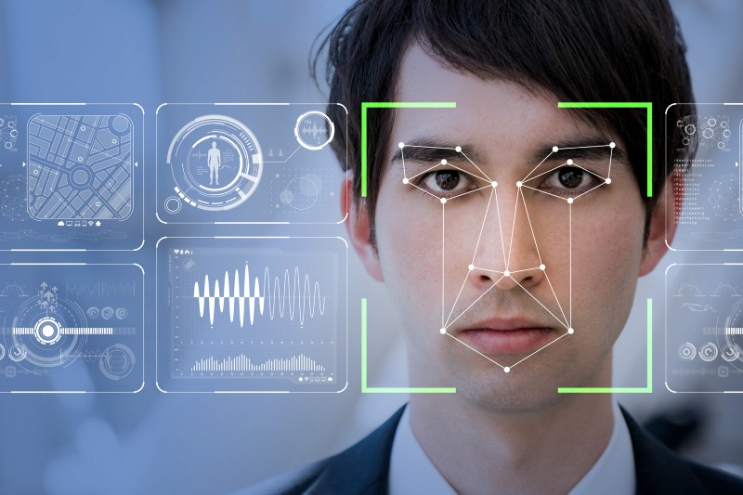
Facial recognition
Avoid a fight in venues with Nonlutte app

Slide 2

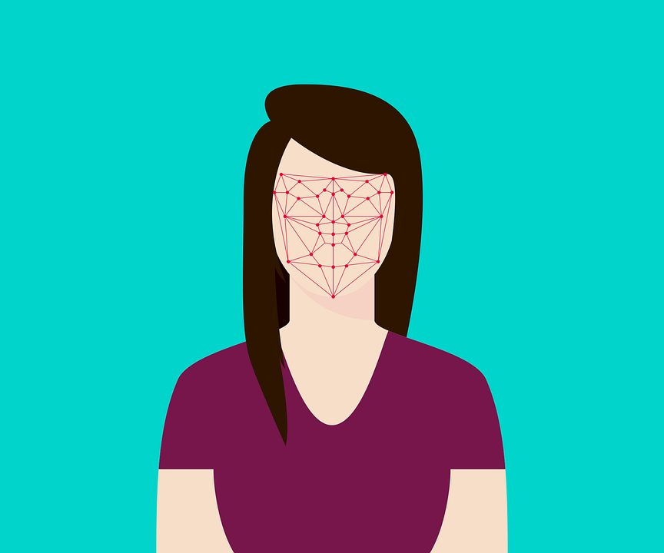
Easy to Implementation and accurateness much better
Emotion Detection APP
The emotions detected are anger, disgust, fear, happy, sad, surprised, and normal. These emotions are understood to be cross-culturally and universally communicated with particular facial expressions.

Slide 3
About the Project
Our model converts the video into vectors of video level feature extracts and to introduce knowledge transfer a largescale emotion-centric auxiliary image set is being used to classify the emotions.

Slide 4




Overview of the System
Key Benefit
Quick and easy. Check each person for less than 5 seconds
Accurate and objective. Different thresholds can be set for objective screening.
The Two main stages in the system are:
Feature extraction
Feature classification
The feature extraction stage involves pre-processing stages such as acquiring a sequence of images (15 frames/second) using a video camera and detecting the facial region of the image and standardizing the properties for lighting the image , this application BRIEF feature extraction is being used.
Friendly shielding. No contact and no interference.
Intelligent early warning. Real-time dynamic early warning function.

Slide 5
Facial Expression Recognition with Keras

Slide 6
Approach
Data Collection
Model Building
Model Evaluation
Testing

Slide 7

Data Collection
We would apply convolutional neural networks to tackle this task. And we will construct CNN with Keras using TensorFlow backend.
Dataset
The both training and evaluation operations would be handled with Fec2013 dataset. Compressed version of the dataset takes 92 MB space whereas uncompressed version takes 295 MB space. There are 28K training and 3K testing images in the dataset. Each image was stored as 48×48 pixel. The pure dataset consists of image pixels (48×48=2304 values), emotion of each image and usage type (as train or test instance).

Slide 8
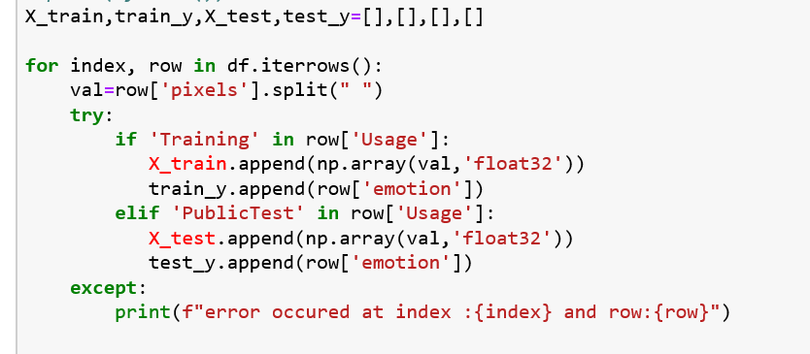
Model Building & Training
Train and test set can be stored into dedicated variables.

Slide 9
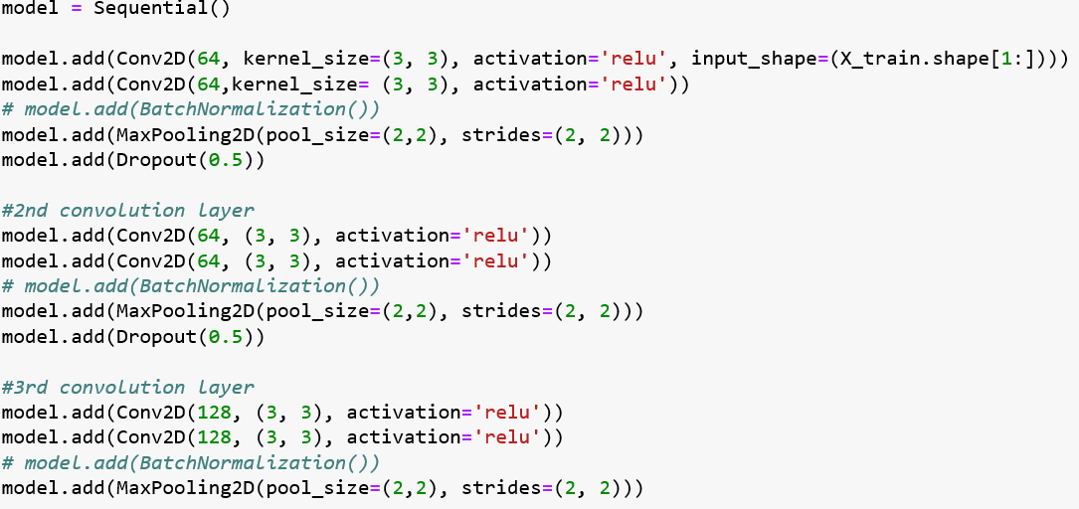
CNN structure

Slide 10
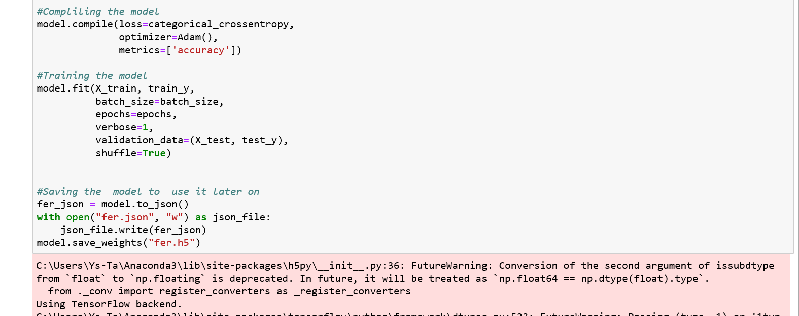
Model Saving

Slide 11
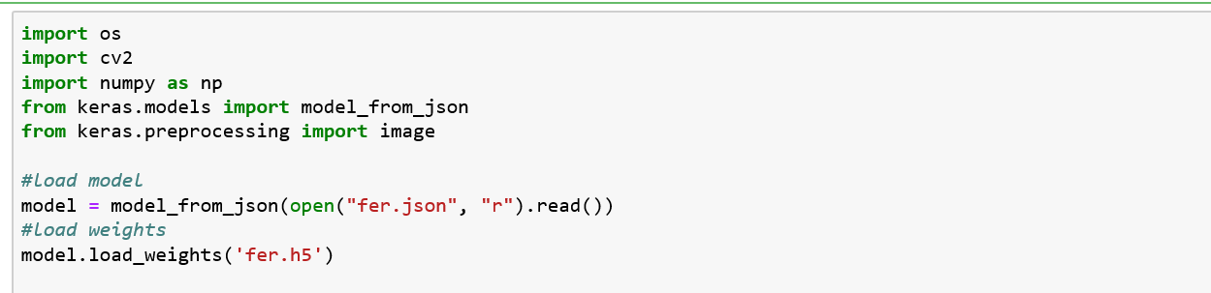
Load Model

Slide 12
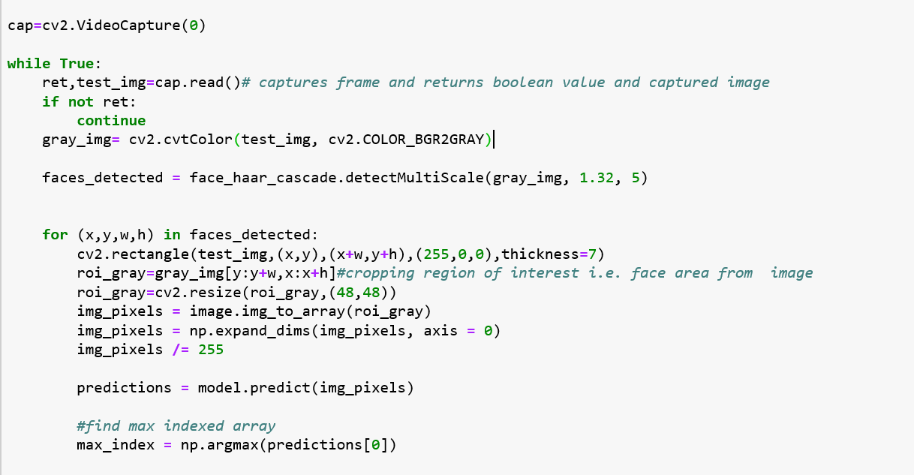
Using OpenCV
Read an image

Slide 13
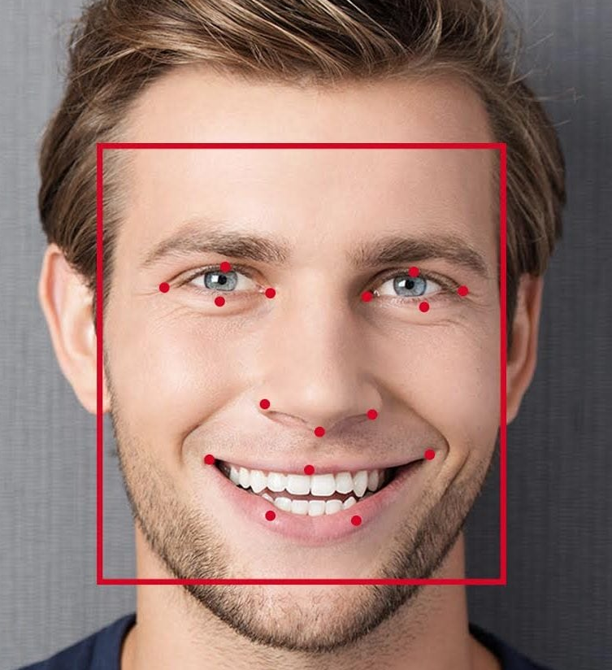
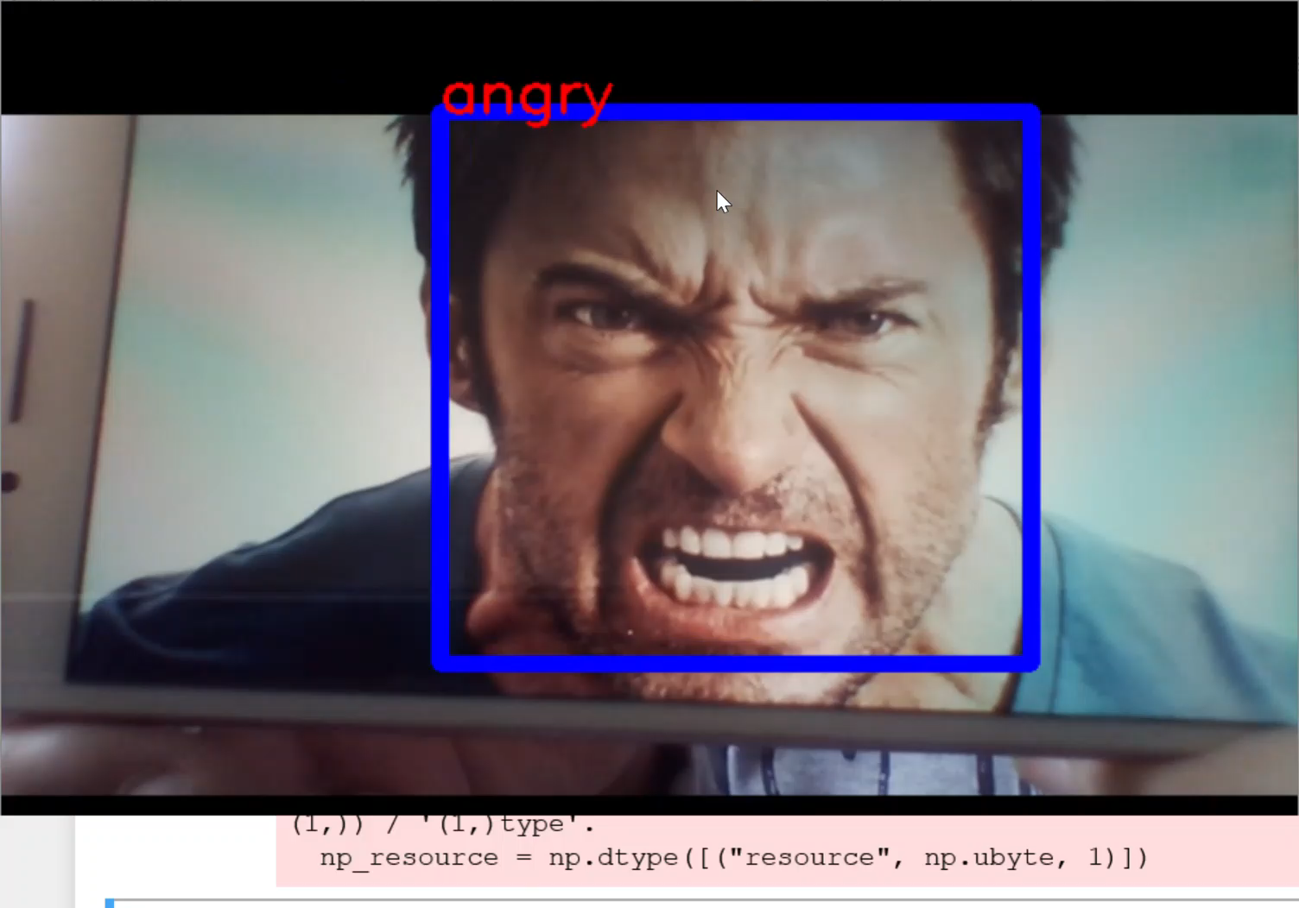
Real time solution
Besides, we can apply emotion analysis on a video streaming or web cam capturing. We try to act all emotion classes. As seen, this implementation runs very fast.

Slide 14
Resource
https://github.com/BishalLakha/Facial-Expression-Recognition-with-Keras
https://sefiks.com/2018/01/01/facial-expression-recognition-with-keras/
https://opencv-python-tutroals.readthedocs.io/en/latest/py_tutorials/py_gui/py_image_display/py_image_display.html
https://www.youtube.com/watch?v=DtBu1u5aBsc

Slide 15
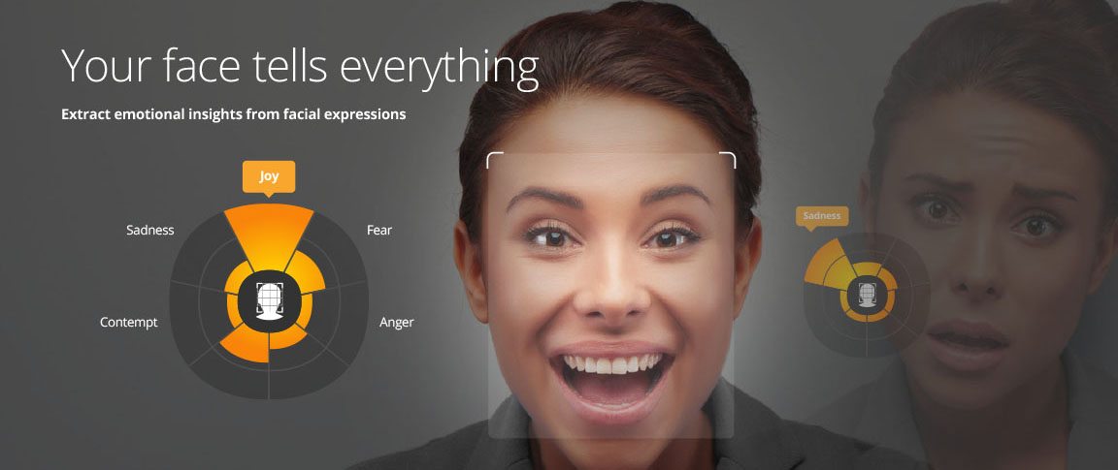
Thank you

