Slide 1
Brazilian E-Commerce Public Dataset by Olist
Presented by: Dat Phung
Course: Data Science - CoderSchool
Last Updated: September 9, 2022

Slide 2
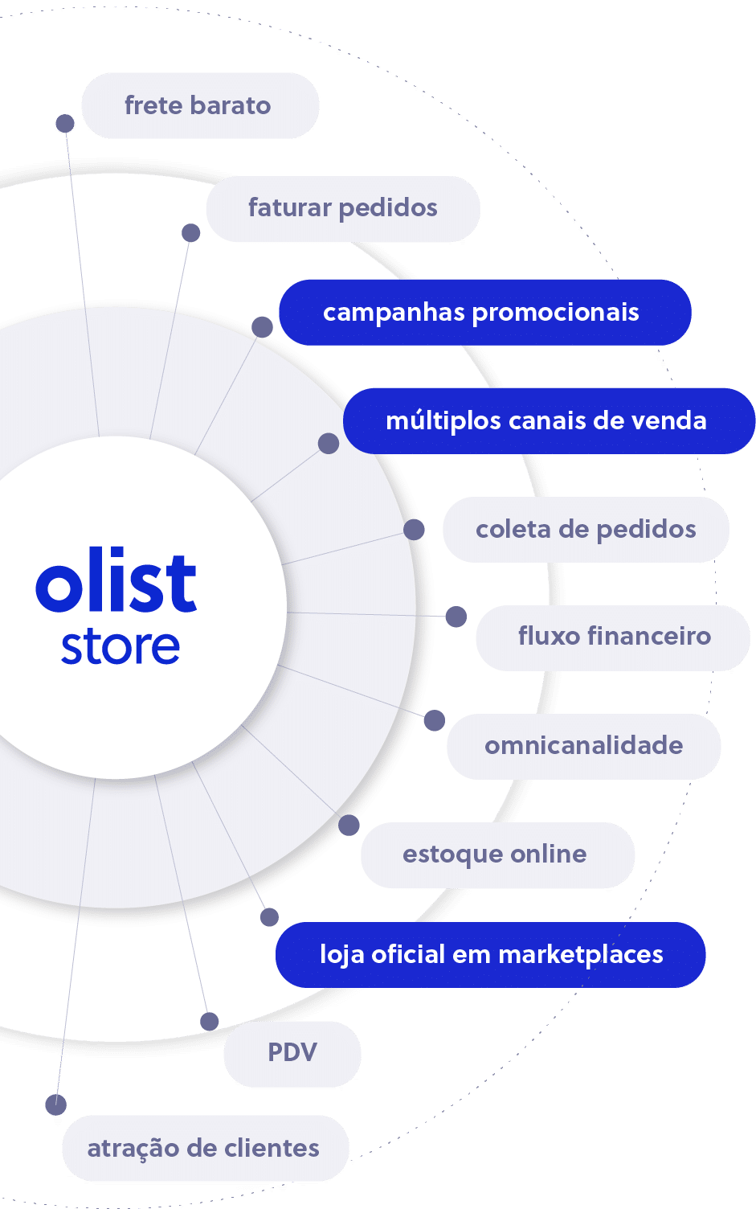

No. Sellers
3095
No. Buyers
96096
No. Orders
99092
https://www.kaggle.com/datasets/olistbr/brazilian-ecommerce
Notes:
Them6 thoi72 gian

Slide 3
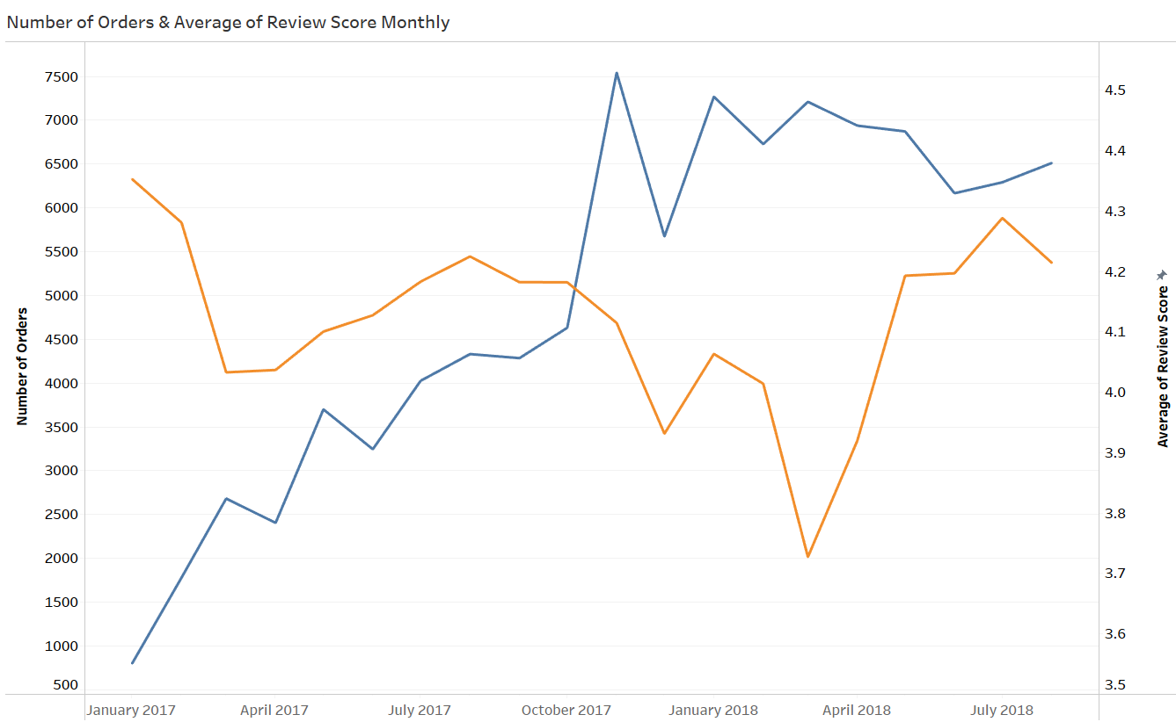

Order growth unusual since 11-2017 go with lots of 1 & 2-star reviews
Notes:
Average review score / total number of orders

Slide 4
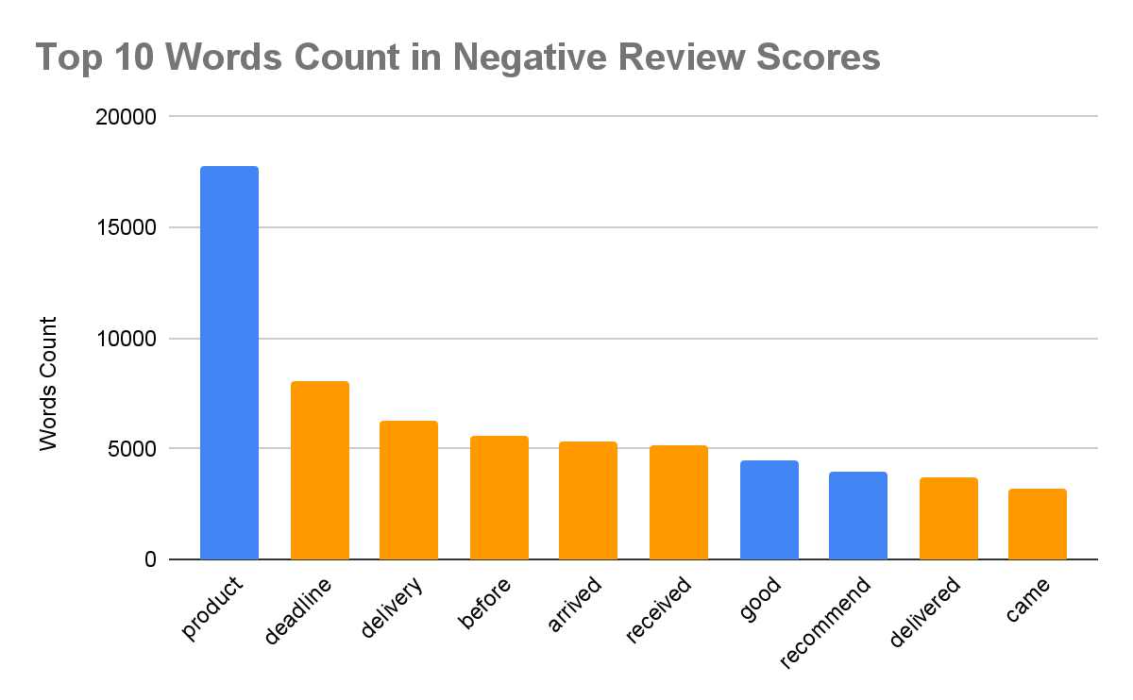
Slow delivery, not as expected, damaged package → Delivery
58%
Notes:
( negative review danh gia 1 sao 2 sao)

Slide 5
Does delivery affect the number of orders?
How Can Olists Improve Delivery To Boost Their Orders Number?
Table of Contents
Does delivery affect the number of orders?
Delivery Late Rate
Delivery Time
Delivery Fee
Conclusion
Solution & Evaluation

Slide 6
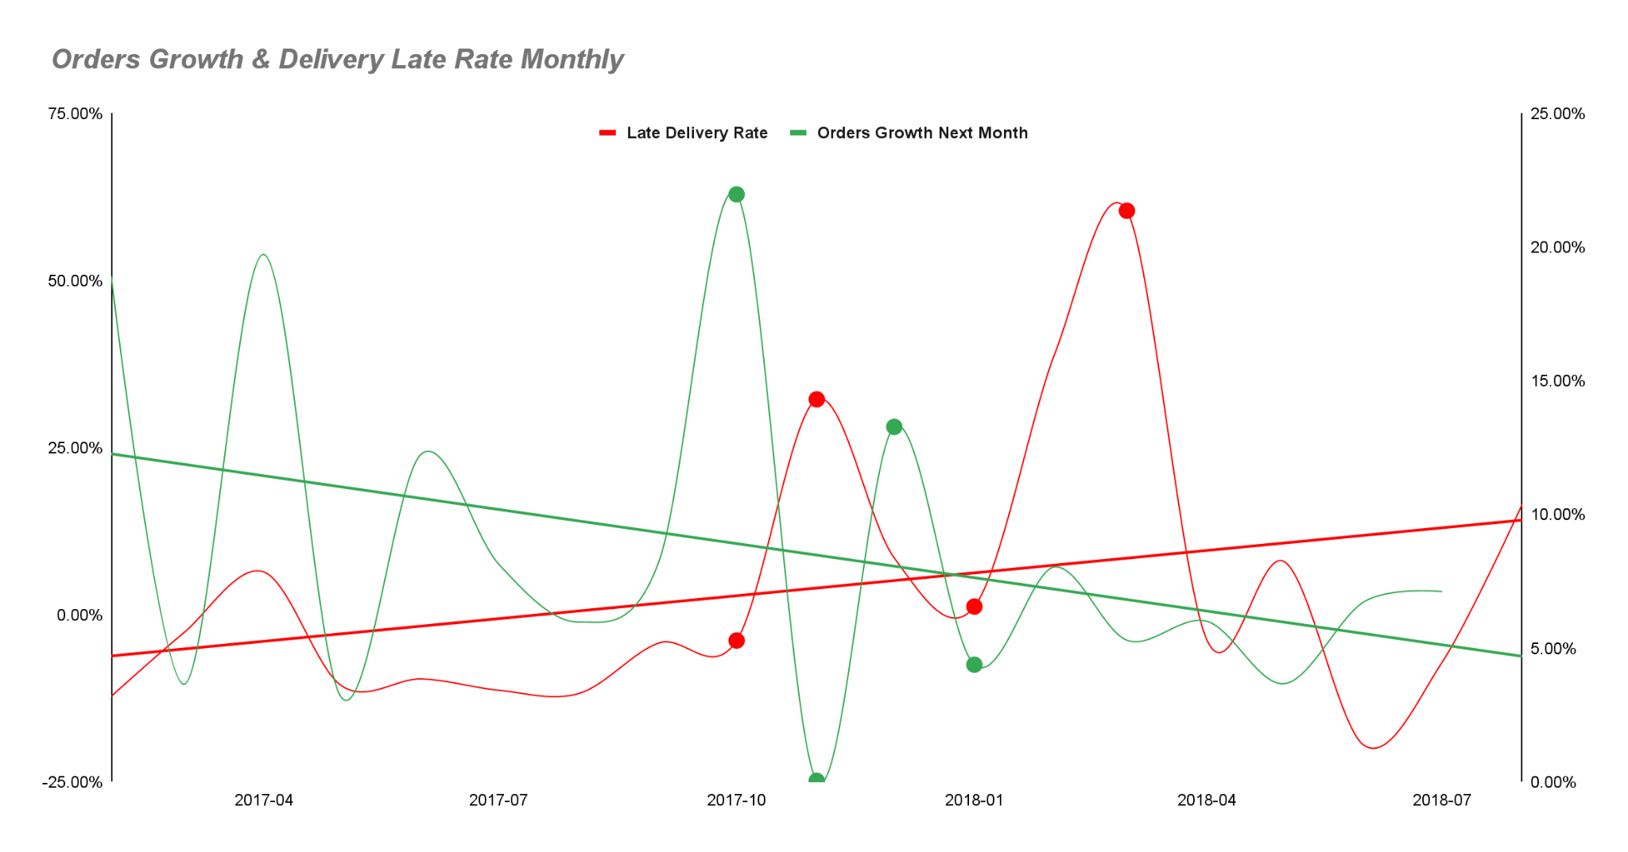
There has been a significant change since 10-2017
The order growth rate increased strongly
The delivery late rate decreased strongly
Correlation between Late Delivery Rate & Orders Growth
Delivery Late Rate
Order Growth
Delivery Late Rate
Notes:
Chú thích ,
Trend line mờ hơn
Không nên chấm đỡ rối, box đậm hơn

Slide 7
“ The results indicate that small delivery delays up to two weeks decrease the sales by maximum 10% during a period of 3–4 weeks” refer to
Niemi, T., Hameri, A.-P., Kolesnyk, P. and Appelqvist, P. (2020), "What is the value of delivering on time?", Journal of Advances in Management Research, Vol. 17 No. 4, pp. 473-503. https://doi.org/10.1108/JAMR-12-2019-0218
Delivery Late Rate
Order Growth
Delivery Late Rate
Notes:
Chú thích ,
Trend line mờ hơn
Không nên chấm đỡ rối, box đậm hơn

Slide 8
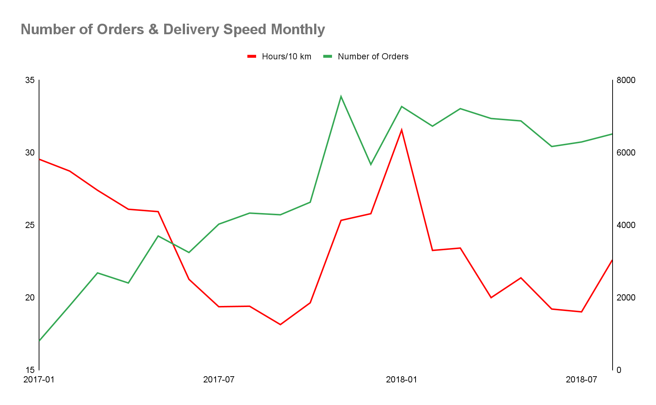
Correlation between Delivery Time & Number of Orders in 2017
Delivery speed affect number of sales in eCommerce refer to:
Fengyangzi Zhang & Guang Song (2016). IEEE. Can delivery speed affect sale in ecommerce: Evidence from household appliance. DOI: 10.1109/LISS.2016.7854601
Delivery Time
Notes:
Độ trễ delivery time

Slide 9
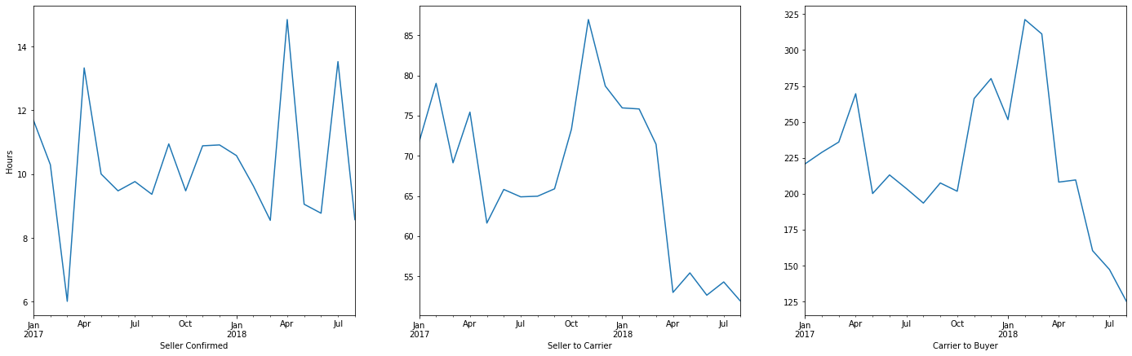
Delivery Time
The seller took a lot of time to prepare the goods (80 hours / 3.3 days), about 25% of the total delivery time.
Average Delivery Time Monthly
Notes:
Đưa về log scale

Slide 10
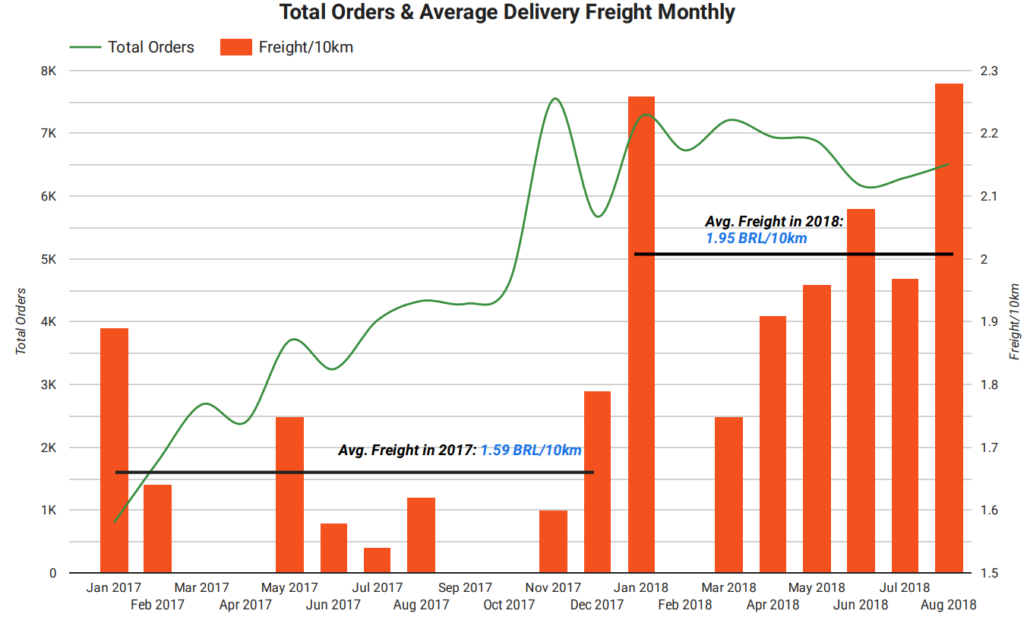
Although the delivery time has improved since 03-2018, the delivery fee has also increased
Average freight in 2018 increased 22% compared to 2017
Delivery Freight
Notes:
Chuyển về log
Trục x

Slide 11

Delivery Freight
“46% of Internet users cited free delivery of large orders as the factor that most likely will entice them to use an online grocery service in the future” a survey conducted by PwC (Clarke, 2000)
“This study aimed to find out how delivery charge and three other situational factors impact upon consumers’ inclination to shop online or in-store for their groceries. Our results show that these four factors all affect the decision whether to shop online for groceries” refer to
Huang, Y. and Oppewal, H. (2006), "Why consumers hesitate to shop online: An experimental choice analysis of grocery shopping and the role of delivery fees", International Journal of Retail & Distribution Management, Vol. 34 No. 4/5, pp. 334-353. https://doi.org/10.1108/09590550610660260
https://www.emerald.com/insight/content/doi/10.1108/09590550610660260/full/html
Notes:
Tìm báo mới hơn

Slide 12
Conclusions
Order growth unusual since 11-2017 go with lots of 1 & 2-star reviews.
Customers complain the most about two things:
Product quality (Low quality, wrong product, etc.)
Delivery (Late, not as expected, damaged package, etc.)
It takes about 83 hours (3.4 days) to prepare the seller's goods for the carrier during peak times, which is 25% of the total delivery time.
Since 03-2018, a delivery time has improved, but the cost is increasing. Orders number tend to decrease during this period.
Delivery Late Rate, Delivery Time and Delivery Freight affect the number of orders.

Slide 13

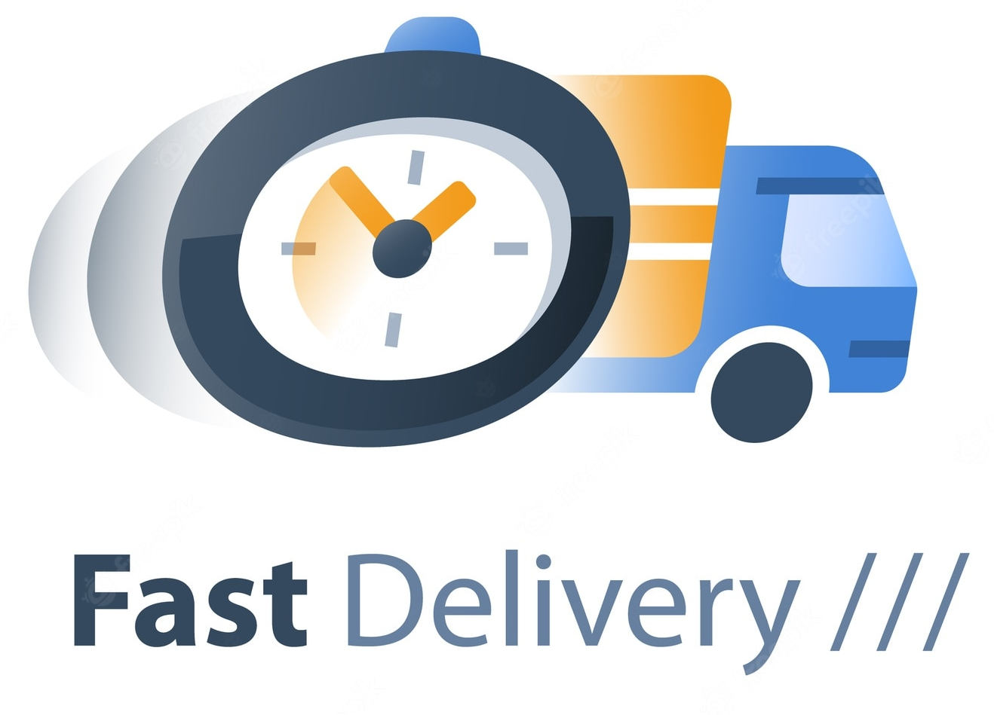

Solution & Evaluation
1
Improve Delivery Freight
2
Improve Delivery Time
3
Predict Delivery Time - Improve Late Delivery Rate

Slide 14
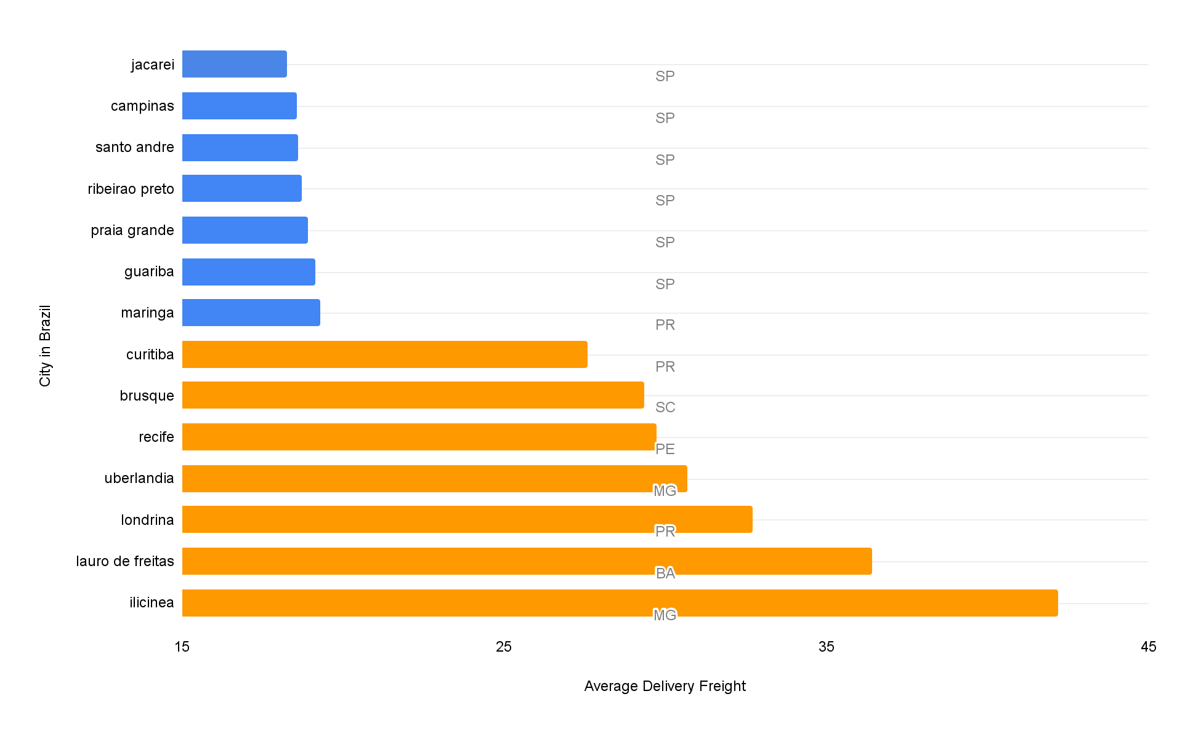
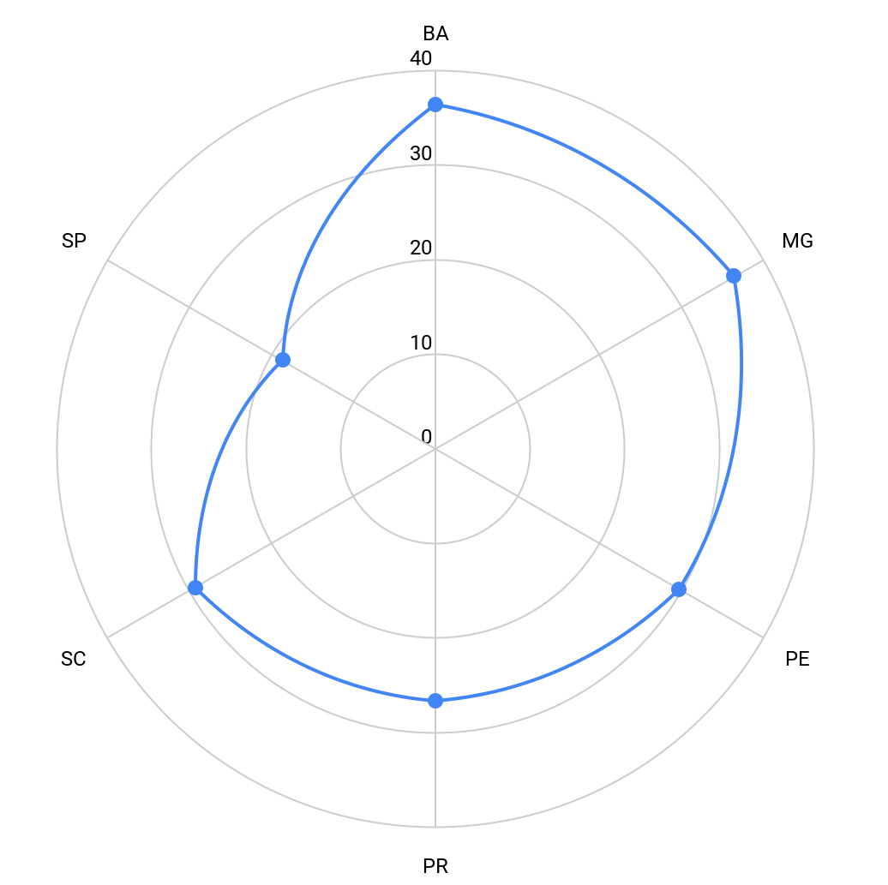
Improve Delivery Freight
Olists already has a reasonable delivery fee in São Paulo state.
Top 7 City With Lowest & Highest Delivery Fee
Average Delivery Freight by State

Slide 15

Improve Delivery Freight
Solution:
Olists continues to deliver orders booked at São Paulo state
Olists should find Third-party logistics providers to provide goods that are outside of São Paulo state
Evaluation:
Third-party logistics providers have substantial experience, technology, and warehousing spread all over the city → Reduce delivery freight
Back in 2015 and 2016, when Shopee entered the Vietnam e-commerce market, they do not have much experience in supply chain fields in VietNam, so they cooperated with Third-Party Logistics.
Source: https://sifted.com/resources/3pls-reduce-supply-chain-costs/

Slide 16
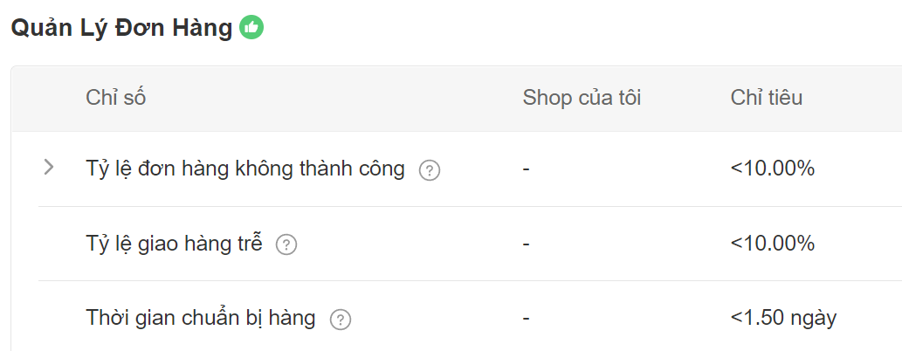
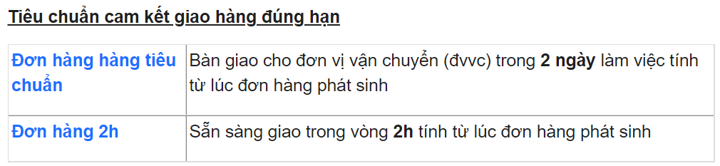
Improve Delivery Time
Shopee
Solution:
Set a target for the seller to deliver cargo to the carrier within a time.
Evaluation:
Top e-commerce companies like Shopee, Lazada have applied target for goods preparation time.
Shopee: Before 1.5 days
Lazada: Before 2 days
Warn seller about peak day (Holiday, Time of day, ...)
Lazada
Source:
https://banhang.shopee.vn/edu/article/3807
https://sellercenter.lazada.vn/seller/helpcenter/giao-hang-dung-han-sla-sot-sla-la-gi-7213.html

Slide 17
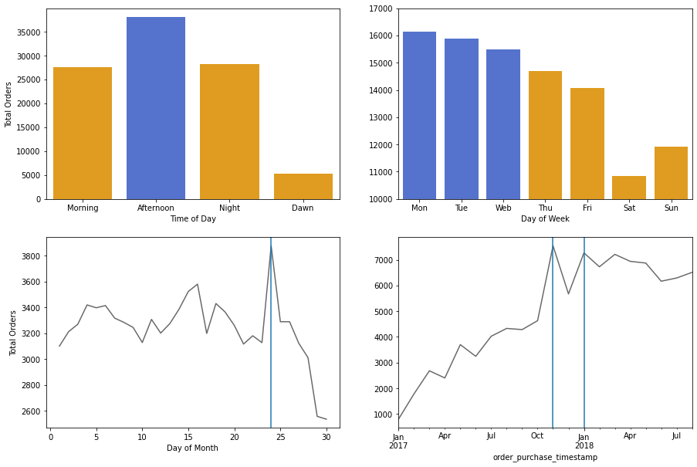
Improve Delivery Time
Number of Orders by
Peak Time:
Afternoon
Beginning of the week
1 week before the end of the month
Black Friday, Valentine, ...

Slide 18




Predict Delivery Time - Improve Late Delivery Rate
Dependent variable: Actual delivery time
Independent variables:
Distance of delivery
Seller & Buyer state
Freight
Product size
Product weight
Day of month
Day of week Purchase day
Time of day
Training
68,923
Data
86,153
Testing
17,230

Slide 19
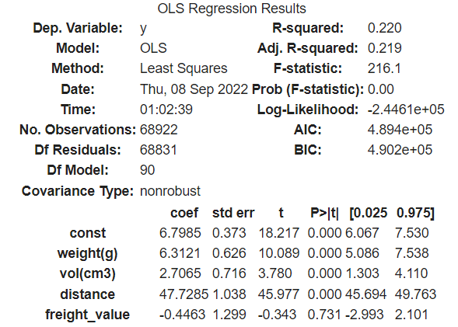
MAE
5.46
MSE
79.03
Evaluate Performance
RMSE
8.89
Evaluation: Delivery Late Rate in testing data
With this model: 5.91%
Actual Olists delivery: 8.11%
→ Reduce 2.2% Delivery Late Rate

