Slide 1

Good Morning
Oct 23, 2026
Narrow rally extends streak
VNIndex | Pts | % DoD
Open | 1,746 | 0.4%
High | 1,764 | 1.4%
Low | 1,746 | 0.4%
Close | 1,761 | 1.3%
Market performance
 | Last trade | 1D (%) | 1M (%) | 1Y (%)
VN INDEX | 1,760.63 | 1.3 | -3.1 | 4.9
HNX | 261.08 | -0.2 | -5.7 | -2.8
UPCOM | 126.91 | 0.5 | 0.6 | 15.6
MSCI EM | 1,615.42 | 1.0 | -7.5 | 17.1
NIKKEI | 62,907.84 | -2.7 | -3.2 | 27.6
HANG SENG | 22,934.68 | -3.0 | -8.6 | -11.0
KOSPI | 5,533.77 | -3.5 | -21.1 | 42.5
FTSE | 10,698.21 | -0.5 | -0.1 | 12.4
S&P 500 | 7,757.17 | 0.6 | -0.1 | 15.8
NASDAQ | 26,702.86 | 1.1 | -2.0 | 17.4

Slide 2

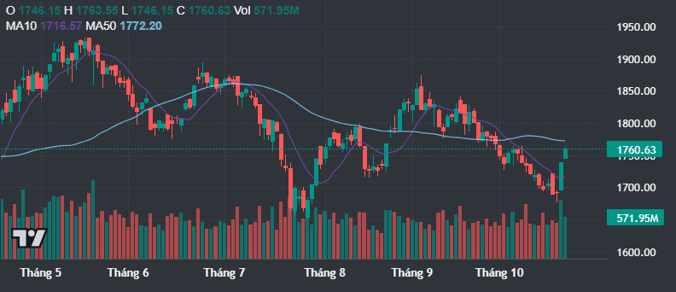
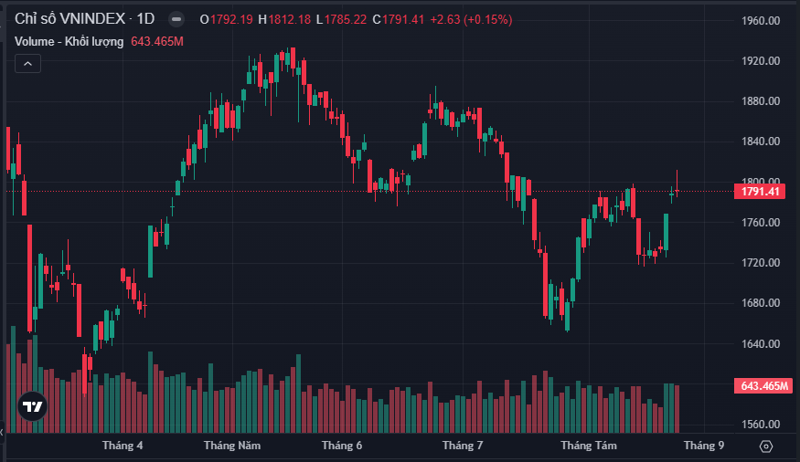
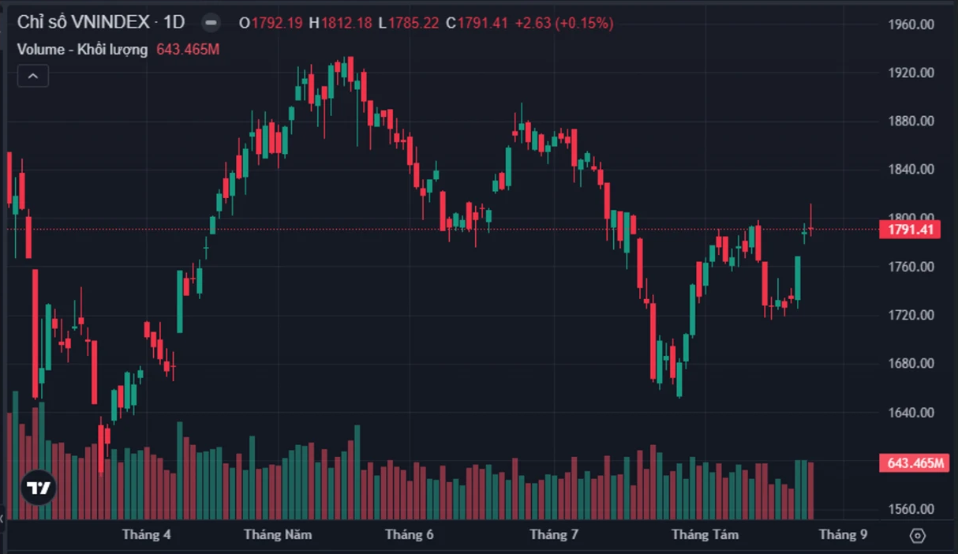
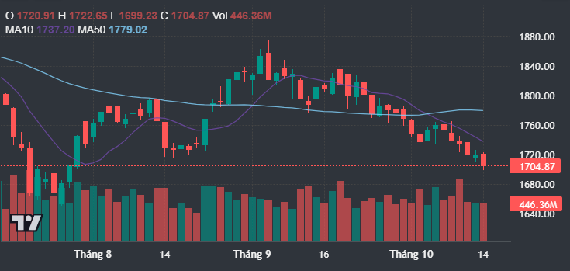
Narrow rally extends streak
The VN-Index climbed from its opening low to 1,760.6pts (+1.3%), a third straight gain.
Energy rose 2.9%, but breadth was negative with 167 decliners vs 149 advancers.
VIC alone adds 15.5pts to the rally
Source: Fireant

Slide 3
Vietnam stock market
HOSE trading value came to VND15,299bn, above both the 1M average of VND12,221bn and the 6M average of VND14,986bn.
VN30 top gainers: VIC, BSR, VHM, TCX
VN30 top decliners: LPB, SSB, SSI, BID
Daily trading value (US$mn)
 | Today | 1M average | 6M average
VN-INDEX | 592 | 473 | 580
HNX | 34 | 27 | 32
UPCOM | 15 | 16 | 13

Slide 4
Vietnam stock market
VN-Index daily change: Top contributors
Source: Bloomberg, Mirae Asset Research
Notes:
9.4 SVN Giroy: 20
8.7

Slide 5
Vietnam stock market
Foreign investors were net buyers, with a net inflow of VND340bn on HOSE
Source: Bloomberg, Mirae Asset Research
Notes:
9.4
8.7

Slide 6
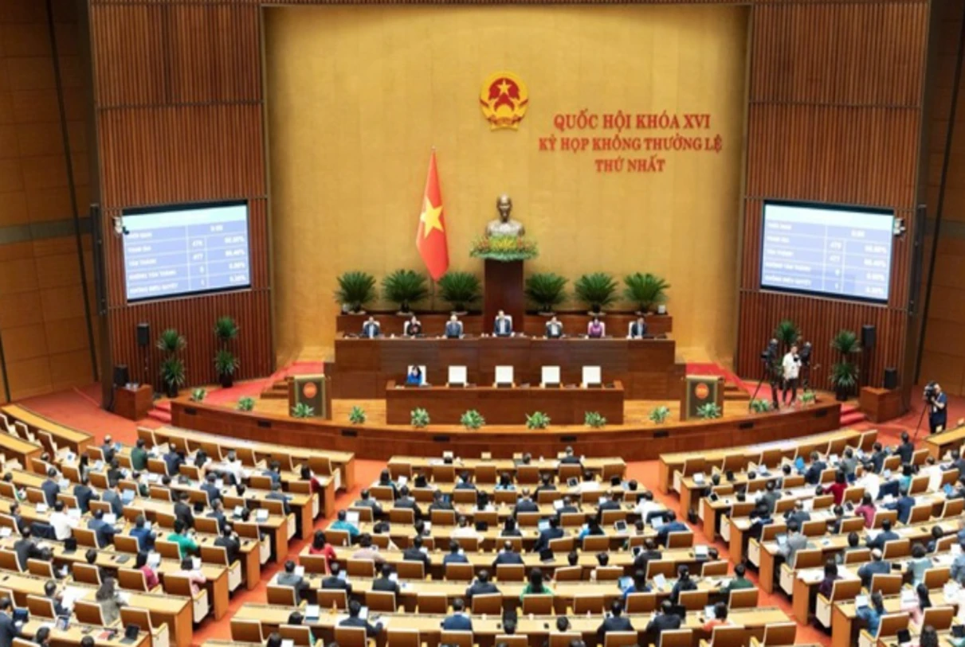

Short news
Vietnam - Denmark relations upgraded to Comprehensive Strategic Partnership
Vietnam, Malaysia boost LNG cooperation to ensure energy security
Ministry proposes US$19mn fund to support industrial energy efficiency
Source: Media reports

Slide 7
Market indicators
VN-Index: Historical P/E band chart
Source: Bloomberg, Mirae Asset Research
Notes:
9.4
8.7
20

Slide 8
Market indicators
VN Index vs. US$/VND
Source: Bloomberg, Mirae Asset Research
Notes:
9.4
8.7
20

Slide 9
Market indicators
Vietnam bond yields
Source: Bloomberg, Mirae Asset Research
Notes:
9.4
8.7
20

Slide 10
Market indicators
Vietnam interbank rate
Source: Bloomberg, Mirae Asset Research
Notes:
9.4
8.7
20

Slide 11
APPENDIX
Analyst Certification
The research analysts who prepared this report (the “Analysts”) are subject to Vietnamese securities regulations. They are neither registered as research analysts in any other jurisdiction nor subject to the laws and regulations thereof. Opinions expressed in this publication about the subject securities and companies accurately reflect the personal views of the Analysts primarily responsible for this report. Mirae Asset Securities (Vietnam) JSC (MAS) policy prohibits its Analysts and members of their households from owning securities of any company in the Analyst’s area of coverage, and the Analysts do not serve as an officer, director or advisory board member of the subject companies. Except as otherwise specified herein, the Analysts have not received any compensation or any other benefits from the subject companies in the past 12 months and have not been promised the same in connection with this report. No part of the compensation of the Analysts was, is, or will be directly or indirectly related to the specific recommendations or views contained in this report but, like all employees of MAS, the Analysts receive compensation that is determined by overall firm profitability, which includes revenues from, among other business units, the institutional equities, investment banking, proprietary trading and private client division. At the time of publication of this report, the Analysts do not know or have reason to know of any actual, material conflict of interest of the Analyst or MAS except as otherwise stated herein.
Disclaimers
This report is published by Mirae Asset Securities (Vietnam) JSC (MAS), a broker-dealer registered in the Socialist Republic of Vietnam and a member of the Vietnam Stock Exchanges. Information and opinions contained herein have been compiled in good faith and from sources believed to be reliable, but such information has not been independently verified and MAS makes no guarantee, representation or warranty, express or implied, as to the fairness, accuracy, completeness or correctness of the information and opinions contained herein or of any translation into English from the Vietnamese language. In case of an English translation of a report prepared in the Vietnamese language, the original Vietnamese language report may have been made available to investors in advance of this report.
The intended recipients of this report are sophisticated institutional investors who have substantial knowledge of the local business environment, its common practices, laws and accounting principles and no person whose receipt or use of this report would violate any laws and regulations or subject MAS and its affiliates to registration or licensing requirements in any jurisdiction shall receive or make any use hereof.
This report is for general information purposes only and it is not and shall not be construed as an offer or a solicitation of an offer to effect transactions in any securities or other financial instruments. The report does not constitute investment advice to any person and such person shall not be treated as a client of MAS by virtue of receiving this report. This report does not take into account the particular investment objectives, financial situations, or needs of individual clients. The report is not to be relied upon in substitution for the exercise of independent judgment. Information and opinions contained herein are as of the date hereof and are subject to change without notice. The price and value of the investments referred to in this report and the income from them may depreciate or appreciate, and investors may incur losses on investments. Past performance is not a guide to future performance. Future returns are not guaranteed, and a loss of original capital may occur. MAS, its affiliates and their directors, officers, employees and agents do not accept any liability for any loss arising out of the use hereof.
MAS may have issued other reports that are inconsistent with, and reach different conclusions from, the opinions presented in this report. The reports may reflect different assumptions, views and analytical methods of the analysts who prepared them. MAS may make investment decisions that are inconsistent with the opinions and views expressed in this research report. MAS, its affiliates and their directors, officers, employees and agents may have long or short positions in any of the subject securities at any time and may make a purchase or sale, or offer to make a purchase or sale, of any such securities or other financial instruments from time to time in the open market or otherwise, in each case either as principals or agents. MAS and its affiliates may have had, or may be expecting to enter into, business relationships with the subject companies to provide investment banking, market-making or other financial services as are permitted under applicable laws and regulations.
No part of this document may be copied or reproduced in any manner or form or redistributed or published, in whole or in part, without the prior written consent of MAS.

