Slide 1
Resource-optimal Testing Mechanisms for COVID-19
Francisco Marmolejo-Cossío
Joint work with:
J. Jonnerby, E. Lock, C. Ramsay, M. Shukla, D. Sridhar
University of Oxford
Mechanism Design for Social Good (MD4SG)

Slide 2
Main Problem
Accurate and extensive testing of population required to combat Covid-19
Resources can be extremely limited:
Tests
Trained personnel
Lab time
How do we maximise the benefit of these limited resources?

Slide 3
Testing Objectives
Minimise propagation of virus
i.e. prioritise those susceptible or likely to spread
Minimise impact of unecessary self-isolation
Essential workers
Those without the economic means to self-isolate

Slide 4
Testing Objectives
Comprehensively test entire population in order to identify those infected and healthy
Crucial for aggressive contact tracing and other containment strategies
Also may eventually allow healthy individuals to return to normalcy
Estimate current infection rate in general population
Ideally by region
Help optimise resource allocation
Monitor groups of `key workers’
Living in close proximity
Must be tested regularly to isolate the sick
Must ensure infection rate does not increase

Slide 5
Group Testing
Recently, researchers in Israel have suggested that Covid-19 tests are sensitive enough to pool 32-64 samples together
If a single individual is sick, test is positive
If all individuals are healthy, test is negative
Has potential to drastically reduce the number of tests needed to tackle objectives from before
There is a substantial literature on the subject

Slide 6
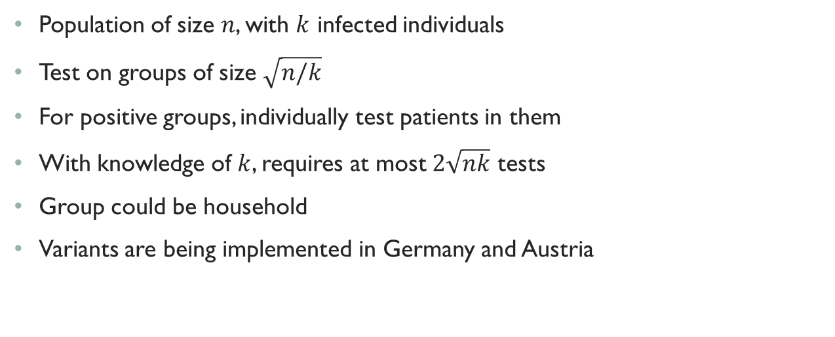
Example: Dorfman’s 2-stage Protocol
Population of size $n$, with $k$ infected individuals
Test on groups of size $\sqrt{n/k}$
For positive groups, individually test patients in them
With knowledge of $k$, requires at most $2\sqrt{nk}$ tests
Group could be household
Variants are being implemented in Germany and Austria

Slide 7
Beyond Dorfman
More complex group testing strategies exist
Rather than starting with a population and trying to figure out the minimal number of tests required, we start with a testing budget and aim to maximise the benefit of a testing allocation
Surprisingly simple mechanisms can yield improvements

Slide 8
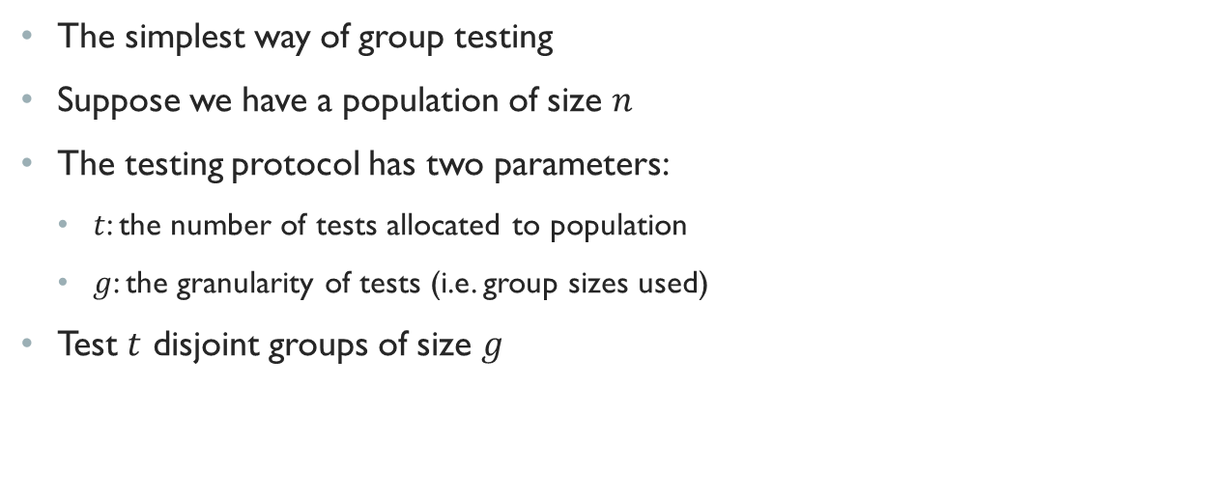
Uniform Group Testing
The simplest way of group testing
Suppose we have a population of size $n$
The testing protocol has two parameters:
$t$: the number of tests allocated to population
$g$: the granularity of tests (i.e. group sizes used)
Test $t$ disjoint groups of size $g$

Slide 9
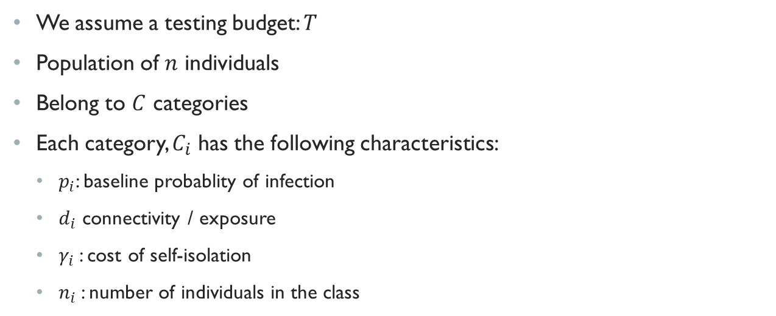
Low Granularity Testing
We assume a testing budget: $T$
Population of $n$ individuals
Belong to $C$ categories
Each category, $C_{i}$ has the following characteristics:
$p_{i}$: baseline probablity of infection
$d_{i}$ connectivity / exposure
$γ_{i}$: cost of self-isolation
$n_{i}$: number of individuals in the class

Slide 10
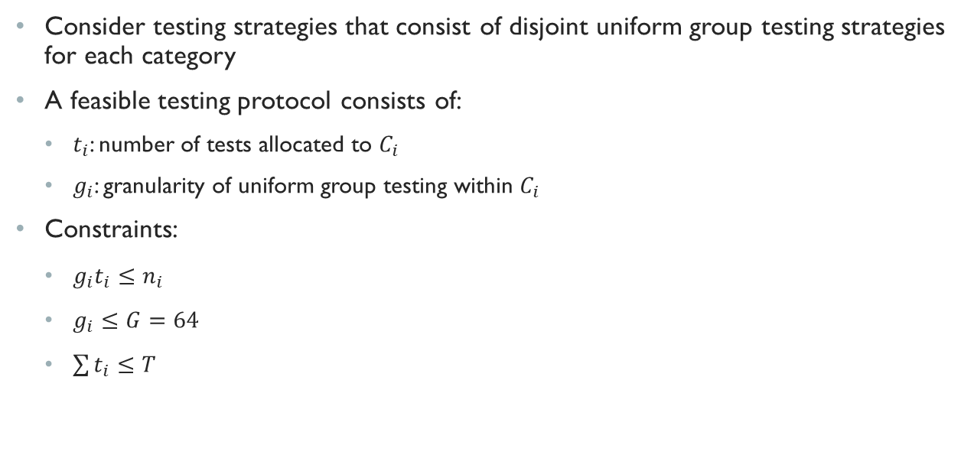
Low Granularity Testing
Consider testing strategies that consist of disjoint uniform group testing strategies for each category
A feasible testing protocol consists of:
$t_{i}$: number of tests allocated to $C_{i}$
$g_{i}$: granularity of uniform group testing within $C_{i}$
Constraints:
$g_{i}t_{i}≤n_{i}$
$g_{i}≤G=64$
$\sum{t_{i}}≤T$

Slide 11
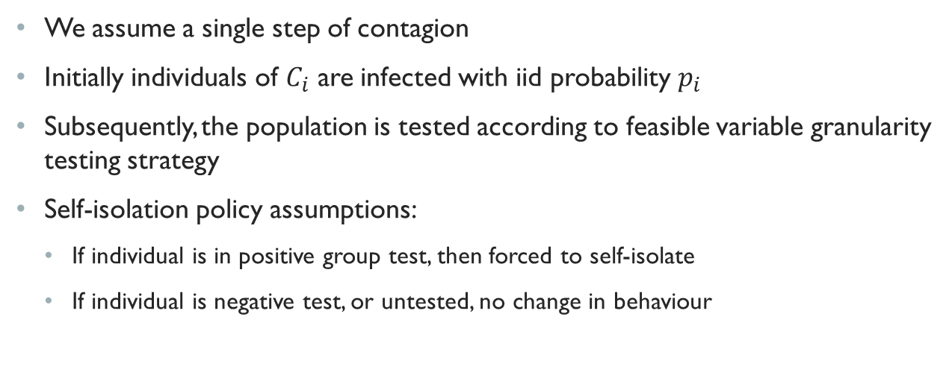
Contagion Model and Self-isolation Policy
We assume a single step of contagion
Initially individuals of $C_{i}$ are infected with iid probability $p_{i}$
Subsequently, the population is tested according to feasible variable granularity testing strategy
Self-isolation policy assumptions:
If individual is in positive group test, then forced to self-isolate
If individual is negative test, or untested, no change in behaviour

Slide 12
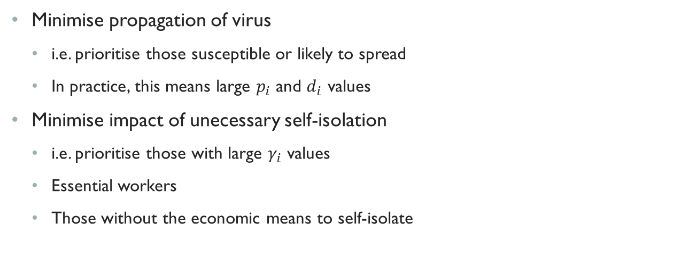
Objectives
Minimise propagation of virus
i.e. prioritise those susceptible or likely to spread
In practice, this means large $p_{i}$ and $ⅆ_{i}$ values
Minimise impact of unecessary self-isolation
i.e. prioritise those with large $γ_{i}$ values
Essential workers
Those without the economic means to self-isolate

Slide 13
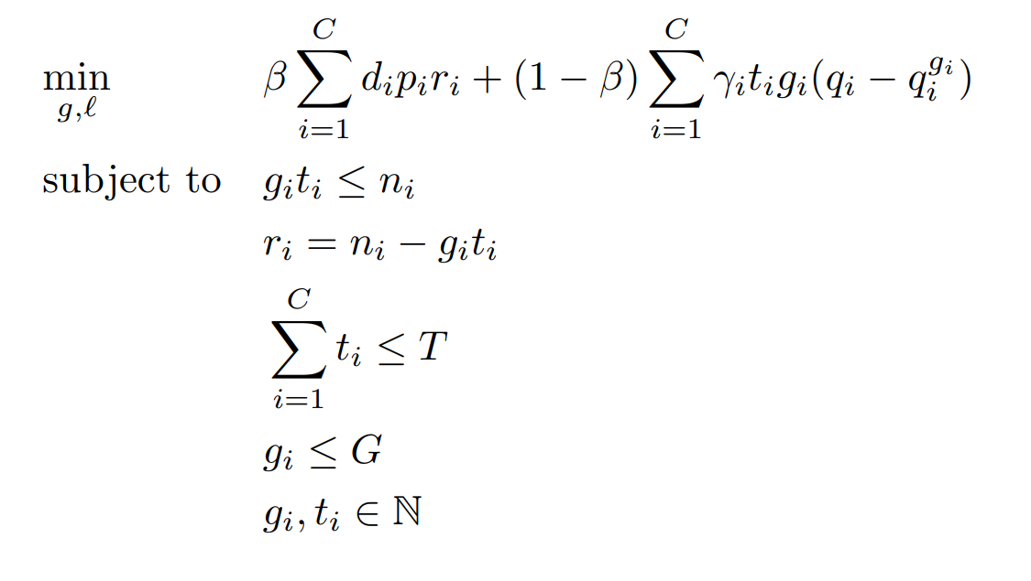

The Optimisation Problem
$r_{i}=n_{i}−g_{i}t_{i}$, the untested individuals in $C_{i}$
$β∈\left[0,1\right]$ is a relative weight of each portion of the objective

Slide 14
Possible scenario
Village of 10,000 people
20 key healthcare workers
480 regular marketplace workers
9,500 other townsfolk
100 tests at your disposal
Can make use of group tests of size at most 64
What’s the best strategy?

Slide 15
Current Practices
If conscious of health workforce, allocate 20 tests
For all others, test if individual is already showing symptoms
Unfortunately these tests are not very informative
There is an inherent bias in results
Many cases go un-noticed

Slide 16
Uniform Group Test on Whole Population
Choose a random assignment of 100 groups of size 64 from village
Place these individuals in group for testing
Benefits:
Covers 64% of the population
Can estimate prevalence of virus
Drawbacks:
May unnecessarily self-isolate healthcare workers
May not necessarily test an infected marketplace worker

Slide 17
Variable Group Testing
We consider the case were cost of self-isolation for marketplace workers is low
Possible testing strategy:
20 tests for individually testing healthcare workers
7 tests of group size 64 and one test of group size 32 (480 individuals tested) for marketplace workers
72 tests for randomly selected groups of size 64 (4608 individuals tested) for other townsfolk

Slide 18
Variable Group Testing
We consider the case were cost of self-isolation for marketplace workers is high
Possible testing strategy:
20 tests for individually testing healthcare workers
20 tests of group size 24 (480 individuals tested) for marketplace workers
60 tests of group size 64 for randomly selected groups of townsfolk (3840 individuals tested)
If cost of self-isolation for marketplace workers is low, can bring the granularity down in their segment while still covering their numbers.
This frees up tests for the townsfolk

Slide 19
Breaking the Group Testing Limit
Individuals with highly correlated infection rates do not need to be tested separately
Household members fall in this category, and a single test from an individual in the household should suffice to determine whether all or none are infected
If the household is the basic unit, pooled tests aggregate over households
In our village example, if the average household is of 3 members, then 50 pooled household tests suffice to cover entire townsfolk segment of population

Slide 20
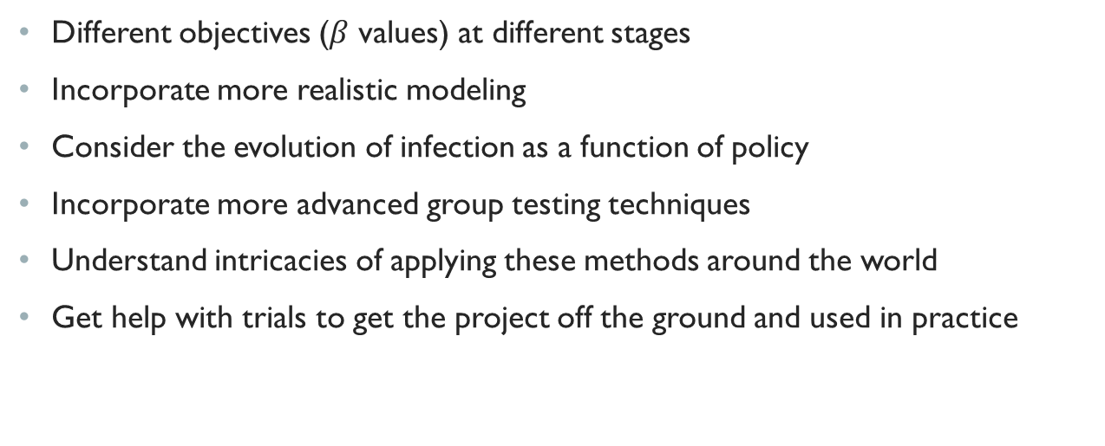
Next Steps
Different objectives ($β$ values) at different stages
Incorporate more realistic modeling
Consider the evolution of infection as a function of policy
Incorporate more advanced group testing techniques
Understand intricacies of applying these methods around the world
Get help with trials to get the project off the ground and used in practice

Slide 21
Thank you for listening!
Email: marmolejo.francisco@gmail.com

