Slide 1
Exploring lockdown exit strategies
Andrei Paleyes, Neil Lawrence
Data Science Africa COVID-19 Response Webinar
April 8, 2020

Slide 2
WORLD ECONOMIC FORUM, 26.03.2020:
Nearly 3 billion people around the globe under COVID-19 lockdowns.

Slide 3
When and how to exit?

Slide 4
World Health Organization:
It would be “historic” to find a vaccine that can be distributed to all countries in 18 months to defeat the coronavirus.

Slide 5
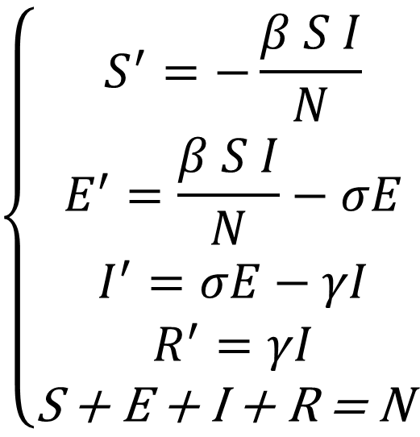

SEIR model
$$\left\{\begin{aligned}S^{′}=−\frac{β S I}{N} \\ E^{′}=\frac{β S I}{N}−σE \\ I^{′}=σE−γI \\ R^{′}=γI \\ \text{S}\text{ + }\text{E}\text{ + }\text{I}\text{ + }\text{R}\text{ = }\text{N} \end{aligned}\right.$$
Susceptible
Exposed
Infected
Removed
$β$ – transmission rate
$σ$ – incubation
$γ$ – recovery/death rate
Kermack, W. O., McKendrick, A. G., 1927, "A Contribution to the Mathematical Theory of Epidemics"

Slide 6
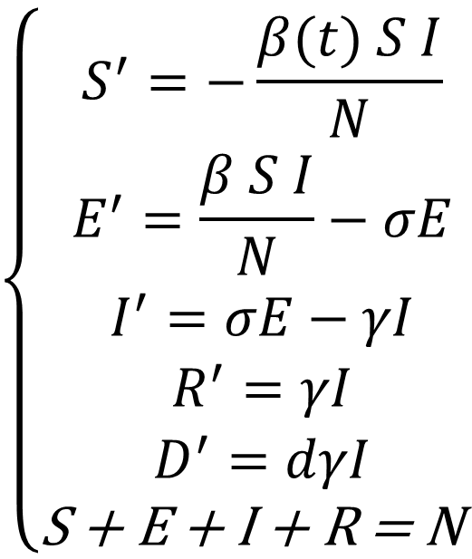
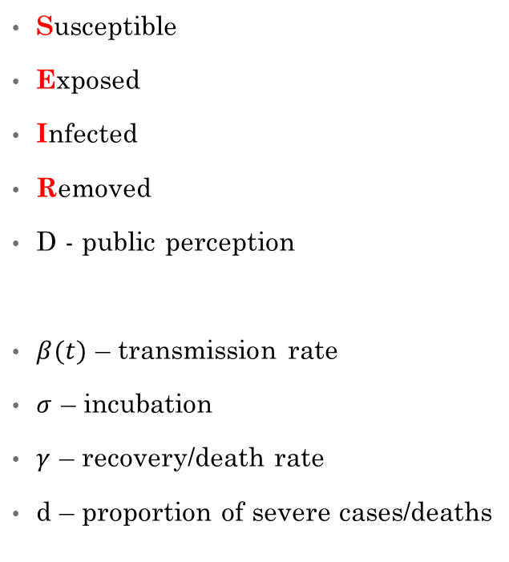
Revised SEIR model
$$\left\{\begin{aligned}S^{′}=−\frac{β(t) S I}{N} \\ E^{′}=\frac{β S I}{N}−σE \\ I^{′}=σE−γI \\ R^{′}=γI \\ D^{′}=dγI \\ \text{S}\text{ + }\text{E}\text{ + }\text{I}\text{ + }\text{R}\text{ = }\text{N} \end{aligned}\right.$$
Susceptible
Exposed
Infected
Removed
D - public perception
$β(t)$ – transmission rate
$σ$ – incubation
$γ$ – recovery/death rate
d – proportion of severe cases/deaths
He et al., 2013, “Inferring the causes of the three waves of the 1918 influenza pandemic in England and Wales”

Slide 7

Revised SEIR model, continued
$$β\left(t\right)=β_{0}\left(1−α\right){\left(1−\frac{D}{N}\right)}^{k}$$
$β_{0}$ – initial transmission rate of the disease
$α$ – governmental action strength
$k$ – intensity of public response
Lin et al., 2020, “A conceptual model for the coronavirus disease 2019 (COVID-19) outbreak in Wuhan, China with individual reaction and governmental action”

Slide 8
Context: South Africa
Population: 56.72 million
Timeline:
March 1 – First case
March 15 – State of disaster declared
March 23 – National lockdown

Slide 9
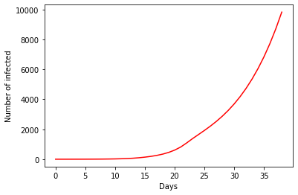
Scenario 0: where we are right now

Slide 10
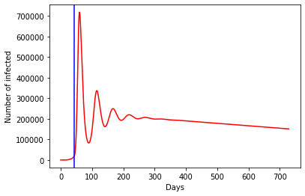
Scenario 1: lockdown ends, no further action

Slide 11
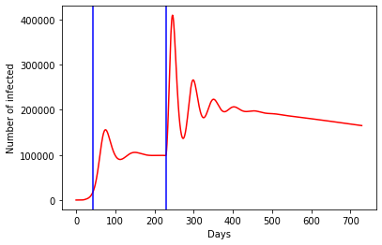
Scenario 2: strict lockdown for 6 months
Cost: R1680 billion (= 2019 budget)

Slide 12
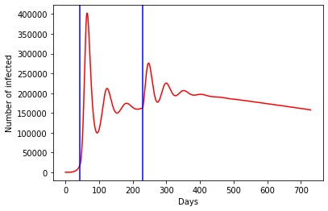
Scenario 3: half-measure for 6 months
Cost: R790 billion

Slide 13
Optimization setup
Split 6 months into 3 week periods
Each period has a separate quarantine strength
Thus: optimization domain is 8 parameters
Objective is the lowest possible peak
Code: Bayesian Optimization via Emukit
… and economic constraint

Slide 14
Economic constraint
Each day of lockdown costs money
Daily loss the country incurs is the same
The softer the measures – the less the loss
South Africa context
R10 billion a day
Limit is R900 billion (50% of 2019 budget)
https://www.dailymaverick.co.za/article/2020-03-27-how-much-could-coronavirus-cost-the-sa-economy-a-preliminary-estimate/

Slide 15
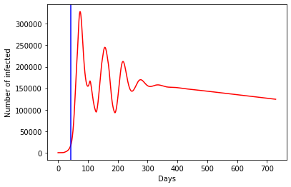
Optimized scenario
Cost: R810 billion

Slide 16
Imperial College, London; US federal plan; other experts:
The COVID-19 pandemic will last 18 months or longer.

Slide 17
Thank you!
ap2169@cam.ac.uk

