Slide 1
BANK AT HAUSE – Factor Xchange
Nsibambi Kyabainze
ashiraf35@gmail.com
Facebook: Ashiraf Nsibambi Kyabainze
Twitter: @Ashiraf_Ola
LinkedIn: ashiraf-nsibambi-kyabainze- 77719071

Slide 2
WHAT | HOW | WHY
An exchange of factors of production. (e.g capital, land, labor and entrepreneurship) in return for rewards known as factor payments. (e.g interest, rent, wage/salary, profit ) | Peer to Peer approach. Integrating socio-economic data about factors of production and sharing it with users to help them make economic decision. One platform | Limited access to factor inputs such as entrepreneurial skills, Finance/Start-up capital, profitable business locations and Affordable skilled labor. This has stalled many promising business ideas.

Slide 3
PROBLEM : Case of Uganda
Uganda ranked as the country with the highest level of entrepreneurship in the world by GEM (Global Entrepreneurship Monitor). 28.1% of the population are micro-entrepreneurs: these are business-people who employ fewer than five individuals – often family members – under informal arrangements. These smaller firms are more likely to fail, due to the high levels of uncertainty and risk in their local environments. | Resources necessary to grow a business – such as finance, human and social capital and infrastructure are less accessible. Making it difficult to earn better factor payments including; Wages paid for the services of labor. Interest paid for the services of capital. Rent paid for the services of land/business location. And Profit paid for services of entrepreneurship.

Slide 4
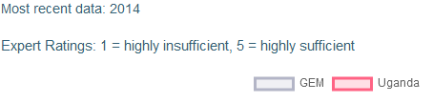
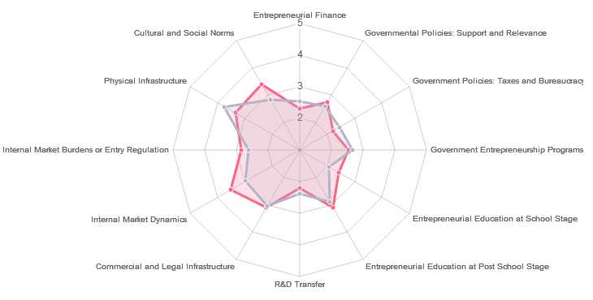
ENTREPRENEURIAL ECOSYSTEM IN UGANDA
2.32
3.39
2.74
3.34
2.2
2.84
2.54
3.53
2.42
3.03
3.11
2.21

Slide 5
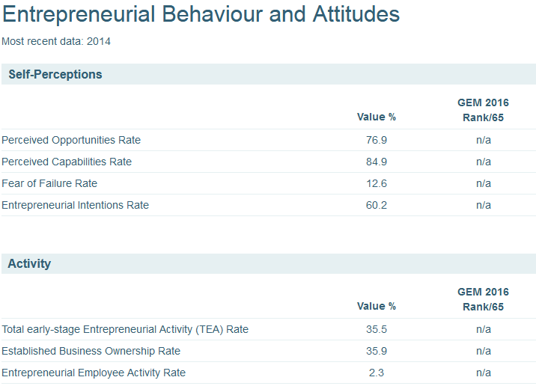

Slide 6
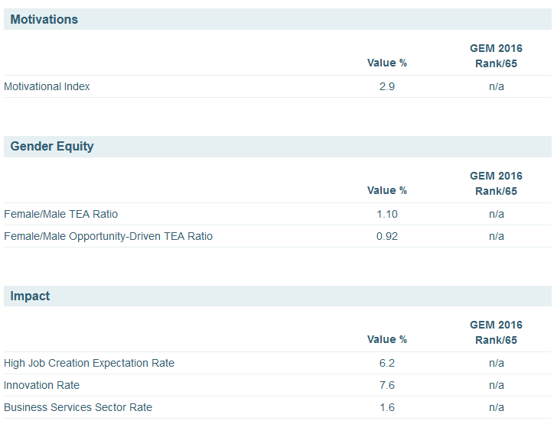

Slide 7
REFERENCE
http://www.gemconsortium.org/country-profile/117
An abundance of willing entrepreneurs held back by limited skills. Support from the government is building.
CHALLENGES FOR THE FUTURE
The number one challenge is to ensure the growth and survival of entrepreneurial ventures. GEM shows that only 2% of businesses expect to employ 20+ people in the next five years, implying that Ugandan entrepreneurship is concentrated in small and micro businesses.
Moreover, there is a high business discontinuation rate (21%).
It is time to create initiatives that both support and improve the quality of entrepreneurship in Uganda.

Slide 8
SOLUTION
Data Mining
Business Space
Social capital
Finance
Profitable business Land / Location
Socio-economic Data
BANK AT HAUSE – Factor Xchange
application
Interest,
Data about stock markets, regulations, financial policies.
Rent
Data about properties to expand,
Profits ,
Data about market prices, new markets
Wages,
Data about training centers, workshops
Cheap/ affordable Skilled Labor
Entrepreneur
Response
Products/ Services
Skills
Query
Database

Slide 9
BUSINESS MODEL
KEY PARTNERS SDK Finance Swarm Vision | KEY ACTIVITIES - Idea testing. - Market Testing - Product design. - Collaboration. | VALUE PROPOSITION Integration of economic Data about factors to aid decision making. Access to factor inputs Business growth Peer Trust Household income rise | CUSTOMER RELATIONSHIPS News letters Notifications Safe & instant transactions | CUSTOMER SEGMENTS Money Lenders Peers Entrepreneurs Landlords Skilled Workers
COST STRUCTURES USD 50,000 for - Product - Operations - Equipment - Internet - Marketing - Scalability | KEY RESOURCES - Developers - Human resource - Workspace - Internet - Start up capital |  | CHANNELS - Web - Mobile - Social Media - Adverts - Campaigns - Meetups | REVENUE STREAMS Factor Payments Adverts

Slide 10


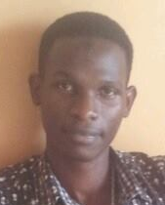
TEAM
NSIBAMBI KYABAINZE | AKOLA TEDDY | LUKANGA HAKIM | NANJERU MARIAM
Team Lead | Finance | Product Development | Business Development

Slide 11
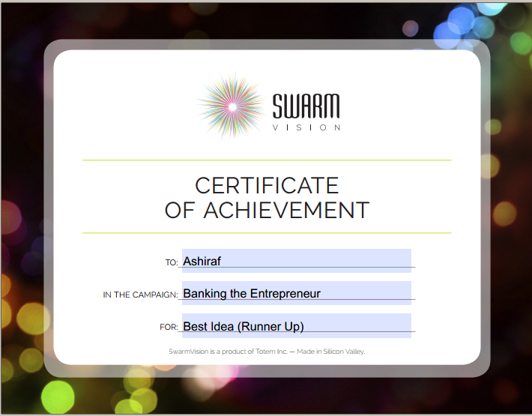
AWARDS

Slide 12
TIMELINE
STEP 1
STEP 2
STEP 3
STEP 4
Market Opportunity
Analysis
Approach Partners
Raise Capital
Platform Development
Web
Mobile
Internet of Things
Device app for business management
We are here

Slide 13
COLLABORATION : Product Developers, Financial support, Direct pass to a Grant, Infrastructure, Resources, Workspace, Technical Support, Mentorship, Links to investors, Business Developers. Please contact me:
ashiraf35@gmail.com
Facebook: vertabra
Twitter: @Ashiraf_Ola
LinkedIn: ashiraf-nsibambi-kyabainze

