Slide 1
ENABLING DATA REVOLUTION
CHARLES BUNDU

Slide 2




What is dLab?
Tanzania Data Lab (dlab) is an open working space where data from multiple sectors and sources can be combined, processed, and shared to drive better policies and decision-making.
It serves as an anchor for Data Collaboratives for Local Impact (DCLI) program, enabling data analysis, and use to become more prominent in decision making in Tanzania.
DCLI Program
Promoting innovation and data literacy through a premier center of excellence
(UDSM, ODI, IntraHealth, SBC4D)
Making data meaningful and accessible to spark citizen action at the community level
Identifying, networking and supporting youth and entrepreneurs to create data-driven innovations for real life problems

Slide 3

dLab Activities
Engagement
Awareness raising and building linkages with data communities through;
→ Round-tables
→ Workshops
→ Mapathons
→ Hackathons
→ Follow up visits
→ Creating Partnerships
Training
Builds local capacity & supports data champions;
→ Face to Face Trainings
→ On-line Trainings
→ Women in data campaigns
→ Supporting Universities
dLab Pillars
dLab carries its activities through various pillars in the project
Resources & Data Science
Support organizations to increase their performances through improved data use and contribute to Tanzania data ecosystem
→ SDG data road-map
→ Data science trainings
→ Demonstrate use of data through data use stories

Slide 4
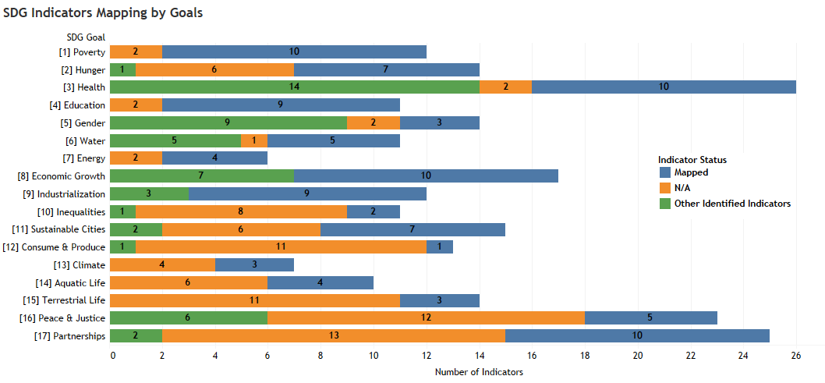
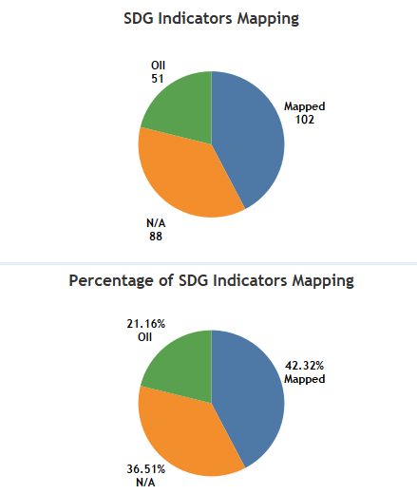
SDG Road-map Outcomes (Joint NBS Work)
Using an Advanced Data Planning Tool (ADAPT) developed by PARIS21 to define national plan (FYDP II). ADAPT is capable of;
  Defining a national monitoring framework for development (FYDP II)
  Cost estimation in implementing data collection activities
  Develop a road-map for achieving data revolution and identification of gaps existing in the national monitoring framework

Slide 5
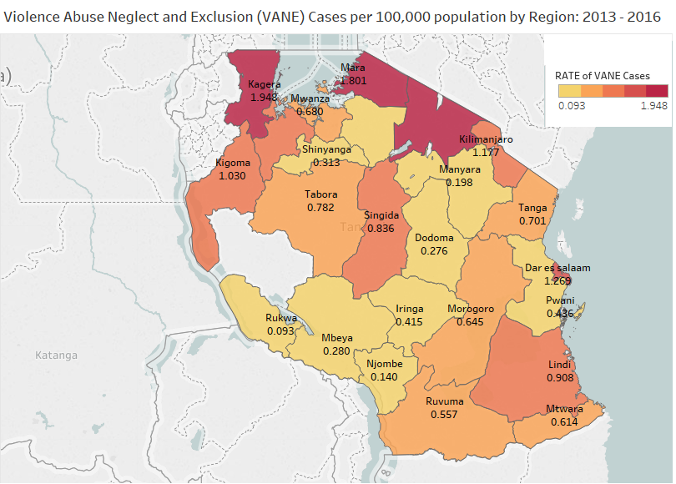
Data Use Stories → C-Sema
Violence, Abuse, Neglect and Exploitation(VANE) prevalence per 100,000 population in 2014
Use of Data to show trend & efficiency
Trend of prevalence of violence, abuse, neglect & negligence (VANE) against children from 2013 to 2016.
Highlighting efficiency of helpline service provided by C-Sema

Slide 6
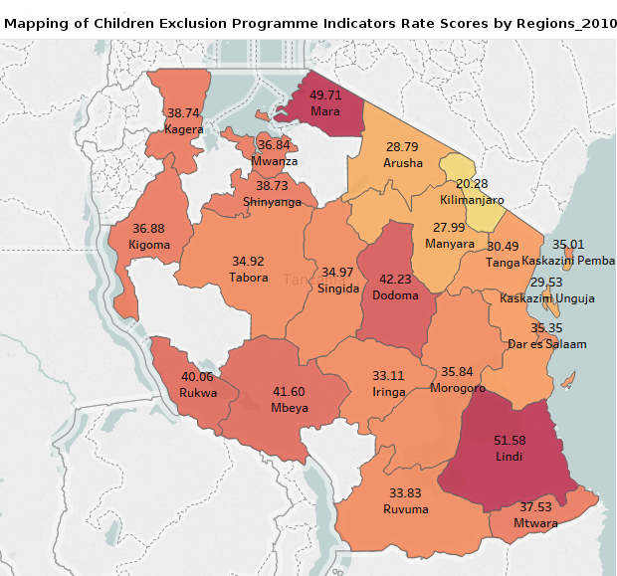
Data Use Stories → Save the Children
Looking at 2010 DHS data, data mapping toolkit was developed to map multiple children related indicators to help evidence based decision in running interventions

Slide 7
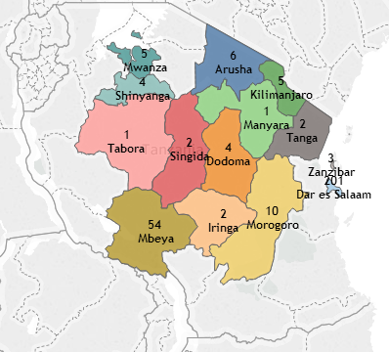
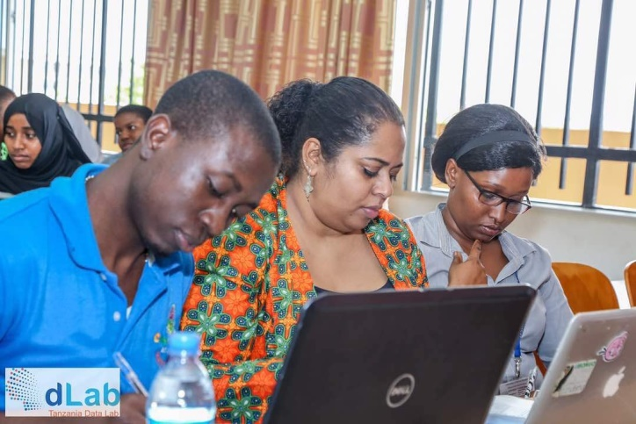
Knowledge Sharing Output → Training
A total of 301 people were imparted with data use/manipulation skills in various trainings

Slide 8
THANKS FOR LISTENING
charles.bundu@dlab.or.tz
@rwi_ge

