Slide 1


Data Revolution: A fitting Model for Developing countries: A case of Tanzania Data Lab
Zaituni Kaijage
University of Dar es salaam
Tanzania

Slide 2

Motivation, problem area
Open data for monitoring Sustainable Development Goals (SDGs) (234 indicators)
Transparency and accountability-Government budget & implementations
Innovations are born from open data
Remove societies inequalities & imbalances
Open data vs Economic growth-Directly proposition(Diff. studies)

Slide 3
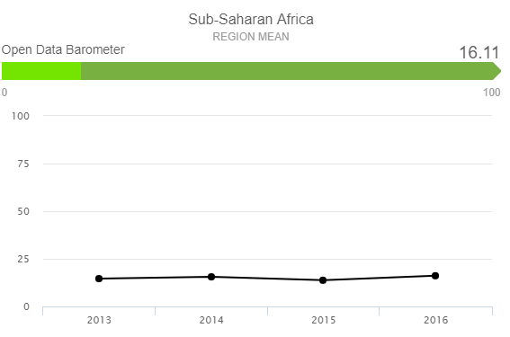
Motivation, problem area
But Low open data participation in developing countries.

Slide 4
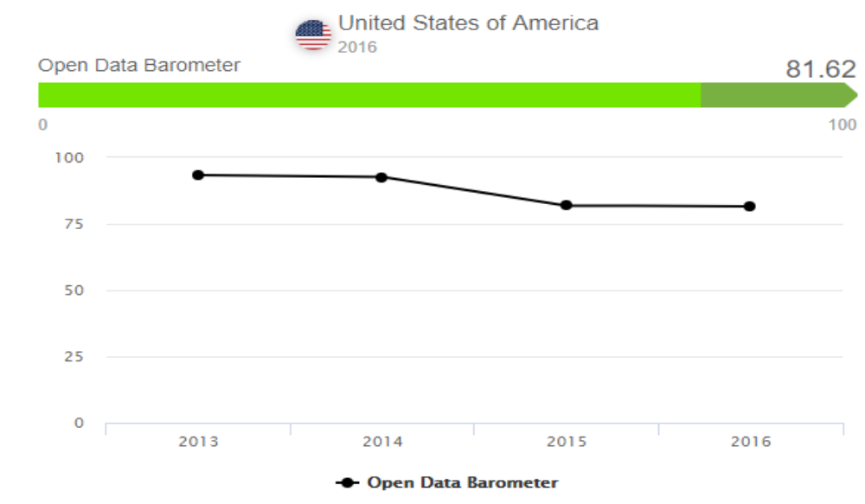
Motivation, problem area

Slide 5
Motivation, problem area
Different open data initiatives have been going on in Tanzania.
DCLI projects-Dlab, Data Zetu,&DLI
Government Portal-e-government
CSOs
National Bureau of statistics (Development of open data policy)

Slide 6

Motivation, problem area
Contribution of Tanzania data lab
Provide data training(Trained more than 300 people)
Involved in SDGs indicator mapping to National Five year development plan
Developed data portal-enhance data ecosystem in Tanzania
Reached out more than 150 organizations in Tanzania.

Slide 7
Motivation, problem area
No research has been done to assess the impact of Tanzania data lab model on open data issues in Tanzania.

Slide 8
Research Objectives
To assess the impact of the Tanzania Data lab
To elicit participants’ awareness and readiness towards open data issue in Tanzania

Slide 9
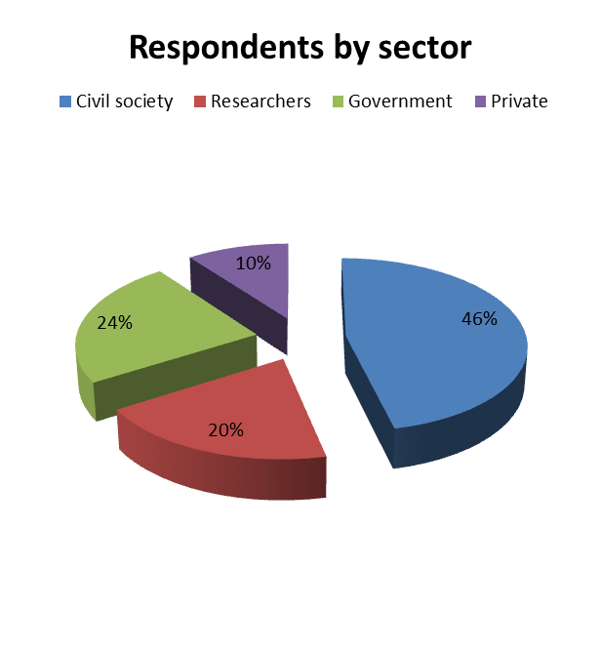
Research approach, methodology
234 respondents returned the survey out of 350 participants.
Previous dLab participants
WHY?
Professionals who have potential to contribute towards the development and implementation of open data policies in Tanzania.

Slide 10
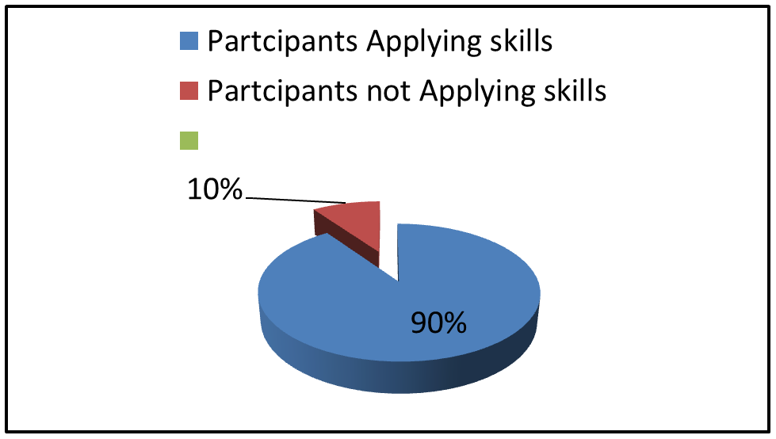
Major Outcomes/Results
Application of skills obtained

Slide 11
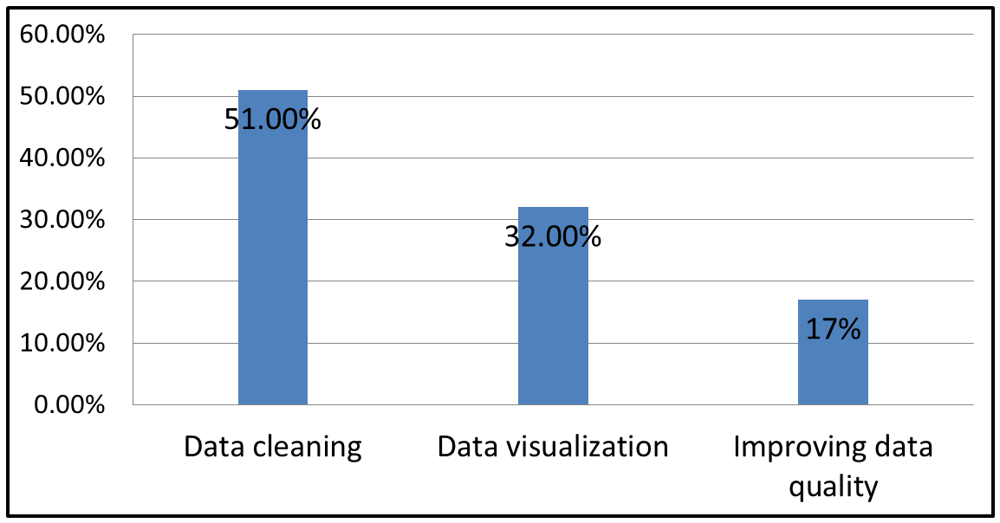
Specific skills which are more useful at the workplace

Slide 12
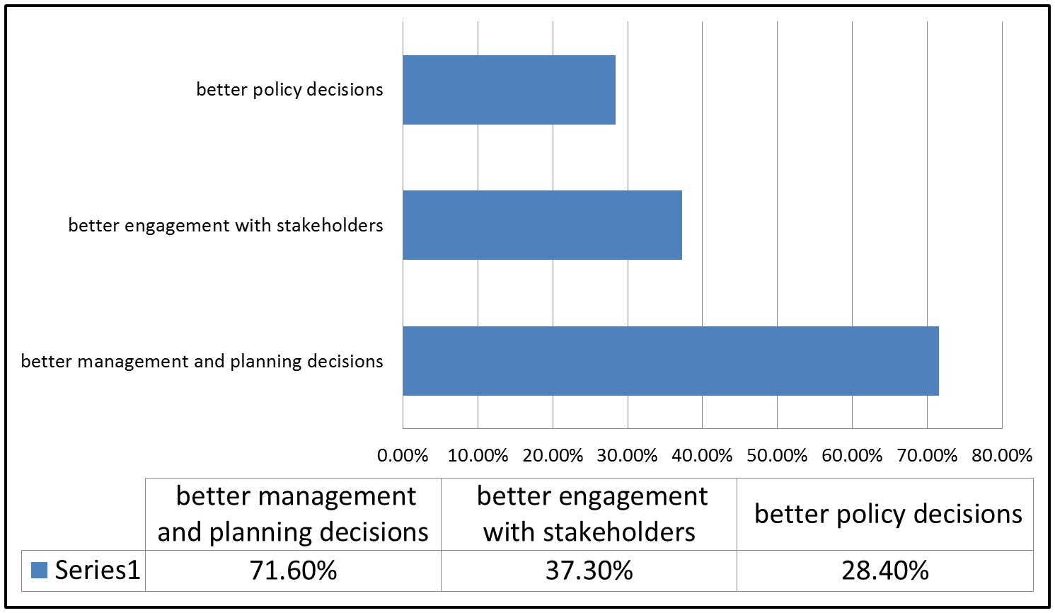
Behavior and improvement in practice as a result of harnessing new skills and knowledge

Slide 13
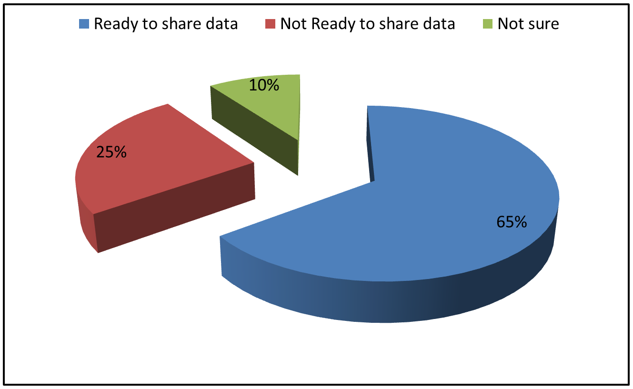
Data Sharing Readiness via Tanzania data lab portal

Slide 14
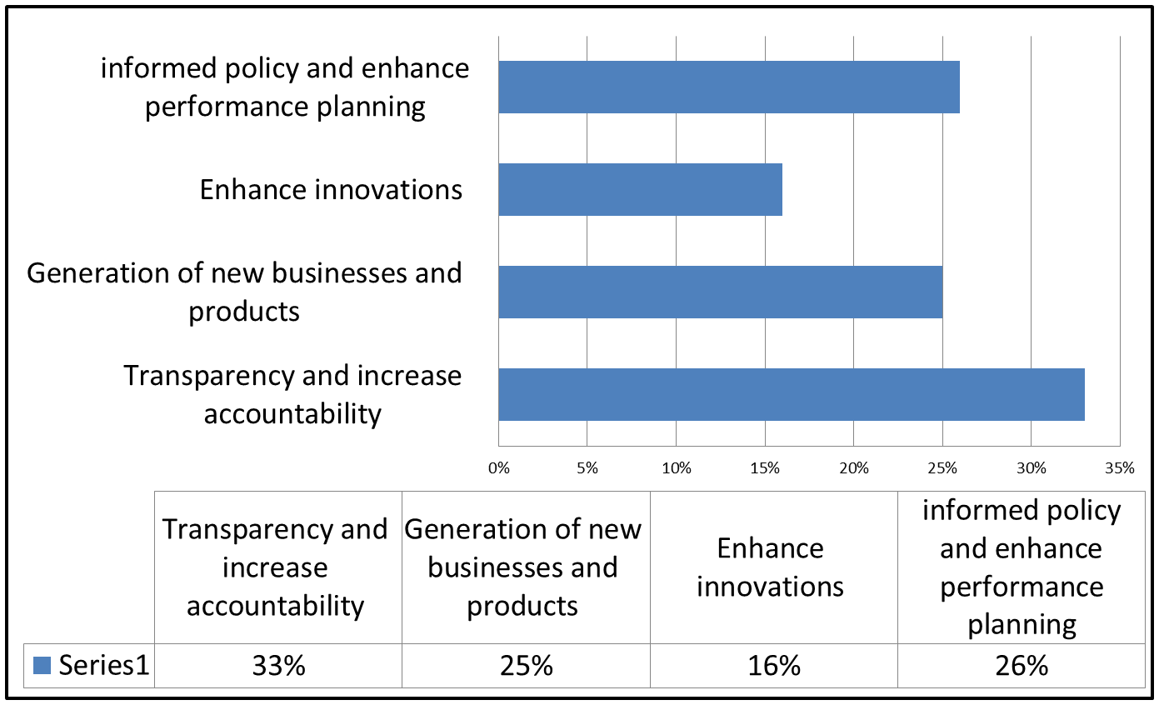
Economic impact of Open data in a country

Slide 15
Conclusion and outlook
In general, the study found that the model was useful
90% of respondents agreed on the importance of data skills obtained and its applicability
65% of respondents were ready to share their data publically through the Tanzania data lab portal.

Slide 16
Conclusion and outlook
In general the results of this study show that Tanzania data lab has its contributions toward unlocking data in Tanzania
According to open data barometer indicator in 2015 Tanzania scored 10.77% while in 2016 scored 21.73.
The achievement might have been contributed by different open data initiatives which are going on in the country i.e:
e-government,
NBS
Tanzania data lab and all Data Collaborative for Local Impact projects (MCC, 2016), CSOs

Slide 17
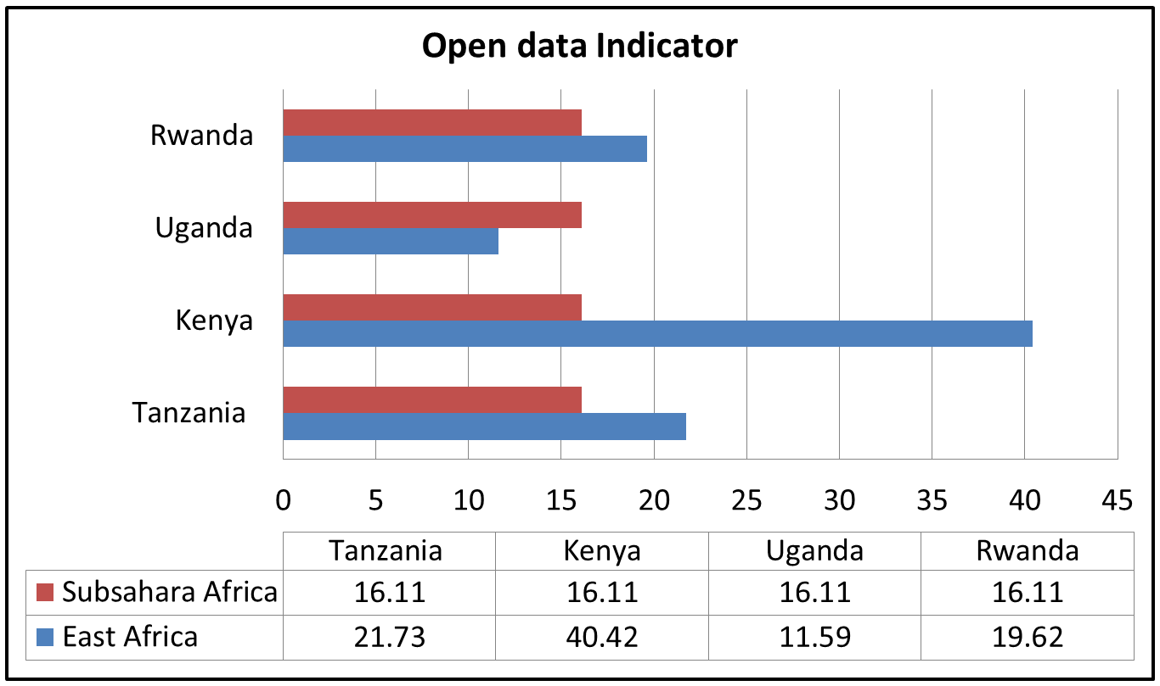
Conclusion and outlook

Slide 18
Recommendations
Open data policy- If enacted as law by the government will go along in solving data publishing and sharing aspects.
Should have more resourceful data portals-Government should be the champion on this
Support Organizations which advocacy open data

Slide 19
THANK YOU FOR LISTENING zaykaijage@gmail.com
@ZKaijage

