Slide 1

(Inter)Active Machine Learning
Introduction
Charles I. Saidu
African University of Science and Technology,
Abuja
isaidu@aust.edu.ng

Slide 2
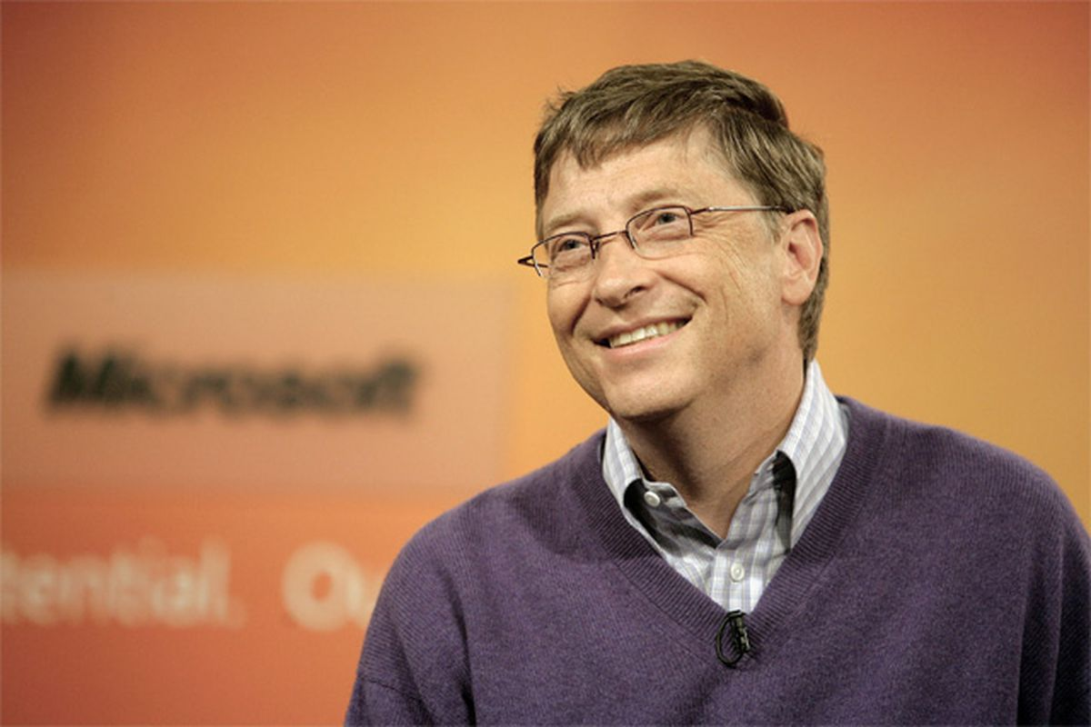
“I will choose a lazy person to do a difficult job because, he will find an easy
way to do it”

Slide 3
Realities of Machine Learning Applications
Unlabeled data is easy to acquire
Sufficient number of labeled data is need for Classification/Regression models (a.ka. Sample Complexity)
Labeling cost does not come cheap (especially for models that require large labeled samples.
Sometimes, labeling can be time consuming
Redundancies in labeled samples,
Etc……..
Hmmmmmm!
Why can’t we just label ONLY what our model need, and how can we do it?
Can we apply the LAZY APPROACH (a.k.a Find a better, smarter and cheaper way to train our models)?

Slide 4
What is Active Learning?
Active learning is a special case of semi-supervised machine learning in which a learning algorithm is able to interactively query the user (or some other information source) to obtain the desired outputs at new data points. In statistics literature it is sometimes also called optimal Experimental design.
In other words, let the learning algorithm ACTIVELY choose the data it wants to learn from…. That way its most likely going to learn more efficiently compared to the traditional (passive) methods

Slide 5
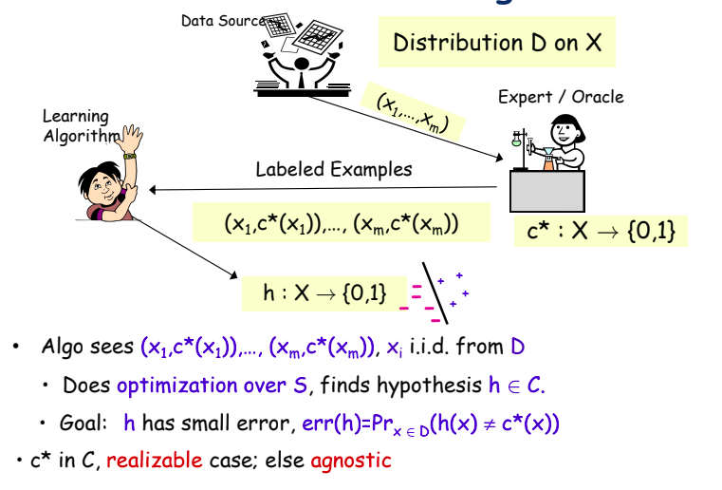
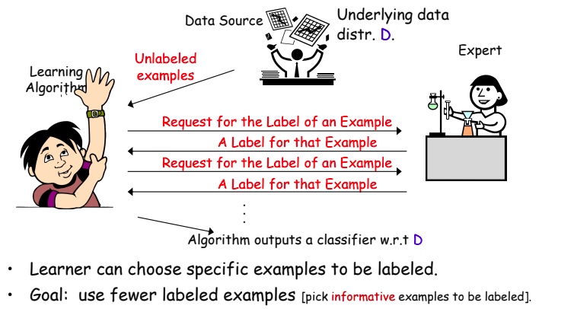
Passive Learning
(Classical Supervised Learning)
Active Learning
Images from Florina Balcan: http://www.cs.cmu.edu/~ninamf/

Slide 6
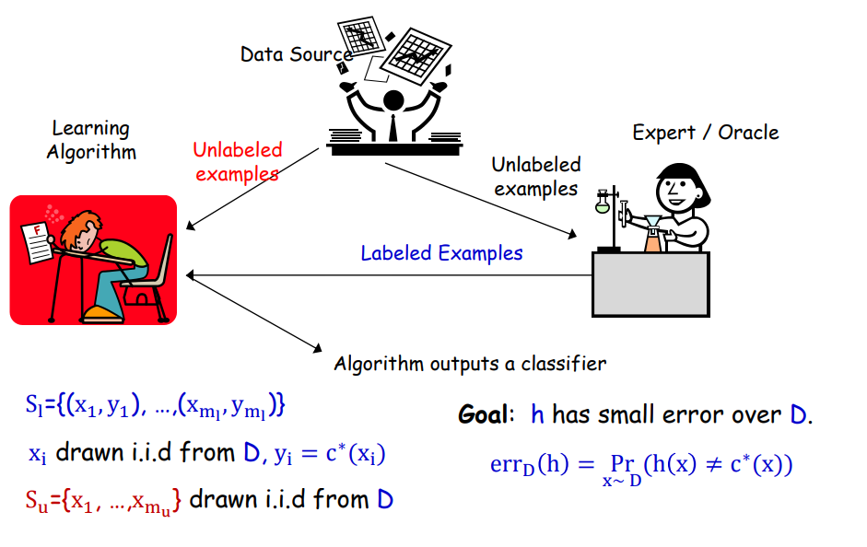
Semi-Supervised learning
Active Learning
Images from Florina Balcan: http://www.cs.cmu.edu/~ninamf/

Slide 7
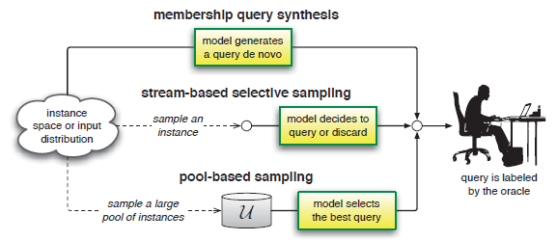
Active Learning Scenario
Image from Steve hanneke

Slide 8
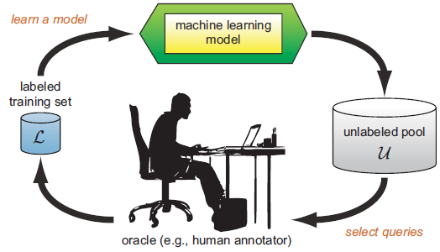
Pool-based Active Learning (This Tutorial)

Slide 9
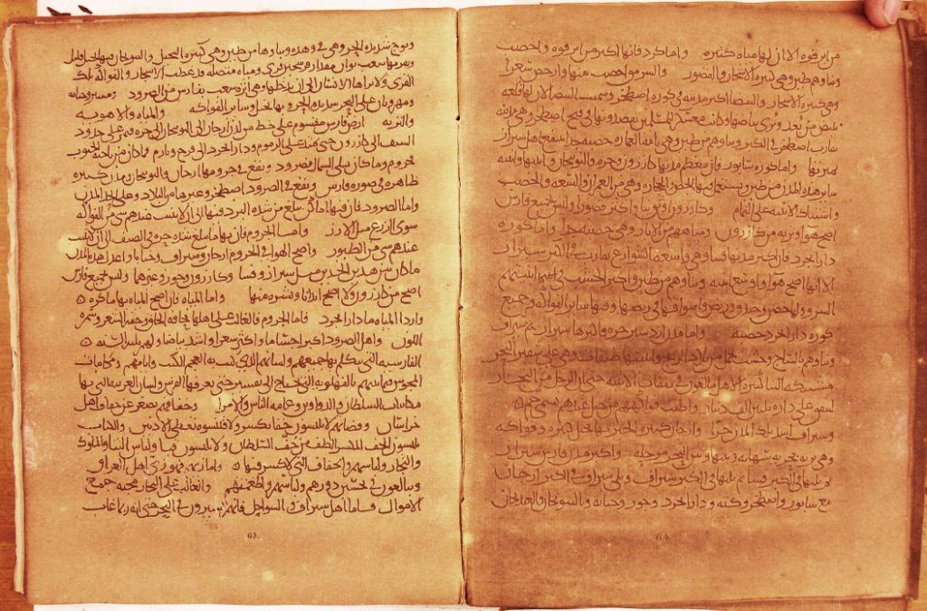
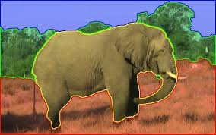
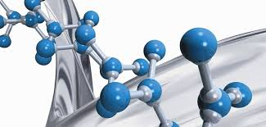
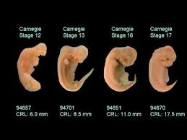
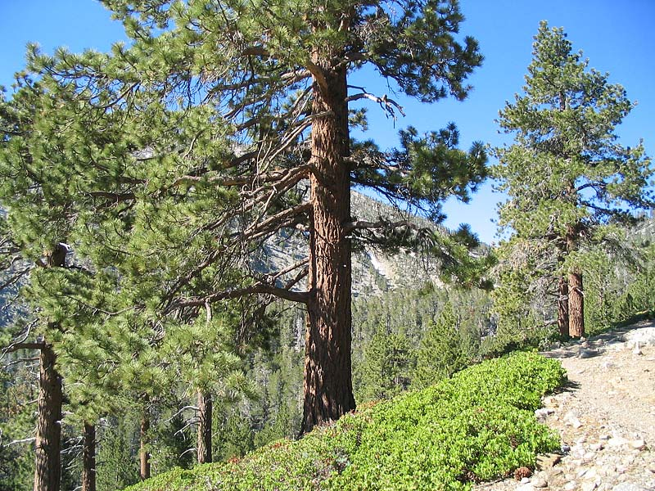
Application Domains
Handwriting and speech recognition
Image Processing
Chemo-informatics
Text processing
Marketing
Ecology
Embryology

Slide 10
Why can’t we just label ONLY what our model need, and how can we do it?
Similary…
How can the learning algorithm SELECT/QUERY ONLY the samples it wants?

Slide 11
Query Strategies
Uncertainty Sampling
Query By Committee
Density-Weighted Methods
Expected Model Change
Variance Reduction
…..
For subsequent slides we assume the following notations:

Slide 12
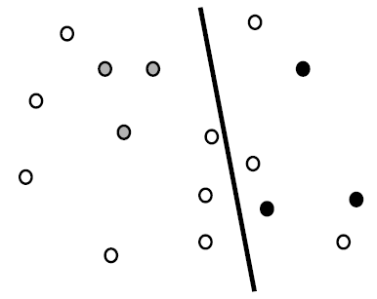
Uncertainty Sampling
An active learner queries the instances about which it is least certain how to label (e.g. closest to the decision boundary).

Slide 13






Uncertainty Measures:
1. Least Uncertainty:
=> max posterio probability under the current model Ө
2.
Margin Based measure:
=> 1st and 2nd max posterio probability under the current model Ө
3. Max entropy:

Slide 14
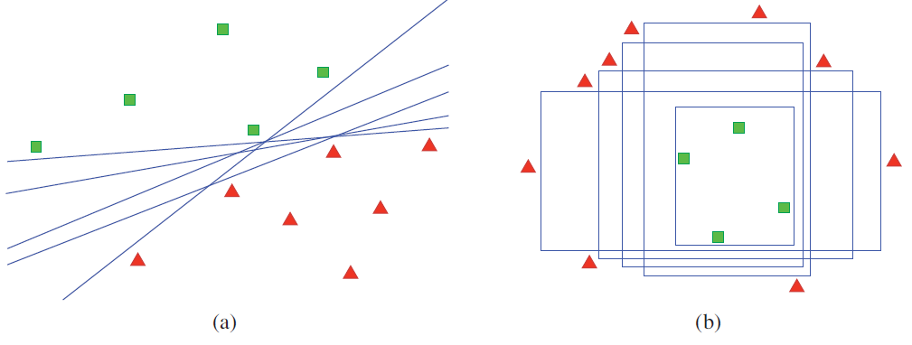
Query by Committee (QBC)
Maintain a committee of models that are ALL trained on the same dataset, with each representing conflicting hypothesis
Each model votes on labeling a sample x
Pick the sample x with the most disgreement/conflicting label (disagreement among hypothesis)
Goal of QBC: minimize the version space (the set of hypotheses that are consistent with the current labeled trained data L), to constrain the size of this space as much as possible with a few labeled instances as possible
Version space examples for (a) linear and (b) axis-parallel box classifiers.
All hypotheses are consistent with the labeled training data in L (as indicated by shaded polygons), but each represents a different model in the version space

Slide 15

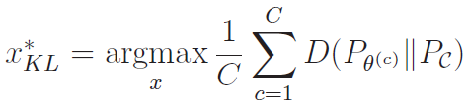

Query measures for QBC:
1. Vote Entropy:
2. Kullback-Leibler Divergence: a measures difference between two probability distributions
C => Represents total number of models

Slide 16
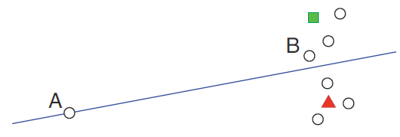
Density Weighted
Less prone to query outliers like Uncertainty, QBC.
Idea is to query instances or samples that are not just uncertain but “informative

Slide 17
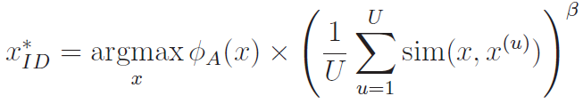
Density Weighted Strategy...
Here φA(x) is the informativeness of x according to some “base” query strategy A, such as an uncertainty sampling or QBC approach. The second term weights the informativeness of x by its average similarity to all other instances in the input distribution (as approximated by U), subject to a parameter β that controls the relative importance of the density term

Slide 18
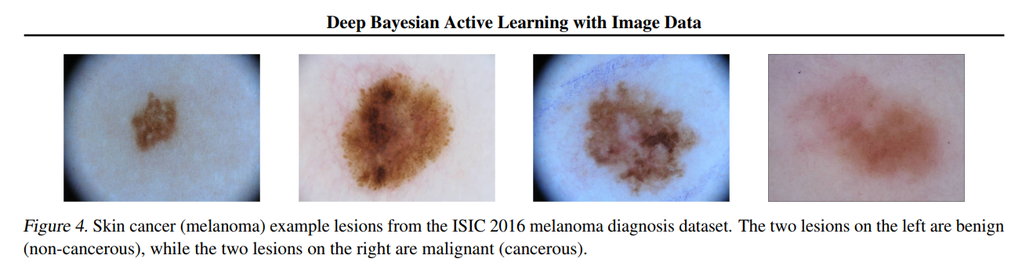
Some Applications
Yarin Gal, et.al

Slide 19
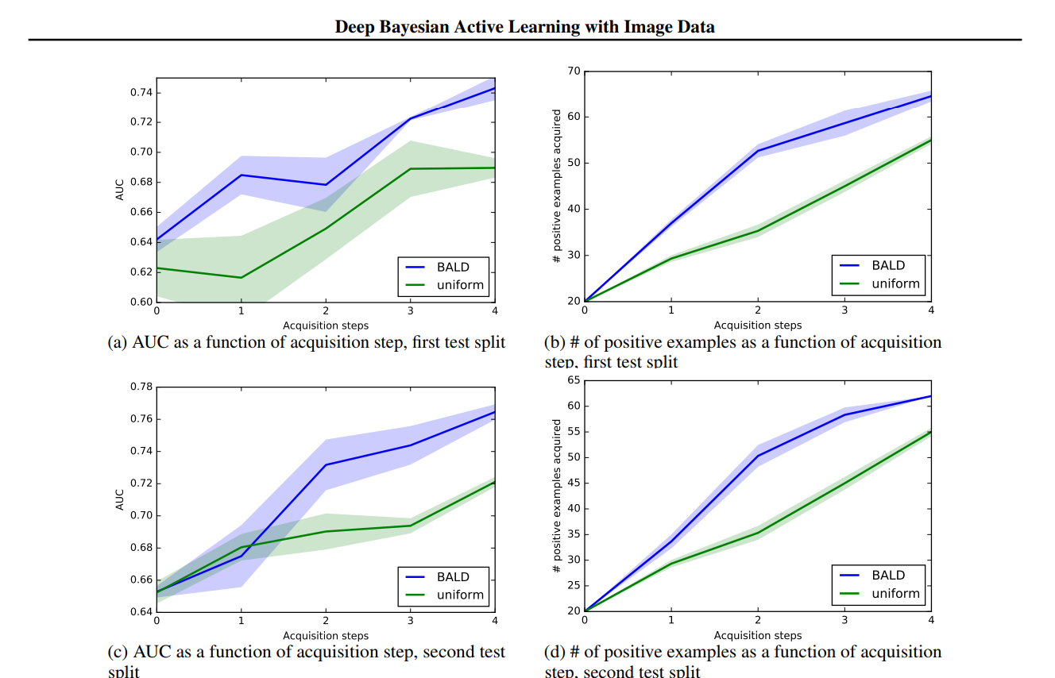
Yarin Gal, et.al

Slide 20
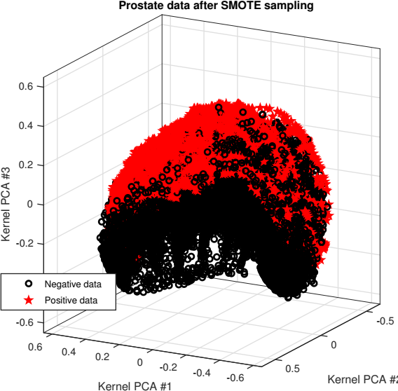
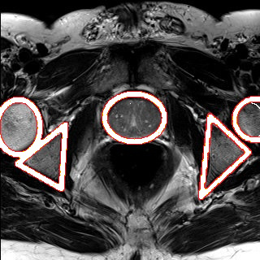
Saidu C. I, Csato. L

Slide 21
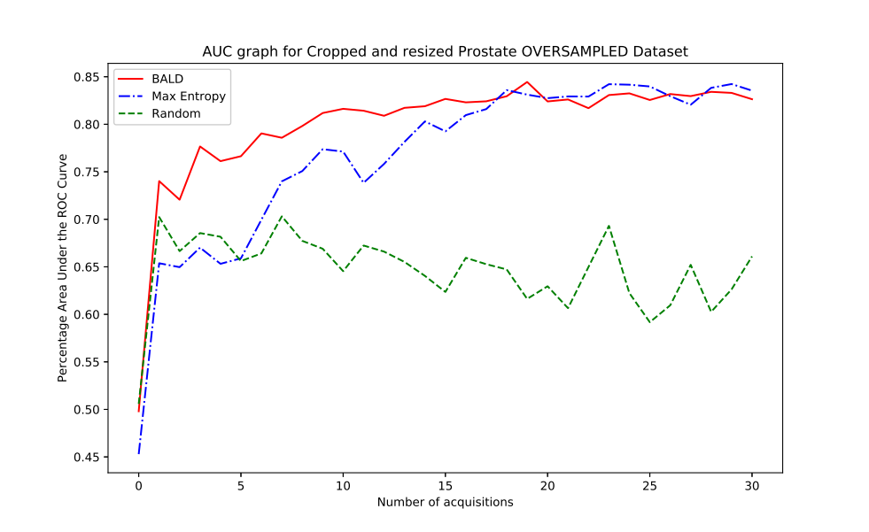
Saidu, I, Csato, L.

Slide 22
Active Learning In Practice
Libact Python Library
Pool-based Active learning library in python
https://libact.readthedocs.io/en/latest/index.html
Easily integrates with scikit-learn

Slide 23
libact Building blocks
Dataset Class: object stores the labeled set and the unlabeled set. Each unlabeled or labeled example within a Dataset object is assigned with a unique identifier.
Labeler: object plays the role of the oracle in the given active learning problem. Its label method takes in an unlabeled example and returns the retrieved label.
Model: object represents a supervised classifiation algorithm. It contains train and predict methods, just like the fit and predict methods of the classification algorithms in scikit-learn. Note that the train method of Model only takes the labeled examples within Dataset for learning. Model can also encapsulate Deep model with probabilistic semantics
QueryStrategy: object implements an active learning algorithm. Each QueryStrategy object is associated with a Dataset object

Slide 24
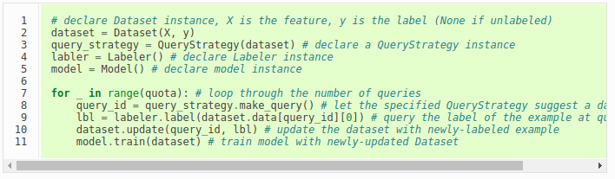
Example usage

Slide 25
More Examples:
https://libact.readthedocs.io/en/latest/examples/examples.html

Slide 26
References
1. B. Setles. Active Learning Literature Survey. Mach. Learn., 15(2):201-221, 2010. ISSN 0048391, doi:10.1.1.167.4245
2. https://libact.readthedocs.io/en/latest/index.html
3.http://www.cs.cmu.edu/~ninamf/courses/601sp15/lectures.shtml

