Slide 1


AirQo Project
Lillian Muyama
Data Scientist

Slide 2
What is AirQo?
AirQo is a social impact project under the department of computer science at the College of Computing and Information Sciences in Makerere University.
We are building and deploying a network of low-cost air quality monitors in Kampala and across Uganda as a whole.
In line with the Sustainable Development Goals

Slide 3
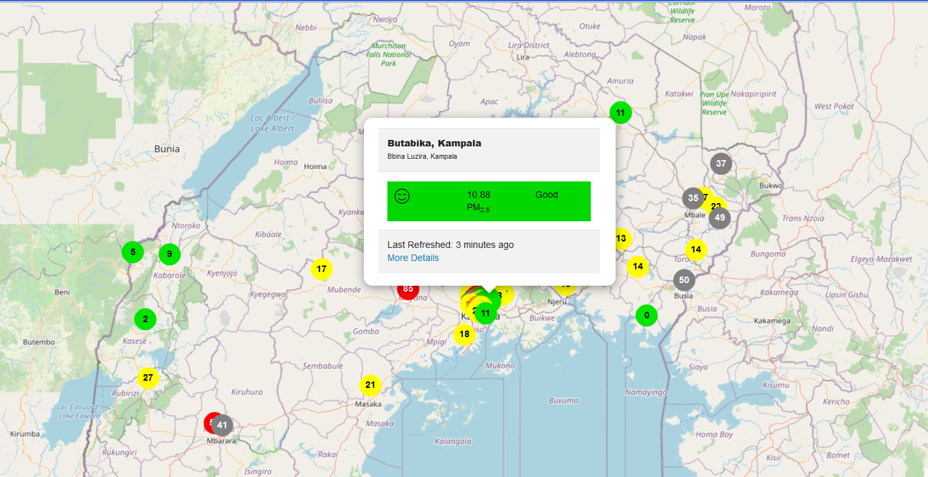
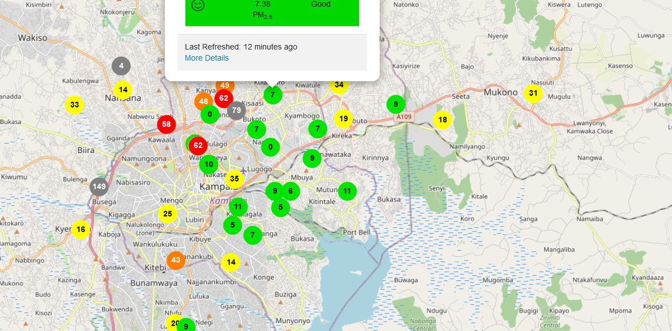
Our installations

Slide 4
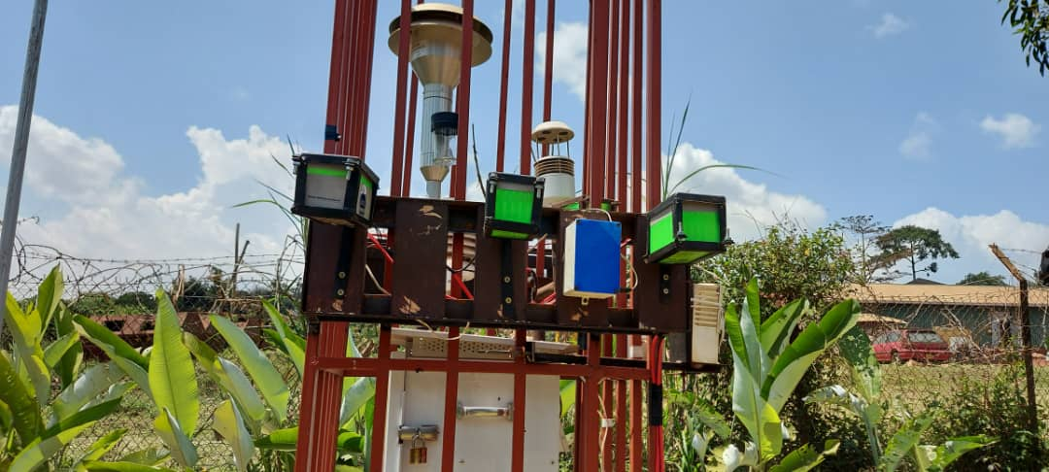
Our installations

Slide 5
AI Usage
Calibration of our low-cost devices
Predicting the air quality in areas without AirQo devices
Making hourly forecasts on the AirQo website
Sensor placement optimization

Slide 6
Contact Information
Physical Address: Software Systems Centre
Block B, Level 3
School of Computing and Informatics Technology
Makerere University
Email address: info@airqo.net
Website: https://airqo.net/
The AirQo app is available in the Google Play Store as well as the App Store.

Slide 7
Thank you

