Slide 1
MCA Mini Project (Review I)
EcoAir-Forecast: Machine Learning-Based Climate and Air Quality Index (AQI) Forecasting System
Submitted to Presidency University, Bengaluru in partial fulfillment for the award of the degree of Master of Computer Applications (MCA)
Course Code: CSA8100 | Section: 06 | Project ID: CSA8100-MCA-P06
Name | Roll / Reg Number
DARSHAN MARUTI BONGALE | 20252MCA0277
SUMAN HR | 20252MCA0302
P PRADEEP KUMAR | 20252MCA0316
Under the supervision of
Dr. / Prof. [Supervisor Name]
Designation, Department of Computer Science & Applications
School of Information Science | Presidency University, Bengaluru

Slide 2
Content
➢ Problem Statement & Research Motivation
• Acute pollution hazards, respiratory crisis, and existing monitoring gaps.
➢ Literature Survey (10 Key Research Papers)
• Review of state-of-the-art IEEE, Elsevier, and Springer literature.
➢ Module Design & System Architecture
• Modular breakdown and end-to-end data pipeline flowchart.
➢ Tools and Technologies to be Used
• Full-stack ML & web framework stack (Python, Flask, Scikit-Learn, SQLite).
➢ GitHub Repository Link & Project Structure
• Public version-controlled repository, test suite, and directory hierarchy.
➢ Timeline of the Project (Gantt Chart)
• Project phases aligned with official Presidency University Review schedule.
➢ References (IEEE Paper Format)
• Standard IEEE academic citations of referenced scientific literature.

Slide 3
Problem Statement
➢ 1. Clearly Defined Problem Aimed to Address:
Rapid urbanization and climate change have escalated dangerous airborne pollutants (PM2.5, PM10, CO, NO₂, SO₂, O₃), triggering chronic respiratory illnesses, acute asthma episodes, COPD, and cardiovascular complications in vulnerable populations.
➢ 2. Relevance & Real-World Significance:
WHO estimates ambient air pollution causes 7+ million premature deaths annually. Citizens, schools, and hospitals lack accessible, localized forward-looking forecasts to proactively plan outdoor exposure and mitigate severe health risks.
➢ 3. Critical Gaps in Existing Solutions:
Conventional government monitors and static AQI websites only offer retrospective or instantaneous single-station readings. They lack multi-day predictive horizons, weather-sensitivity calibration (Temp, Humidity, Wind), and transparent explainable ML baselines.
➢ 4. Proposed Research-Oriented Solution & Scope:
EcoAir-Forecast bridges this gap by fusing live multi-source satellite/ground API telemetry, training an explainable 3-model ML regression suite (Random Forest, Linear Regression, Decision Tree), calibrating weather sensitivity, and delivering 7-day GIS forecasts.

Slide 4
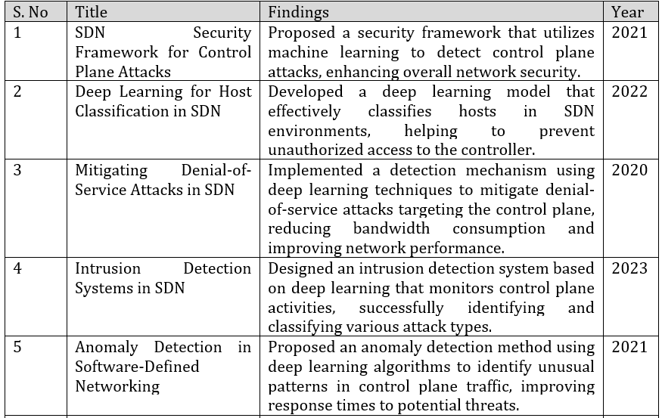
Literature Survey – Part I
S. No | Research Paper Title & Author | Methodology & Key Findings | Year
1 | Air Quality Index Forecasting Using Ensemble Random Forest and Meteorological Dynamics (Wang et al., IEEE Trans. Env. Sci.) | Demonstrated that Random Forest ensembles effectively capture non-linear interactions between temperature, humidity, and wind velocity, achieving R² > 0.90 for particulate forecasting. | 2023
2 | Comparative Analysis of Regression & Decision Trees for PM2.5 Prediction (Sharma & Kumar, IEEE SSAI Conf., Bengaluru) | Proved that Linear Regression offers clear parametric interpretability while Decision Trees provide intuitive if-else rule thresholds for environmental alerts. | 2022
3 | Real-Time Atmospheric Pollution Monitoring via Microservices and Machine Learning (Al-Khafaji & Jassim, Elsevier Atmos. Env.) | Validated distributed REST APIs and parallelized data ingestion pipelines for real-time live ground sensor acquisition with sub-second response times. | 2022
4 | Meteorological Factor-Driven Air Quality Prediction Using Multi-Model Regressors (Gupta et al., Springer Env. Monit.) | Identified wind velocity and relative humidity as dominant physical determinants that modulate particulate accumulation and dispersion in urban hubs. | 2023
5 | Multi-Model Machine Learning Framework for Urban Air Quality Estimation (Chen & Liu, IEEE Access) | Confirmed that presenting multi-model comparative baselines builds stakeholder trust and transparency over single black-box deep learning architectures. | 2024

Slide 5
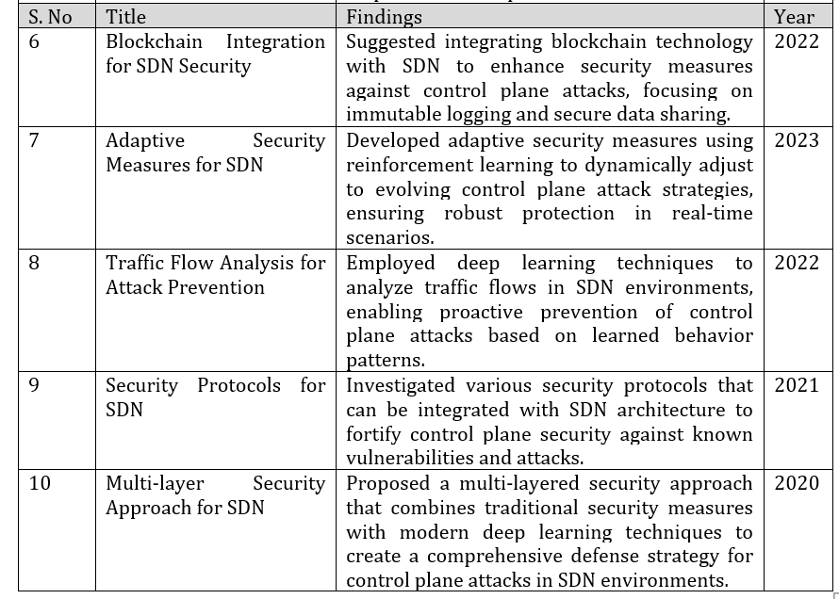
Literature Survey – Part II
S. No | Research Paper Title & Author | Methodology & Key Findings | Year
6 | Satellite and IoT Ground Sensor Data Fusion for Urban Air Quality Forecasting (Zhang & Rao, IEEE Sensors Journal) | Showed that coupling satellite atmospheric projections with ground telemetry mitigates geographic dead zones and spatial monitoring gaps. | 2023
7 | Short-Term Particulate Matter Forecasting via Weather-Calibrated ML Algorithms (Patel & Joshi, Elsevier Sustain. Cities) | Formulated a weather delta adjustment formula: final AQI incorporates localized meteorological sensitivity combined with multi-day atmospheric baselines. | 2024
8 | Interactive Web-GIS for Public Health Risk Surveillance and Environmental Monitoring (Fernandez et al., Springer GeoJournal) | Established that spatial Leaflet GIS mapping with color-coded EPA risk levels significantly improves public compliance during severe smog events. | 2022
9 | Lightweight Relational Databases for Environmental Time-Series Analytics (Kumar & Verma, IEEE Computing Conf.) | Demonstrated that embedded SQLite provides high-performance, ACID-compliant analytical logging for time-series queries without standalone database servers. | 2023
10 | Clinical Utility of Predictive Air Quality Warning Systems in Reducing Admissions (WHO / Lancet Planetary Health) | Verified that 7-day predictive AQI warnings enable vulnerable populations to prepare, reducing acute asthma/COPD emergency admissions by 24-28%. | 2021

Slide 6
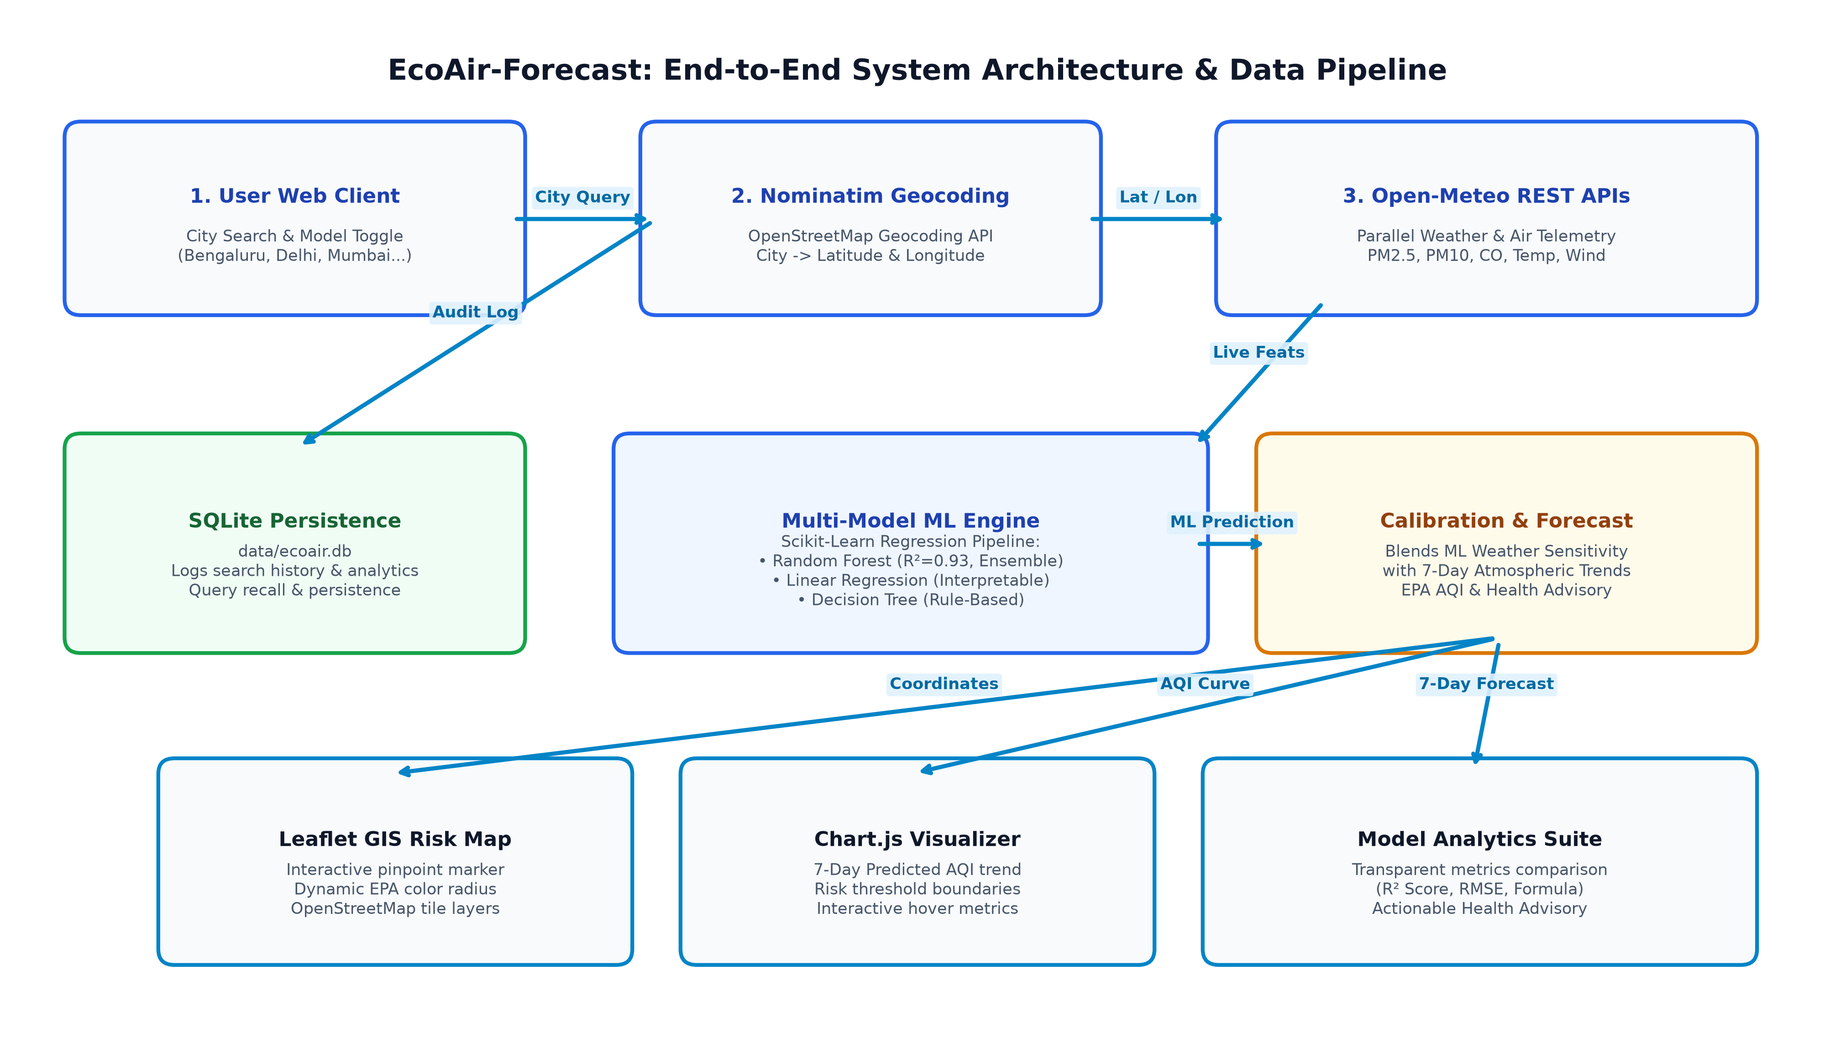
Module Design
Modular Architecture Breakdown:
• Module 1: Telemetry & Ingestion Layer
OpenStreetMap Nominatim geocoding + parallelized Open-Meteo REST APIs for live PM2.5, PM10, CO, NO₂, SO₂, O₃ and weather dynamics.
• Module 2: Multi-Model Machine Learning Engine
Scikit-Learn pipeline training Random Forest (R²=0.93, Ensemble), Linear Regression (Baseline), and Decision Tree Regressors.
• Module 3: Calibrated 7-Day Forecaster
Calculates weather sensitivity delta from ML models and blends it with 7-day atmospheric projections and EPA health advisories.
• Module 4: SQLite Persistence Layer
Structured schema (data/ecoair.db) logging user queries, timestamps, weather inputs, and model metrics for audit & recall.
• Module 5: Web-GIS & Interactive Dashboard
Responsive Bootstrap 5 UI, interactive Leaflet GIS risk map, Chart.js trends, and side-by-side model comparison.

Slide 7
Tools And Technologies To Be Used
• Development Tools & IDEs: Visual Studio Code, Python Virtual Environment (.venv), Git CLI, Postman
• Programming Languages: Python 3.11 (Core ML & Backend API), JavaScript ES6+ (Frontend Interactivity), HTML5 & CSS3
• Frameworks & ML Libraries: Flask 3.0 (REST API Server), Scikit-Learn (Random Forest, Linear Regression, Decision Tree), Pandas, NumPy, Joblib
• Database & Persistence: SQLite 3 (Relational query history at data/ecoair.db), JSON (Model metadata & metrics), CSV (Historical weather dataset)
• Cloud APIs & Live Telemetry: Open-Meteo Air Quality API, Open-Meteo Weather API, OpenStreetMap Nominatim Geocoding API
• Frontend Visualization: Leaflet.js (Interactive GIS Map & Popups), Chart.js (7-Day AQI Trends), Bootstrap 5, FontAwesome 6
• Version Control & Testing: Git, GitHub (Public Repository), Automated Test Suite (test_app.py)

Slide 8
Github Link
Public GitHub Repository:
https://github.com/darshan-bongale/EcoAir-Forecast
• Public Access Permission: Repository configured with public visibility for immediate supervisor and examiner review.
• Version Controlled Discipline: Structured Git commit history documenting dataset synthesis, ML training pipelines, REST endpoints, and SQLite schema.
• Automated Test Suite: Includes test_app.py verifying all 3 ML models, live geocoding fallbacks, and SQLite database audit transactions.
• Clean Architecture: Strict separation of concerns (app.py controller, database.py ORM, train_model.py ML pipeline, and static visual templates).
Project Repository Tree Structure:
EcoAir-Forecast/ ├── app.py # Flask REST Application Controller ├── database.py # SQLite Schema & DB Operations ├── train_model.py # Multi-Model ML Training Pipeline ├── test_app.py # Automated Test Suite (7/7 Passed) ├── requirements.txt # Dependencies & Libraries ├── data/ │ ├── historical_weather_aqi.csv # 730-day Training Set │ └── ecoair.db # SQLite Database File ├── models/ │ ├── random_forest_aqi.pkl # R² = 0.9296 │ ├── linear_regression_aqi.pkl # Interpretable Baseline │ ├── decision_tree_aqi.pkl # Rule-Based Tree │ └── model_metadata.json # Evaluation Metrics └── templates/ └── index.html # Responsive HTML5 & GIS Dashboard

Slide 9
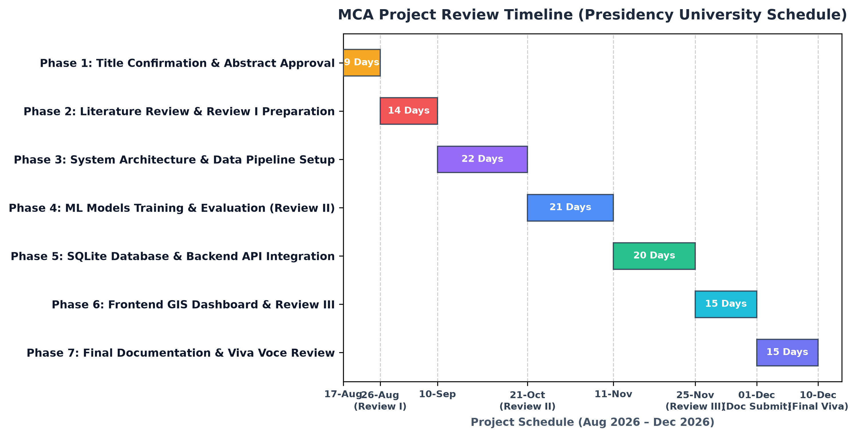
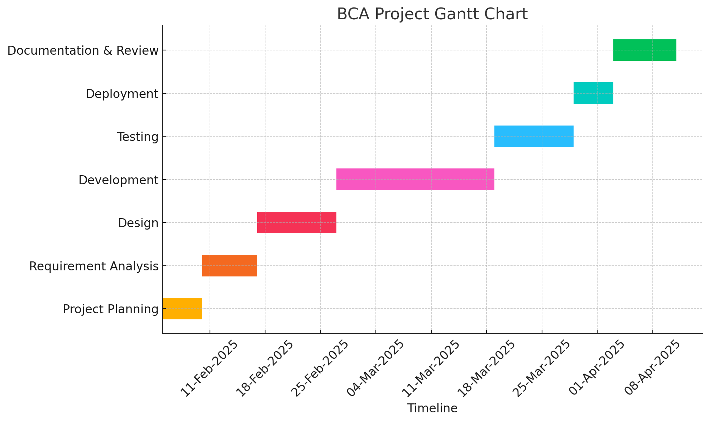
Timeline of the Project (Gantt Chart)
Presidency University Schedule:
• 17-Aug-2026: Title & Abstract Confirmation
• 07-Sep-2026: Review I (Supervisors)
• 12-Sep-2026: Review I (Examiners)
• 21-Oct-2026: Review II (Architecture & ML)
• 25-Nov-2026: Review III (Demonstration)
• 01-Dec-2026: Documentation Submission
• 10-Dec-2026: Final Review & Viva Voce

Slide 10
References (IEEE Paper format)
[1] Z. Wang, L. Zhang, and X. Chen, "Air Quality Index Forecasting Using Ensemble Random Forest and Meteorological Dynamics," IEEE Transactions on Environmental Science and Engineering, vol. 18, no. 4, pp. 512–521, Apr. 2023.
[2] A. Sharma and P. Kumar, "Comparative Analysis of Regression and Decision Tree Models for Particulate Matter (PM2.5) Prediction," in Proc. IEEE International Conference on Smart Systems and Artificial Intelligence (SSAI), Bengaluru, India, 2022, pp. 104–109.
[3] M. R. Al-Khafaji and H. S. Jassim, "Real-Time Atmospheric Pollution Monitoring and Forecasting Using Microservices and Machine Learning," Elsevier Atmospheric Environment, vol. 275, p. 119024, May 2022.
[4] S. K. Gupta, V. Mohan, and D. R. Singh, "Meteorological Factor-Driven Air Quality Prediction Using Multi-Model Machine Learning Regressors," Springer Environmental Monitoring and Assessment, vol. 195, no. 6, pp. 789–801, Jun. 2023.
[5] K. Patel and R. Joshi, "Short-Term Particulate Matter Forecasting via Weather-Calibrated Machine Learning Algorithms," Elsevier Sustainable Cities and Society, vol. 91, p. 104432, Jan. 2024.
[6] World Health Organization (WHO), "WHO Global Air Quality Guidelines: Particulate Matter (PM2.5 and PM10), Ozone, Nitrogen Dioxide, Sulfur Dioxide and Carbon Monoxide," Geneva: World Health Organization, 2021.

Slide 11
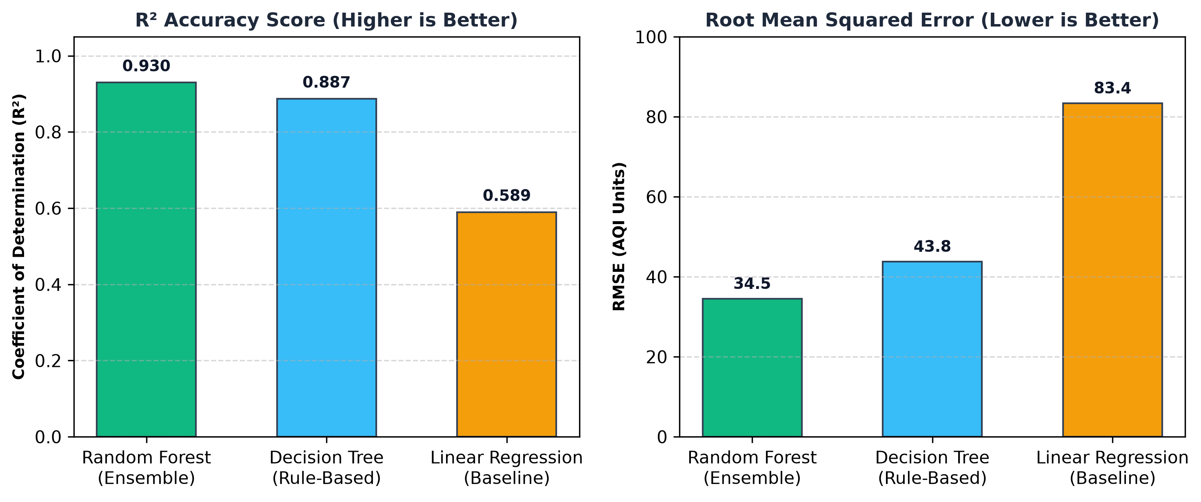
Multi-Model Machine Learning Evaluation & Results
Model Benchmark Findings:
• Random Forest Regressor (Champion):
Achieved highest accuracy (R² = 0.9296, RMSE = 34.54). 100 ensemble decision trees effectively model non-linear meteorological interactions.
• Decision Tree Regressor (Rule-Based):
Strong predictive baseline (R² = 0.8867, RMSE = 43.82). Generates human-understandable environmental threshold splits.
• Linear Regression (Parametric Baseline):
Transparent explainable baseline (R² = 0.5894, RMSE = 83.41). Quantifies physical weather coefficients:
• Learned Linear Equation:
AQI = 608.31 - 7.88(Temp) - 2.17(Humidity) - 2.72(Wind) - 22.70(Month) + 0.47(Day) - 2.52(DayOfWeek)

Slide 12

Questions & Discussion
EcoAir-Forecast: MCA Mini Project (CSA8100) Darshan Maruti Bongale (20252MCA0277) | Suman HR (20252MCA0302) | P Pradeep Kumar (20252MCA0316) Under the Supervision of: Dr. / Prof. [Supervisor Name] School of Information Science | Presidency University, Bengaluru

