Slide 1
IT Seminar #13
Danish/Finnish Day 1

Slide 2
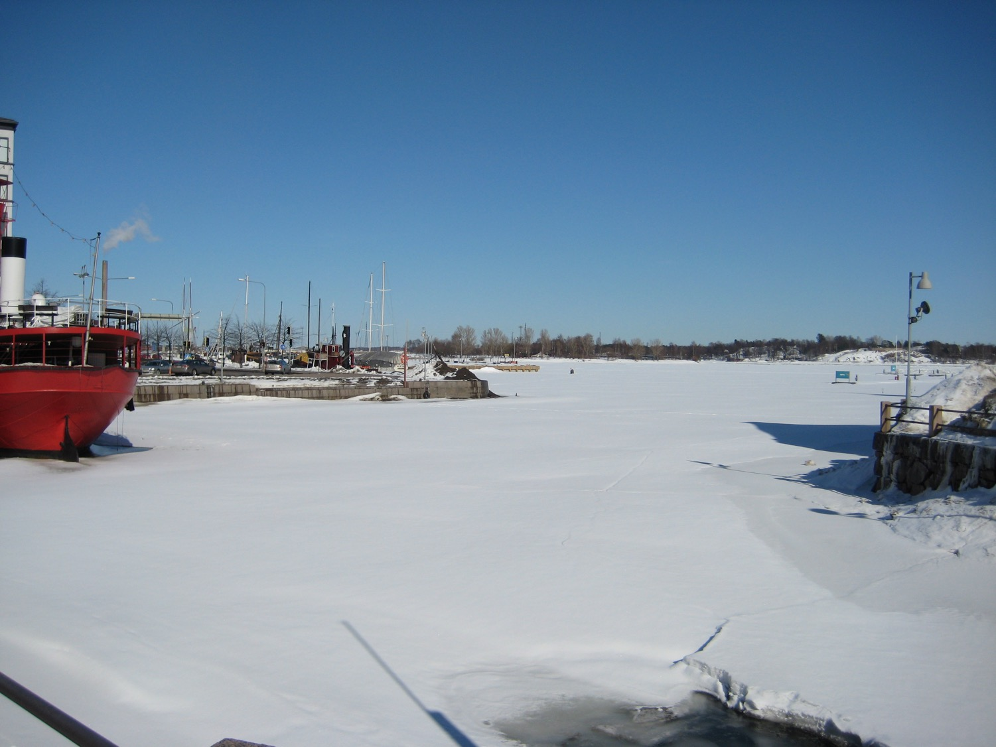
Notes:
2010 Helsinki

Slide 3
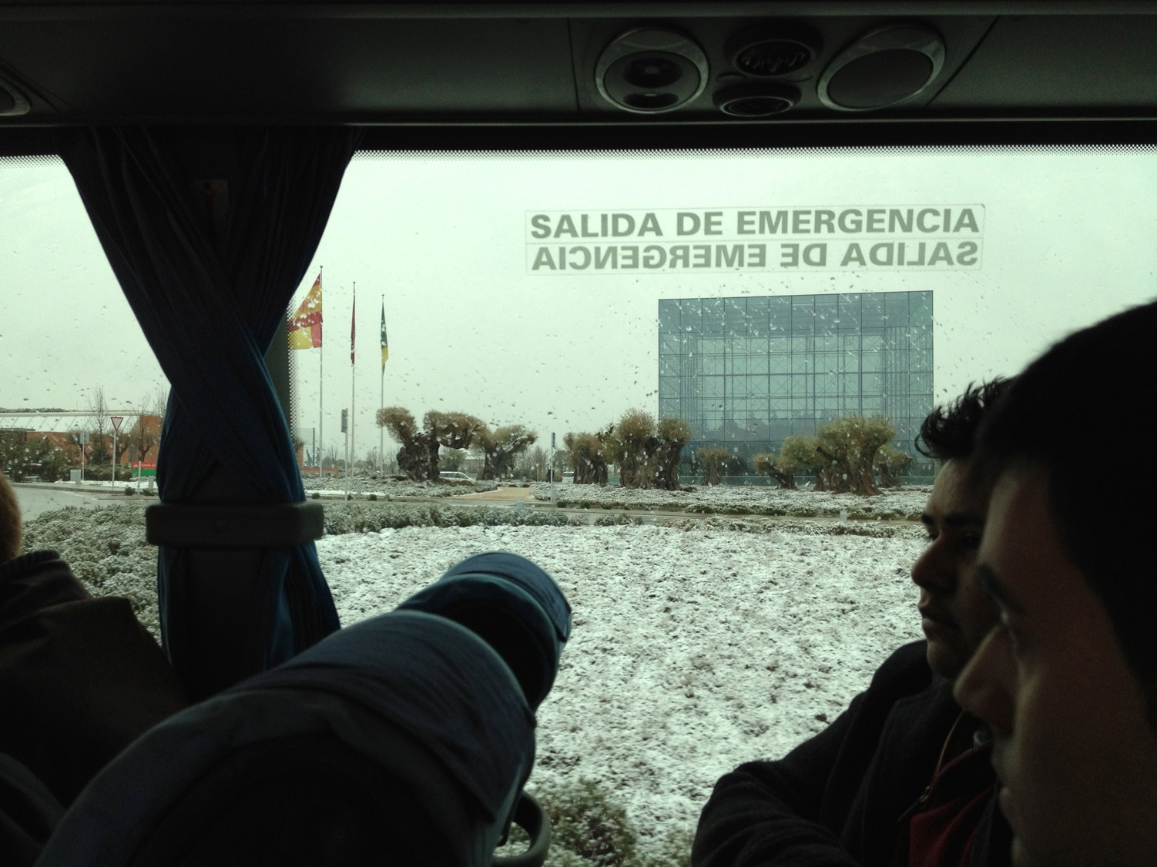
Notes:
2012 Madrid

Slide 4
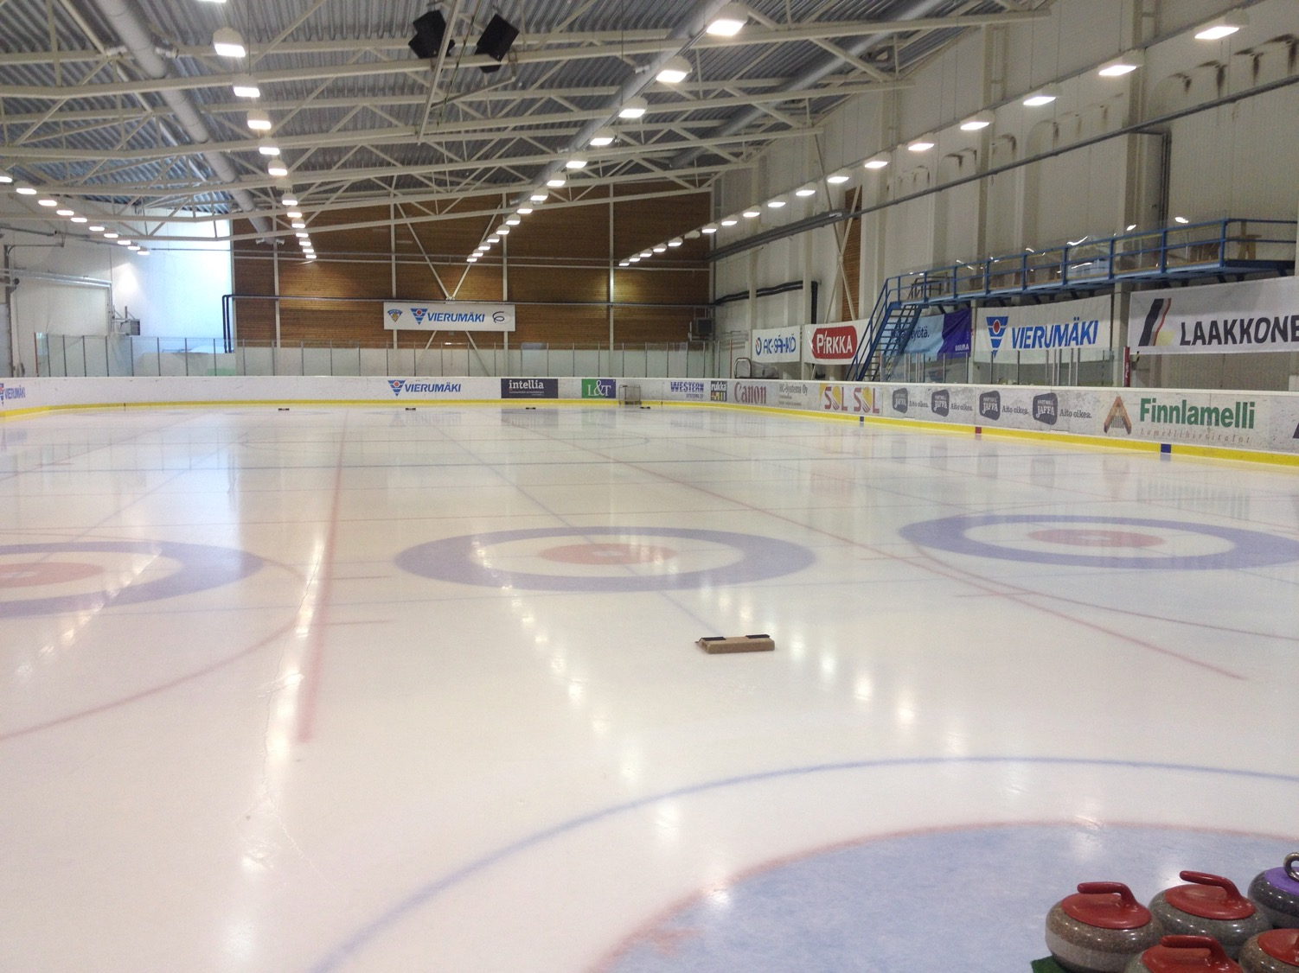
Notes:
2014 Helsinki

Slide 5
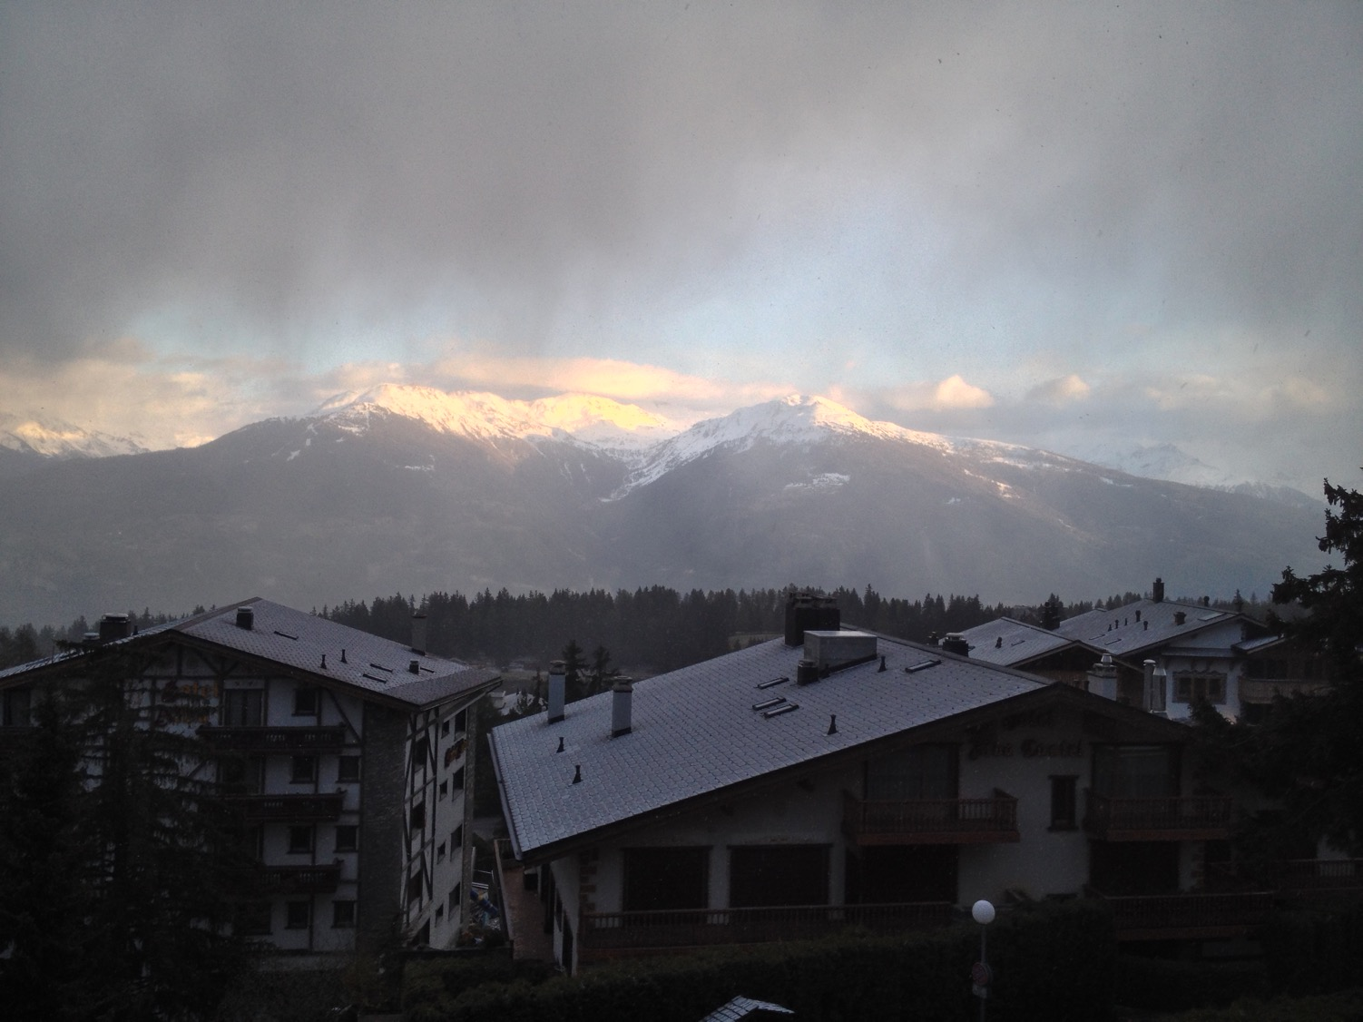
Notes:
2017 Sierre

Slide 6

Largest business academy in Denmark
5.800 full time students
7.200 part time students
380 employees
Five campuses in Copenhagen and Northern Zealand
Notes:
900 international students

Slide 7
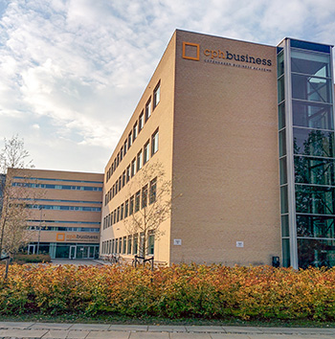
Lyngby campus
Computer Science
Multimedia
Marketing
Finance
Controller
Sport
Entrepreneurship
Bachelor top-ups
Notes:
900 international students

Slide 8
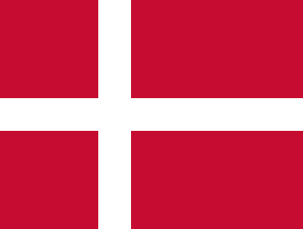
Denmark
Size: ¾ of EU
If we include Greenland
And goes back to about 1450
Status in 2017: ≈ 1% of EU
Size:
¾
of
EU
Dannebrog – the oldest national flag in use
Fell from Heaven in 1219 in Estonia when
Valdemar Atterdag was re-christening the Estonians
But we have …

Slide 9
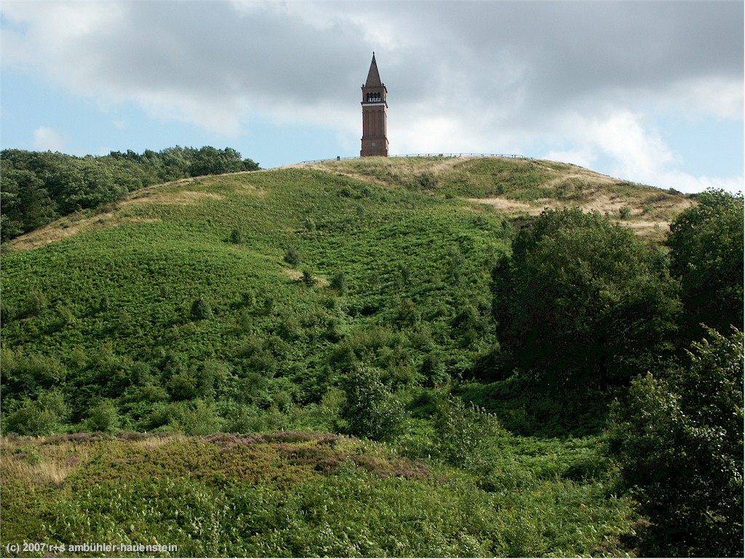
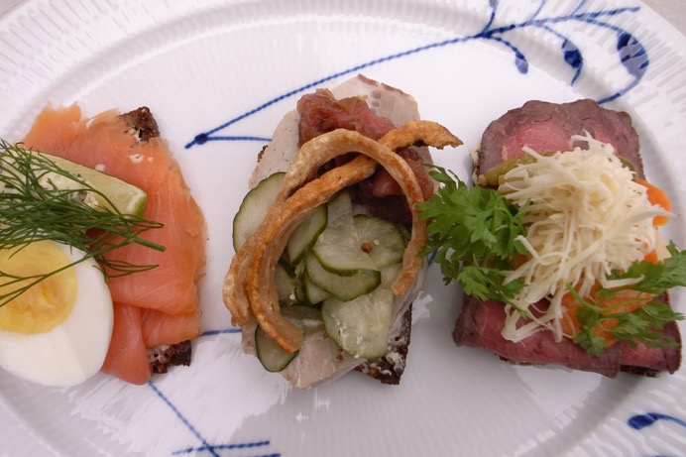
Sky mountain
Danish weather
147 m
But Yding Skovhøj is even higher
172,54 m including a bronze age burial mound
The land of “smørrebrød” open sandwiches Royal Copenhagen, Carlsberg, and Lego

