Slide 1
Algorithms & Data Structures
Graphs – Part III – Topological sorting, PC scheduling
Jacob Trier Frederiksen & Anders Kalhauge
Spring 2019

Slide 2
Program, Week 15
Mentimeter: review of curriculum self-evalution results
Presentation from all groups of Assignment #4, Airline Network
Topological order
Precedence-constrained scheduling
Reverse DFS postorder
Topological sorting
Exercises
The plan ahead, towards the final exam
Begin review of core curriculum

Slide 3

Mentimeter, self-evaluation on curriculum.

Slide 4
Student Presentations – Assignment #4, Airline Networks
All teams are up.

Slide 5
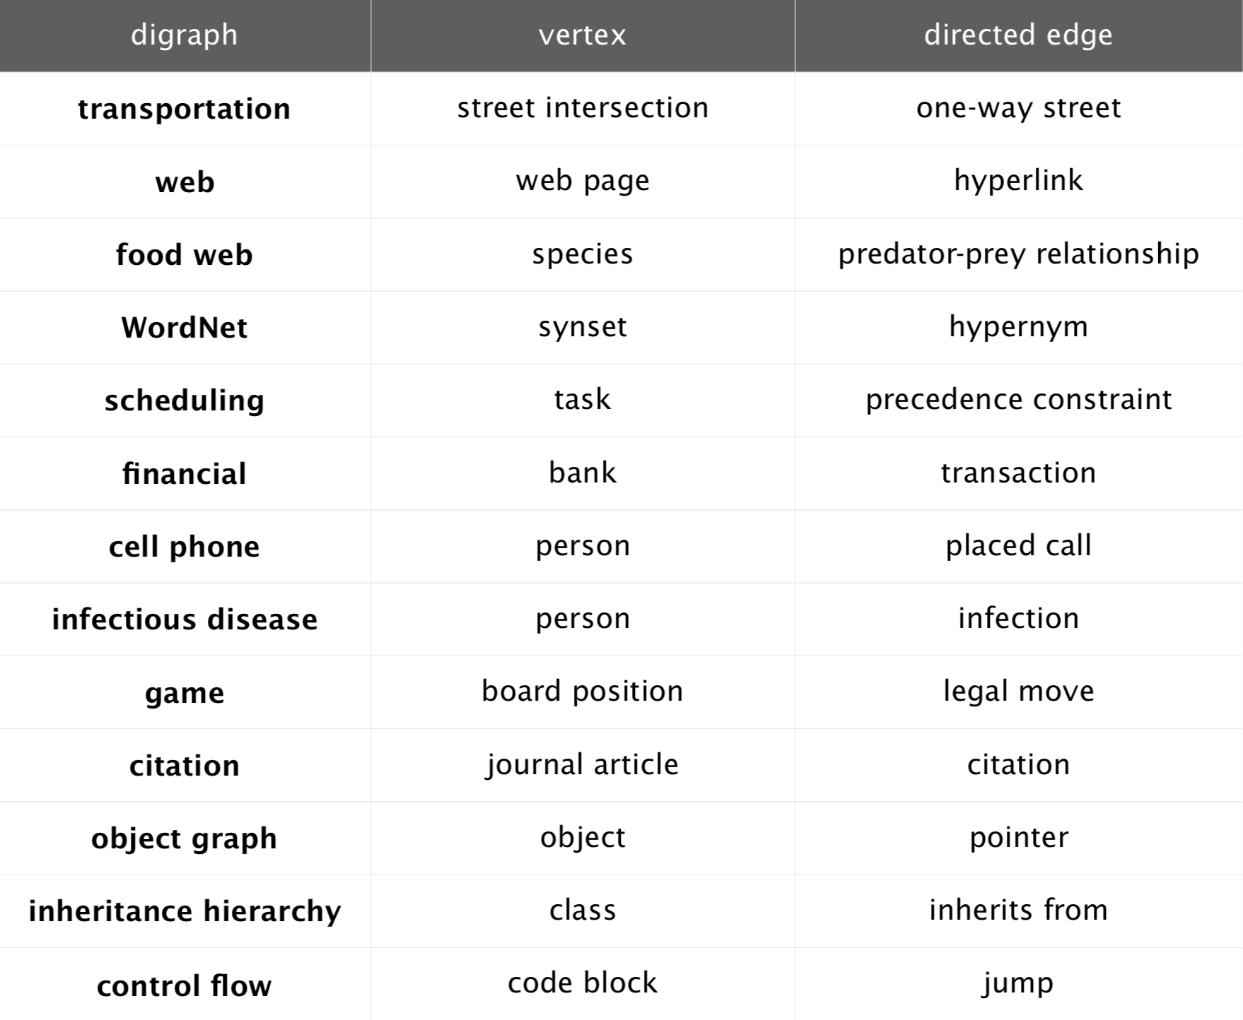
Applications of digraphs

Slide 6
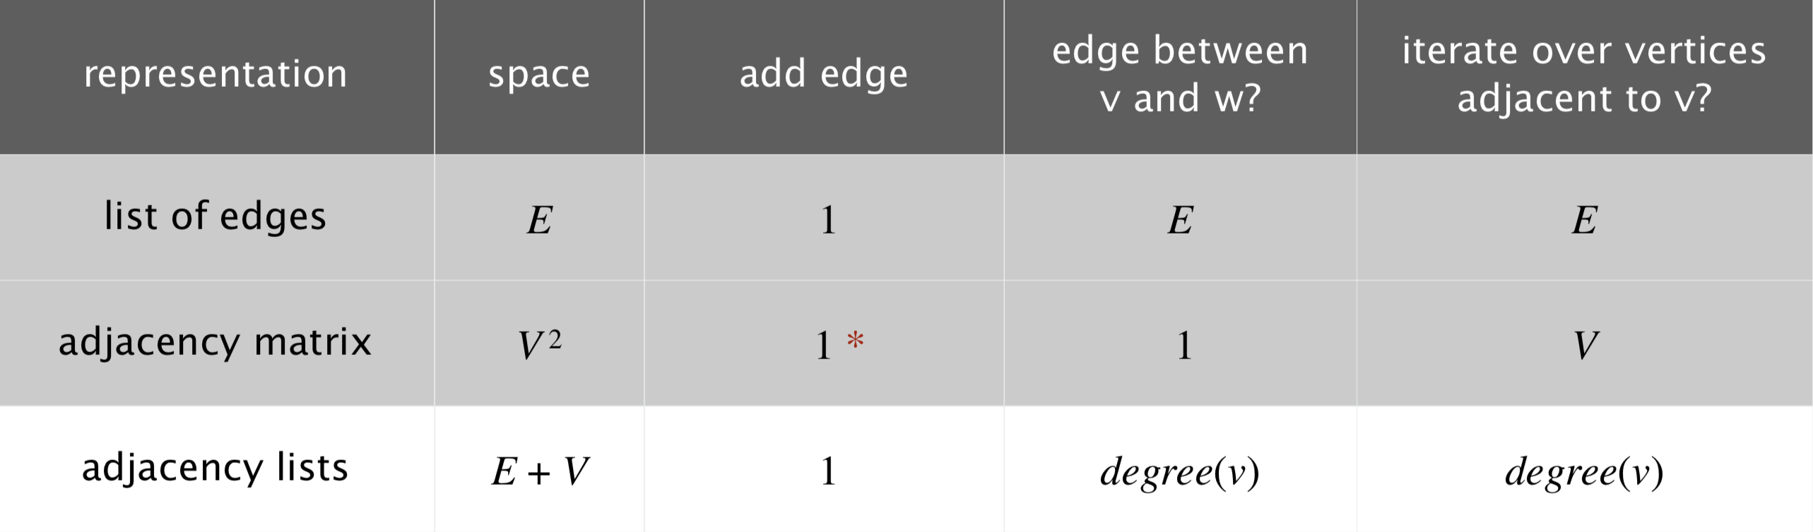
Graphs – representations, data structures.
Array of edges, E? Nope.
Adjacency matrix, VxV? Nope.
Array of adjacency lists? Yep.

Slide 7
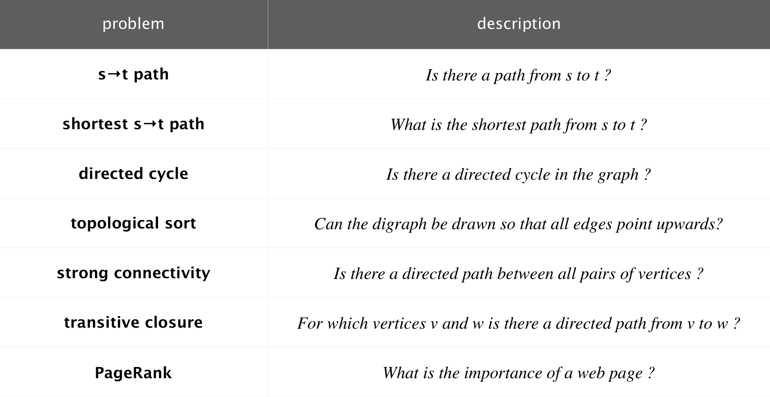
Typical digraph theory questions

Slide 8
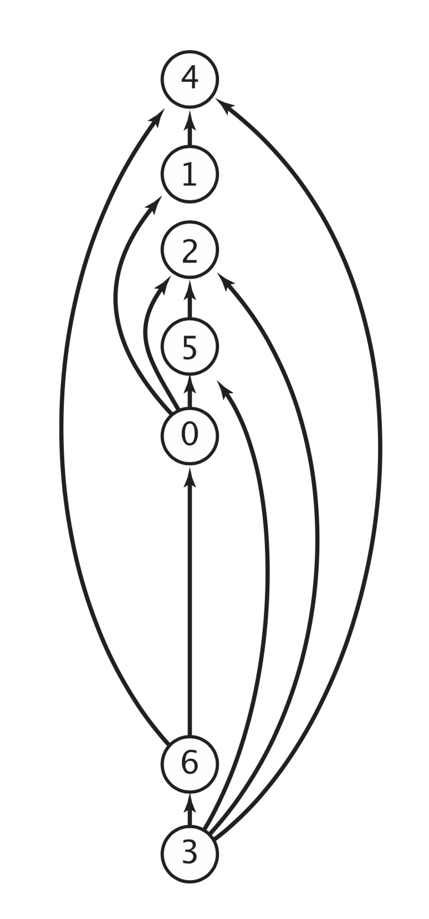
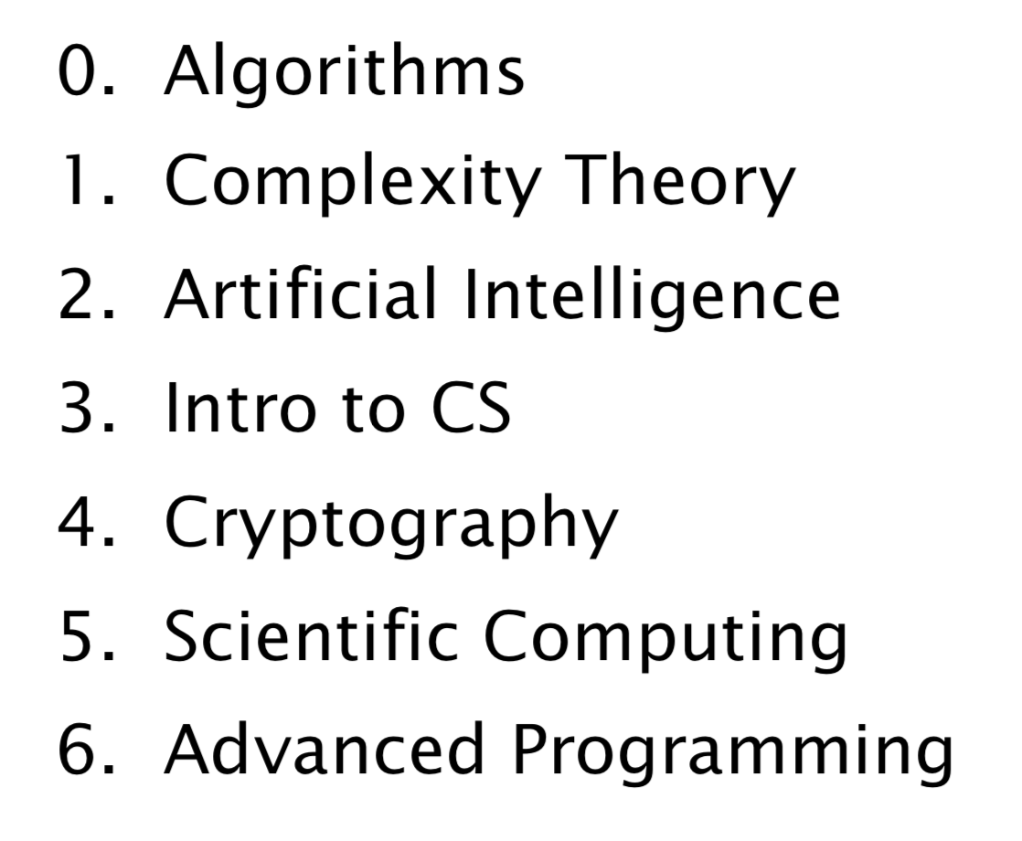
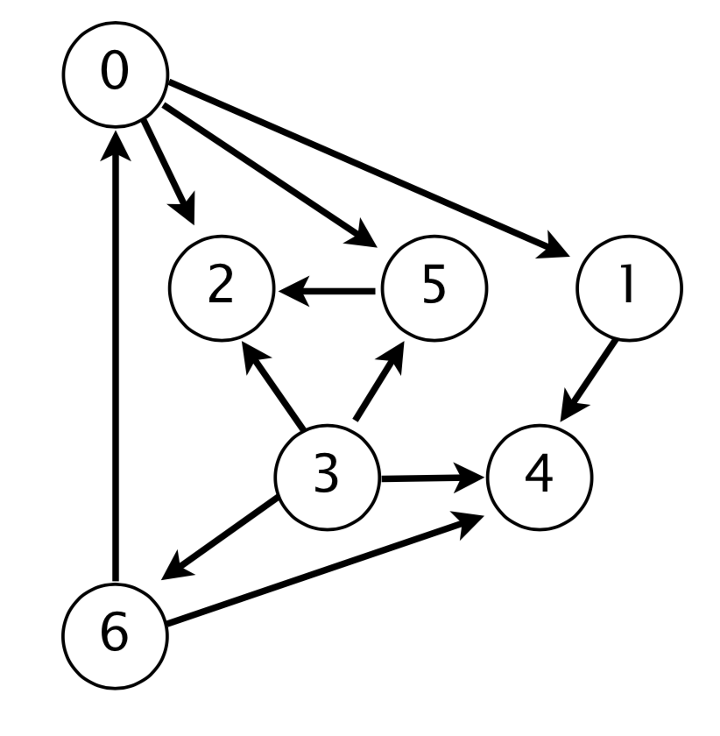
Topological Sort on DAGs
Example of use of topological sorting of DAGs: order of precedence scheduling.
Theorem: a reverse DFS postorder stack of a DAG is a topological order.
PLENUM EXERCISE:
show by demo’ing.....on the white board.
discussion: does the order of visits matter, actually?

Slide 9

Exercise 1 -- getting dressed!
Topological sorting of a DAG

Slide 10
Exercise 1.1 -- getting dressed!
Topological sorting of a DAG
list all cloting items on the average western civilian – the more, the merrier!

Slide 11
Exercise 1.2 -- getting dressed!
Topological sorting of a DAG
list all cloting items on the average western civilian – the more, the merrier!
Produce a simple DAG on how to get dressed properly.

Slide 12
Exercise 1.3 -- getting dressed!
Topological sorting of a DAG
list all cloting items on the average western civilian – the more, the merrier!
Produce a simple DAG on how to get dressed properly.
By Reverse DFS Postorder, produce a topological sort of the process.

Slide 13

Acknowledgement
Some material has been taken from the Princeton course ‘Algorithms 4th Edition’, by Sedgewick & Wayne.

