Slide 1
Brain-o-vision : Brain Tumor Detection
Paper ID : 159
Author : Swati Datta
Co-authors : Ish Kwatra, Angelin Claret S.P.

Slide 2
INTRODUCTION & MOTIVATION
Introduction
Brain tumors are among the most challenging medical conditions, with their detection and diagnosis playing a crucial role in patient outcomes. Timely detection is paramount for effective treatment planning and improved prognosis. However, traditional diagnostic methods such as visual interpretation of MRI scans have limitations including subjectivity and reliance on human expertise. These limitations underscore the necessity for automated and accurate brain tumor detection systems.
Deep learning neural networks, such as convolutional neural networks (CNNs), have shown remarkable performance in various image recognition tasks, making them promising candidates for accurately identifying brain tumors in MRI scans.

Slide 3
Motivation
The motivation behind this project stems from the need to address the shortcomings of conventional diagnostic methods and to explore the potential of deep learning in improving the accuracy and efficiency of brain tumor identification. By leveraging the power of deep learning algorithms, we aim to develop a robust and automated system that can assist clinicians in accurately detecting brain tumors from MRI scans.

Slide 4
LITERATURE SURVEY
S.Nagaraja Rao & Machiraju Jaya Lakshmi (2022): This study proposed a deep learning approach for brain tumor magnetic resonance image classification. They employed a CNN architecture and achieved significant improvements in accuracy and sensitivity compared to traditional methods. By leveraging CNN's ability to automatically learn relevant features from MRI data, they demonstrated robust performance in classifying brain tumors accurately. The study utilized a diverse dataset and conducted rigorous validation, ensuring the reliability of their findings.
Jiang et al. (2019): Jiang et al. introduced a new method based on statistical thresholding and multiscale CNN for brain tumor segmentation. Their approach combined statistical thresholding techniques with the feature learning capability of CNNs to achieve accurate segmentation results. By incorporating multiscale information, the model captured both local and global features, leading to improved segmentation performance. The study conducted extensive experiments on benchmark datasets and demonstrated the effectiveness of their proposed method in segmenting various types of brain tumors.

Slide 5
Liu et al. (2018): Liu et al. proposed a 3D kernel anisotropic network for brain tumor segmentation. Their method leveraged 3D convolutional operations with large kernels to capture spatial features efficiently. By incorporating anisotropic convolutions, the model adapted to the irregular shapes and structures of brain tumors, resulting in more accurate segmentation. The study conducted comprehensive evaluations on both public and in-house datasets, demonstrating superior performance compared to existing methods. The proposed network architecture showed robustness across different MRI modalities and tumor types.
Bhanothu et al. (2020): Bhanothu et al. developed a deep convolutional network for the detection and classification of brain tumors in MRI images. Their approach utilized a combination of convolutional and pooling layers to extract discriminative features from MRI scans. By training the network on a large dataset of labeled images, they achieved high accuracy in both detection and classification tasks. The study employed transfer learning techniques to leverage pre-trained models and fine-tuned them for brain tumor detection. Experimental results demonstrated the effectiveness of their approach in accurately identifying different types of brain tumors.
Ahmed et al. (2017): Ahmed et al. fine-tuned convolutional deep features for MRI-based brain tumor classification. They employed a transfer learning approach, utilizing pre-trained deep CNN models and fine-tuning them on brain tumor MRI data. By fine-tuning the network's parameters on a large dataset of brain tumor images, they achieved state-of-the-art performance in distinguishing between different tumor types. The study conducted extensive experiments on benchmark datasets, demonstrating the robustness and generalization capability of their proposed method across different MRI modalities and tumor classes.

Slide 6
METHODOLOGY
Data Collection: The first step involves acquiring medical imaging data, usually in the form of MRI (Magnetic Resonance Imaging) or CT (Computed Tomography) scans. These scans provide detailed images of the brain, allowing specialists to identify abnormalities like tumors.
Preprocessing: Before feeding the data into the machine learning model, preprocessing steps are applied to enhance the quality of the images and remove any artifacts or noise. This may include data augmentation and rescaling, grey scale conversion and guassian blurring, and image resizing techniques.

Slide 7
Feature Extraction: Segmentation provides a means to extract quantitative features from the tumor region, such as shape descriptors, texture features, and intensity statistics. These features can be used to characterize the tumor's morphology, heterogeneity, and spatial distribution, which can aid in diagnosis and prognosis.
Convolutional Neural Networks (CNNs): CNNs are particularly effective for image analysis tasks due to their ability to automatically learn features from data. They are commonly used for tasks like image classification and segmentation. The 4 algorithms implemented are MobileNetV2, EfficientNet, ResNet50 and VGG16.
Training: The machine learning model is trained using labelled data, where the input is the extracted features from the medical images, and the output is the presence or absence of a tumor.

Slide 8
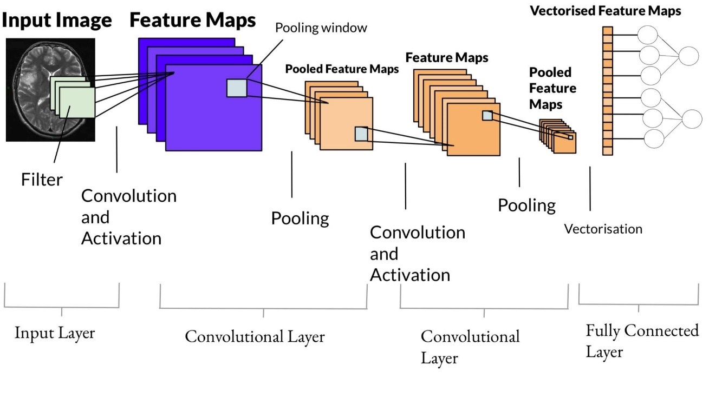
Basic building blocks of the algorithm

Slide 9
Validation and Testing: The trained model is then validated using separate datasets to ensure its generalizability. Testing involves evaluating the performance of the model on unseen data to assess its accuracy, sensitivity, specificity, and other relevant metrics.
Grad-Cam Segmentation: Gradient-weighted Class Activation Mapping, often known as Gram-Cam segmentation is a method that divides an image into its component parts according to its visual properties, usually with the use of deep learning algorithms. It is produced for the features extracted from intermediate layers of a convolutional neural network (CNN), which is a sort of pre-trained deep neural network that have been trained on a big dataset for a particular purpose like object identification or image classification. The network can distinguish between various visual patterns or textures in the picture by examining the correlations between features in these intermediary levels.

Slide 10
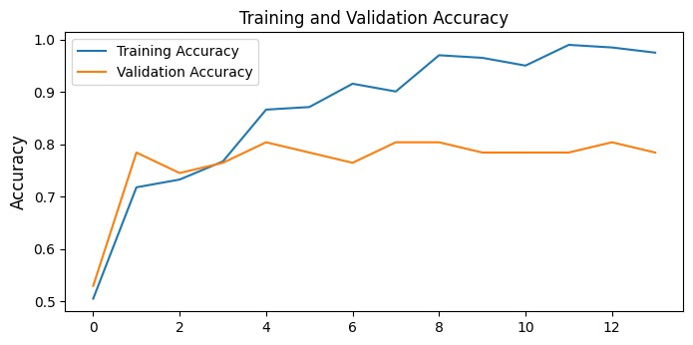
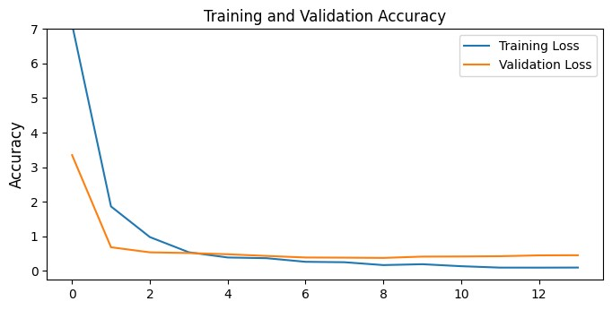
RESULTS & DISCUSSIONS
The training and validation accuracies and losses of MobileNetV2 is shown. There are similar graphs for other 3 algorithms as well with some variations.

Slide 11
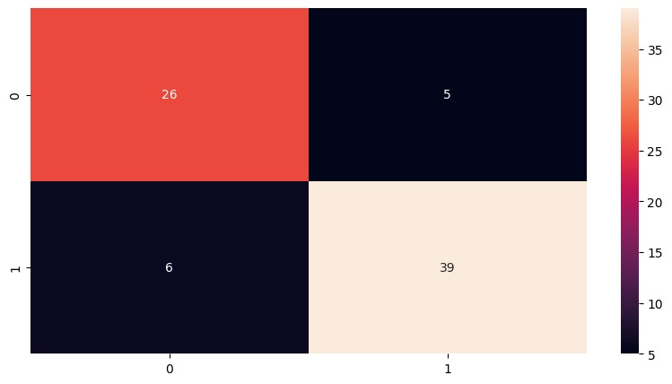
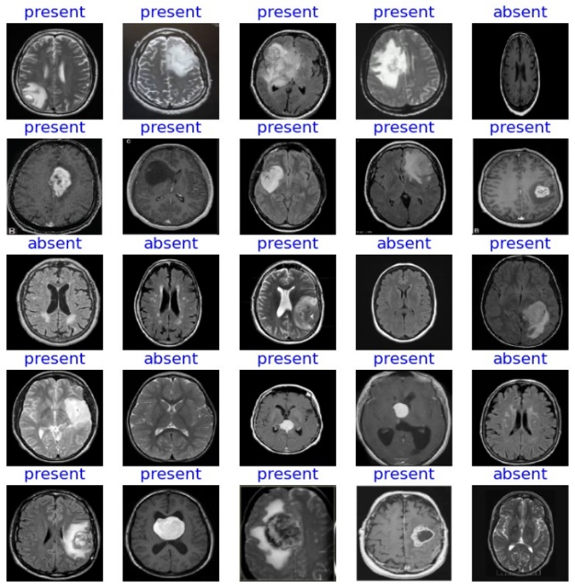
The below figure is the confusion matrix of MobileNetV2. The other algorithms also has the same confusion matrix differing in TP, FP, TN, FN.
The segmentation results of some random samples.

Slide 12
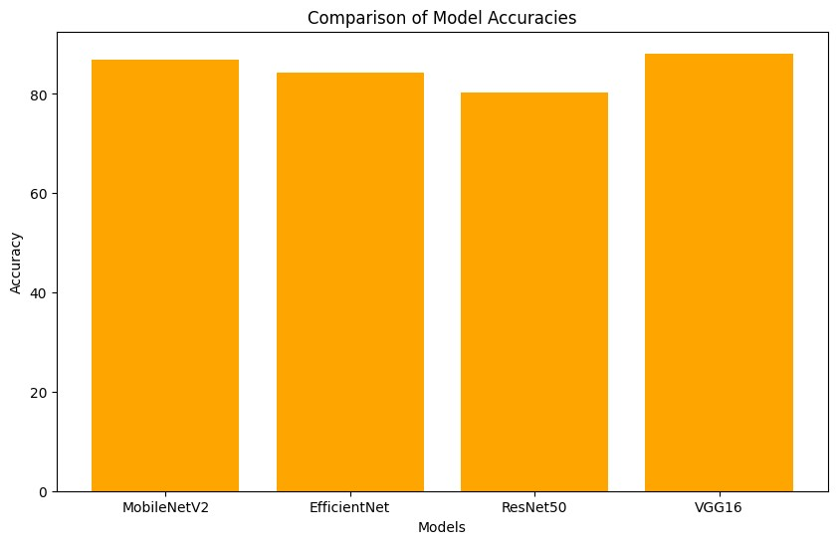
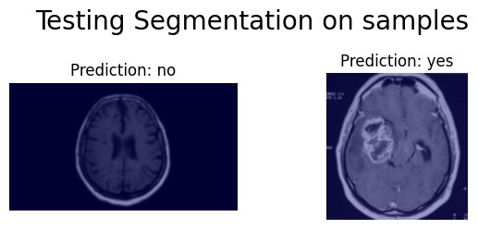
Comparison analysis of accuracies
Output through Grad-Cam Segmentation

Slide 13
Discussions
We got the accuracies of algorithms as shown in the table. VGG16 got the highest accuracy of 88%.
VGG16 may perform better on the specific dataset used for training and evaluation due to its suitability for the dataset's complexity. VGG16 has a relatively large number of parameters compared to MobileNetV2 and EfficientNet at similar depths. In some cases, having a higher model capacity may enable VGG16 to capture more complex patterns and representations from the data, leading to better performance. VGG16 might benefit more from transfer learning if pre-trained weights from a large dataset (e.g., ImageNet) were used.
MODEL NAME | ACCURACY
MobileNetV2 | 86.8421052631579
EfficientNet | 84.21052631578947
ResNet50 | 80.26315789473685
VGG16 | 88.1578947368421

Slide 14
CONCLUSION & FUTURE WORK
Conclusion
By combining state-of-the-art imaging modalities (MRI, CT, and PET scans) with novel machine learning algorithms and artificial intelligence, medical professionals can now efficiently and precisely diagnose brain tumors, pinpointing their location and characteristics with previously unheard-of accuracy. This game-changing combination of computational analysis and medical imaging not only speeds up diagnosis but also makes it possible to create individualized treatment plans that are specific to the needs of each patient, improving prognosis and therapeutic efficacy in the process. Additionally, the development of non-invasive techniques reduces danger and discomfort for patients, allowing for early intervention and lowering morbidity related to late-stage illness. Future developments in neuroimaging and computational medicine promise to yield even more sophisticated methods, which could completely alter the field of brain tumor diagnosis and treatment and ultimately enhance patient outcomes andquality of life across the globe.

Slide 15
Future works
Future developments in the field of brain tumor detection include artificial intelligence algorithms in conjunction with advances in imaging technology, such as high-resolution MRI and functional imaging modalities, will make it possible to identify even the smallest anomalies early on. Furthermore, including non-invasive biomarkers into diagnostic procedures—like exosomes and circulating tumor DNA—will provide a less invasive way to track the development of tumors and their response to therapy.

Slide 16
REFERENCES
Machiraju Jaya Lakshmi & S.Nagaraja Rao., “Brain tumor magnetic resonance image classification: a deep learning approach,” Soft Computing, vol. 26, pp.6245–6253, 2022.
Jiang, Y. et.al., “A Brain Tumor Segmentation New Method Based on Statistical Thresholding and Multiscale CNN,” Intelligent Computing Methodologies, vol. 2, issue (3), pp. 235-245, 2019.
Liu, D. et.al., “3D Large Kernel Anisotropic Network for Brain Tumor Segmentation,” Neural Information Processing, pp. 444-454, 2018.
Bhanothu, Y. et.al., “Detection and classification of brain tumor in mri images using deep convolutional network,” International Conference on Advanced Computing and Communication Systems , pp. 248–252, 2020.
Ahmed et.al., “Fine-tuning convolutional deep features for MRI based brain tumor classification,” Medical Imaging, Vol. 10134, 2017.

Slide 17
THANK YOU
Any Queries ??

