Slide 1
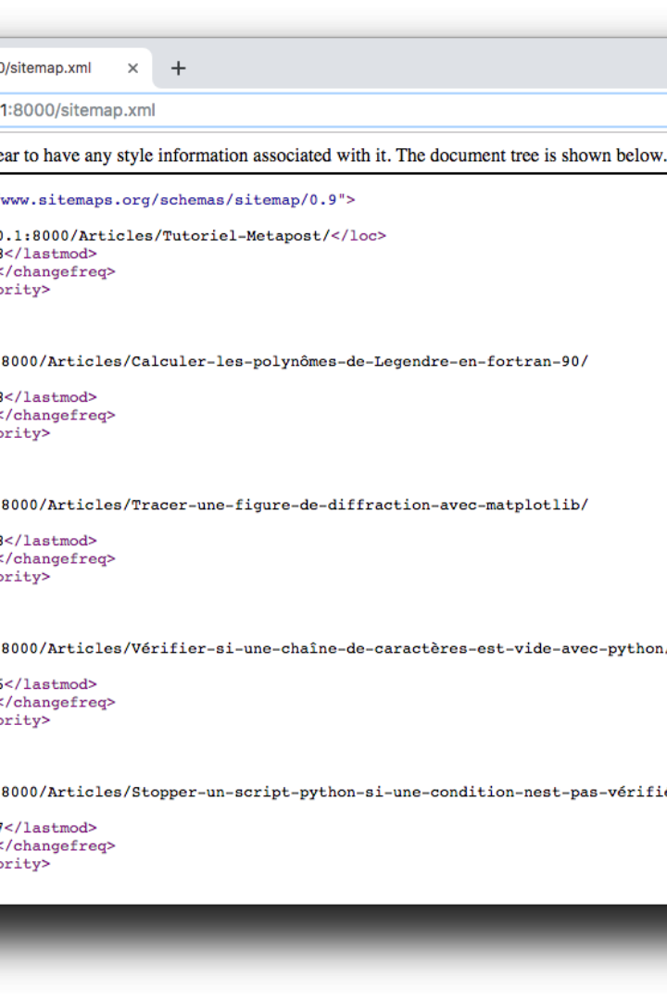

Introduction to Django Framework's
Django is a high-level Python web framework that encourages rapid development and clean, pragmatic design. It focuses on automating as much as possible and adheres to the "Don't Repeat Yourself" principle.
by Datta Ankushrao

Slide 2
Features of Django
1
Scalability
2
Security
Django allows you to handle the busiest sites, scaling as needed.
It helps you avoid many common security mistakes.
3
Administration Panels
4
Community Support
Django automatically generates a customizable admin interface.
Access to a large community and extensive documentation.

Slide 3
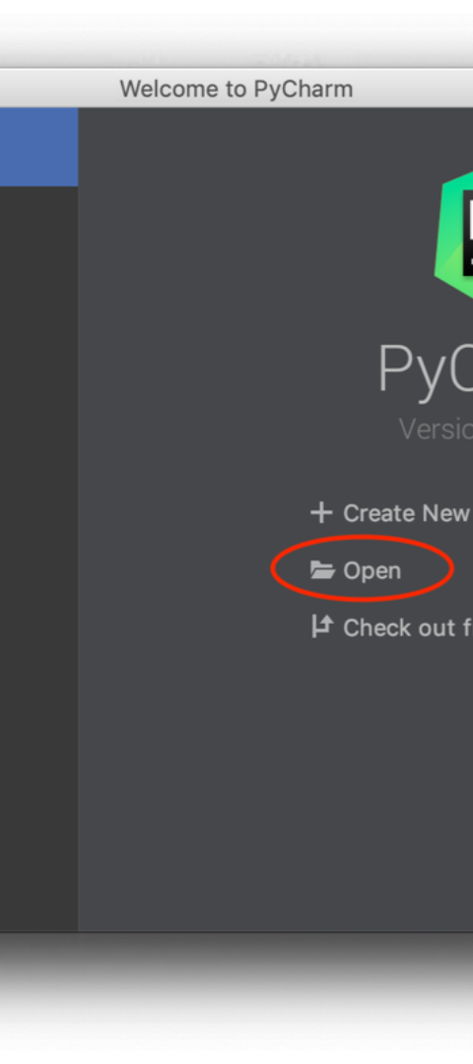
Setting up a Django project
Requirements
Creating a Virtual Environment
Ensure Python and pip are installed on your system.
Isolating your project's dependencies.
Installing Django
Use pip to install the Django package, creating a new project.

Slide 4
Understanding Django's MTV architecture
Model Layer
Template Layer
View Layer
Represents the data and the business logic of the application.
Handles the presentation and user-interaction elements of the application.
Processes user requests and returns responses.

Slide 5
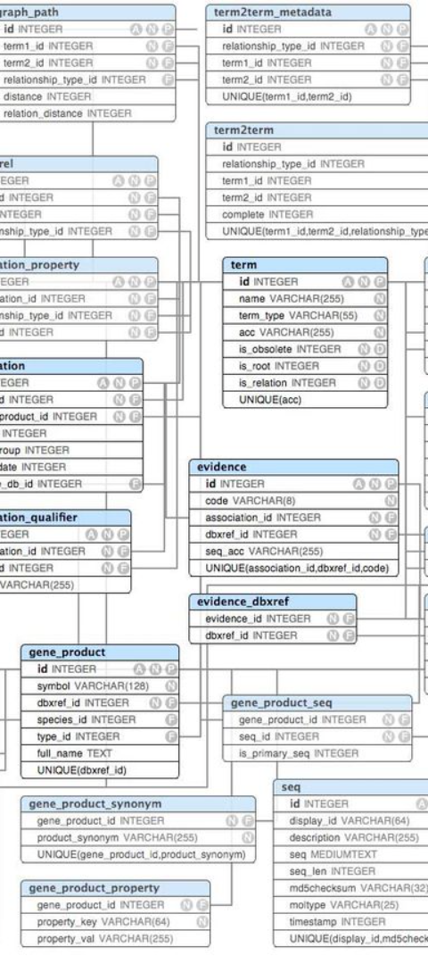



Creating models and database schema
Define Models
Create Python classes to define the characteristics of the data.
Generate Schema
Run python manage.py makemigrations to create database schema.
Apply Migrations
Execute python manage.py migrate to apply changes to the database.

Slide 6
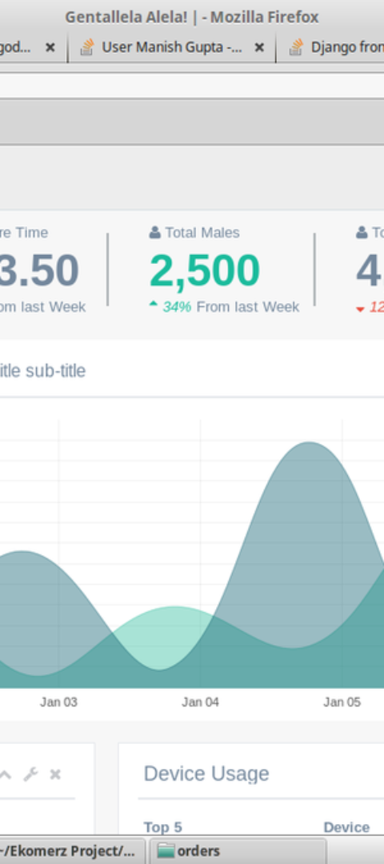
Building views and templates
1
Create Views
Views are Python functions that receive web requests.
2
Design Templates
Templates are HTML files with embedded template tags.
3
Link Views to Templates
Connect views to specific templates to render web pages.

Slide 7

Working with forms in Django
1
Building Forms
2
Handling Form Submissions
Present HTML forms through Django's forms module.
Process form submissions and validate input data.
3
Customizing Form Behavior
Use additional features like formsets and model forms.

Slide 8
Deploying a Django application
1
2
3
Choose a Hosting Provider
Prepare the Application
Run the Server
Collect static files, configure settings, and setup the database.
Start the web server and monitor for any deployment issues.
Select a reliable hosting service for deployment.

Slide 9
Thank you

