Slide 1

Java Bootcamp
Datta diware

Slide 2
Agenda
Introduction to Java
Basic input output
Data Structures in Java
Assignments

Slide 3
Introduction to Java

Slide 4
What is Java ?
Java is high-level object-oriented programming language.
Java is simple and easy to learn
Java is platform independent
Java has automatic memory management
Java supports Multi-threading and Concurrency
Java has strong community support
Java has built-in security mechanisms
Its popularity ensures a high demand for Java developers, offering ample job opportunities.

Slide 5
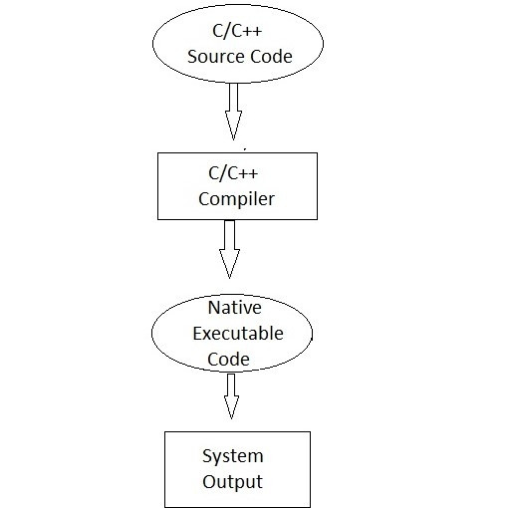
What is platform independence ?
Platform Dependent means the program / software that we have developed can run /execute (show results) on a specific platform. That is on a specific operating system.

Slide 6
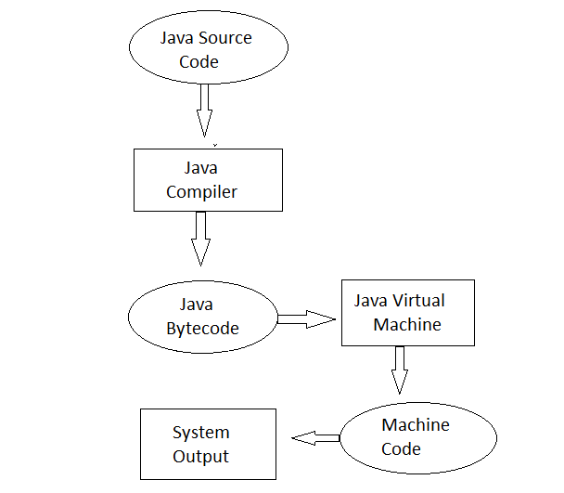
Contd.
Platform Dependent means the program / software that we have developed can run /execute (show results) on a specific platform. That is on a specific operating system.

Slide 7

Let’s get hands dirty

Slide 8
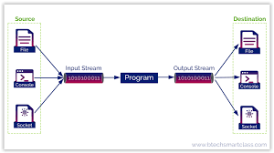
Java I/O

Slide 9
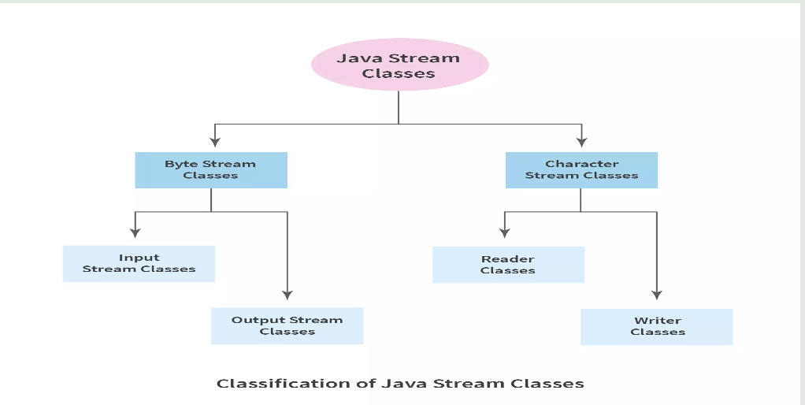
Java I/O

Slide 10
Java I/O
Byte Stream | Character Stream
They process the data byte by byte. | They process the data character by character.
They read/write data 8 bits maximum at a time. | They read/write data 16 bits maximum at a time.
They are most suitable to process binary files. | They are most suitable to process text files.
All byte stream classes in Java are descendants of InputStream and OutputStream. | All character stream classes in Java are descendants of Reader and Writer.

Slide 11
Java Data Structures
What are the data types ?
A data structure is a specialized format for organizing, processing, retrieving and storing data.
Example : Array, LinkedList, Queue, Stack

Slide 12
Data Structure
Five factors to consider when picking a data structure include the following:
What kind of information will be stored?
How will that information be used?
Where should data persist, or be kept, after it is created?
What is the best way to organize the data?
What aspects of memory and storage reservation management should be considered?

Slide 13
Characteristics of Data Structure
Linear or non-linear
Homogeneous or heterogeneous
Static or dynamic

Slide 14
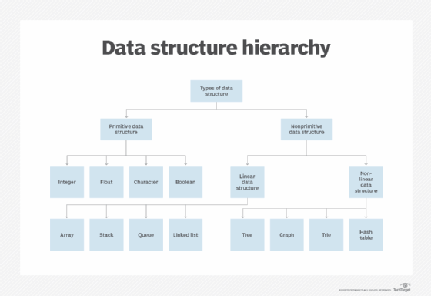
Data Structure Hierarchy

Slide 15
Data Structure - Array
An array stores a collection of items at adjoining memory locations.
Arrays are homogeneous data structure
Element can be calculated or retrieved easily by an index
Mostly fixed in size

Slide 16
Data Structure - Array
Ways to declare arrays in Java
Ways to initialize arrays in java
How to add elements in Array
How to delete element from array
How to print elements from Array
Operations we can perform on arrays
Multidimensional Arrays

Slide 17
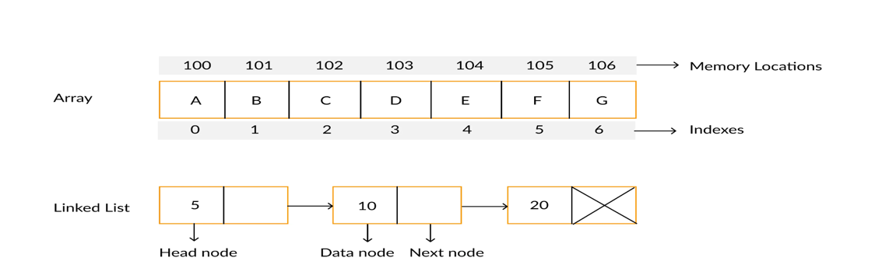
Data Structure – LinkedList
A linked list is a linear data structure, in which the elements are not stored at contiguous memory locations. The elements in a linked list are linked using pointers as shown in the below image:
First object of the Linked List is known as the head and the last object is known as the tail of the Linked List.

Slide 18
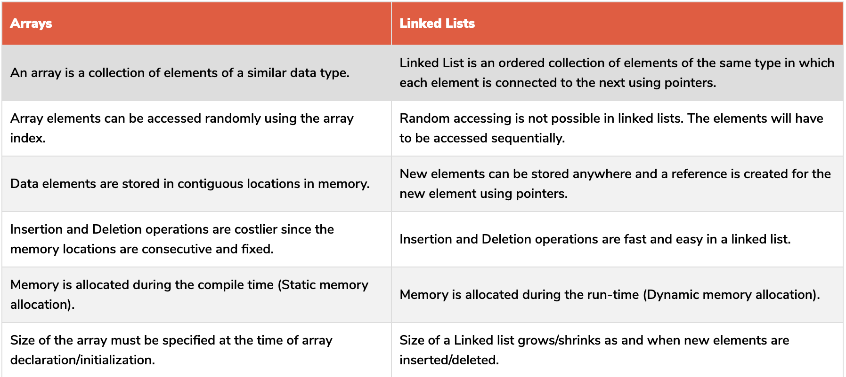
Array vs LinkedList

Slide 19
Assignments
Write a Java program to take your name as input and print “Hello ${name}”
Write a Java program add() two numbers and print sum
Write a Java program to sum all the elements from array
Write a java program to print 2D array
Write a program to count number of elements in 2D array
Write a program to implement Queue in Java

Slide 20
Data Structure : Stack
A stack is a data structure that follows a last in, first out (LIFO) protocol
The stack data structure has three main methods: push(), pop() and peek().
The push() method adds a node to the top of the stack.
The pop() method removes a node from the top of the stack.
The peek() method returns the value of the top node without removing it from the stack.

Slide 21
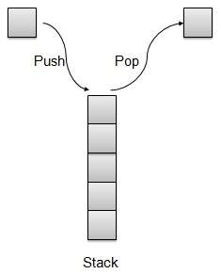
Data Structure : Stack

Slide 22
Stack contd.

Slide 23
Stack contd.
Can u tell me few examples of Stack use in real life
Back and Forward button on web browser
Undo Redo functionality
Compilers bracket balancing

Slide 24
Java Stack Implementation
Push 10 elements in stack
Pop all elements from stack
Check stack is full while pushing
Check stack is empty while popping

Slide 25
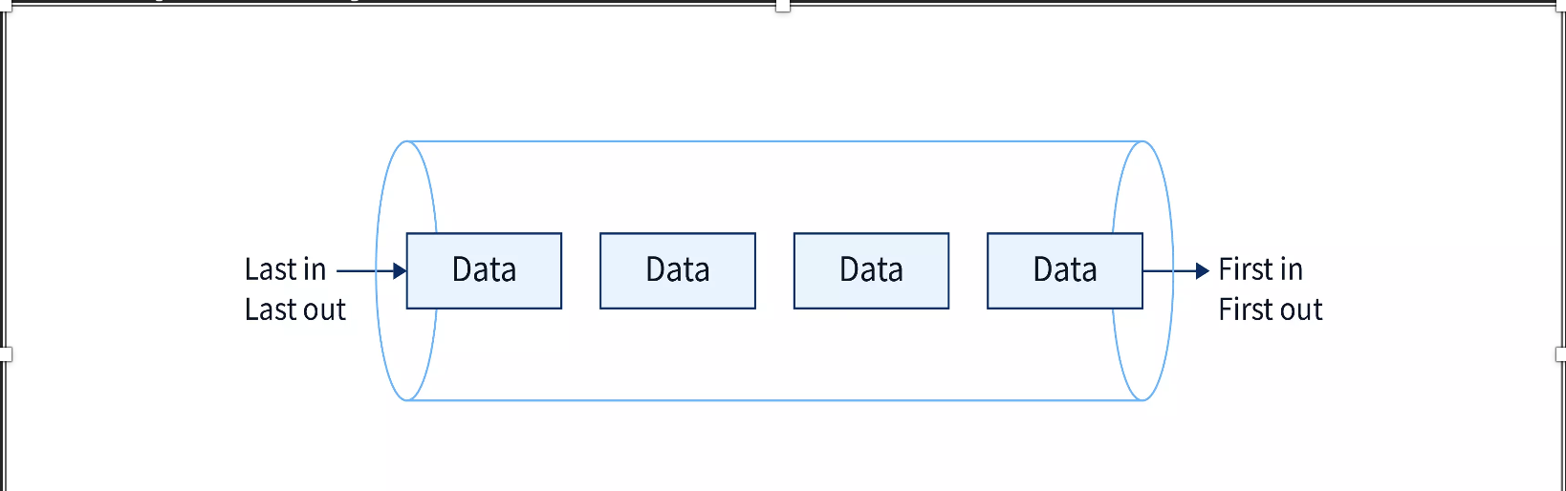
Data Structure : Queue
What is Queue?
The Queue in data structure is an ordered, linear sequence of items. It is a FIFO (First In First Out) data structure, which means that we can insert an item to the rear end of the queue and remove from the front of the queue only.

Slide 26
Data Structure : Queue
The following are some basic functions defined for a queue.
enqueue(): It's used to add an element to the back of the queue.
dequeue(): This method removes an element from the queue's front.
IsEmpty(): This method is used to determine whether or not the queue is empty.
IsFull(): This method is used to determine whether or not the queue is full.
peek(): It's used to get the front value without eliminating it from the equation.

Slide 27
Thank you !!
Connect@ https://dattadiware.github.io/

