Slide 1

Java Bootcamp
Datta diware

Slide 2
Agenda
Introduction to Java
Basic input output
Data Structures in Java
Assignments

Slide 3
Introduction to Java

Slide 4
What is Java ?
Java is high-level object-oriented programming language.
Java is simple and easy to learn
Java is platform independent
Java has automatic memory management
Java supports Multi-threading and Concurrency
Java has strong community support
Java has built-in security mechanisms
Its popularity ensures a high demand for Java developers, offering ample job opportunities.

Slide 5
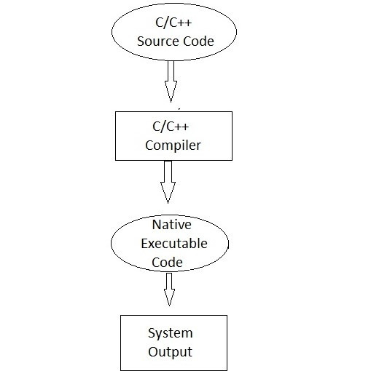
What is platform independence ?
Platform Dependent means the program / software that we have developed can run /execute (show results) on a specific platform. That is on a specific operating system.

Slide 6
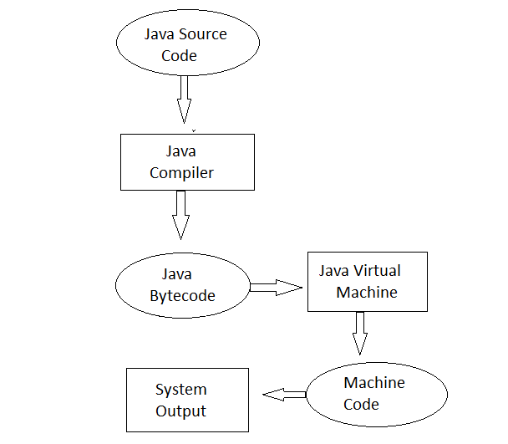
Contd.
Platform Dependent means the program / software that we have developed can run /execute (show results) on a specific platform. That is on a specific operating system.

Slide 7
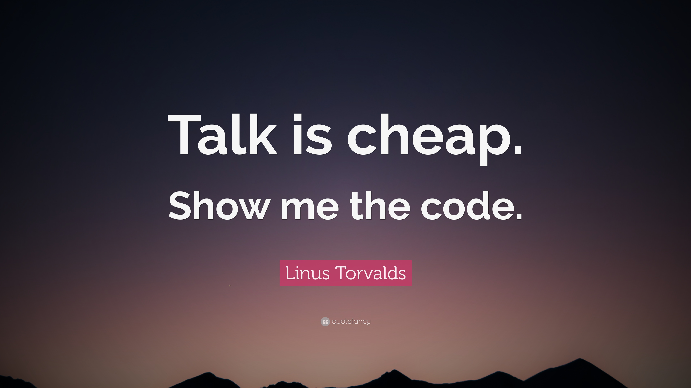
Let’s get hands dirty

Slide 8
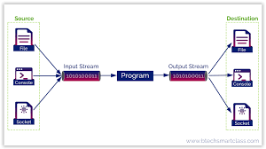
Java I/O

Slide 9
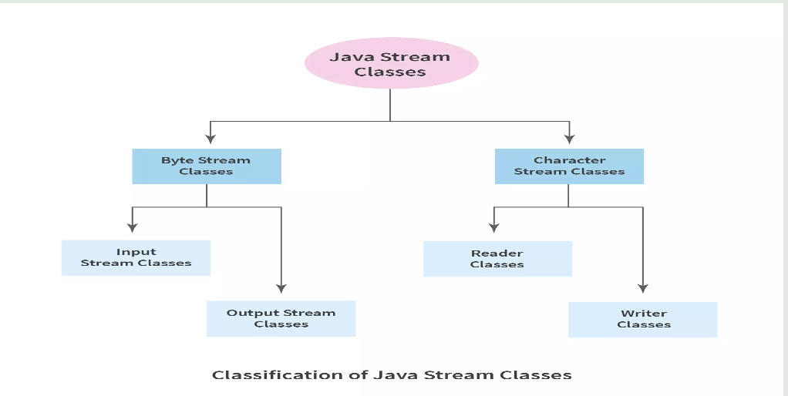
Java I/O

Slide 10
Java I/O
Byte Stream | Character Stream
They process the data byte by byte. | They process the data character by character.
They read/write data 8 bits maximum at a time. | They read/write data 16 bits maximum at a time.
They are most suitable to process binary files. | They are most suitable to process text files.
All byte stream classes in Java are descendants of InputStream and OutputStream. | All character stream classes in Java are descendants of Reader and Writer.

Slide 11
Java Data Structures
What are the data types ?
A data structure is a specialized format for organizing, processing, retrieving and storing data.
Example : Array, LinkedList, Queue, Stack

Slide 12
Data Structure
Five factors to consider when picking a data structure include the following:
What kind of information will be stored?
How will that information be used?
Where should data persist, or be kept, after it is created?
What is the best way to organize the data?
What aspects of memory and storage reservation management should be considered?

Slide 13
Characteristics of Data Structure
Linear or non-linear
Homogeneous or heterogeneous
Static or dynamic

Slide 14
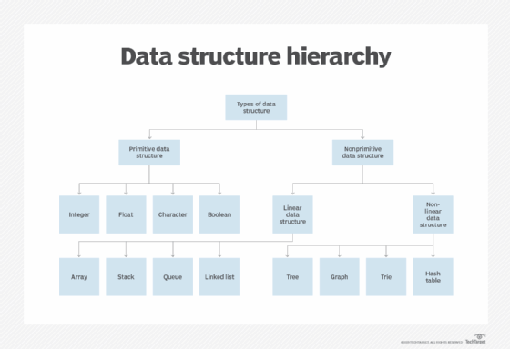
Data Structure Hierarchy

Slide 15
Data Structure - Array
An array stores a collection of items at adjoining memory locations.
Arrays are homogeneous data structure
Element can be calculated or retrieved easily by an index
Mostly fixed in size

Slide 16
Data Structure - Array
Ways to declare arrays in Java
Ways to initialize arrays in java
How to add elements in Array
How to delete element from array
How to print elements from Array
Operations we can perform on arrays
Multidimensional Arrays

Slide 17
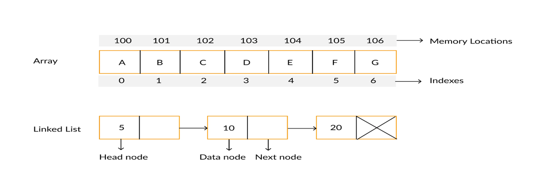
Data Structure – LinkedList
A linked list is a linear data structure, in which the elements are not stored at contiguous memory locations. The elements in a linked list are linked using pointers as shown in the below image:
First object of the Linked List is known as the head and the last object is known as the tail of the Linked List.

Slide 18
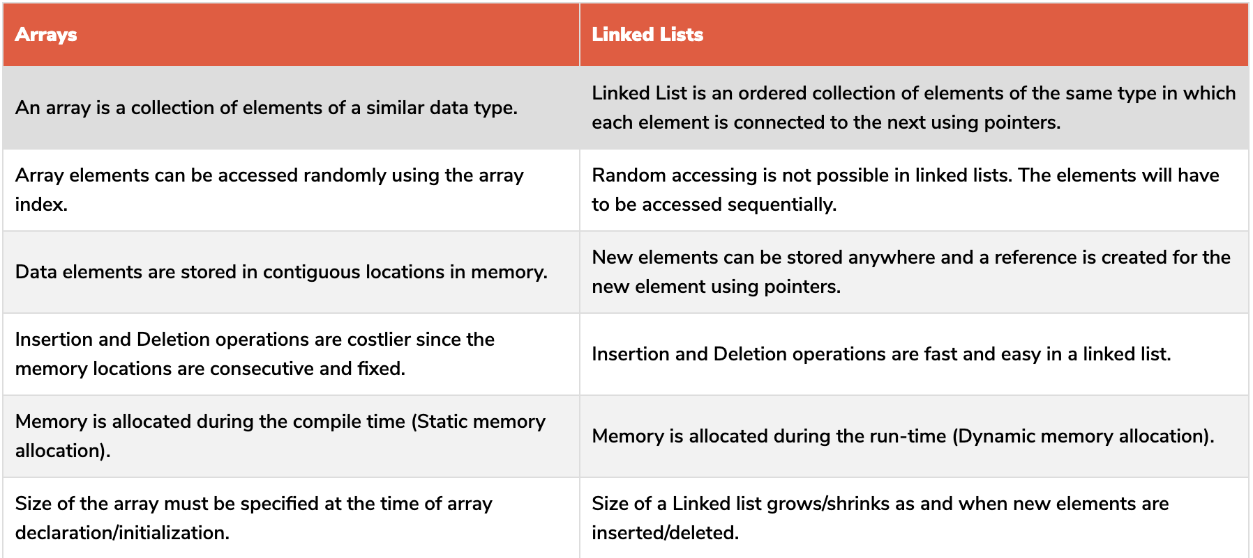
Array vs LinkedList

Slide 19
Assignments
Write a Java program to take your name as input and print “Hello ${name}”
Write a Java program add() two numbers and print sum
Write a Java program to sum all the elements from array
Write a java program to print 2D array
Write a program to count number of elements in 2D array
Write a program to implement Queue in Java

Slide 20
Data Structure : Stack
A stack is a data structure that follows a last in, first out (LIFO) protocol
The stack data structure has three main methods: push(), pop() and peek().
The push() method adds a node to the top of the stack.
The pop() method removes a node from the top of the stack.
The peek() method returns the value of the top node without removing it from the stack.

Slide 21
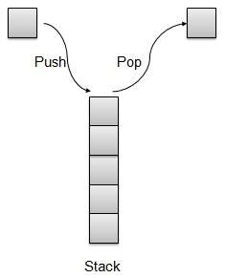
Data Structure : Stack

Slide 22
Stack contd.

Slide 23
Stack contd.
Can u tell me few examples of Stack use in real life
Back and Forward button on web browser
Undo Redo functionality
Compilers bracket balancing

Slide 24
Java Stack Implementation
Push 10 elements in stack
Pop all elements from stack
Check stack is full while pushing
Check stack is empty while popping

Slide 25
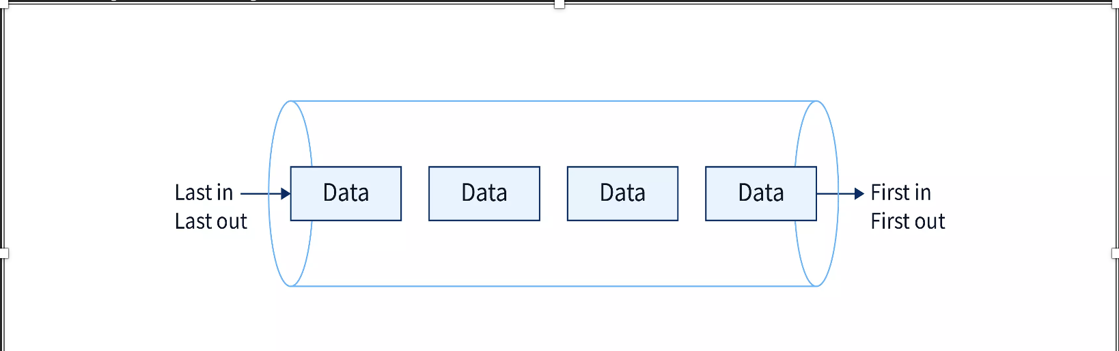
Data Structure : Queue
What is Queue?
The Queue in data structure is an ordered, linear sequence of items. It is a FIFO (First In First Out) data structure, which means that we can insert an item to the rear end of the queue and remove from the front of the queue only.

Slide 26
Data Structure : Queue
The following are some basic functions defined for a queue.
enqueue(): It's used to add an element to the back of the queue.
dequeue(): This method removes an element from the queue's front.
IsEmpty(): This method is used to determine whether or not the queue is empty.
IsFull(): This method is used to determine whether or not the queue is full.
peek(): It's used to get the front value without eliminating it from the equation.

Slide 27
Java Exceptions
What is exception :
Exceptions are unwanted conditions that disturb the program execution
Exception handling in Java is the process of responding to the occurrence of exceptions
Exceptions can be of both checked(exceptions that are checked by the compiler) and unchecked(exceptions that cannot be checked by the compiler) type.
In Java, exceptions belong to java.lang.Exception class.

Slide 28
Java Errors
An error is also an unwanted condition but it is caused due to lack of resources and indicates a serious problem.
Errors are of unchecked type only.
In java, errors belong to java.lang.error class.
Eg: OutOfMemmoryError, StackOverFlowError

Slide 29
What is Exception Handling ?
Exception handling in java is a mechanism to handle unwanted interruptions like exceptions and continue with the normal flow of the program.
Java uses try-catch blocks and other keywords like finally, throw, and throws to handle exceptions. JVM(Java Virtual Machine) by default handles exceptions, when an exception is raised it will halt the execution of the program and throw the occurred exception.

Slide 30
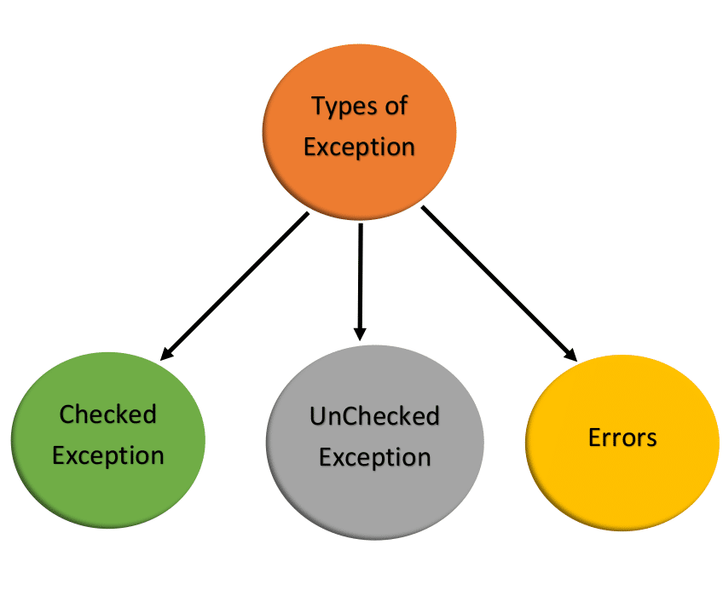
Types of Exceptions

Slide 31
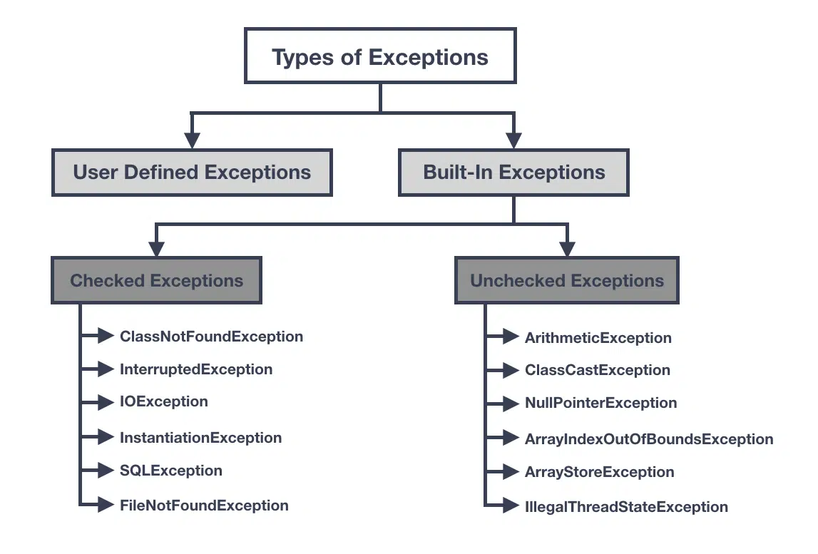
Types of Exceptions

Slide 32
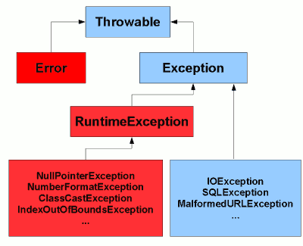
Class hierarchy

Slide 33
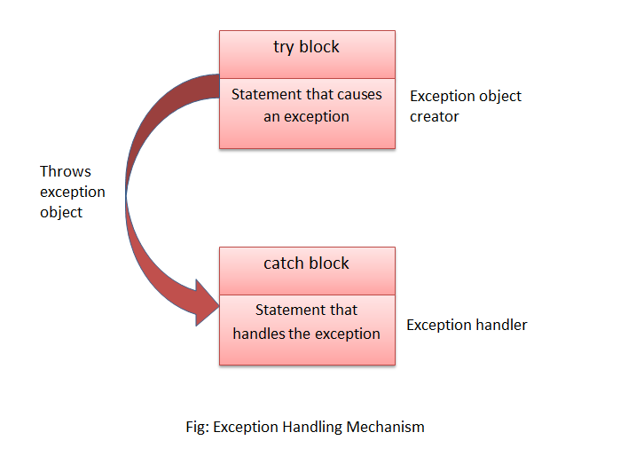
Exception Handling process

Slide 34
Keywords
Try
Catch
Throw
Throws
Finally

Slide 35
Java File I/O
Java File I/O classed allows you to interact with files on the file system, performing operations such as reading data from files, writing data to files, creating new files, deleting files, and more.
To perform file I/O operations in Java, you typically use classes from the java.io package.

Slide 36
Contd
Most commonly used classes and their functionalities:
File class: This class represents a file or directory on the file system. It provides methods to query information about the file, such as its name, path, existence, and more. It does not provide methods for reading or writing data.
FileReader and FileWriter classes: These classes are used for reading and writing character data to files, respectively. They are typically used for reading and writing text files.
BufferedReader and BufferedWriter classes: These classes provide buffering capabilities on top of FileReader and FileWriter, respectively. They improve performance by reducing the number of disk reads and writes.

Slide 37
Contd
InputStream and OutputStream classes: These classes are the foundation of byte-oriented I/O in Java. They are used for reading and writing binary data, such as images or audio files. InputStream is an abstract class, while OutputStream is an abstract class with various concrete implementations.
FileInputStream and FileOutputStream classes: These classes are concrete implementations of InputStream and OutputStream, respectively, specifically designed for reading and writing data from files.
DataInputStream and DataOutputStream classes: These classes provide higher-level methods for reading and writing data types such as integers, floats, and strings. They wrap an underlying InputStream or OutputStream to provide convenient methods.

Slide 38
Contd
ObjectInputStream and ObjectOutputStream classes: These classes are used for reading and writing serialized objects. They can read/write entire objects from/to files, allowing you to store and retrieve complex data structures.
RandomAccessFile class: This class provides random access to files, allowing you to read from or write to any position within the file. It supports both text and binary data.

Slide 39
Examples
Read data from existing file
Write data to existing file
Create new file and read/write data
Relative vs Absolute path
Read/write binary file

Slide 40
Assignments
Assignment: File Information
Write a Java program that takes a file path as input and displays the following information File name,Absolute path,Size (in bytes,;ast modified date
Assignment: File Copy
Write a Java program that copies the contents of one text file to another.
Implement the file copying logic using FileReader and FileWriter classes.
Assignment: Binary File Analysis
Write a Java program that reads a binary file (e.g., image file) and performs analysis on Its contents. Display the file size, file type, and any other relevant information.

Slide 41
Assignments
Assignment: File Search
Write a Java program that searches for a specific keyword in a directory of text files.
Prompt the user to enter a directory path and a keyword to search for.
Traverse all text files in the directory and its subdirectories.
Display the names of files that contain the keyword.

Slide 42
Thank you !!
Connect@ https://dattadiware.github.io/

