Slide 1

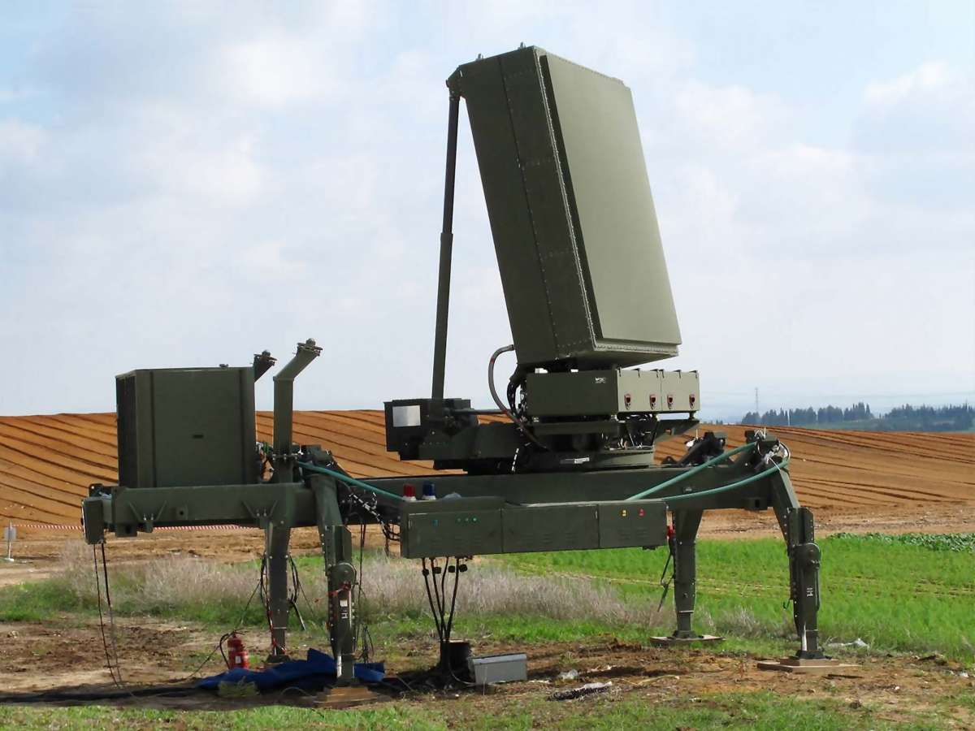
AdaCFAR-1D
Deep Adaptive Detection for Heterogeneous Radar Clutter
Daniel Attali & Sapir Bashan Deep Learning Course | 26/06/2026

Slide 2
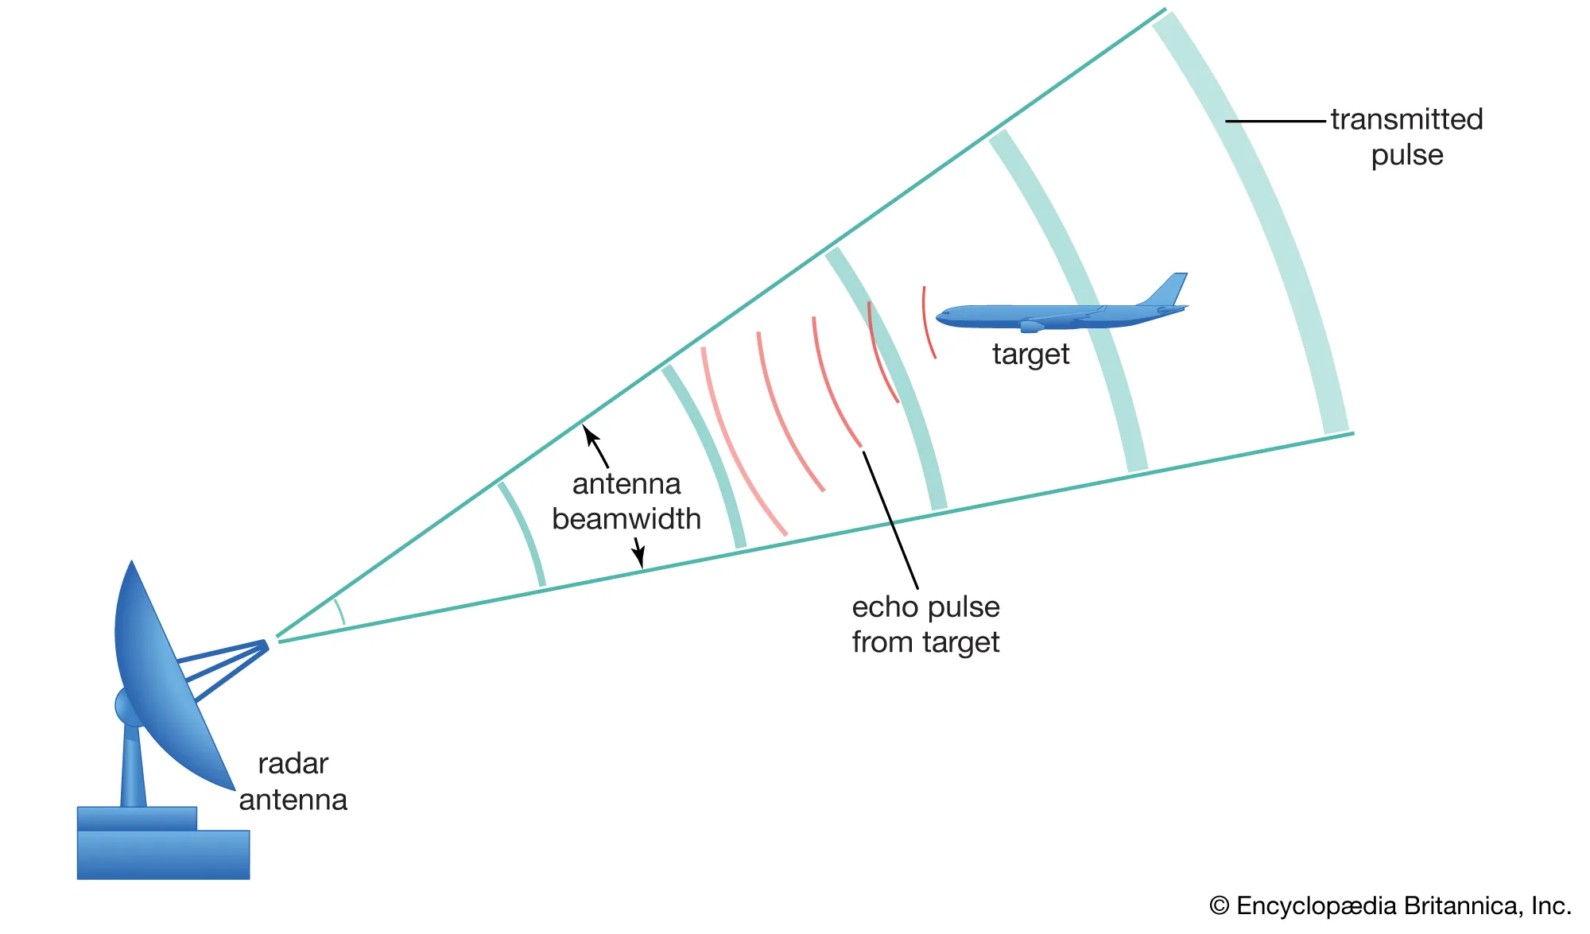

Radar Detection Problem
Detection is the first hard decision in the radar chain
Missed detections reduce target observability
False alarms overload downstream tracking and association
Two-way propagation delay
AdaCFAR-1D | Deep Learning Course | 2

Slide 3
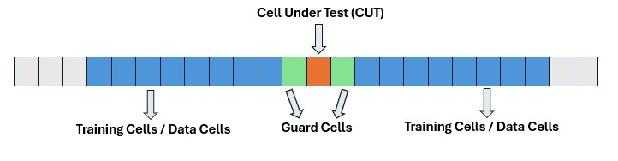


Classical Solution: CA-CFAR
Local noise estimate
Adaptive threshold
Works well in homogeneous environments
AdaCFAR-1D | Deep Learning Course | 3

Slide 4
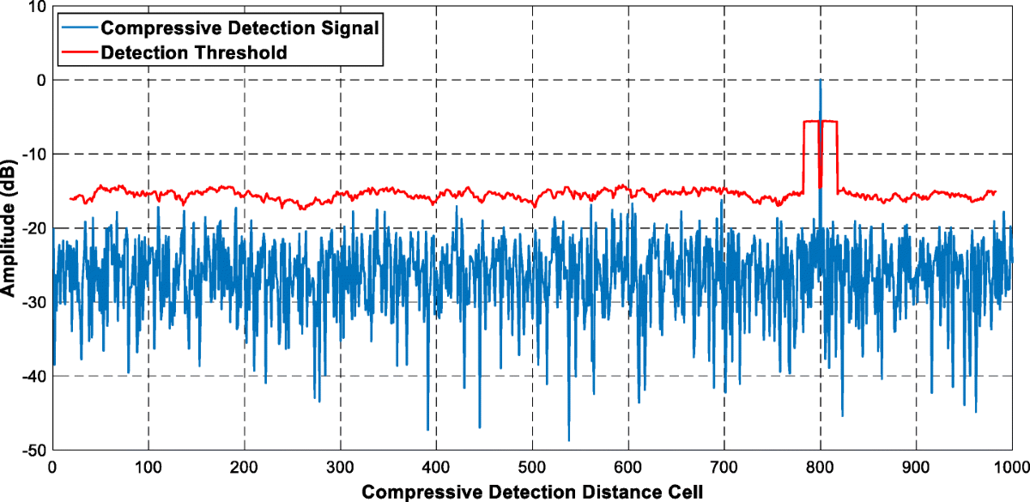

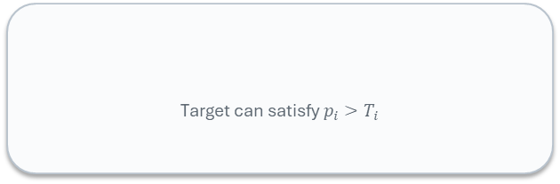
The Problem: Target Masking
Training cells include high-power clutter
Estimated noise floor becomes biased upward
Threshold rises and masks nearby targets
Target can satisfy $p_{i}>T_{i}$
AdaCFAR-1D | Deep Learning Course | 4

Slide 5
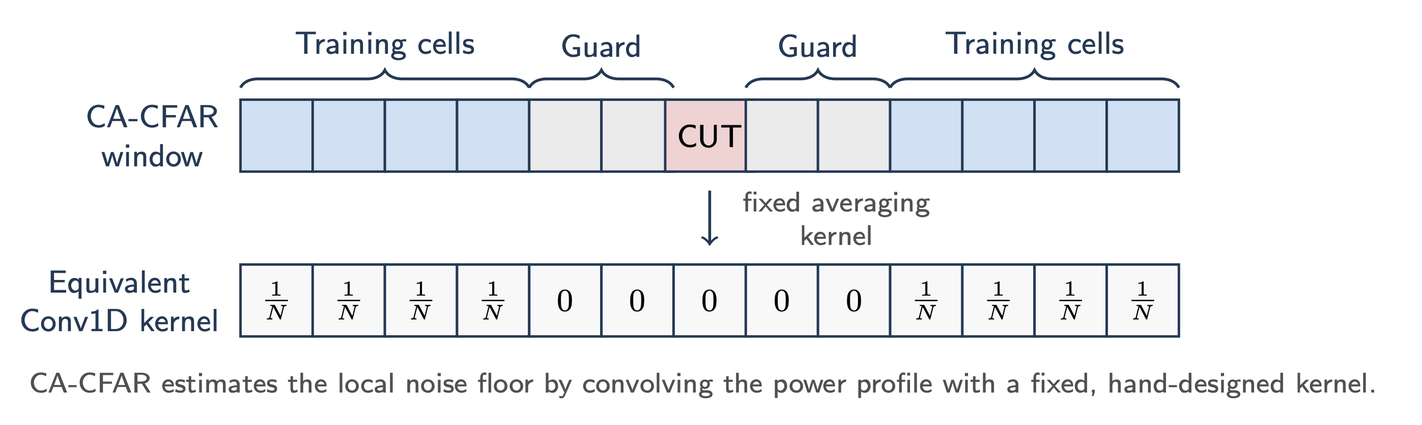


Key Observation: CFAR is a Fixed Convolution
CFAR is not unrelated to deep learning — it is already convolutional
The difference: CFAR weights are hand-designed and fixed
Conv1D weights can be learned for the target clutter regime
AdaCFAR-1D | Deep Learning Course | 5

Slide 6
Research Question
Can a learned Conv1D detector outperform fixed CA-CFAR in heterogeneous clutter?
CA-CFAR Fixed detector Manual parameters Analytical assumptions
AdaCFAR-1D Learned detector Task-specific parameters Trained on simulated radar profiles
AdaCFAR-1D | Deep Learning Course | 6

Slide 7
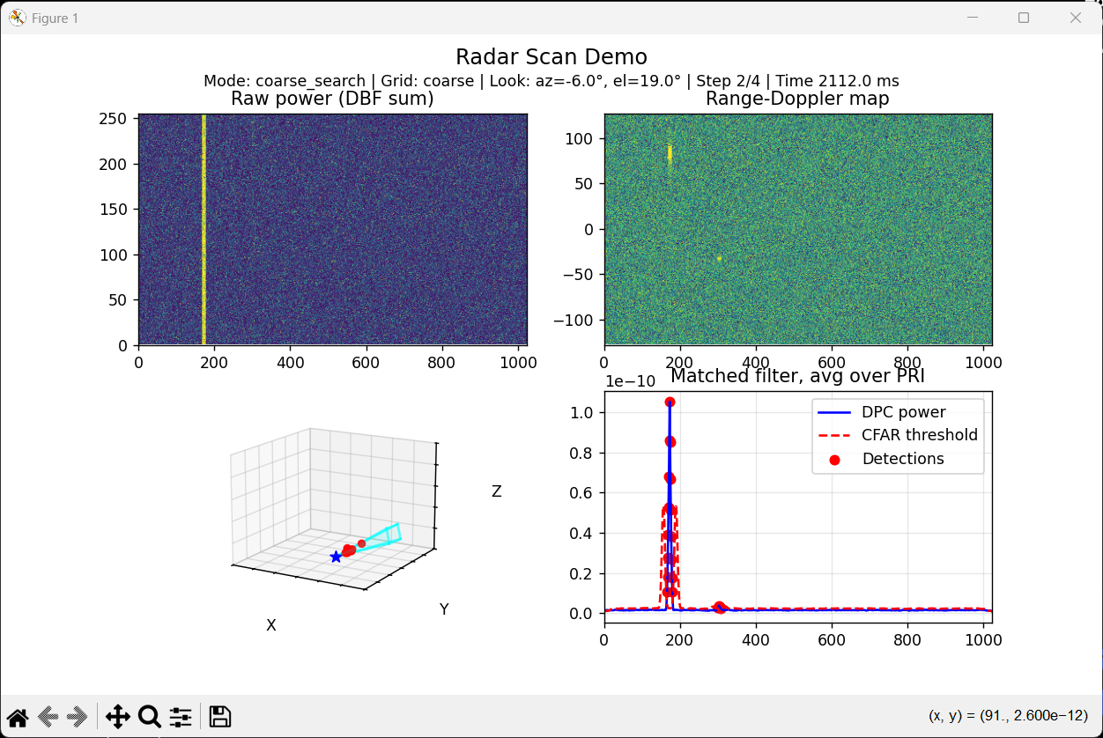
Dataset Generation
Targets
Radar Eq.
Beamforming
Pulse Compression
Envelope
NCI
1D Profile
Clutter + Mask
Item | Value
Training profiles | 25,000
Validation profiles | 1,000
Range gates | 1024
Targets/profile | 0–4
SNR range | 15–30 dB
Stress clutter multiplier | 5.0
AdaCFAR-1D | Deep Learning Course | 7

Slide 8
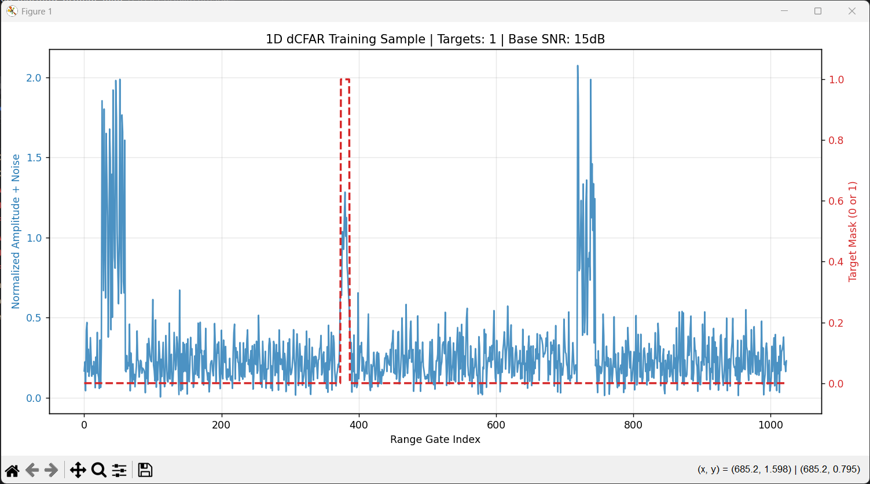
Example Training Sample
Labels are generated from the clean processed target response
The target is not a single bin: it occupies the pulse-compressed response
AdaCFAR-1D | Deep Learning Course | 8

Slide 9
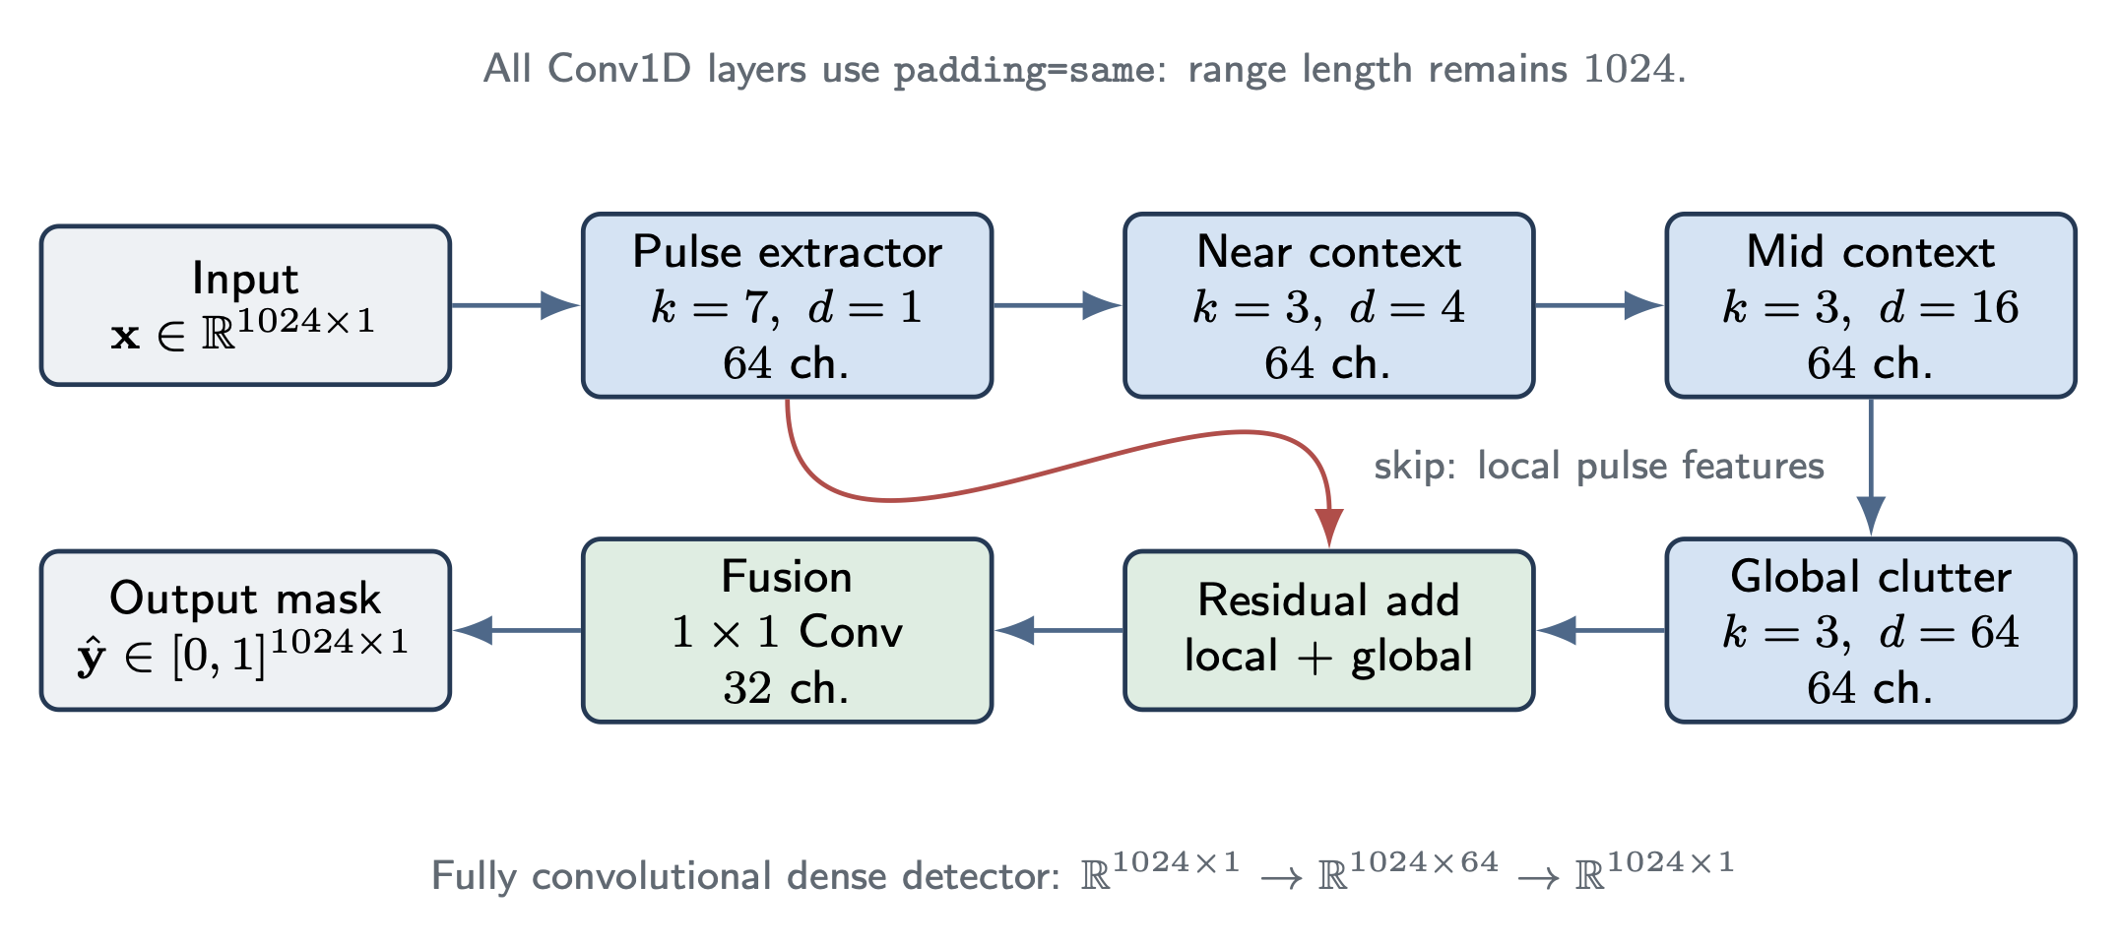
AdaCFAR Architecture
Wide first kernel captures pulse morphology
Dilated convolutions capture long-range clutter context
Skip connection preserves local target features
40k Parameters (very small for RT inference)
AdaCFAR-1D | Deep Learning Course | 9

Slide 10
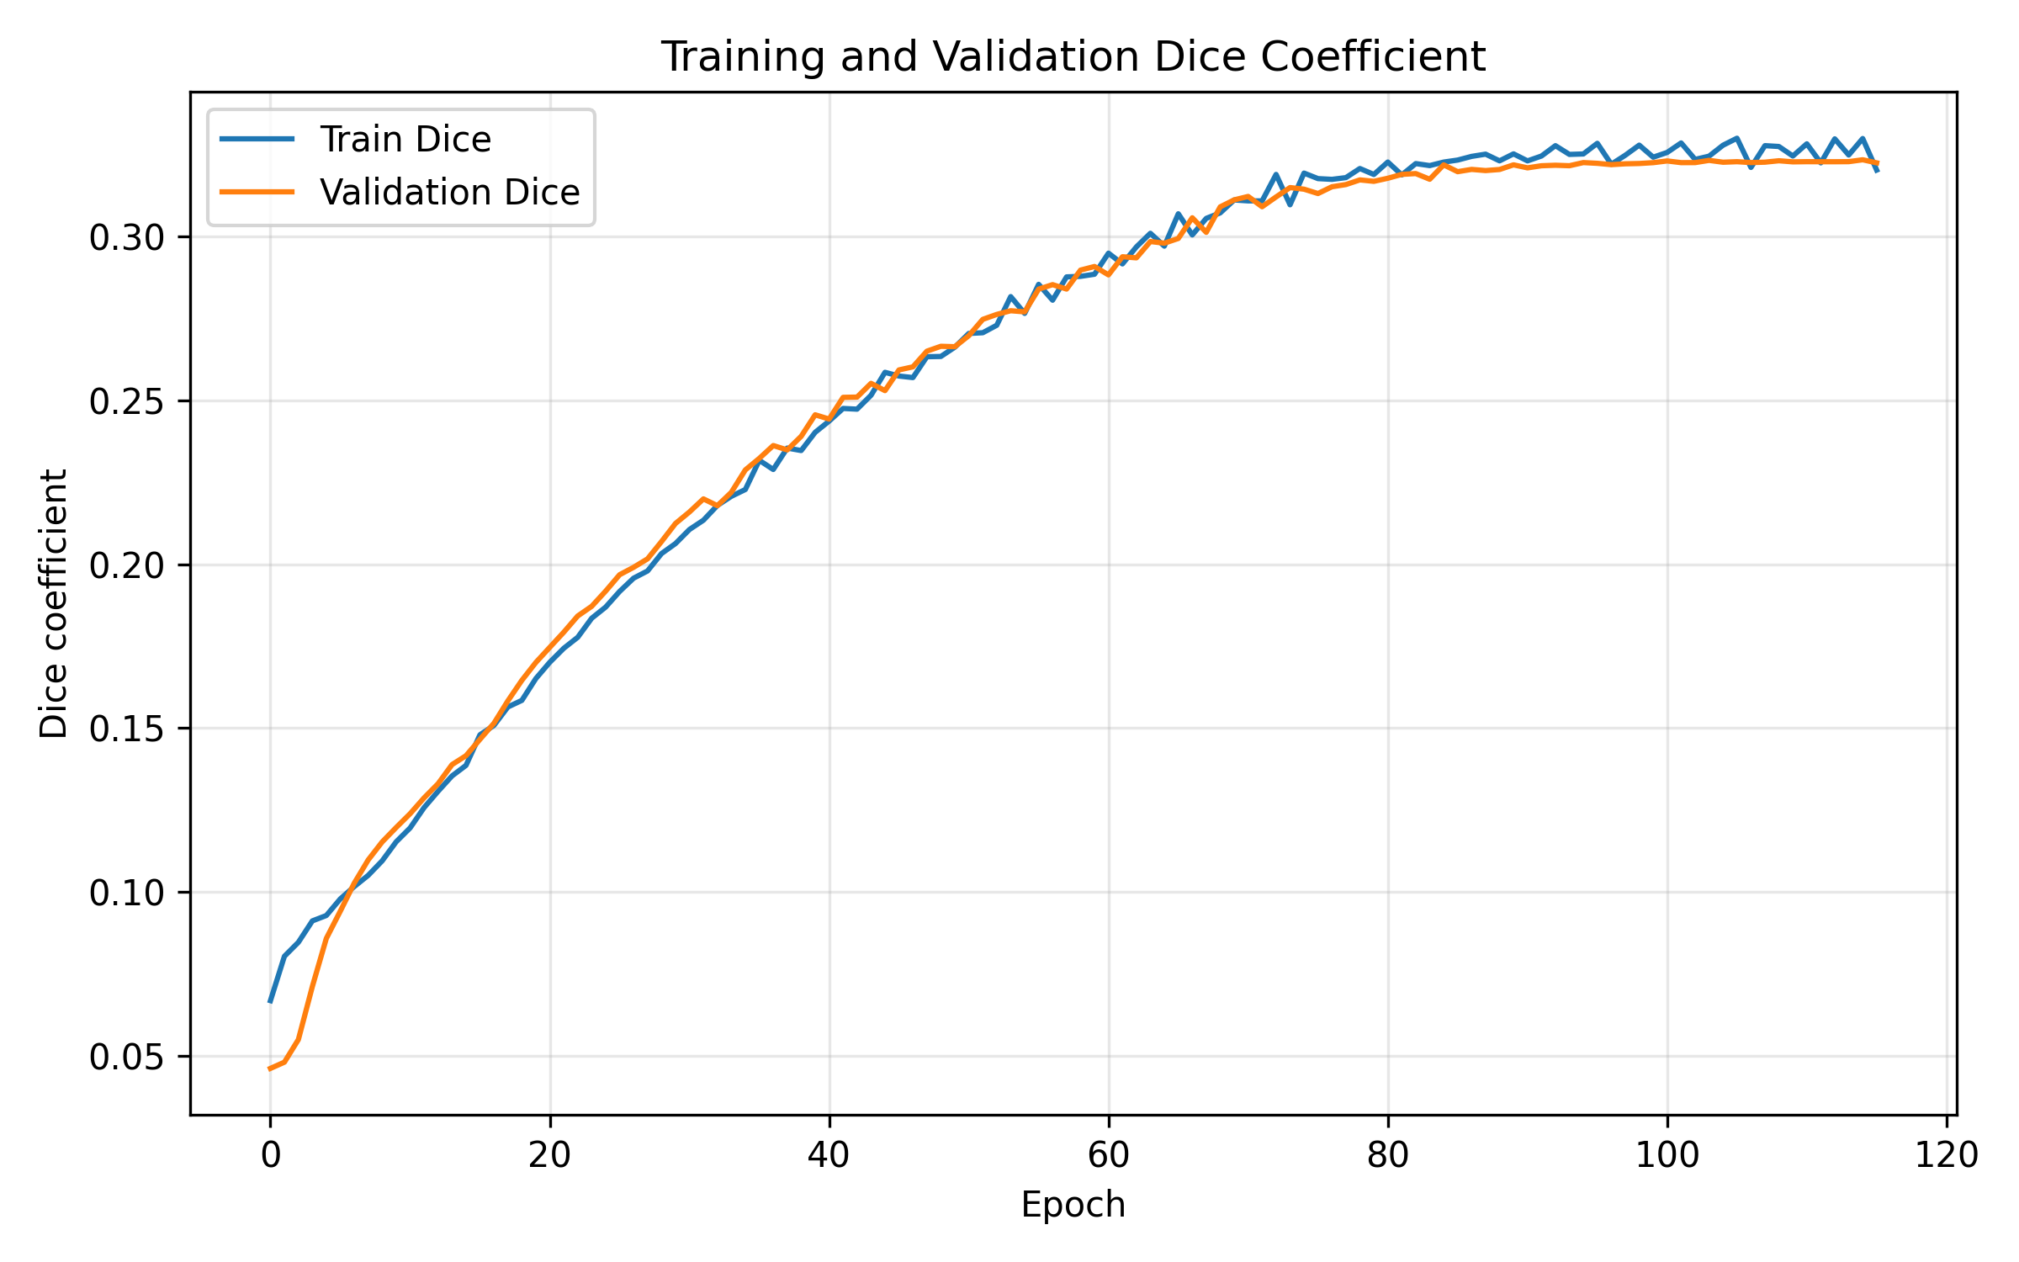
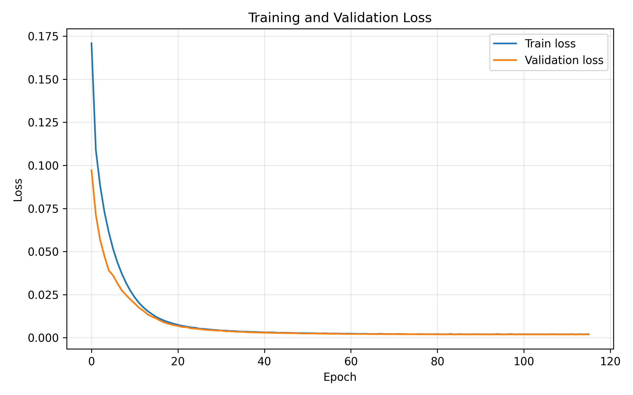
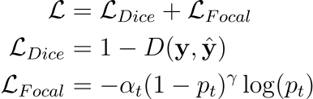
Training Performance
We had to find a suitable loss function:
AdaCFAR-1D | Deep Learning Course | 10

Slide 11
Detection Probability: CA-CFAR vs AdaCFAR
SNR | CA-CFAR | AdaCFAR V4 | Improvement
30 dB | 78.4% | 88.5% | +10.1 pts
25 dB | 68.8% | 82.4% | +13.6 pts
20 dB | 55.6% | 71.7% | +16.1 pts
15 dB | 41.3% | 58.9% | +17.6 pts
AdaCFAR improves $P_{D}$ at every tested SNR
The gain grows as the scenario becomes harder
AdaCFAR-1D | Deep Learning Course | 11

Slide 12
False Alarm Performance
SNR | CA-CFAR FA | AdaCFAR V4 FA
30 dB | 285 | 0
25 dB | 287 | 7
20 dB | 291 | 3
15 dB | 278 | 7
False alarms are counted as connected predicted components
The final model improves detection without flooding the tracker
AdaCFAR-1D | Deep Learning Course | 12

Slide 13
Qualitative Comparison: V4 vs CA-CFAR
The chart mixes Pd (%) and FA counts for visual contrast only
Use actual profile figure for final qualitative evidence
AdaCFAR-1D | Deep Learning Course | 13

Slide 14
Conclusions
CA-CFAR can be interpreted as a fixed convolutional detector
AdaCFAR-1D learns a task-specific Conv1D detection rule
The final model improves detection probability while suppressing false alarms
This is a proof of concept, not a general CFAR replacement
Manual detector → learned adaptive detector
AdaCFAR-1D | Deep Learning Course | 14

Slide 15
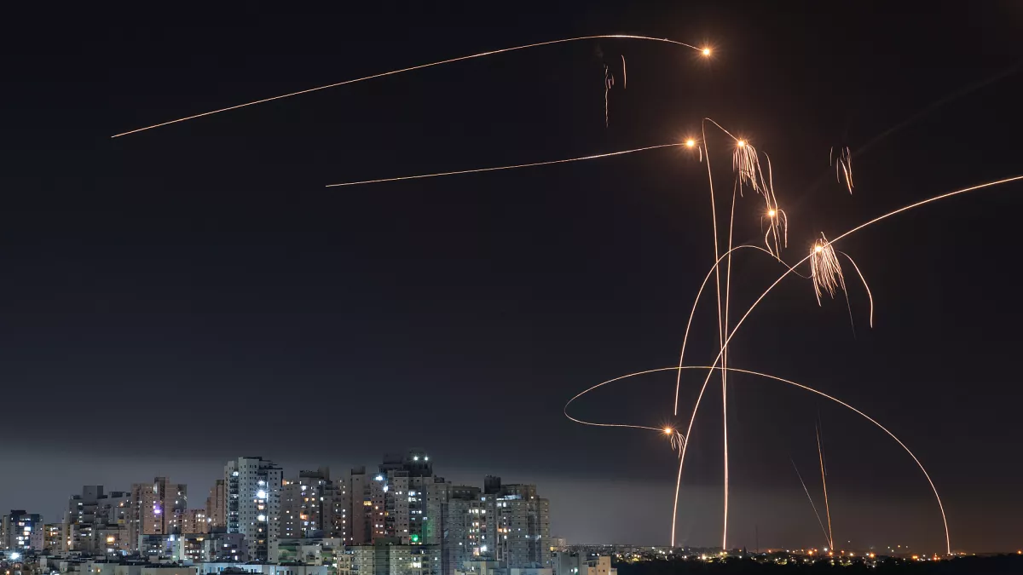
Questions?
Daniel Attali & Sapir Bashan
AdaCFAR-1D | Deep Learning Course | 15

