Slide 1

Competitive Games Multiplayer Rating Strategy

Slide 2
Problem Statement
Estimate individual player skill level for a game win/loss.

Slide 3
Why Ratings
One of the main goals of online competitive games is increasing player engagement by ensuring fair matches.
These games use rating systems for creating balanced match-ups between players
Rating systems leverage statistical estimation to rate players’ skills and use skill ratings to predict rank before matching players.

Slide 4
More often the higher rating player would win over the lower rating player and increase the SR.
In order to have a fair ratings the SR should be increased or decreased dynamically based on the matchup Skills between players.
For example, if a 1700 skill player beats a 1300 skill player, not many points are awarded — as this outcome was expected. On the other hand, if the 1300 level player beats the 1700 level player, almost the entire pool of points is awarded to the 1300 level player and deducted from the 1700 level player. Hence Rating strategy.

Slide 5
Types of Rating Algorithms
ELO
Glicko
Trueskill
Previous Rank

Slide 6
ELO Rating System

Slide 7
Introduction
In the Elo system, competitors are assigned a numerical rating. When matching two players against each other, the player with the higher numerical rating is expected to win.
A player’s Expected Score is calculated as the difference between the ratings of two players, which for our purposes can be considered the likelihood of winning.
After a game is completed, each player’s rating will be adjusted based on the outcome. The winner will take points from the loser, with no points being exchanged on a draw.
Here the rating adjustment happens under the Elo system is based on the outcome of the game.

Slide 8
Factors Influencing the Rating
The two things that majorly factor into the exchange of points are :
1. The starting conditions and
2. The outcome, taking into account the relative rankings of the two players.
The Elo system doesn’t directly measure a player’s skill but instead infers a player’s skill based on their wins, losses, draws and the relative skill of the opponents they play.

Slide 9
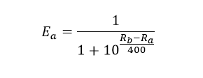
ELO Computations
In the Elo system, if Player A has the ranking R_a and Player B has the ranking R_b, then we can calculate Player A’s Expected Score (E_a) in a match against Player B as follows:
K’= 400(Meta)

Slide 10
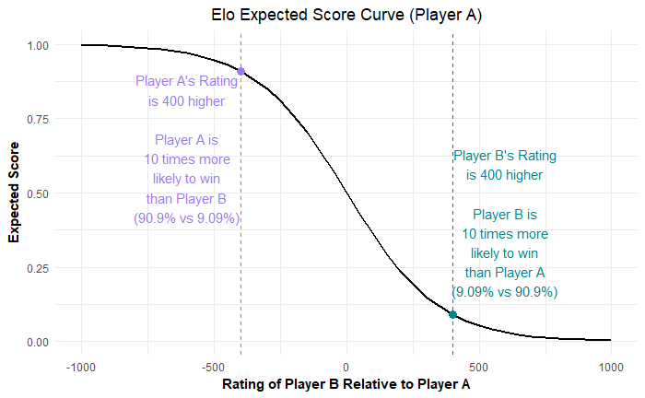
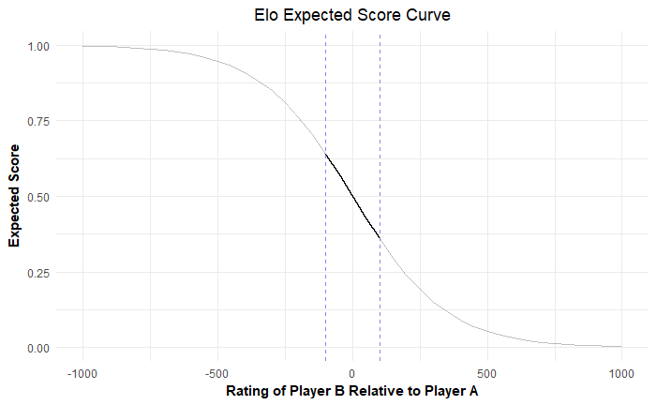
Experimental Analysis-1

Slide 11
Experimental Analysis-2
From Previous plot it turns out that the curve is approximately linear in +/-100 range and fitting this section of the curve with a simple linear regression gives an Adjusted R-Squared value of 0.999 with a high degree of significance for the intercept and slope coefficient.
This allows us to estimate (pretty closely) how Player A’s Expected Score (likelihood of winning) increases or decreases for each extra rating point they have over their opponent — or their opponent has over them.
According to the fit: for each rating point they have over their opponent, Player A’s likelihood of winning increases by 0.14%, and similarly decreases by 0.14% percent for each point that their opponent has on them.
Note: This only holds for the range of +/- 100 rating points, where the curve is essentially linear.

Slide 12
Experimental Analysis-3
If Overwatch used the exact same parameters as the Elo system, a team with a 50 point rating advantage would be 7% more likely to win than if they had no rating advantage (going from 50% to 57%).
Conversely, a team with a 50 rating disadvantage would be 7% less likely to win than if there was no rating difference (going from 50% to 43%). Therefore, in a match-up where Team A has a 50 point rating advantage over Team B, Team A is actually 14% more likely to win than is Team B (57% for Team A vs. 43% for Team B).

Slide 13
Approach to Award SR
The factors influence the rating are the difference in the rating with opposite team, Win/Loss and changing Meta(k’).
A win/loss with Higher negative delta, higher reward(+/-25-30 SR) and wise-versa.
A win/loss with Lower negative delta, lower reward(+/-15-25 SR) and wise-versa.
The Winning/Losing streak can be considered as well in order to reward/penalize.
Meta(Hyper Parameter) is decided based on the Historical data and Business Inputs.

Slide 14
Conclusion
The skill of a player is rated by not just by winning or losing but includes the Skill of the Opponent.

