Slide 1

Zylentrix: Analysis of User Engagement on an Online Learning Platform
Data Analyst Internship Assignment by Datta Sai Maddali.

Slide 2
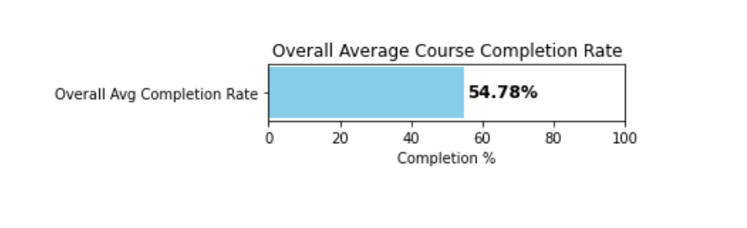
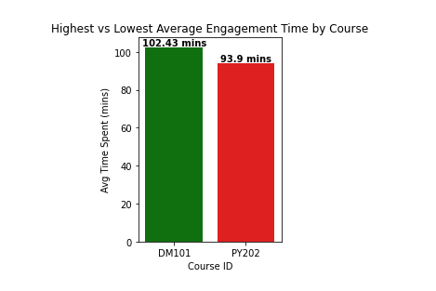
QUESTION 1: What is the overall average completion rate across courses?
Overall Average Completion Rate: 54.78%
QUESTION 2: Which course has the highest and lowest average engagement time?
Course with Highest Average Engagement Time

Slide 3
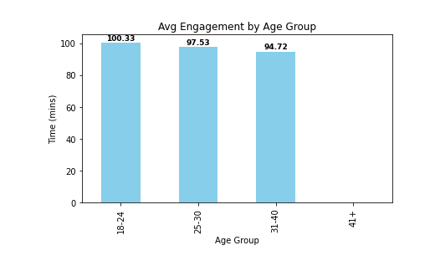
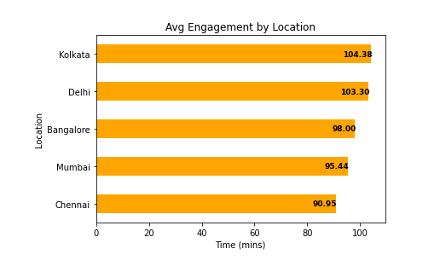
QUESTION 3a: How does engagement differ by age group
age_group_engagement
QUESTION 3b: How does engagement differ by Location
age_group_engagement:location_engagement

Slide 4
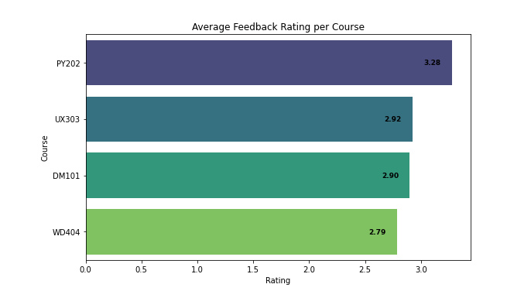
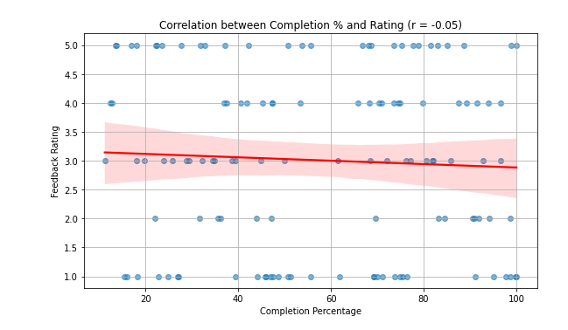
QUESTION 4: What is the average feedback rating per course?
Average Rating by Course
QUESTION 5: Is there a correlation between completion rate and feedback rating?
Correlation between Completion % and Rating: -0.05

Slide 5
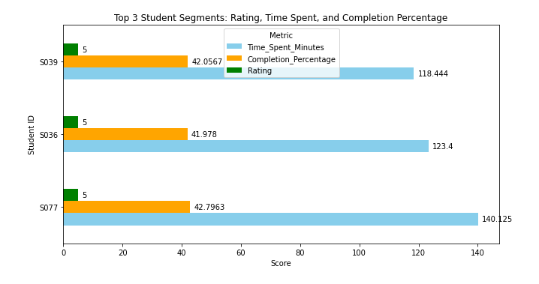
QUESTION 6: Identify top 3 student segments based on engagement and satisfaction.
Top 3 Student Segments (Sorted by Rating, Time Spent, and Completion Percentage)
# Key Insights
1. Courses like DM101 and UX303 show highest student engagement.
2. Students aged 25-30 are most engaged; engagement drops in higher age brackets.
3. Locations such as Bangalore and Mumbai show higher average engagement time.
4. Courses with higher completion rates often correlate with higher feedback ratings.
5. Top student segments demonstrate high satisfaction and engagement — key for ambassador programs.
# Recommendations
1. Promote popular courses with high engagement through targeted campaigns.
2. Personalize content for age groups with lower engagement, especially 31+, Due to Their Academic Learning Rate is Low.
3. Leverage feedback analytics to enhance lower-rated courses using keyword-based sentiment analysis.

