Slide 1
Irrigation Requirement Classification
Predicting irrigation need from soil moisture, weather & crop-stage data
Agriculture • Binary Classification • 10-Day Capstone

Slide 2
Problem Statement
Classify agricultural observations by whether irrigation is likely required
Inputs: soil moisture, temperature, humidity, crop growth stage, recent rainfall
Output: a clear 0/1 prediction, with a probability score where useful
Constraint: free/open-source tools only, feasible within 10 days

Slide 3
Dataset
2,400+ raw observations; domain-realistic synthetic data (no live internet access in this sandbox to pull a live Kaggle file)
Modeled on real smart-irrigation sensor datasets: capacitive soil-moisture + DHT11 temp/humidity + crop stage
Encodes real agronomy: crop coefficient (Kc) by growth stage, field capacity by soil type, evapotranspiration
Includes injected missing values, duplicates & sensor-fault outliers for realistic cleaning practice
README.md documents exact steps to swap in a real Kaggle CSV

Slide 4
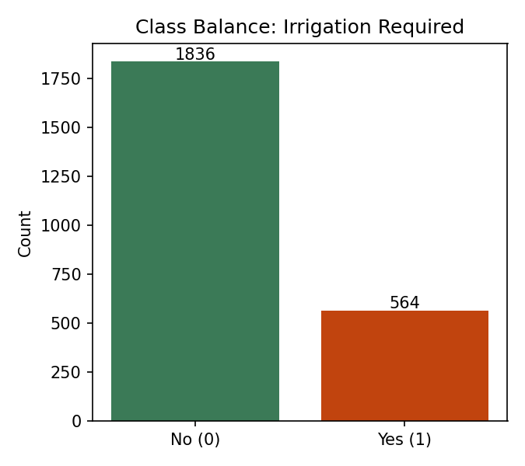
EDA: Class Balance & Key Driver
~23% of observations require irrigation — an imbalanced target, so F1/ROC-AUC matter more than raw accuracy.

Slide 5
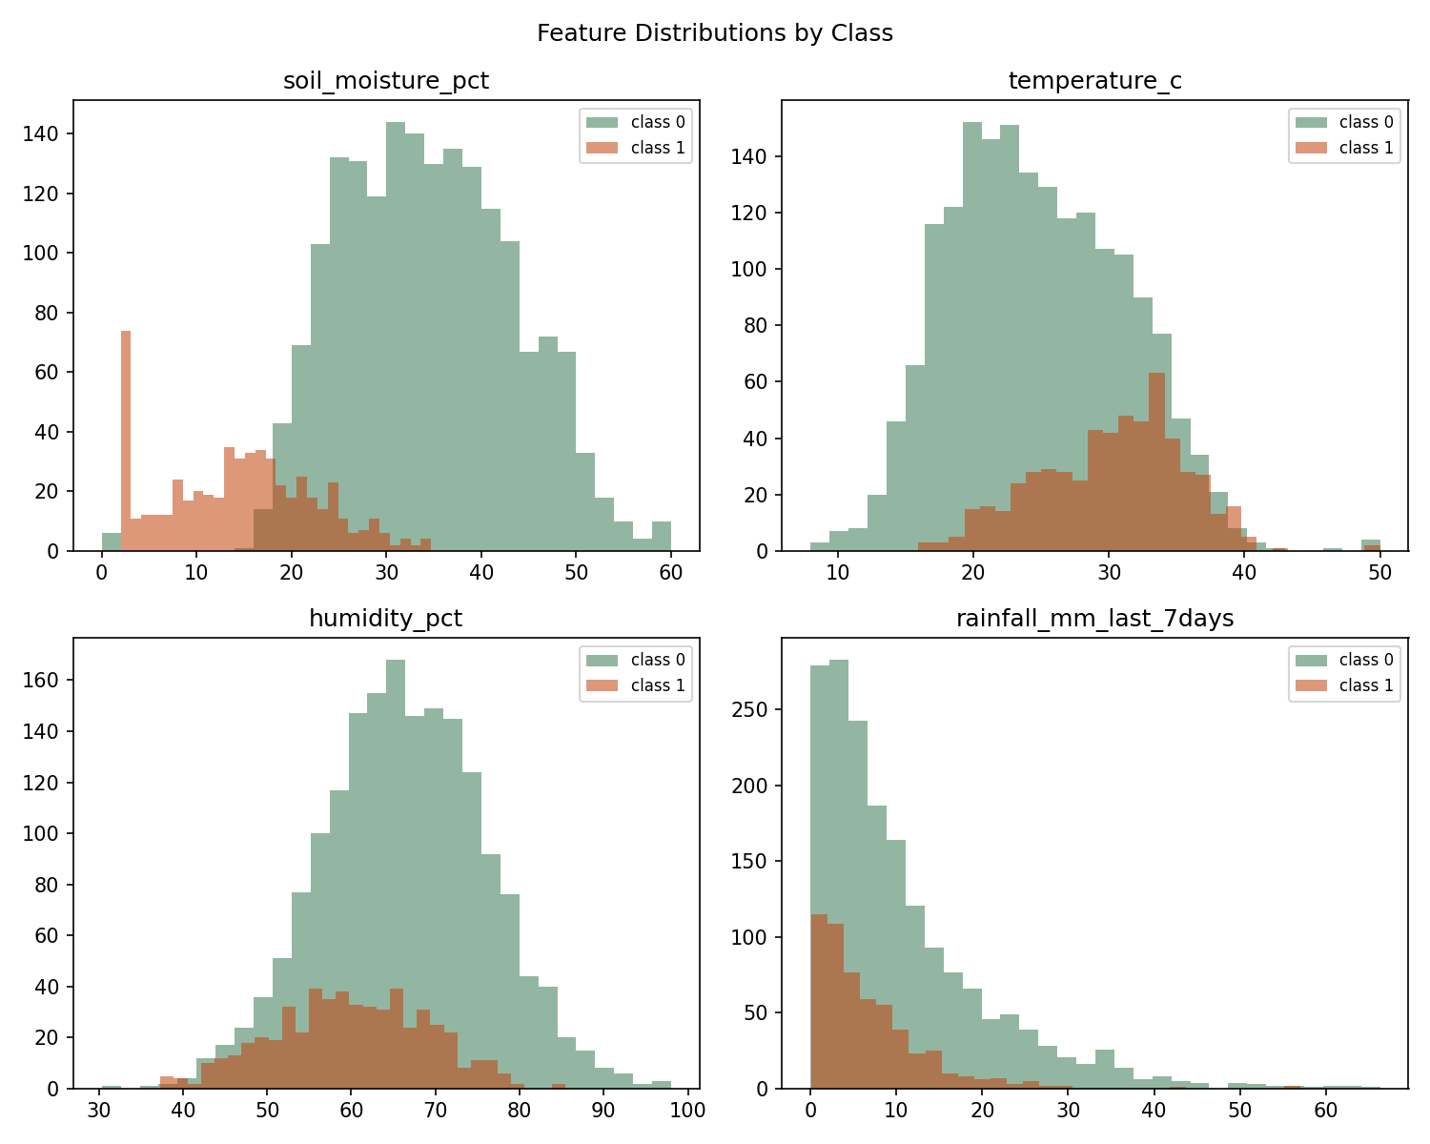
EDA: Feature Distributions by Class
Soil moisture separates the two classes most clearly; temperature & humidity act more as modifiers.

Slide 6
Methodology
Clean data: drop duplicates, clip sensor-fault outliers, impute inside the pipeline (no leakage)
Stratified 80/20 train/test split
ColumnTransformer: median/most-frequent imputation + scaling / one-hot encoding
5-fold GridSearchCV (scoring = F1) over Logistic Regression, KNN, Decision Tree
Best model selected on held-out test F1, tie-break ROC-AUC

Slide 7
Results: Model Comparison
Model | Accuracy | Precision | Recall | F1 | ROC-AUC
logistic regression | 96.0% | 89.8% | 93.8% | 91.8% | 99.2%
knn | 95.6% | 95.1% | 85.8% | 90.2% | 98.8%
decision tree | 95.2% | 87.5% | 92.9% | 90.1% | 97.2%

Slide 8
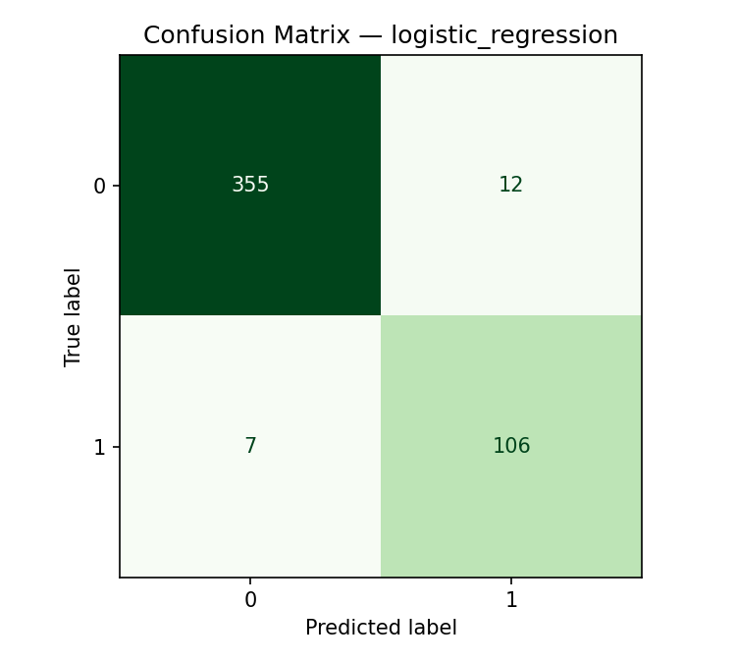
Evaluation — logistic regression
Selected for the highest F1 (91.8%) and ROC-AUC (99.2%), plus full interpretability.

Slide 9
Prototype: Streamlit App
Farmer/agronomist enters today's readings: soil moisture, temperature, humidity, rainfall, crop stage, soil & crop type
Inputs validated against the same physical ranges used to clean training data
Same preprocessing pipeline as training — no train/serve skew
Returns a clear prediction plus a probability-of-irrigation-need score
Run locally: streamlit run app/streamlit_app.py

Slide 10
Limitations & Future Scope
Synthetic data — real sensor data would likely be noisier; swap-in path documented in README
No real-time sensor integration yet; manual input only
Binary label only — doesn't say how much water to apply
Future: real Kaggle/field data, ensemble models, real-time IoT ingestion, multi-region generalization

Slide 11
Conclusion
Delivered a complete, zero-cost pipeline: data -> EDA -> 3 tuned models -> evaluation -> Streamlit prototype
Selected model: logistic regression (F1 = 91.8%, ROC-AUC = 99.2%)
Fully reproducible with open-source tools only; ready to re-run on real field data
Thank you — questions welcome

