Slide 1
SMART STREET LIGHT MONITORING
By :- Datta sai -19h61a12d8 Gnaneshwar -19h61a04g3 Snehith -19h61a04h9 Sushmitha -19h61a04d5 Shreeja -19h61a04d9 Vaishnavi- 19h61a04h0

Slide 2
CONTENTS:
• AIM OF THE PROJECT
INTRODUCTION
• COMPONENTS USED
• DESCRIPTION OF COMPONENTS
• BLOCK DIAGRAM
WORKING MECHANISM
• CODE EXPLANATION
NODE RED
APPLICATIONS &ADVANTAGES
RESULT & DISCUSSION
• CONCLUSION

Slide 3
AIM OF THE PROJECT:-
The aim is to designing and executing the advanced development for energy saving of street lights. Nowadays, human has become too busy, and is unableto find time even to switch the lights wherever not necessary. The present system is like, the street lights will be switched on in the evening before the sun sets and they are switched off the next day morning after there is sufficient light on the roads. this paper gives the best solution for electrical power wastage. Also the manual operation of the lighting system is completely eliminated. In this paper the two sensors are used which are Light Dependent Resistor LDR sensor to indicate a day/night time and the photoelectric sensors to detect the movement on the street. the microcontroller PIC16F877A is used as brain to control the street light system, where the programming language used for developing the software to the microcontroller is C-language. Finally, the system has been successfully designed and implemented as prototype system

Slide 4
INTRODUCTION:
The idea of designing a new system for the streetlight that do not consume huge amount of electricity and illuminate large areas with the highest intensity of light is concerning each engineer working in this field. Providing street lighting is one of the most important and expensive responsibilities of a city. Lighting can account for 10–38% of the total energy bill in typical cities Street lighting is a particularly critical concern for public authorities in developing countries because of its strategic importance for economic and social stability. Inefficient lighting wastes significant financial resources every year, and poor lighting creates unsafe conditions. Energy efficient technologies and design mechanism can reduce cost of the street lighting drastically.In this paper two kinds of sensors will be used which are light sensor and photoelectric sensor. The light sensor will detect darkness to activate the handle its intensity switch, so the streetlights will be ready to turn on .

Slide 5
COMPONENTS USED:
LDR SENSOR
PHOTO ELECTRIIC SENSOR
RPS
RELAY CIRCUIT
PIC16F877A MICRO CONTROLER

Slide 6
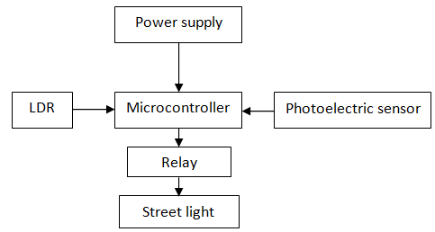
BLOCK DIAGRAM:

Slide 7
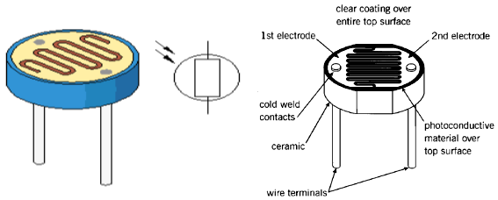
DESCRIPTION OF COMPONENTS:
The system basically consists of a LDR, Photoelectric sensor, Power supply, Relays and Micro controller.
LDR:
The theoretical concept of the light sensor lies behind, which is used in this circuit as a darkness detector. The LDR is a resistor as shown in Fig. and its resistance varies according to the amount of light falling on its surface. When the LDR detect
light its resistance will get decreased, thus if it detects darkness its resistance will increase.

Slide 8
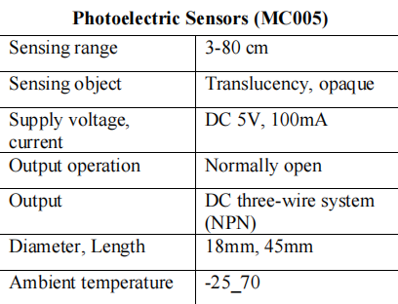
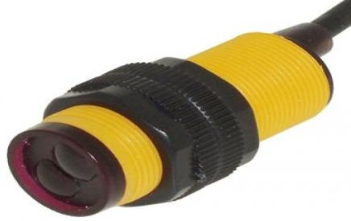
PHOTO ELECTRIC SENSOR:
Light from the emitter strikes the target and the reflected light is diffused from the surface at all angles. If the receiver receives enough reflected light the output will switch states.
TABLE:-

Slide 9

REGULATED POWER SUPPLY:
Usually, we start with an unregulated power supply ranging from 9volt to 12volt DC. To make a 5volt power supply, KA8705 voltage regulator IC as
shown in Fig.has been used The KA8705 is simple to use. Simply connect the positive lead form unregulated DC power supply (anything from 9VDC to 24VDC) to the input pin,
connect the negative lead to the common pin andthen turn on the power, a 5 volt supply from the output pin will be gotten

Slide 10
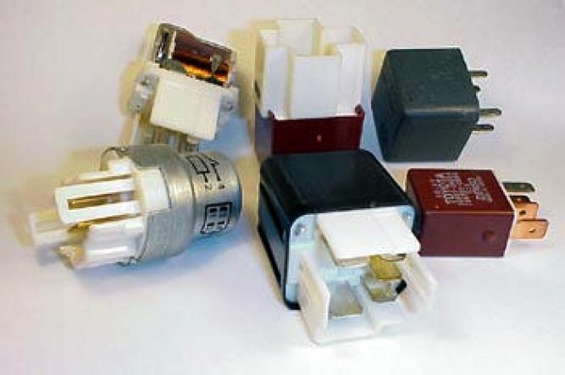
Relay:
Relays are remote control electrical switches that
are controlled by another switch, such as a horn
switch or a computer as in a power train control
module. Relays allow a small current flow circuit to
control a higher current circuit. Several designs of
relays are in use today, 3-pin, 4-pin, 5-pin, and 6-
pin, single switch or dual switches. Relays which
come in various sizes, ratings, and applications, are
used as remote control switches. Fig. 5 shows
different types of relays. In this paper, the 4-pin
relay will be used.

Slide 11
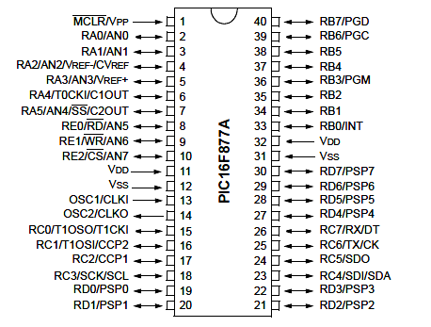
Micro controller:
PIC16F877A Microcontroller A microcontroller is a computer control system on a single chip. It has many electronic circuits built into it, which can decode written instructions and convert them to electrical signals. The
microcontroller will then step through these instructions and execute them one by one. As an example of this a microcontroller we can use it to
controller the lighting of a street by using the exact
procedures. Microcontrollers are now changing electronic designs. Instead of hard wiring a number of logic gates together to perform some function we now use instructions to wire the gates electronically. The list
of these instructions given to the microcontroller is
called a program. There are different types of
microcontroller, this project focus only on the
PIC16F877A Microcontroller where it's pins as

Slide 12
WORKING PROCEDURE :
The following are the different steps included in building a Smart street light.
1. Output of the LDR pin is connected to A0 (analog) port of Arduino Uno board.
2. Connect all output of the LDR sensors to port numbers 4,5 and 6 respectively
(digital) which is the input signal to the Arduino board.
3. Connect the ground of all the LDR sensors to GND port.
4. The output signals from LEDs are connected to port numbers 7,8,9,10,11 and 12
respectively.
5. Again connect all the negative terminals of LED’s to GND port.
6. Power is passed to the Arduino (7-12V)

Slide 13
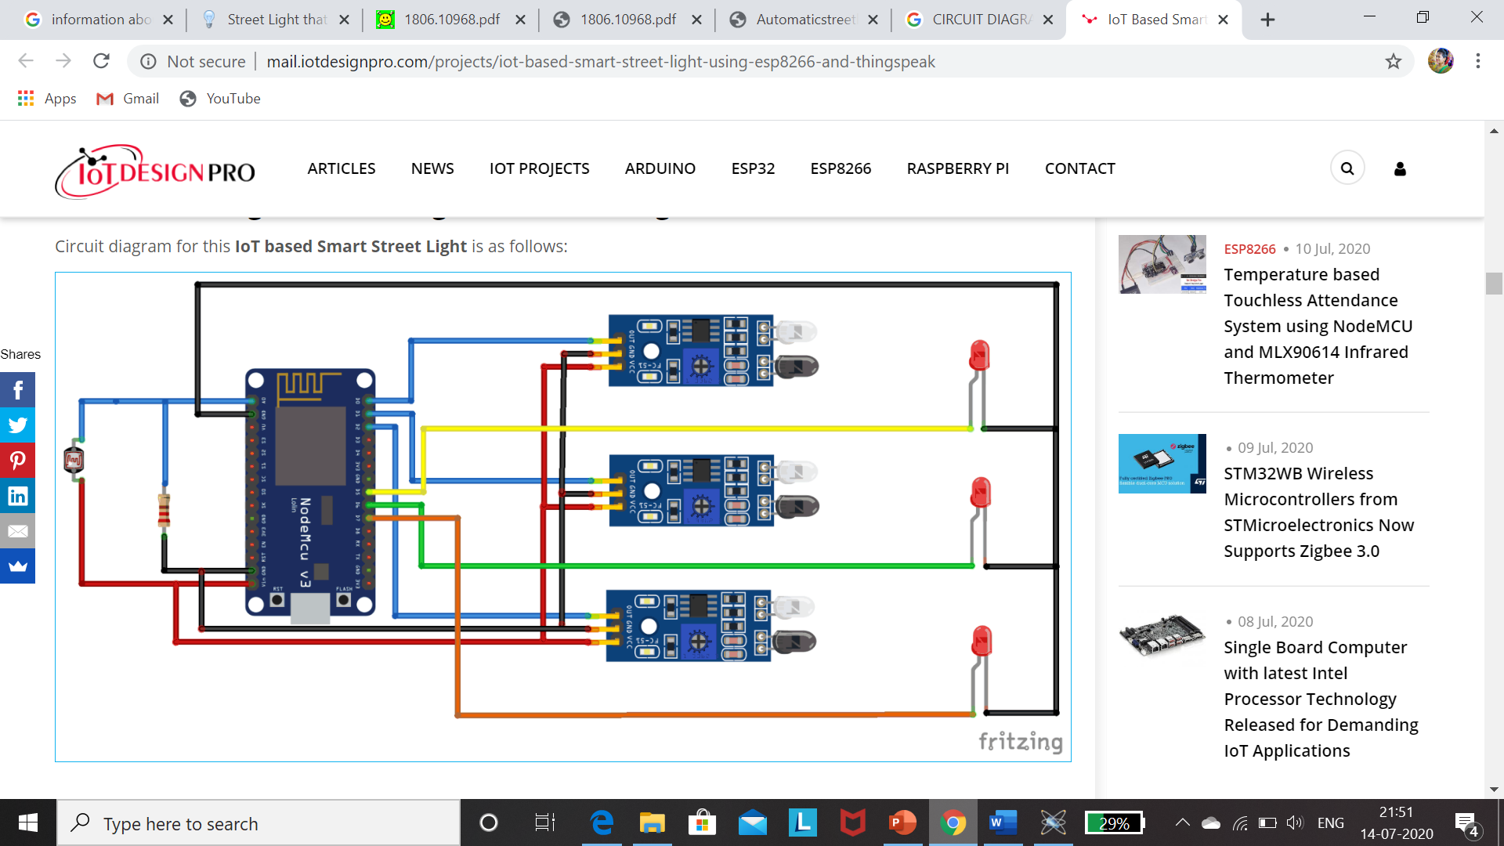
CIRCUIT DESIGN:

Slide 14

CODE:

Slide 15
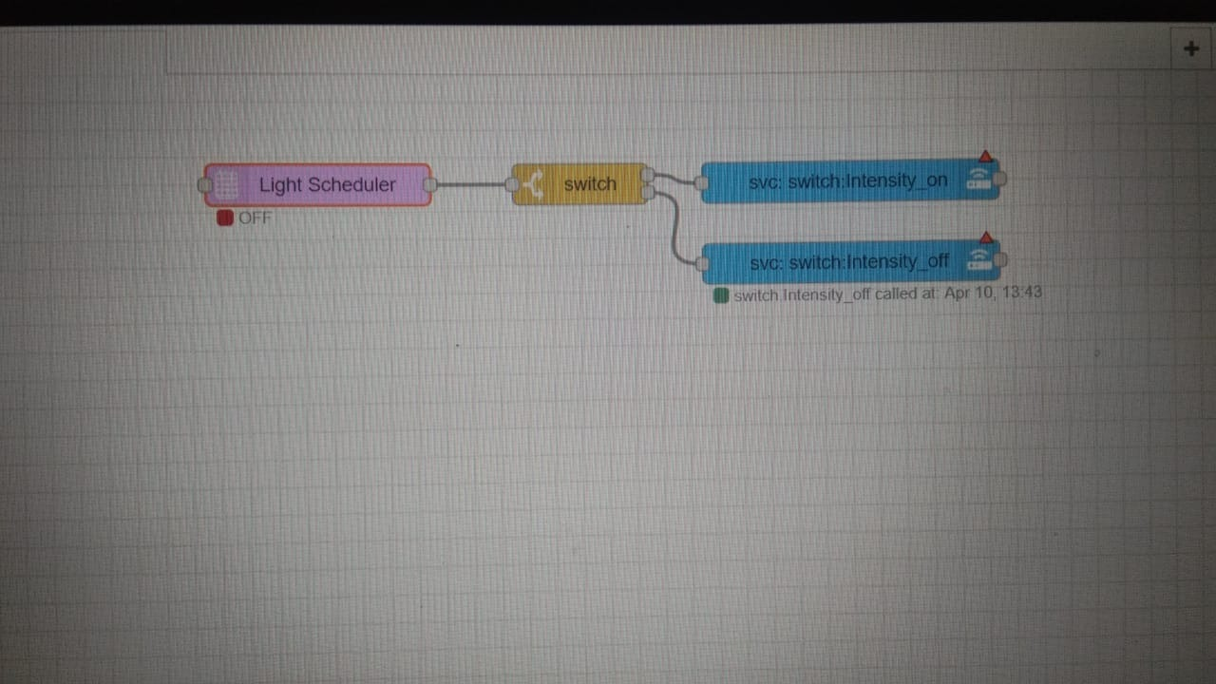
NODE- RED:

Slide 16
APPLICATIONS & ADVANTAGES:
The applications of this street light that glows on
detecting vehicle movement mainly involve in highways,
real time street lights, hotels, parking areas and
restaurants, etc. The advantages are; low cost, more life
span and energy can be saved

Slide 17
RESULTS &DISCUSSION:
The project aims were to reduce the side effects of the current street lighting system, and find a solution to save power. In this project the first thing to do, is to prepare the inputs and outputs of the system to control the lights of the street. The prototype as shown in Fig. 9 has been implemented and works as expected and will prove to be very useful and will fulfill all the present constraints if implemented on a large scale. Prototype of street light system shows the street light system, from the figure it can be seen that, all lighting column are OFF, because there is no any object passes through the street, even though the weather is night. This is the idea of using the microcontroller to control each lighting column alone. When any object passes in Mathematical Methods and Optimization Techniques in Engineering front specific photoelectric sensor the lighting column which connected to it will be turn on automatically.

Slide 18
CONCLUSION :
This paper elaborates the design and construction of automatic street control system circuit. Circuit works properly to turn street lamp ON/OFF. After designing the circuit which controls the light of the street as illustrated in the previous sections. LDR
sensor and the photoelectric sensors are the two main conditions in working the circuit. If the two conditions have been satisfied the circuit will do the desired work according to specific program. Each sensor controls the turning ON or OFF the lighting column. The street lights has been successfully controlled by microcontroller. With commands from
the controller the lights will be ON in the places of the movement when it's dark. furthermore the drawback of the street light system using timer controller has been overcome, where the system depends on photoelectric sensor. Finally this control
circuit can be used in a long roadways between the cities.

Slide 19
THANK YOU
FROM THE TEAM CYBER SQUAD

