Slide 1
INTELLIGENT TRAFFIC LIGHT SYSTEM
Presented by
Datta Sainath D (12261A0409)
Vijay Varma P (12261A04G3)
Shravya K (12261A0483)
ECE Dept.
MGIT
UNDER THE GUIDANCE OF
M Sanjeev Kumar,
Assistant Prof., ECE Dept.,
MGIT

Slide 2

CONTENTS OF THE PROJECT
ABSTRACT
INTRODUCTION
EXISTING WORK
PROPOSED WORK
CONCLUSIONS & FUTURE SCOPE
REFERENCES

Slide 3
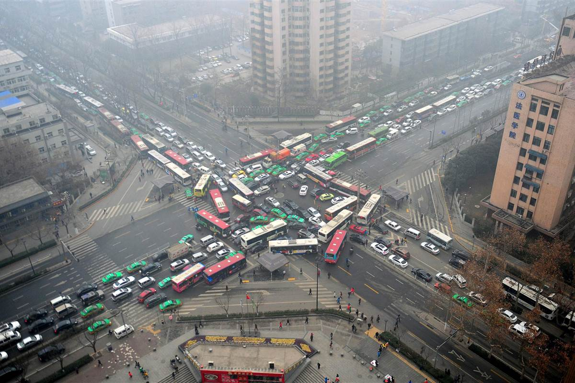
Introduction
Problem Statement:
Nowadays, Uneven traffic congestion is a serious issue.
Making an intelligent/smart traffic light system is the need of the hour

Slide 4

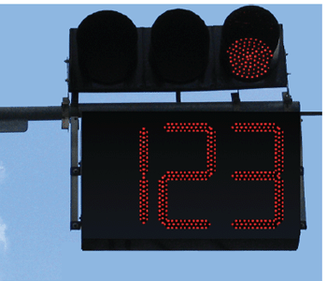
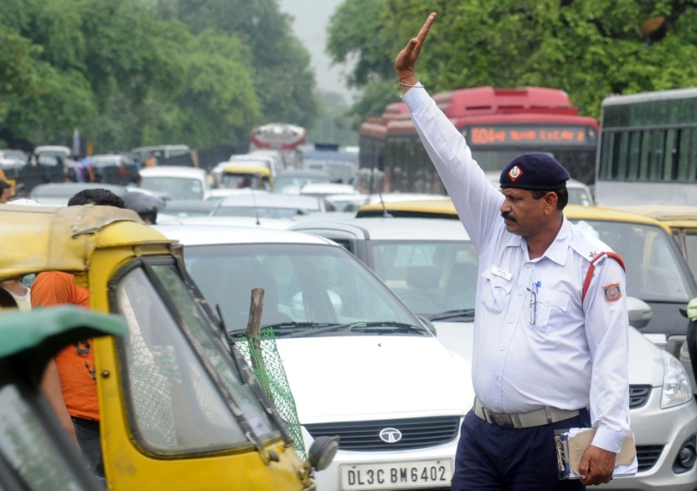
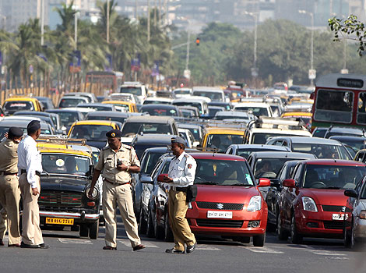
EXISTING WORK
No polling is done
Manual polling is done
More manpower is used for dense traffic

Slide 5
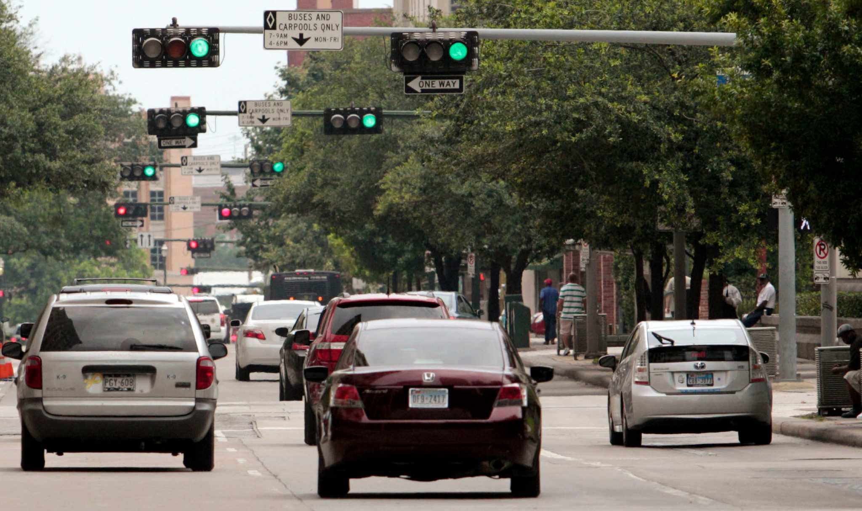
EXISTING WORK (Advanced Stage)
Traffic Synchronization
StatisticalAnalysis:
1. 40-50 seconds travel time
(25% - 30%)
2. Rs 150 saving for two wheelers
3. Rs 400 saving for four wheelers
Notes:
A pilot project to synchronize traffic signals on the Karve road stretch has been completed between Deccan corner and Nal stop.

Slide 6

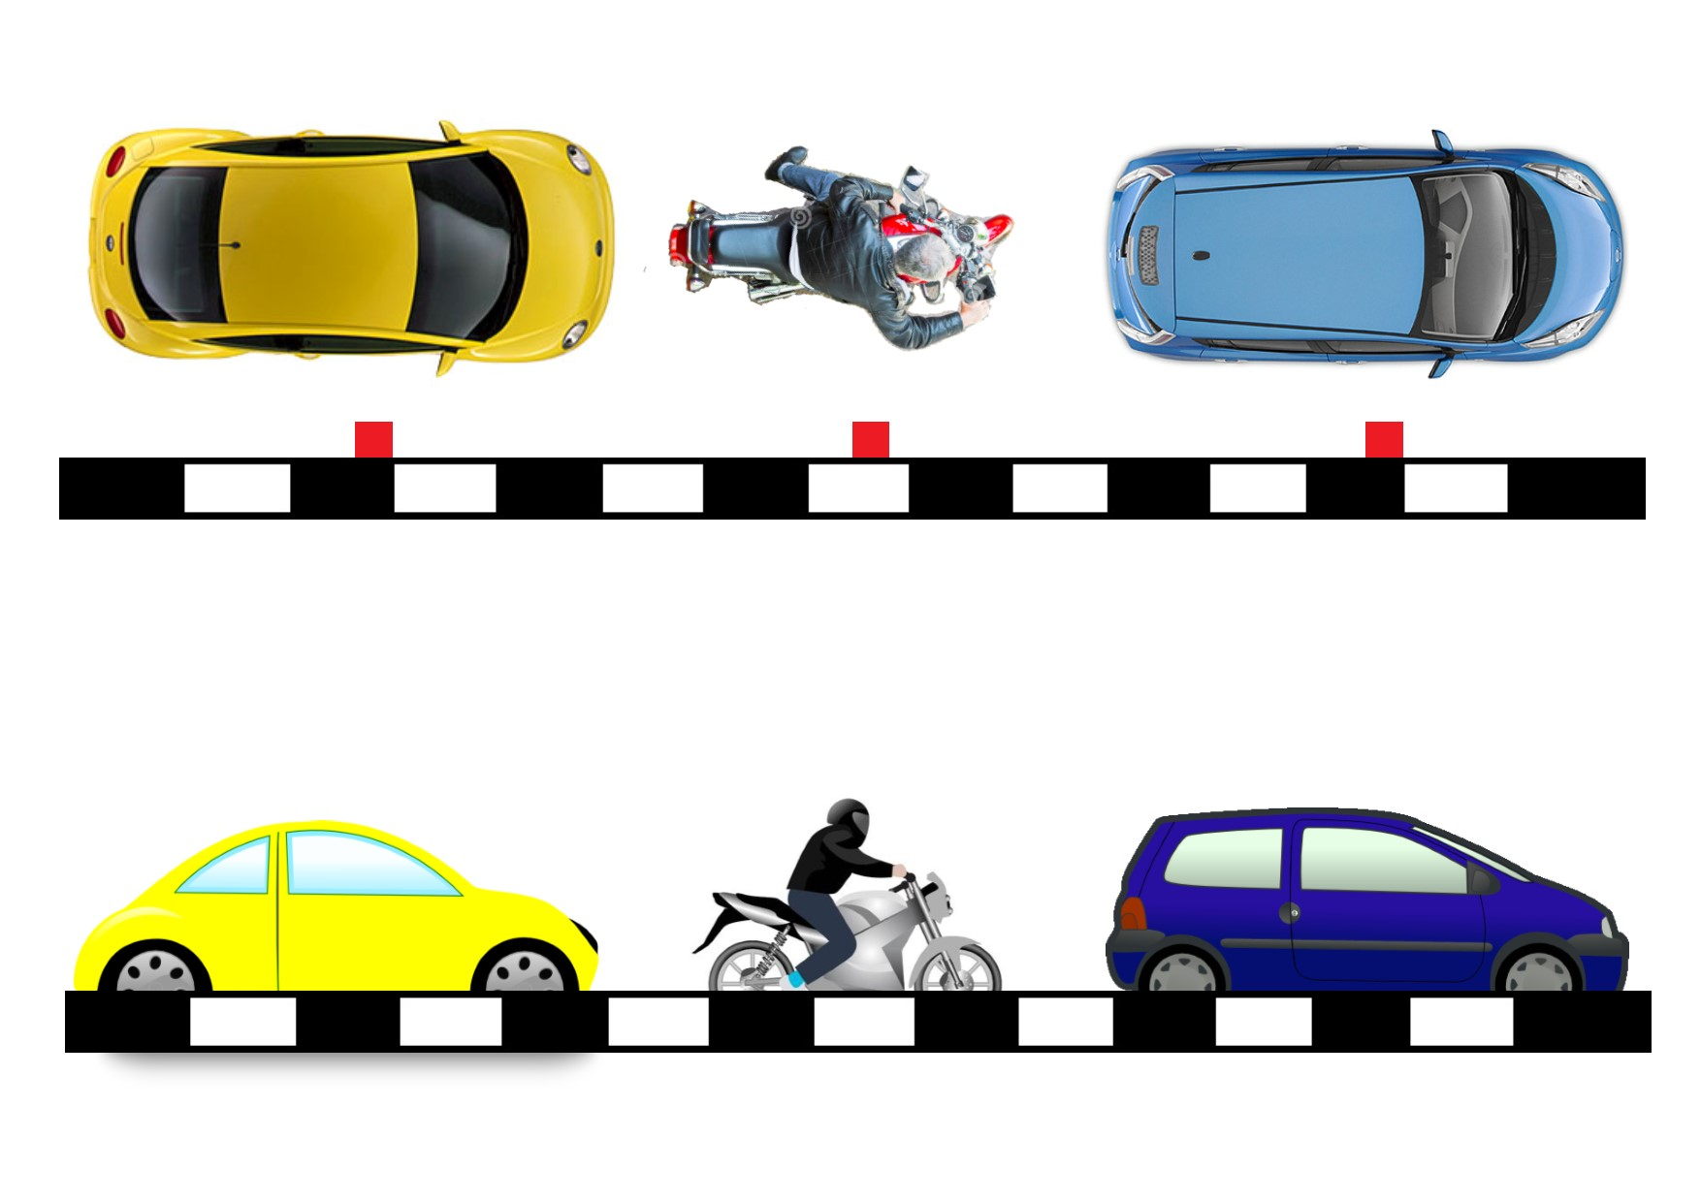
PROPOSED PRODUCT/TECHNOLOGY

Slide 7
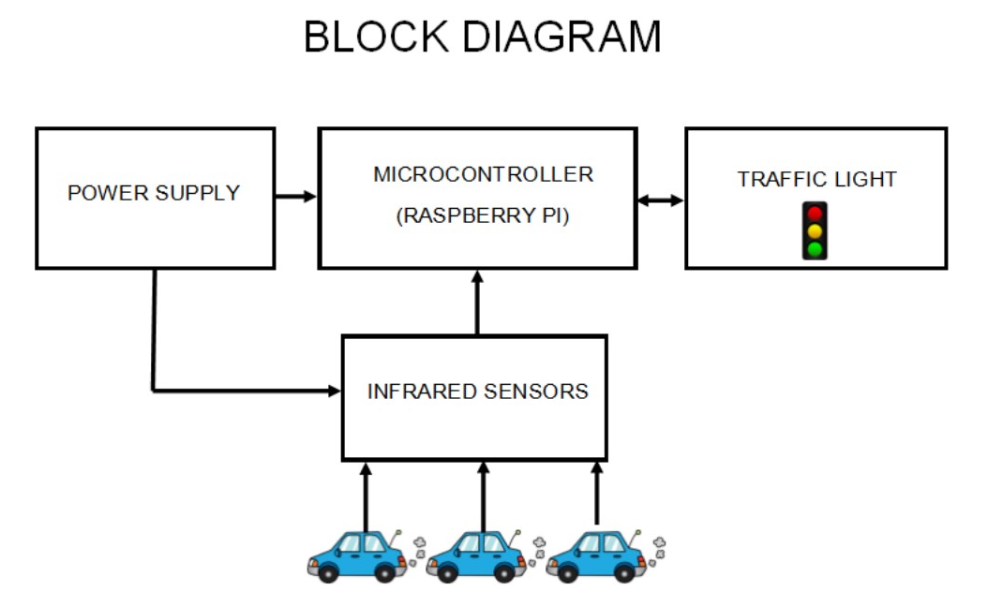
EXPLANATION

Slide 8
DEMO VIDEO

Slide 9

Efficiency
Assume a situation:
Red light timing: 60 seconds
Green light timing: 20 seconds
Best Case Scenario:
The time saved for a vehicle: 45 seconds
(equivalent to 75% of travelling time at junctions)
Worst Case Scenario:
The time saved for a vehicle: 0 seconds
(same obsolete traffic light system)
Notes:
Assuming a red light is for 60 seconds
An a green light is given for 20 seconds

Slide 10

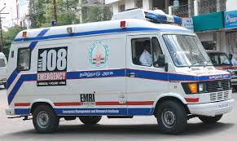
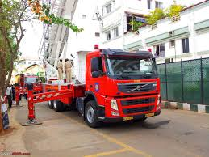
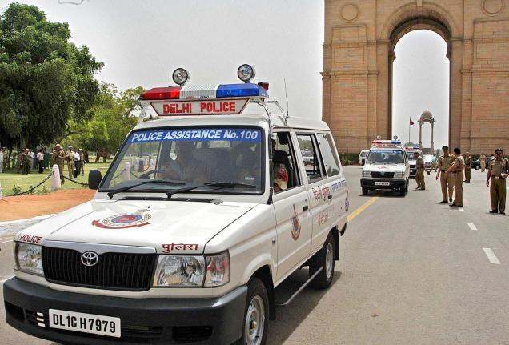
FUTURE SCOPE
Mode 1:
As explained earlier
Mode 2:
For EMERGENCY VEHICLES
Mode 3:
Deals with AI, used when problems persist with sensors.

Slide 11
THEORETICAL REFERENCES
Mehryar Mohri, Afshin Rostamizadeh, Ameet Talwalkar (2012) Foundations of Machine Learning, MIT Press ISBN 9780262018258.
C. M. Bishop (2006). Pattern Recognition and Machine Learning. Springer.
Russell, Stuart; Norvig, Peter (2003) [1995]. Artificial Intelligence: A Modern Approach (2nd ed.). Prentice Hall. ISBN 978-0137903955.
Michael Graham Richard, “Networked Traffic Lights could save time, fuel, and live, http://www.treehugger.com.
Shilpa S. Chavan(Walke), Dr. R. S. Deshpande, J. G. Rana (2009) “Design of Intelligent Traffic Light Controller using Embedded System”, Second Internation Conference on Emerging trends in Engineering and Technology.
Cai Bai-gen, ShangGuan Wei, Wang Jian & Chen Rui(2009) “The Research and Realization of Vehicle Detection System Based on Wireless Magneto-resistive Sensor”, Second Internation Conference on Intelligent Computation Technology and Automation.
Tavladakis and Voulgaris (1999) “Development of an autonomous adaptive traffic control system”, In ESIT ’00 – the European Symposium on Intelligent Techniques.
David Millward, “Smart traffic lights to stop speeders”, www.telegraph.co.uk.
Thorpe (1997) “Vehicle traffic light control using sarsa”, Master’s thesis, Department of Computer Science, Colorado State University.

Slide 12

PRACTICAL REFERENCES

Slide 13
THANK YOU

