Slide 1
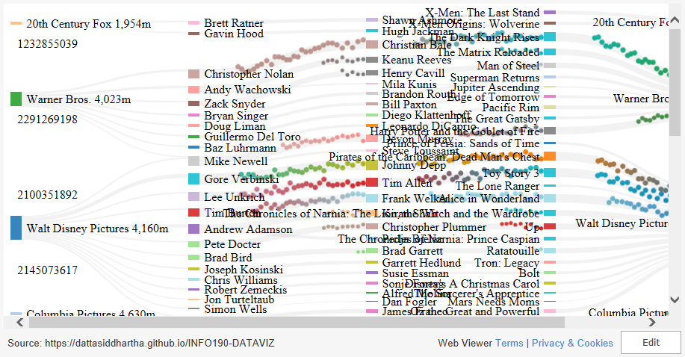

Slide 2
Steps
On computer of design:
Office add-in (Web Viewer) or just use this template
Append d3.js link (username.github.io/reponame)
On computer of execution:
When load deck on new computer, go to this slide, click “Trust Add-on”, and click Preview

