Slide 1
















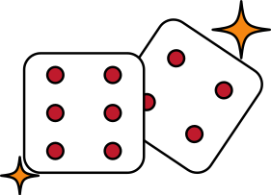
Hate, did you fake it? Deep learning model with multitasking for the detection of fake content in Code-Mixed hate speeches.
CSE ,2018-2022
MAJOR PROJECT
NOT FAKE
FAKE
HATE
NOT HATE

Slide 2
Group Members:
Under Guidance of:
V Harsha Vardhan -18bcs118
Rama Dundi Saketh -18bcs076
Pokala Dattatreya -18bcs067
Sampath Sakala -18bcs087
Dr. Sunil Saumya
Asst. Professor
IIIT-Dharwad.
NOT FAKE
FAKE
HATE
NOT HATE

Slide 3
Problem Statement
NOT FAKE
FAKE
HATE
NOT HATE

Slide 4
IIIT-Dharwad
CSE
Problem Statement:
Detection of fake,hate news that are widely spreading these days by people using social media platforms and other networks to share their views on many topics. While sharing their views,they includes fake,hate news to gather more attention towards it which effects many individuals or organizations.
Because of huge data manual verification is difficult.So,we can use AI and DL models to overcome this difficulty.
Major Project
2018-2022

Slide 5
Context & Motivation
NOT FAKE
FAKE
HATE
NOT HATE

Slide 6
IIIT-Dharwad
CSE
Hate Speech
Initially hate speech is not defined in any law in india.
But later law commission of India on 23 March,2017 in its 267th report stated that
“Hate speech is any word written or spoken,signs,visible representations within the hearing or sight of the person with the intention to cause fear or alarm,or incitement to violence”.
Hate speech can be derived as any sort of communication which derogates any
person or a community based on nationality, race, caste, gender, ethnicity etc...
• Tell those idiots to go hell!
• That women should mind her own business.
Major Project
2018-2022

Slide 7
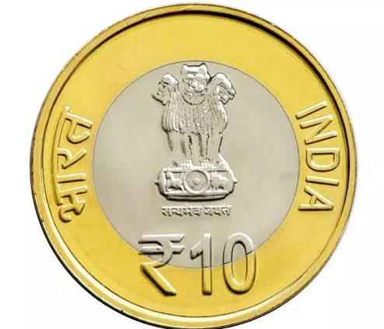
IIIT-Dharwad
CSE
Fake News
Fake news is the news which is not based on truths and facts.
News plays an important role in our day to day life and that is why fake news can create a significant problem to our society.
Ex:
Virat is dropped from T20 world cup.
10 rupee coin is no more a legal tender.
Major Project
2018-2022

Slide 8


IIIT-Dharwad
CSE
The laws that exist or not powerful enough to stop hate content spreading through web and of course it is tough to identify & catch people behind it.
There we had Automatic hate speech detection techniques to find such speeches easily which are in single language.
Major Project
2018-2022

Slide 9

IIIT-Dharwad
CSE
But in a diverse country like India having around more than 24 recognised languages the hate content would be in code-mixed form which is little challenging.
Hindi being most speaking language in india usually most of hate speeches are in Hindi-English (Hinglish) combination.
Major Project
2018-2022

Slide 10
IIIT-Dharwad
CSE
Motivation
By using modern technologies like AI and ML it is possible to detect and control the hate and fake news increasing drastically.
Although there are some implementation of AI and ML models where they are specific to either hate speech or fake news or specific to single language.So,this type of implementations consume more resources and time.
It is benefit to have a single model which can do multi-task for prediction.
Major Project
2018-2022

Slide 11
Dataset
NOT FAKE
FAKE
HATE
NOT HATE

Slide 12
IIIT-Dharwad
CSE
Dataset
Datasets were not found for code-mixed hate speeches labelled for fake,hate, sentiment classes.
Then started finding datasets for each class of data required individually.
And finally found datasets for all three required classes in various platforms.
Major Project
2018-2022

Slide 13
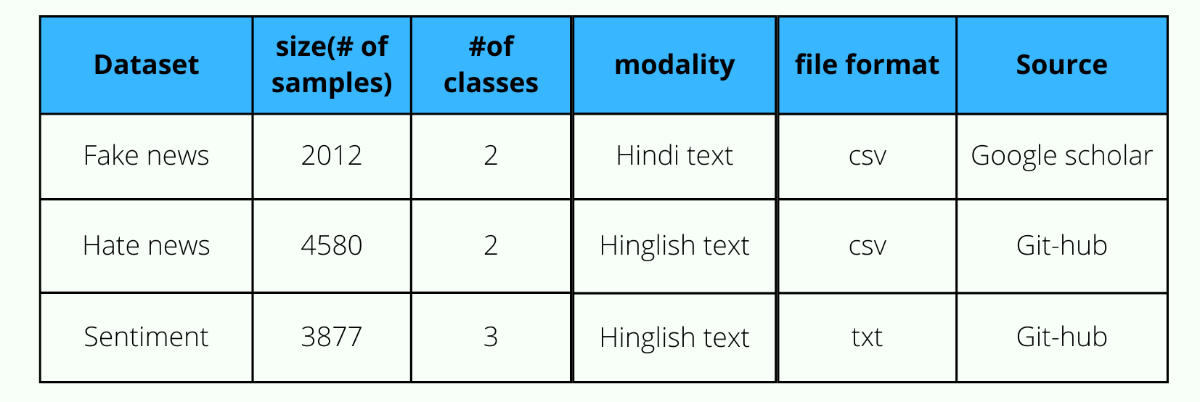
IIIT-Dharwad
CSE
Dataset
Description of Datasets
Major Project
2018-2022

Slide 14
Proposed Methodology
NOT FAKE
FAKE
HATE
NOT HATE

Slide 15
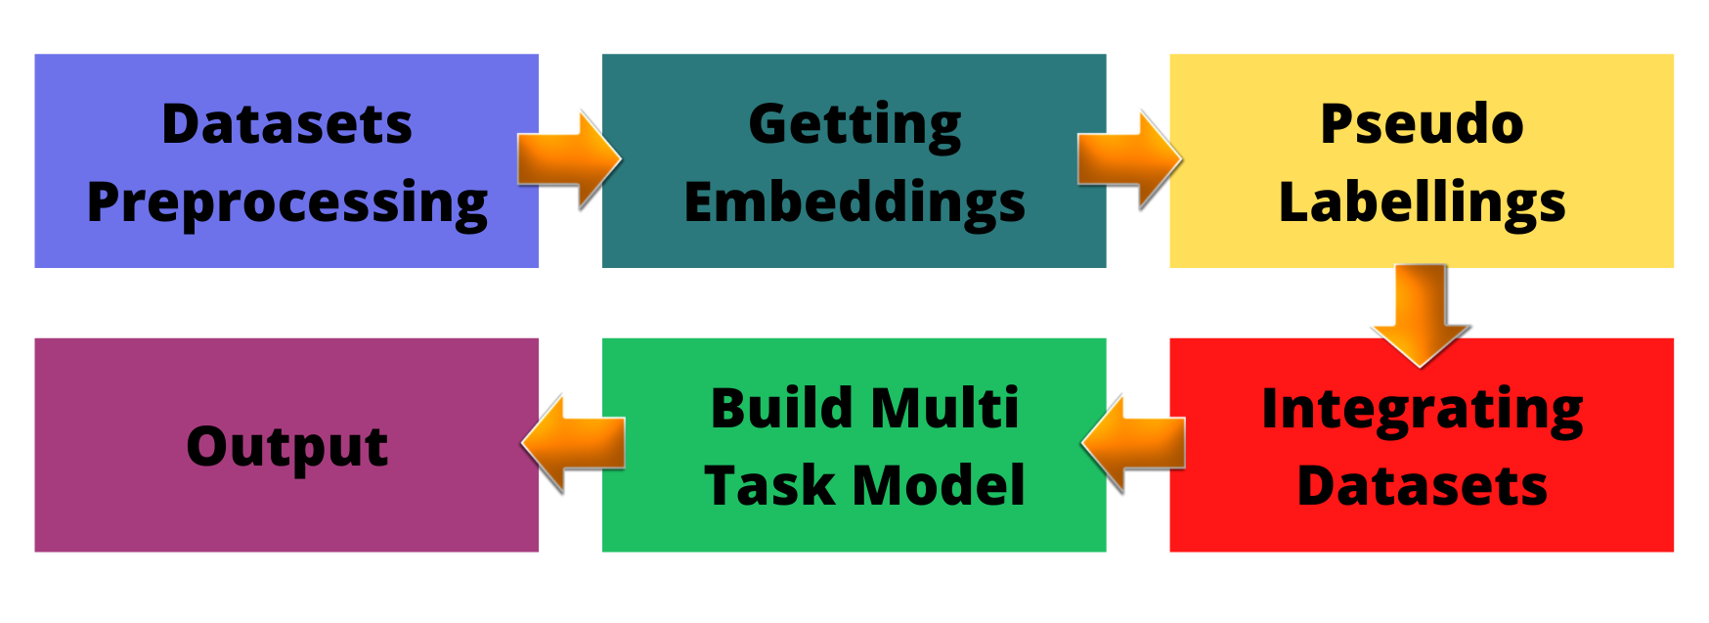
IIIT-Dharwad
CSE
Proposed Methodology
Major Project
2018-2022

Slide 16
Data Pre-Processing
NOT FAKE
FAKE
HATE
NOT HATE

Slide 17
IIIT-Dharwad
CSE
Dataset Transliteration:
Code-mixed data which we found for fake data is in Hindi text.So In order to make all the documents being processed to be in same language(english text) it was transliterated using Indic NLP.
Major Project
2018-2022

Slide 18
IIIT-Dharwad
CSE
Dataset Transliteration:
Code-mixed data which we found for fake data is in Hindi text.So In order to make all the documents being processed to be in same language(english text) it was transliterated using Indic NLP.
Dataset Transformation:
Code-mixed data which we found with sentiment labels is in txt file format.It was transformed into csv format.Thus,dataset will be structured and accessible for further process.
Major Project
2018-2022

Slide 19
IIIT-Dharwad
CSE
Datasets Balancing:
All the datasets found for fake,hate are imbalanced but sentiment we found balanced.
Generally for imbalanced datasets models get biased towards majority class and minimizes the accuracy.
So to maximize accuracy we used SMOTE oversampling technique to balance the datasets.
DATASET | BEFORE | AFTER
FAKE | (0,761) (1,1250) | (0,1250) (1,1250)
HATE | (0,2918) (1,1661) | (0,2918) (1,2918)
Major Project
2018-2022

Slide 20
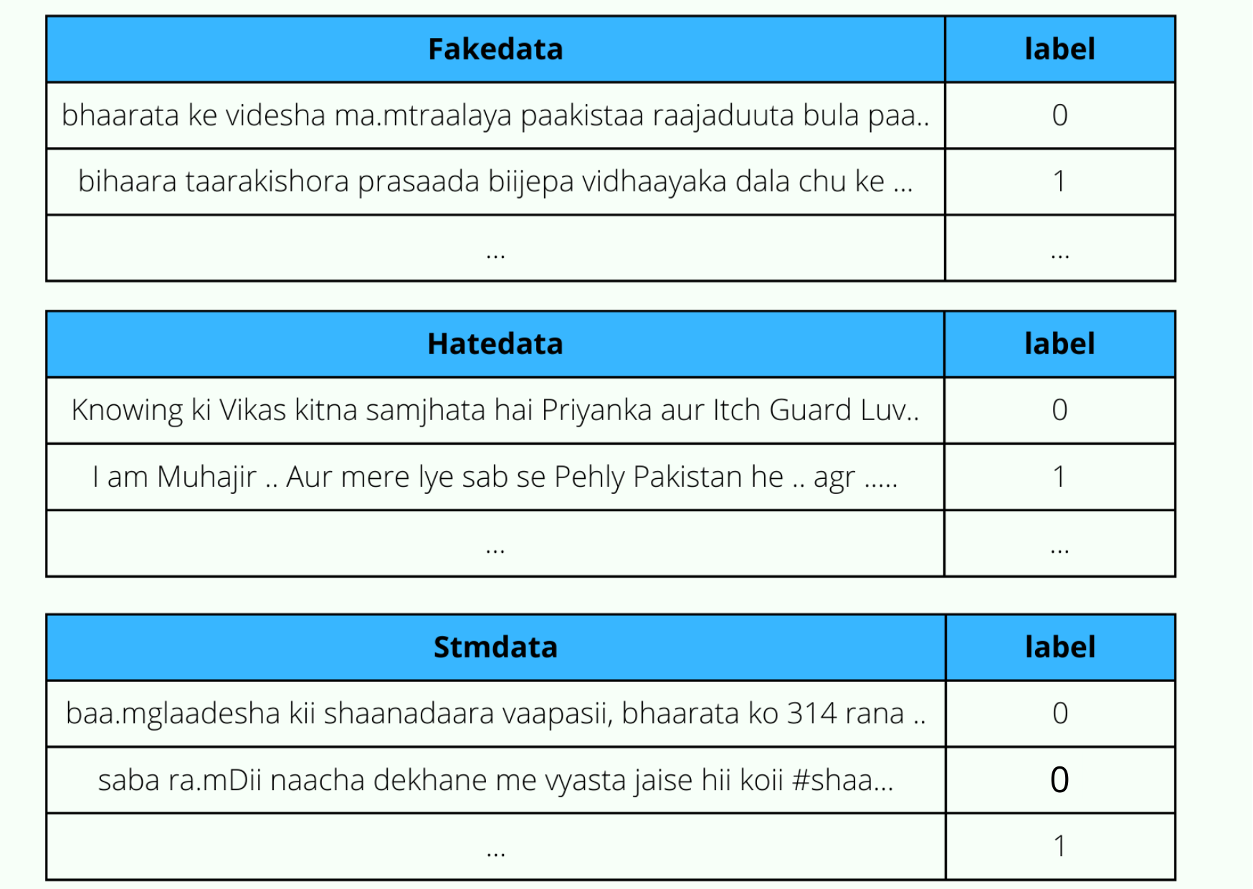
IIIT-Dharwad
CSE
Thus,we had balanced datasets for fake ,hate and sentiment after balancing fake and hate datasets.
Major Project
2018-2022

Slide 21
Embeddings and Pseudo labeling.
NOT FAKE
FAKE
HATE
NOT HATE

Slide 22
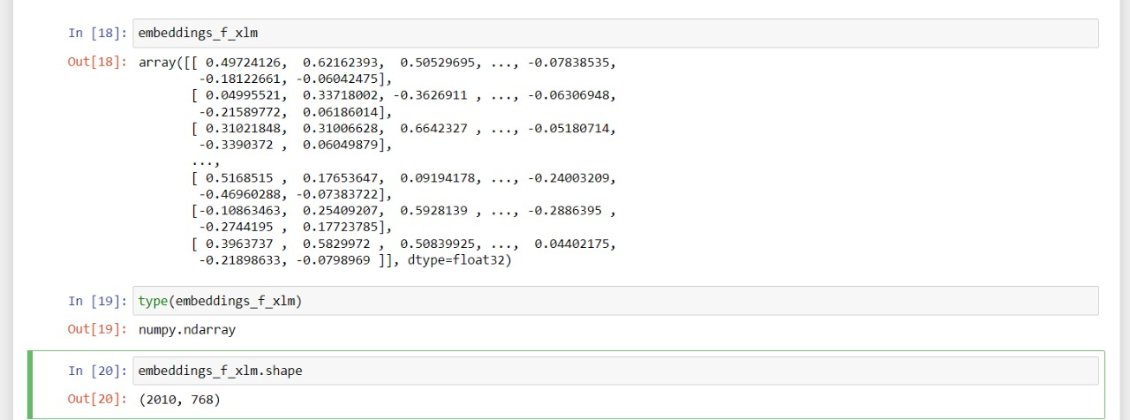
IIIT-Dharwad
CSE
Embeddings:
Embeddings for all three datasets have been generated using mBert and XLM-R based sentence transformers.
Sentence transformers maps sentences to 768 dimensional vector space.
Thus we get shape of embeddings like (no:of sent,768) and embeddings of type numpy.
Major Project
2018-2022

Slide 23
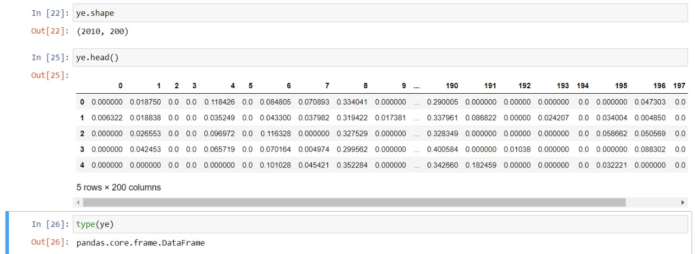
IIIT-Dharwad
CSE
Embeddings:
Then averaged the embeddings generated by both models for each class of datasets.
Then reduced dimensions of embeddings by passing it through dense layers to
(no:of sent,200)
Major Project
2018-2022

Slide 24
IIIT-Dharwad
CSE
Pseudo Labeling:
Pseudo labeling is important because we don’t have a dataset having three labels(fake,hate,sentiment).
So,we take one dataset and generate other two labels which are not present in the original dataset.Thus,we will get a dataset which contains all three labels,by using this dataset we can train the multi-task model.
For each class of dataset pseudo labels have been generated for the other two classes
Ex:
To generate fake labels for hate and sentiment class datasets we using LSTM model by passing embedding of fake dataset generated before.
Major Project
2018-2022

Slide 25
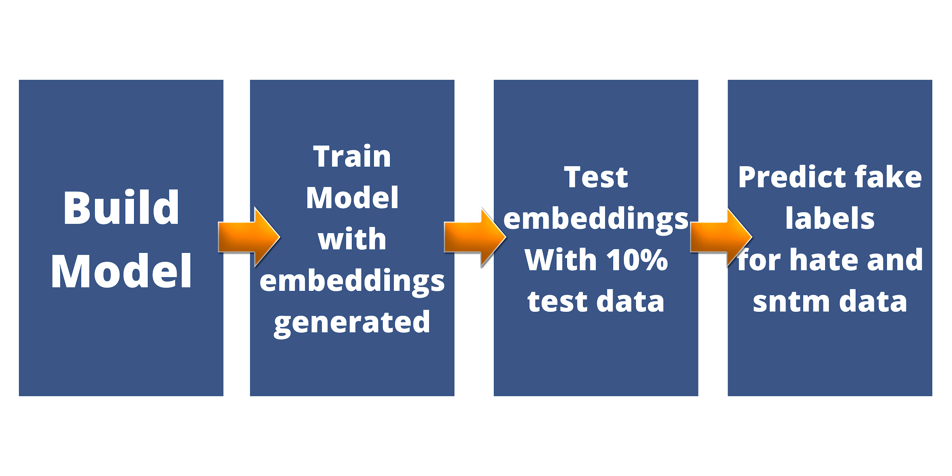
IIIT-Dharwad
CSE
Pseudo Labeling:
For each class of dataset pseudo labels have been generated for the other two classes
Ex:
To generate fake labels for hate and sentiment class datasets we using LSTM model by passing embedding of fake dataset generated before.
And the same process repeated for hate labels with sentiment,fake datasets and sentiment labels with hate,fake datasets.
Major Project
2018-2022

Slide 26
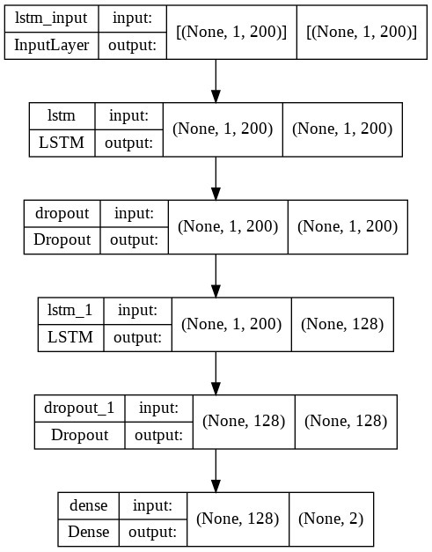
IIIT-Dharwad
CSE
LSTM:
Long Short-Term Memory (LSTM) networks are a type of recurrent neural network capable of learning order dependence in sequence prediction problems.
Steps:
Clean the data
Get Embeddings
We split the data
Train:90% , Test:10%
Train the model(Epochs:40,Softmax,Embeddings)
Test the model
Predict the outputs for hate and sentiment data sets.
Major Project
2018-2022

Slide 27
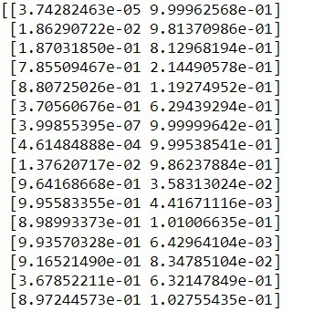
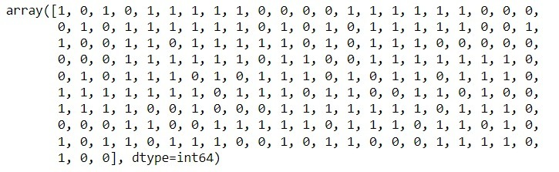
IIIT-Dharwad
CSE
Outputs:
Predicted Probabilities of sentences belonging to 0 and 1:
Using argmax function to get the argument having maximum probability :
Ex: argmax[3.7428e-05,9.99e-01] = 1
Major Project
2018-2022

Slide 28
IIIT-Dharwad
CSE
Pseudo Labeling:
LSTM MODEL | EPOCHS | MODEL ACCURACY | MODEL LOSS | VALIDATION ACCURACY | VALIDATION LOSS
HATE | 40 | 0.6969 | 0.5741 | 0.6444 | 0.6392
FAKE | 40 | 0.8272 | 0.3718 | 0.8011 | 0.4181
SENTIMENT | 40 | 0.7059 | 0.5543 | 0.6361 | 0.6505
Major Project
2018-2022

Slide 29
IIIT-Dharwad
CSE
Major Project
2018-2022

Slide 30
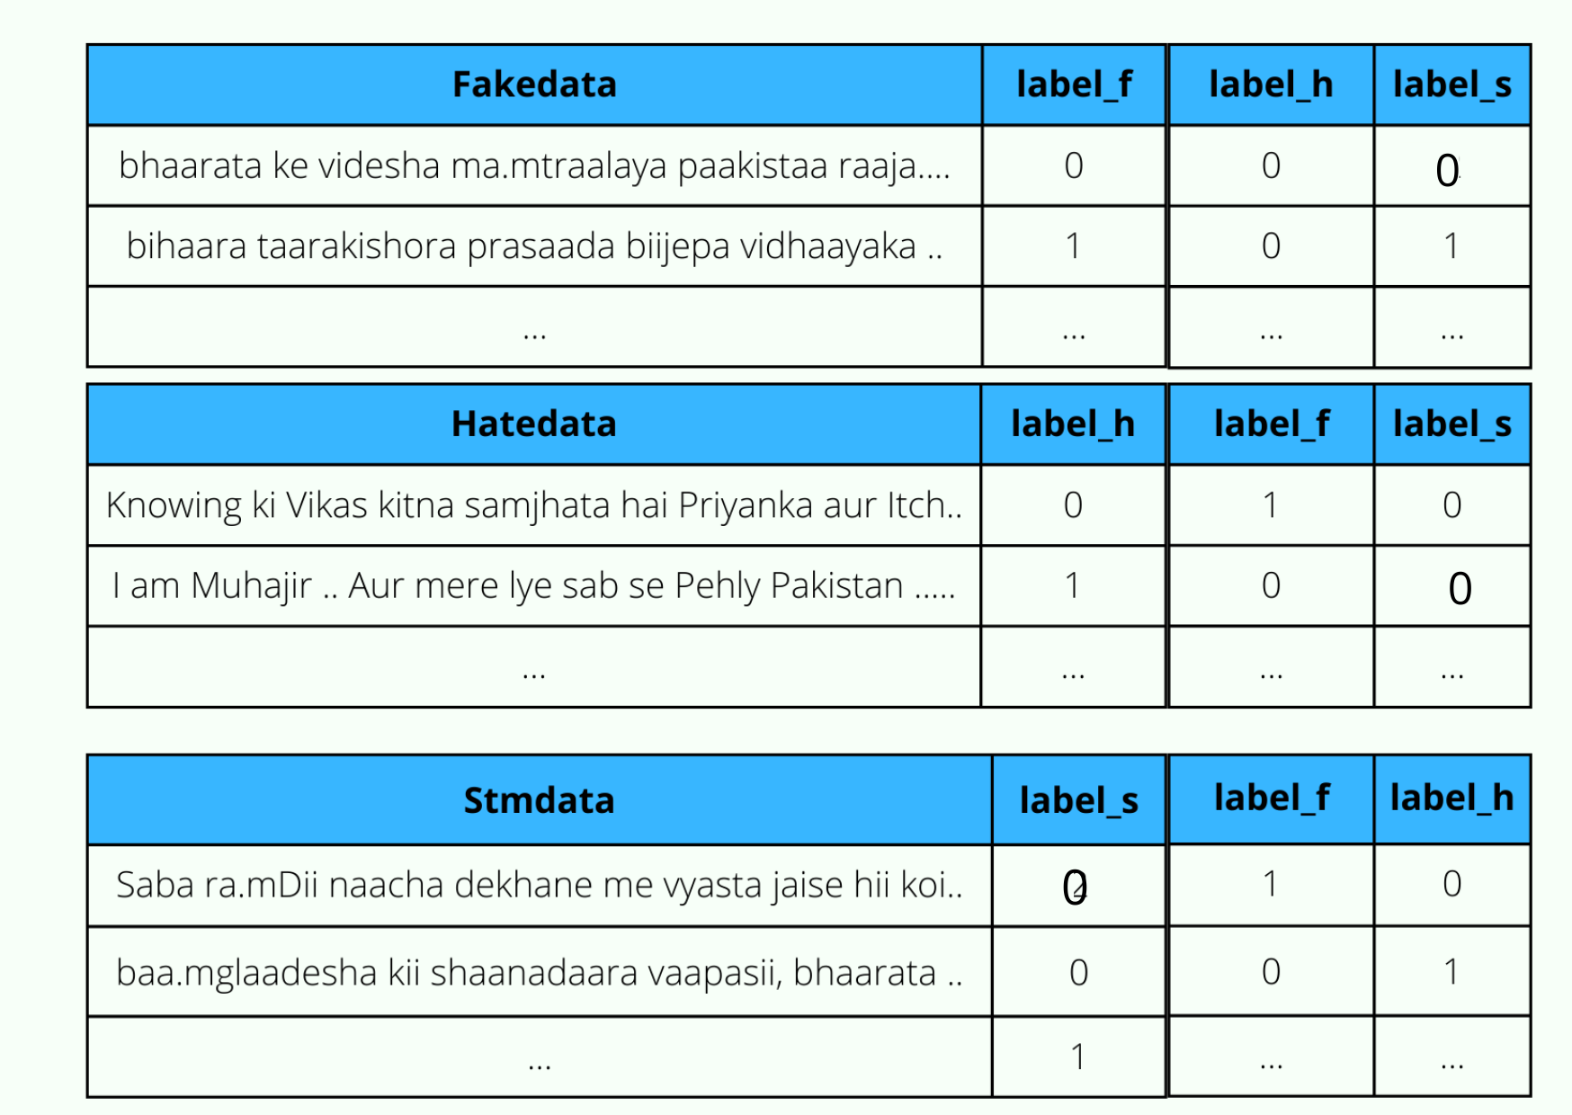
IIIT-Dharwad
CSE
Major Project
2018-2022

Slide 31
IIIT-Dharwad
CSE
Analysing Pseudo labels:Fake
Sentence | Label_F | Label_H (G,M) | Label_S (G,M)
bhaarata ke videsha mamtraalaya paakistaa raajaduuta bula paakistaa bala dvaara nirdosha naagarika jaanabuujha nisha bana kada shabda nimda | 0 | (0,1) | (0,1)
bihaara taarakishora prasaada biijepa vidhaayaka dala chu ke charcha sushiila moda jagaha vo niitiisha kumaara ke upakaptaana raha | 0 | (0,0) | (1,0)
uttara pradesha ke sambhala jaila kisaana shaamta bhamga aashamka ke kaarana laakha rupaya ke bnda bhara sambamdha notisa jaara kiya gaya | 0 | (1,1) | (1,1)
baabara mugala saltanata sthaapa bulamda ke dina usaka paasa duniya chautha adhika daulata saltanata kshetraphala aphagaaanistaana sameta lagabhaga puura upamahaadviipa phaila | 0 | (0,0) | (0,0)
mugala saltanata ke samsthaapaka baabara jaha vije ke ruupa dekha varnita kiya duusara ora unha bada kalaakaara lekhaka maa | 0 | (1,0) | (0,0)
Major Project
2018-2022

Slide 32
IIIT-Dharwad
CSE
Analysing Pseudo labels:Hate
Sentence | Label_H | Label_F (G,M) | Label_S (G,M)
muslamno ko mecca aur madina k nam pe cash karwata raha | 0 | (1,1) | (0,0)
bad politics ek hindu bhai dusre hindu bhai ka khoon pene k liye taiyar hogaya he | 0 | (1,1) | (0,0)
vivad hone pr freedom of speech khatre mein aa jata hai | 0 | (0,0) | (0,0)
admi acha kaam kare to b bhakto k chati pe saanp lotne lagte k ye acha kyun karra bhakto ko padwaoo to ye hate mongring lies chor dege | 1 | (0,0) | (1,0)
punjab me terrorism ki jimmebar to bjp ki dost log he jhooth ki bhi ek had hoti he | 0 | (1,1) | (1,0)
Major Project
2018-2022

Slide 33
IIIT-Dharwad
CSE
Analysing Pseudo labels:Sentiment
Sentence | Label_S | Label_F (G,M) | Label_H (G,M)
isna muslim ko chalang kiya ha iska movie koi mat dekhna agr tum sab muslim hoga to nhi dekho ge | 0 | (0,0) | (1,1)
bakwas actor ki bakwaas film | 0 | (1,1) | (1,1)
jo sachcha musalman hoga vo iski movie nahi dekhega bhai kyu k isne muslamano ko chalange kiya hai so mai to nahi dekhunga jiski jo marzi bhai | 0 | (0,0) | (1,0)
eid mubarak bhaijan | 0 | (0,0) | (0,0)
salman khan bolliwood ki shan banchuka back to back blockbuster superhit movi name dabbang redy bodyguard ek tha tiger dabbang jai ho kick bajarangi bahizan superhit jayagi fix | 0 | (1,1) | (0,0)
Major Project
2018-2022

Slide 34
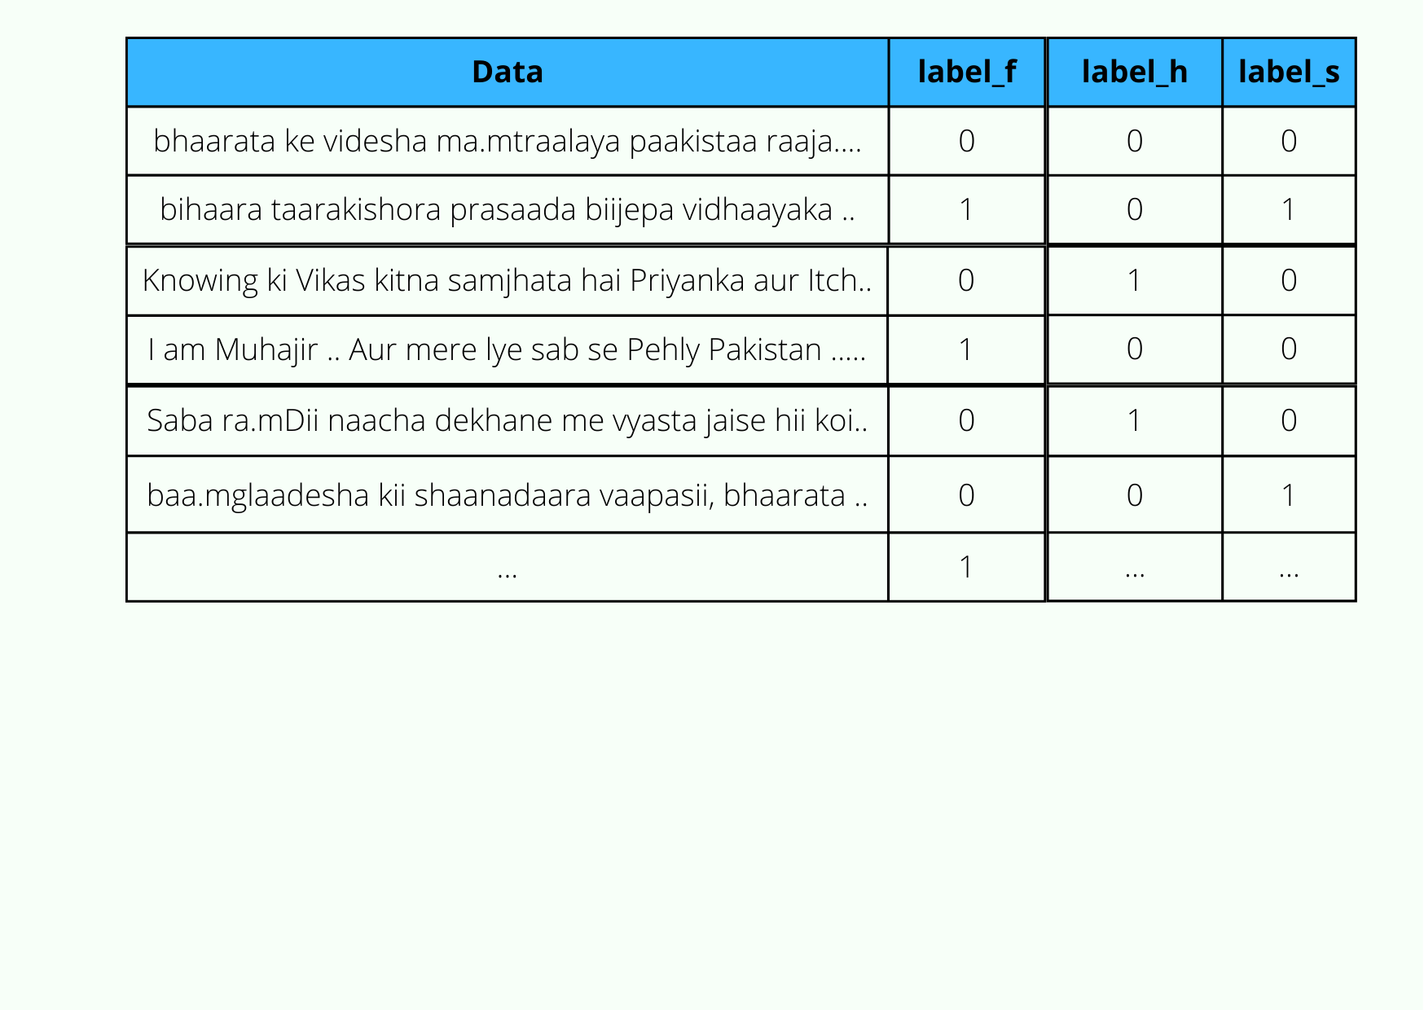
IIIT-Dharwad
CSE
Then finally combined all the 3 pseudo labels generated datasets into single final dataset which having all three lables for each sentence.
Major Project
2018-2022

Slide 35
Building Multi-label classification model.
NOT FAKE
FAKE
HATE
NOT HATE

Slide 36
IIIT-Dharwad
CSE
Models Used:
LSTM
Bi-LSTM
Bert-Base
Bert-Large
Multilingual-Bert
Roberta Base
Roberta Large
Major Project
2018-2022

Slide 37
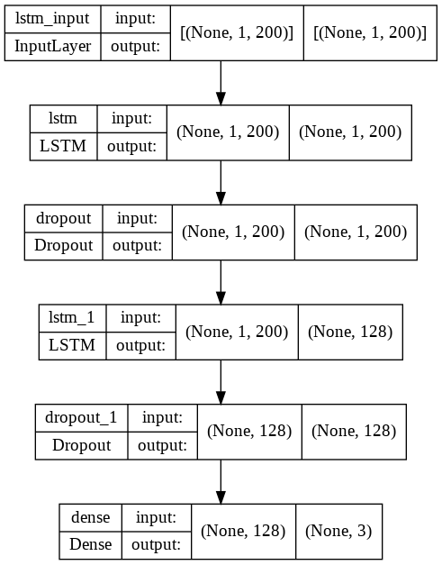
IIIT-Dharwad
CSE
LSTM Model:
Long Short-Term Memory (LSTM) networks are a type of recurrent neural network capable of learning order dependence in sequence prediction problems.
Steps:
Clean the data
Get Embeddings
We split the data
Train:85% , Test:15%
Train the model(Epochs:30,Softmax)
Test the model
Major Project
2018-2022

Slide 38
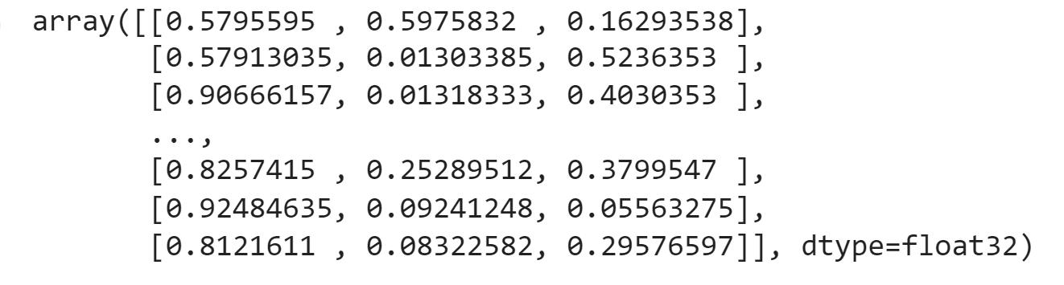
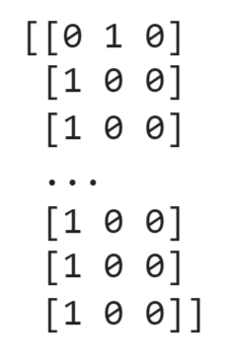
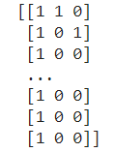
IIIT-Dharwad
CSE
Output:
Predicted Probabilities of sentence belonging to one of the 8 possibilities as shown below :(0,0,0)(0,0,1),(0,1,0),(0,1,1),(1,0,0),(1,0,1),(1,1,0),(1,1,1) :
As we should do multilabel classification So, at each index:
if probability<0.5 then labeled as: 0
else labeled as : 1
Ex: [0.761,0.476,0.03792] = [1,0,0]
Major Project
2018-2022

Slide 39
IIIT-Dharwad
CSE
Results:
Lstm with SoftMax:
Model Accuracy:0.7310
Model Loss:0.4999
Validation Accuracy:0.7225
Validation Loss:0.4900
Lstm with Sigmoid:
Model Accuracy:0.7302
Model Loss:0.4994
Validation Accuracy:0.7371
Validation Loss:0.4907
Major Project
2018-2022

Slide 40
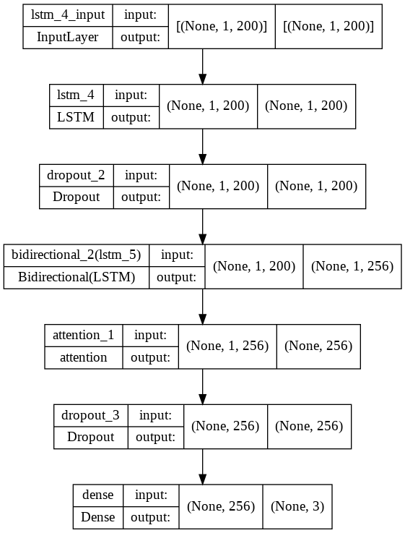
IIIT-Dharwad
CSE
Bi-LSTM with Attention:
BiLSTM is simply bidirectional LSTM, which means the signal propagates backward as well as forward in time.
Steps:
Clean the data
Get Embeddings
We split the data
Train:90% , Test:10%
Train the model(Epochs:22,Softmax)
Test the model
Major Project
2018-2022

Slide 41
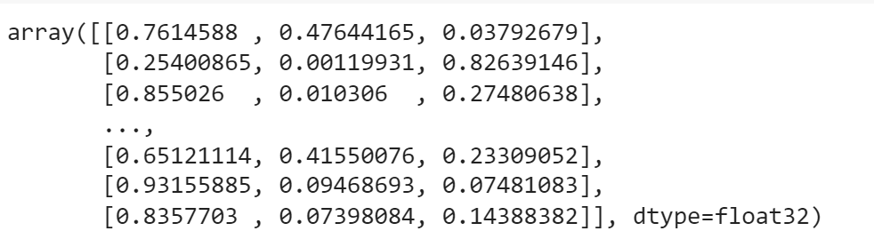
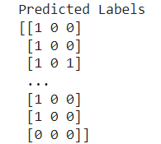
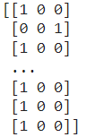
IIIT-Dharwad
CSE
Output:
Predicted Probabilities of sentence belonging to one of the 8 possibilities as shown below :(0,0,0)(0,0,1),(0,1,0),(0,1,1),(1,0,0),(1,0,1),(1,1,0),(1,1,1) :
As we should do multilabel classification So, at each index:
if probability<0.5 then labeled as: 0
else labeled as : 1
Ex: [0.761,0.476,0.03792] = [1,0,0]
Major Project
2018-2022

Slide 42
IIIT-Dharwad
CSE
Results:
Bi-Lstm Attention with SoftMax:
Model Accuracy:0.7286
Model Loss:0.4941
Validation Accuracy:0.7146
Validation Loss:0.4880
Bi-Lstm Attention with Sigmoid:
Model Accuracy:0.7295
Model Loss:0.4949
Validation Accuracy:0.7331
Validation Loss:0.4877
Major Project
2018-2022

Slide 43
IIIT-Dharwad
CSE
Bert
BERT, which stands for Bidirectional Encoder Representations from Transformers
Roberta
RoBERTa stands for Robustly Optimized BERT Pre-training Approach.
Implementation of Bert and Transformer Models
Simple Transformer models are built with a particular Natural Language Processing (NLP) task in mind.
To create a task-specific Simple Transformers model, you will typically specify a model_type and a model_name
Major Project
2018-2022

Slide 44
IIIT-Dharwad
CSE
Sl.No | Model Name | Layers | Hidden Layers | Attention Heads
1 | Bert-Base | 12 | 768 | 12
2 | Bert-Large | 24 | 1024 | 16
3 | Multilingual Bert | 12 | 768 | 12
4 | Roberta-Base | 12 | 768 | 12
5 | Roberta-Large | 12 | 1024 | 12
Comparing Parameters
Major Project
2018-2022

Slide 45
IIIT-Dharwad
CSE
Steps:
Divide the train data and test data
We split the data:
Train:60%
Evaluation:20%
Test:20%
Load a pre trained Models
Bert,Roberta
Train the model
Epochs:5, Max_SequenceLength:200,Learning_Rate:3e-5
Major Project
2018-2022

Slide 46
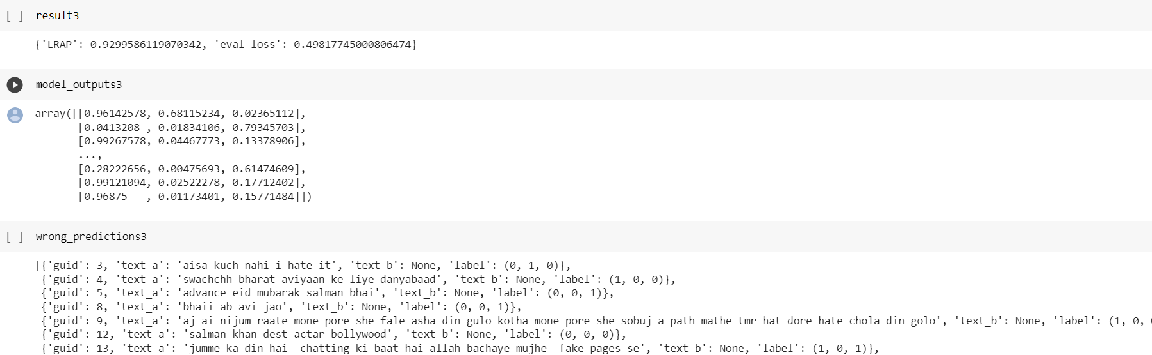
IIIT-Dharwad
CSE
Steps:
Evaluate the model(Below are the parameters we get after evaluating the model):
Test the model
Predict the Output
Major Project
2018-2022

Slide 47
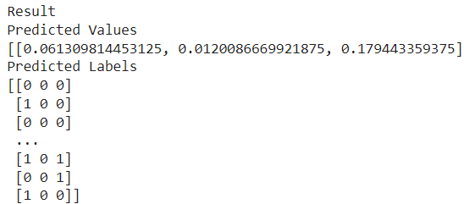
IIIT-Dharwad
CSE
Output:
Test Model
Get the predictions using to_predict
Predicted Probabilities of sentence belonging to one of the 8 possibilities as shown below :(0,0,0)(0,0,1),(0,1,0),(0,1,1),(1,0,0),(1,0,1),(1,1,0),(1,1,1) :
pred:[[0.152,0.578,0.68]……..[0.95,0.32,0.56]
As we should do multilabel classification So, at each index:
if probability<0.5 then labeled as: 0
else labeled as : 1
Ex: [0.761,0.476,0.03792] = [1,0,0]
o/p: [[0,1,0]....[1,0,0]]
Major Project
2018-2022

Slide 48
Comparing Results.
NOT FAKE
FAKE
HATE
NOT HATE

Slide 49
IIIT-Dharwad
CSE
Comparing LSTM models:
MODEL | EPOCHS | MODEL ACCURACY | MODEL LOSS | VALIDATION ACCURACY | VALIDATION LOSS
LSTM with Soft Max | 30 | 0.7310 | 0.4999 | 0.7225 | 0.4900
LSTM with Sigmoid | 30 | 0.7302 | 0.4994 | 0.7371 | 0.4907
Bi-LSTM with Attention using Soft Max | 22 | 0.7286 | 0.4941 | 0.7146 | 0.4880
Bi-LSTM with Attention using Sigmoid | 22 | 0.7295 | 0.4949 | 0.7331 | 0.4877
Major Project
2018-2022

Slide 50
IIIT-Dharwad
CSE
Comparing models:
MODEL | EPOCHS | ACCURACY SCORE | MICRO AVERAGE F1 SCORE | MACRO AVERAGE F1 SCORE
LSTM using Softmax | 30 | 0.3649 | 0.60 | 0.45
LSTM using Sigmoid | 30 | 0.4070 | 0.65 | 0.51
Bi-LSTM with Attention using Softmax | 22 | 0.3605 | 0.60 | 0.49
Bi-LSTM with Attention using Sigmoid | 22 | 0.3847 | 0.62 | 0.48
Bert-Base | 5 | 0.4728 | 0.70 | 0.63
Bert-Large | 5 | 0.4788 | 0.70 | 0.64
Bert-Base-Multilingual | 5 | 0.4985 | 0.72 | 0.66
Roberta-Base | 5 | 0.4692 | 0.71 | 0.64
Roberta-Large | 1 | 0.4713 | 0.66 | 0.59
Major Project
2018-2022

Slide 51
Conclusion & Future Scope
NOT FAKE
FAKE
HATE
NOT HATE

Slide 52
IIIT-Dharwad
CSE
Conclusion & Future Scope
Identifying fake and hate news generating in social media platforms can help to reduce its impact over that thing,area,person or group of people targeted by such news.
Major Project
2018-2022

Slide 53
IIIT-Dharwad
CSE
Conclusion & Future Scope
Identifying fake and hate news generating in social media platforms can help to reduce its impact over that thing,area,person or group of people targeted by such news.
And it can further developed along with image processing to read the thumbnails of videos,social media posts to avoid misleading public towards fake news.
Major Project
2018-2022

Slide 54
References
NOT FAKE
FAKE
HATE
NOT HATE

Slide 55
IIIT-Dharwad
CSE
References
htpps://www.analyticsvidhya.com/blog/2020/01/3-important-nlp-libraries-indian-languages-python/
https://huggingface.co/sentence-transformers/paraphrase-xlm-r-multilingual-v1
https://simpletransformers.ai/docs/multi-modal-classification-model/
Major Project
2018-2022

Slide 56

IIIT-Dharwad
CSE
Major Project
2018-2022

