Slide 1
Interim-Project Presentation Development of AI Based Diet Consultant and exercise application Programme: B. Tech in CSE
Mentor : Dr. Rinki Sharma
Group No. : 31
Team Leader : Pasupuleti Rohithsaidatta
Department : Computer Science

Slide 2
Project Team
Sl no. | Registration no. | Students
1 | 19ETCS002083 | Pasupuleti Rohithsaidatta
2 | 19ETCS002152 | Rakesh kumar
3 | 19ETCS002098 | Rakshith
4 | 19ETCS002066 | Jayendra
5 | 19ETCS002081 | Nithin Krishna

Slide 3
Outline
Title and Aim
Objectives
Methods and Methodology ( or Block Diagram)
Status of the Work
Results
Expected Outcomes
Cost Estimation
Gantt Chart
References

Slide 4
Title
Development of AI Based Diet Consultant and exercise application
Aim
To Create an application that efficiently help people to be healthy and delivering them with easier accessibility, to a new and innovative way towards the healthy lifestyle.

Slide 5
Objectives
Objectives of our AI Based Diet Consultant store are –
Gathering physical details such as medical histories, age, BMI, Weight and physiological parameters
Identify the most appropriate predefined trained dataset
Generate the diet plan accordingly to the customer preferences considering the allergies and over intake concerns of certain food items etc. based on the given medical history
Modify the diet plan based on the customer feedback to the shared diet plan
It must include the physical activities along with the diet plan undertaking the client current health

Slide 6
Methods and Methodology
Methods used to develop the are AI Based Diet Consultant are:
Admin Login
Add Dietitian:
System allows admin to add a dietitian details into the system who can create the diet plan for the users.
View/Edit Dietitian:
Can view and edit the dietitian details whenever required.
View User:
Can view the list of registered users with their details.
View Feedback
Can view feedback provided by the registered users.

Slide 7
Methods and Methodology
User Login
Register:
To continue with the diet plan details, user first need to fill up all the required details.
Calculate BMI:
Based on details provided by the user, system automatically calculate the BMI of the user.
View Diet Plan:
The diet plan for the user is generated by the system itself using artificial intelligence.

Slide 8
Methods and Methodology
Request Diet Plan:
If the user is unsatisfied with the diet plan provided by the system, the he/she can raise a request to generate the proper diet plan him/herself.
The diet plan request is forwarded to dietitian.
View Profile:
User can view his/her own profile.
Write Feedback:
Registered users can provide the feedback.

Slide 9
Methods and Methodology
Dietitian Login
View Diet Plan Request:
Here, dietitian can view the diet plan request from the users.
Create Diet Plan:
Based on user’s request, dietitian creates a diet plan for him/her.
Update Diet Plan:
The user resends the request to dietitian about unsatisfied diet plan. So, as per the user’s request, dietitian regenerates the diet plan and sends to the user.
View User:
Can view user details as a when needed.

Slide 10
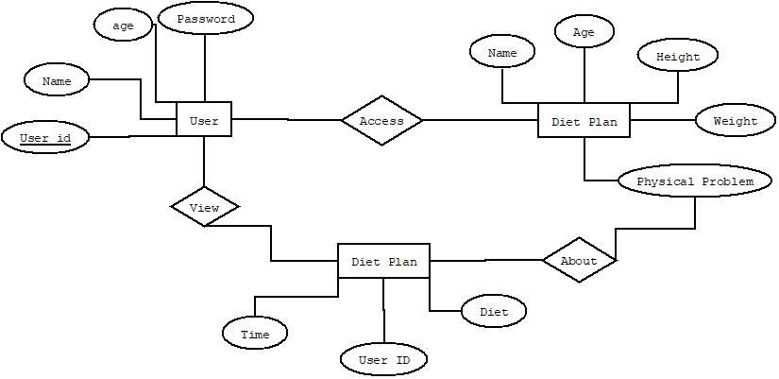
Design
ER Diagram

Slide 11
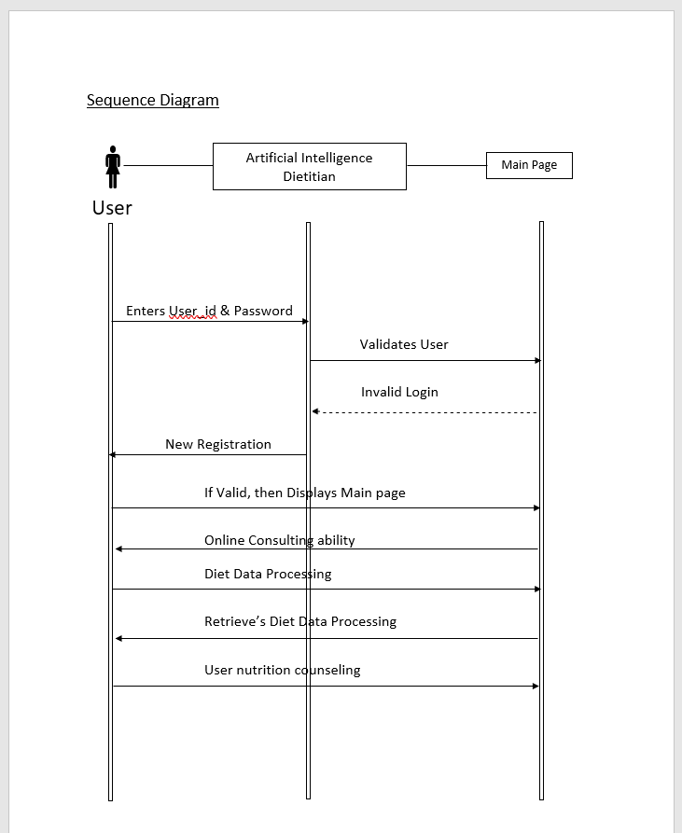
Design

Slide 12
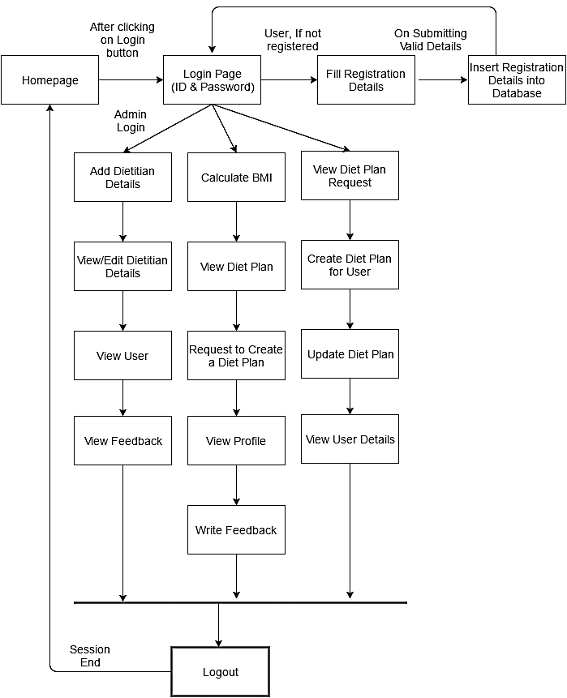
Design
System Architecture

Slide 13
Technologies used
Front End Technology
Microsoft .NET Framework
.NET Framework Class Library
Windows GUI applications (Windows Forms).
Client Application Development
Server Application Development
ASP.NET applications.
XML Web services.
Windows services.
BACK END TECHNOLOGY:
About Microsoft SQL Server
Relational Database
Client/Server
Structured Query Language (SQL)

Slide 14
Status of the Work
Currently we have created an AI Diet Consulting Application where it consisting of Admin Login, User Login , Dietician Login.
Admin login:
In Admin Login admin needs to provide his credentials to login.
Their will be 4 modules that can be accessed by the admin
Add dietician
View Customers
BMI Calculator
View Charts
Admin needs to add dietician to the system with his/her Name , mobile number, email id, Gender and the password.

Slide 15
Status of the Work Contd…
User Login:
User needs to enter user id and password to login.
After successful login it consists of 5 Modules:
My details
BMI Calculator
Diet plan
Diet Chart
Food Pyramid
User can see his/her details by clicking on My details.
User can calculate his/her BMI by clicking on BMI Calculator
User can get generated diet plan with the preferable timings
User can refer to diet chart and food pyramid for references

Slide 16
Status of the Work (on progress)
Dietician Login:
Dietician should login with user name and password
Dietician can view the request from the user for the change in generated diet plan.
Dietician can create new plan to the user based on user preferences and pre medical disease and food type.
Whatever the changes made by the dietician in the new diet plan it should be stored in the database and it should display to the user.

Slide 17
Expected Outcomes
Successfully Development of Application.
Demonstration of working Model.

Slide 18
Cost Estimation
S.No. | Particulars/Components/Devices | Estimated Cost
1
2
 | Total:
Man hours:
Man hours per week (students): 18 *4 students =72
Man hours per week (faculty): 3

Slide 19
Gantt Chart
Project Work (UG) 16 weeks
Week | 1 | 2 | 3 | 4 | 5 | 6 | 7 | 8 | 9 | 10 | 11 | 12 | 13 | 14 | 15 | 16
Major Activities
1.1
1.2
2.1
2.2
2.3
2.4
3.1
3.2
4.1
4.2
5.1
5.2
6.1
6.2

Slide 20
References
https://www.researchgate.net/publication/357352908_Artificial_Intelligence_Applications_in_Nutrition_and_Dietetics
https://www.nytimes.com/2022/03/14/well/eat/ai-diet-personalized.html
https://www.forbes.com/sites/ilkerkoksal/2020/03/07/how-ai-determines-the-diet-plans/?sh=7d29b7de3ed7

Slide 21
Thank You

